Slide 1
Multi-link Constraint Signaling
Date: 2020-06-01
Authors:

Slide 2
Recap: Constrained Multi-Link Device (MLD)
A MLD that supports multiple links can announce whether it can support transmission on one link concurrent with reception on the other link for each pair of links.
  NOTE 1 – The 2 links are on different channels.
  NOTE 2 – Whether to define a capability of announcing the support transmission on one link concurrent with transmission on the other link is TBD.
  [Motion 38, [3] and [37]]

Slide 3
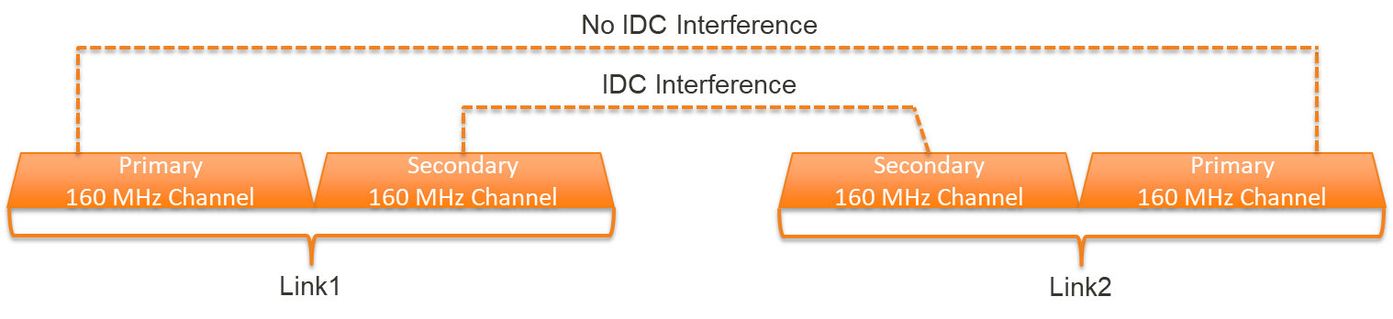
Motivation
Each link of the MLD can operate with a different operating bandwidth.
In such case, the IDC interference can be happened on only some combination of channels among the links.

Slide 4
Motivation
The MLD should be able to announce to the peer MLD the TX-RX constraint on a channel basis.
  TX-RX constraint: The IDC interference caused by a transmission on one channel may make a decoding failure of a frame on another channel.
    The peer MLD can utilize that information for the bandwidth or the RU determination when it transmits the PPDU to the constrained MLD.

Slide 5
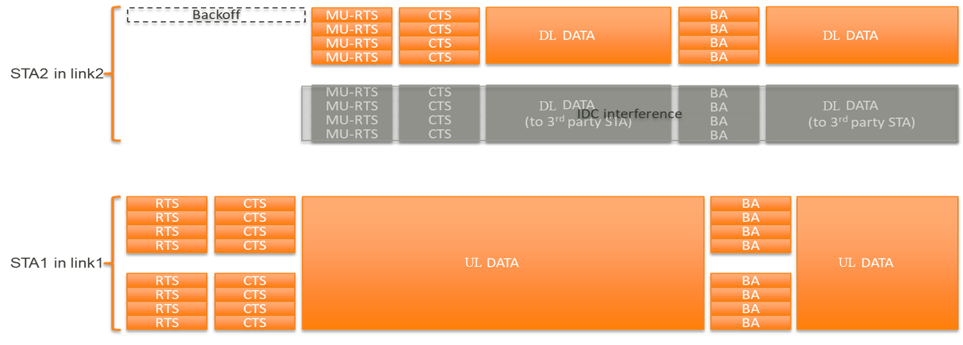
Example of the TX-RX constraint
When the AP MLD knows that a set of operating channels of the STAs in the non-AP MLD has a TX-RX constraint, it does not transmit to that constrained MLD the PPDU on the channel that is effected.
TX-RX Constraint

Slide 6
TX-RX Constraint Indication
The constrained non-AP MLD indicates to the AP MLD the following constrained channel information.
  The First Channel Entry field indicates the Operating Class and Channel (defined in 9.4.1.22 (Operating Class and Channel field)) of the first channel in each pair of channels impacted by IDC interference.
  The Second Channel Entry field indicates the Operating Class and Channel (defined in 9.4.1.22 (Operating Class and Channel field)) of the second channel in each pair of channels impacting IDC interference.
  The IDC Interference Level field indicates the interference power (in units of dBm) caused by a transmission on one channel
 |  |  | Repeat for each pair of IDC interference channels
Element ID | Length | Element ID Extension | First Channel Entry | Second Channel Entry | IDC Interference Level
1 Octet | 1 Octet | 1 Octet | 2 Octets | 2 Octets | 1 Octet

Slide 7
TX-RX Constraint Indication
Even though the non-AP MLD indicates that there is no TX-RX constraint on a specific channel combination, it should be able to report when those constraint status is updated.
  For example, the constrained non-AP MLD reports to the AP MLD the channel availability of another link by using the BQR Control Information in the A-Control field.
  When there is an strong IDC interference (>= ED Threshold level), the channel effected by the IDC interference in the reported link is indicated as the busy or unavailable.

Slide 8
Conclusion
The MLD may have the TX-RX constraint on some combination of channels among the links.
But, because those constraints are dynamically changed depending on the operating parameters (e.g., the channel frequency, the channel bandwidth, and the transmit power) of each link, a MLD should be able to report the constraints whenever it is updated.

Slide 9
Straw Poll 1
Do you support that the MLD should be able to announce to the peer MLD the TX-RX constraint on a channel basis?
  TX-RX constraint: The IDC interference caused by a transmission on one channel may make a decoding failure of a frame on another channel.
    The peer MLD can utilize that information for the bandwidth or the RU determination when it transmits the PPDU to the constrained MLD.

