Slide 1
Multi-link Constraint Signaling
Date: 2020-04-13
Authors:

Slide 2
Recap: Constrained Multi-Link Device (MLD)
A MLD that supports multiple links can announce whether it can support transmission on one link concurrent with reception on the other link for each pair of links.
NOTE 1 – The 2 links are on different channels.
NOTE 2 – Whether to define a capability of announcing the support transmission on one link concurrent with transmission on the other link is TBD.
[Motion 38, [3] and [37]]

Slide 3
Motivation
Each link of the MLD can operate in the non-contiguous channel mode (e.g., 80+80 MHz, 160+80 MHz, 160+160 MHz).
In such case, the IDC interference can be happened on only some combination of channels among the links.

Slide 4
Motivation
In that case, the MLD can announce to the peer MLD the following multi-link constraints:
TX-RX constraint: The IDC interference caused by a transmission on one channel may make a decoding failure of a frame on another channel.
The peer MLD can utilize that information for the bandwidth determination when it transmits the PPDU to the constrained MLD.
TX-TX constraint: The IDC interference caused by a transmission on one channel may make the CS status on another channel to be busy (above the ED threshold).
The peer MLD can utilize that information for the RU allocation when it triggers to the constrained MLD the TB PPDU with the CS requirement.

Slide 5
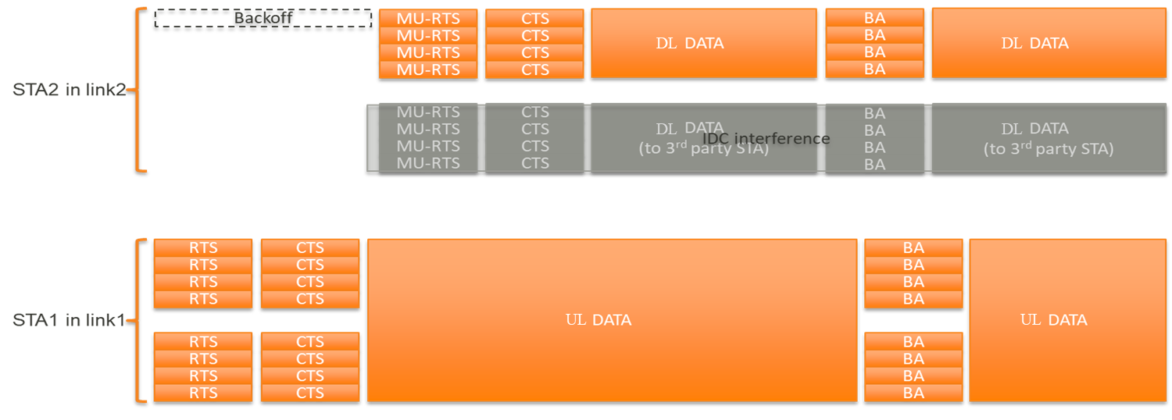
Example of the TX-RX constraint
When the AP MLD knows that a set of operating channels of the STAs in the non-AP MLD has a TX-RX constraint, it does not transmit to that constrained MLD the PPDU on the channel that is effected.
TX-RX Constraint

Slide 6
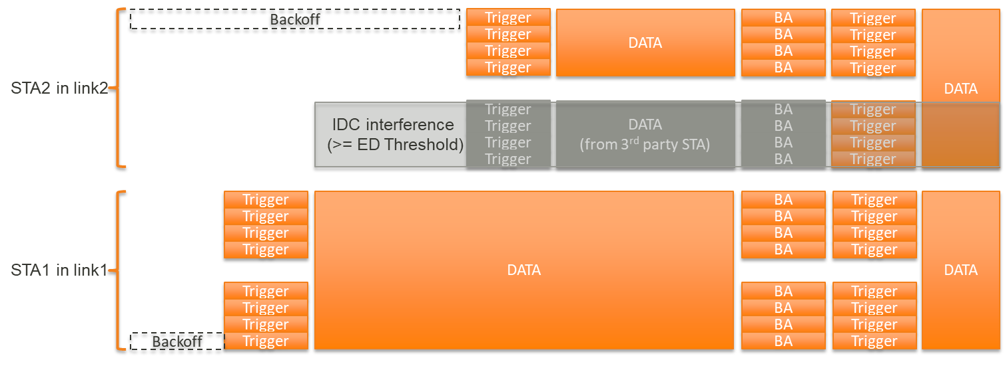
Example of the TX-TX constraint
When the AP MLD knows that a set of operating channels of the STAs in the non-AP MLD has a TX-TX constraint, it does not simultaneously solicit the TB PPDU from the channel that is effected.
TX-TX Constraint

Slide 7
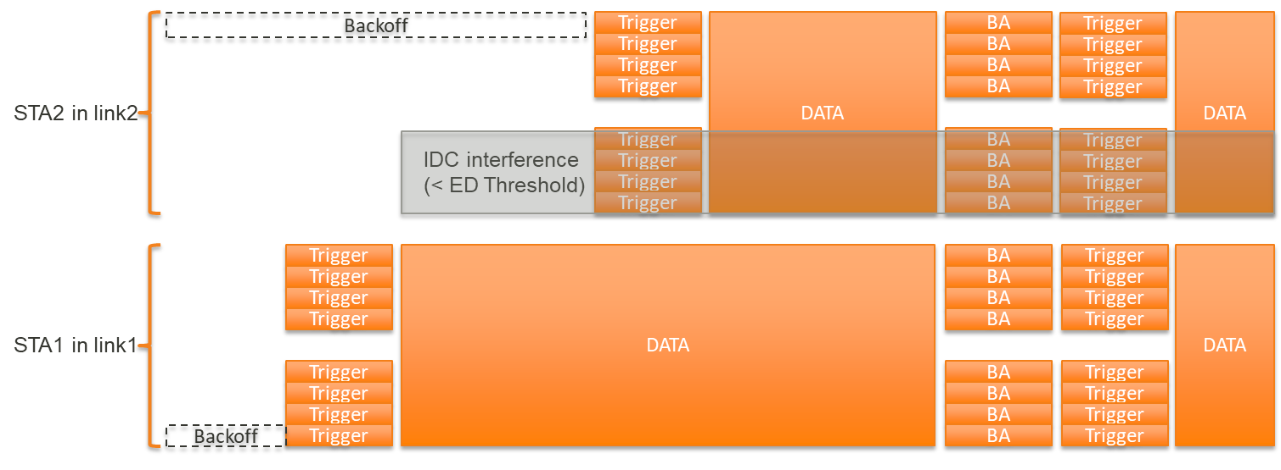
Example of the TX-TX constraint
When the AP MLD knows that none of operating channels of the STAs in the non-AP MLD has no TX-TX constraint, it may simultaneously solicit the TB PPDU on all available channels.
No TX-TX Constraint

Slide 8
Multi-link Constraint Indication (Option 1)
The constrained non-AP MLD indicates to the AP MLD the following constrained frequency gap information.
If the frequency gap between two channels is less than the value of the TX-RX Minimum Frequency Gap field, the IDC interference caused by a transmission on one channel may make a decoding failure of a frame on another channel.
If the frequency gap between two channels is less than the value of the TX-TX Minimum Frequency Gap field, the IDC interference caused by a transmission on one channel may make the CS status on another channel to be busy (above the ED threshold).
Element ID | Length | Element ID Extension | TX-RX Minimum Frequency Gap | TX-TX Minimum Frequency Gap

Slide 9
Multi-link Constraint Indication (Option 2)
The constrained non-AP MLD indicates to the AP MLD the following constrained frequency gap information.
The Operating Class Of First Channel field and the Operating Class Of Second Channel field are set to the operating class of the first channel and the second channel in each pair of channels impacting IDC interference, respectively.
The Channel Number Of First Channel field and the Channel Number Of Second Channel field are set to the channel number of the first channel and the second channel in each pair of channels impacting IDC interference, respectively.
The IDC Interference Level field has the following bit fields.
B0 is set to 1 if a TX-RX constraint in present between the first channel and the second channel. Otherwise it is set to 0.
B1 is set to 1 if a TX-TX constraint in present between the first channel and the second channel. Otherwise it is set to 0.
Element ID | Length | Operating Class Of First Channel | Channel Number Of First Channel | Operating Class Of Second Channel | Channel Number Of Second Channel | IDC Interference Level
 |  | Repeat for each pair of IDC interference channels

Slide 10
Conclusion
The MLD may have the TX-RX constraint and TX-TX constraint on some combination of channels among the links.
But, because those constraints are dynamically present depending on the operating parameters (e.g., the channel frequency, the channel bandwidth, and the transmit power) of each link, all MLD should support this signaling mechanism.

Slide 11
Straw Poll 1
Do you support to update the current SFD as the following?
A MLD that supports multiple links can announce whether it can support transmission on a channel one link concurrent with reception on the other link for each pair of links.
NOTE 1 – The 2 links are on different channels.
NOTE 2 – Whether to define a capability of announcing the support transmission on one link concurrent with transmission on the other link is TBD.
A MLD can can announce to the peer MLD the following multi-link constraints:
TX-RX constraint: The IDC interference caused by a transmission on one channel may make a decoding failure of a frame on another channel.
TX-TX constraint: The IDC interference caused by a transmission on one channel may make the CS status on another channel to be busy (above the ED threshold).

