Slide 1
MLD Address Management Discussion
Date: 2020-06-04
Authors:
Name | Company | Address | Phone | Email
Harry Wang | Tencent | Tencent Building, Kejizhongyi Avenue, Hi-tech Park, Nanshan District, Shenzhen | +86-755-86013388 | harryhwang@tencent.com
Xin Zuo
Glenn Hu
Lander Li

Slide 2
MAC Addresses for MLD
Commonly, a Wi-Fi device has ONE pre-installed global unique MAC address:
  The 48-bit address is composed by a 24-bit OUI, bought from IEEE, and a 24-bit extension
  The MAC address is used to identify both MAC-SAP and MLME-SAP
    Encapsulated in the TA/RA field in the MAC header
  The uniqueness of the address is guaranteed solely by the OUI prefix
  For other types of prefix such as CID, SAI, and AAI, there is no guarantee of unique MAC address
  For AP, the MAC address provides the basis of Multi-BSSID
  In a multi-link BSS, the consumption of MAC addresses will be boosted by multiple times compared to the legacy, all MAC functions require unique addresses.
For .11be MLD, it is preferable to have only ONE pre-installed MAC address as the legacy
  A single pre-installed MAC address for MLD MAC-SAP;
  A mechanism to configure the address for each link
  with respect to functional requirements (slide 3,4) already agreed

Slide 3
Background – Multiple Addresses
MLD address issues have been discussed in the group [1,2,3,4,5] as a function of MLO;
Some of general principles are summarized as follows,
  MAC SAP may need unique* address, which may be used to identify a MLD on DS, i.e the MLD address z;
  STAs may have separate addresses x/y i.e the STA/MAC/Link address, which may be the same or different as the MLD address z;
  AP MLD is preferred to have different STA address (x≠y) for the backward compatibility with legacy STAs;
  Non-AP MLD is therefore to use different STA addresses to enable symmetric operations, and to honor existing authentication process.
In nutshell, (x,y) is used for STA (low MAC) and (z) is for MLD (high MAC), if the MAC functions are separated in 11be.
With the support of Multiple BSSID, many more MAC addresses need to be managed by AP MLD.
Addr(z)
MAC SAP
MLD
Addr(x)
Addr(y)
STA 1
STA 2

Slide 4
Address for Different Purposes
During MLD BSS setup,
  AP MLD needs to inform both its MLD address (z) and the STA addresses (x, y) to Non-AP MLD, and only the STA addresses (x or y) to the legacy;
  Non-AP MLD should present all its addresses to AP MLD as well, so that
  The connection being setup on one link works for all links;
After successful setup,
  TA/RA in MAC headers are preferred to use STA address (say x);
  SA/DA for MSDUs are preferred to use MLD address (z);
All MLD, both AP and Non-AP, should have at least a MLD address built-in or pre-installed by the network administrator, that is unique at some extent.
Addr(z)
MAC SAP
MLD
Addr(x)
Addr(y)
STA 1
STA 2

Slide 5
Proposal
In this contribution, we propose to use dynamic allocation and management for the STA addresses for both AP and Non-AP.
With respect to the concept and protocols defined in 802c, 802.11aq and P802.1CQ.

Slide 6
AP MLD (STA) Address Management
AP MLD
Option I
Option II
SME
STA 1
MLME
MLME-AddrAssign. request
STA address generated
MLME-AddrAssign. confirm
w/ STA1 addresses
Beacon (w/ STA1 address)
AP MLD
SME
STA 1
MLME
The collision probability of STA address is low and can be solved by algorithm.
Better to use dedicated address management primitive e.g MLME-AddrAssign.request/confirm.
In current spec, MLME-RESET is used to reset MLME with an initial address.
MLME-AddrAssign. request
w/ STA1 addresses
STA1 address assigned
MLME-AddrAssign. confirm
Beacon (w/ STA1 address)

Slide 7
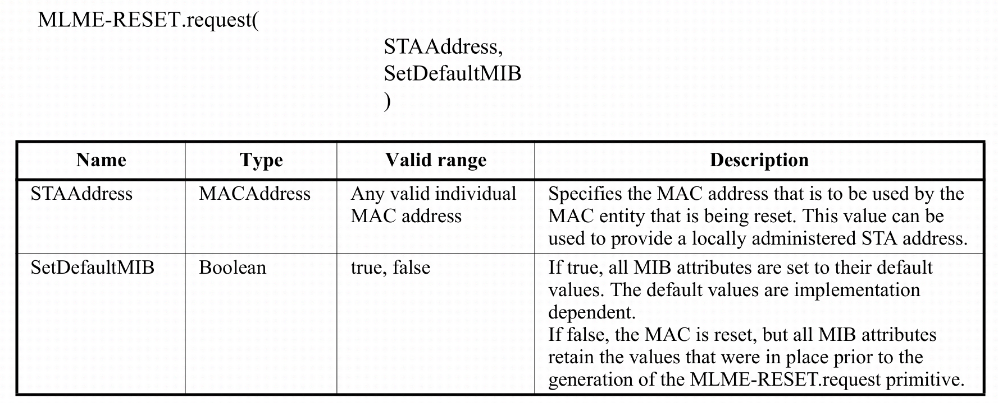
Issues When ‘Reset’ MAC Address for MLD
In current spec, MLME-Reset primitive is used to reset the MAC address together with the MIBs
For an MLD, operations on one link may correlate with other links, thus reset addresses may cause chaos for MLO

Slide 8
Non-AP MLD (STA) Address Management
AP MLD
STA MLD
Option I
Option II
STA 1
STA 2
STA 12
STA 11
Request w/ MLD address
Response w/ STA address assignment for STA12 and STA11
AP MLD
STA MLD
STA 1
STA 2
STA 12
STA 11
Request w/ self-assigned STA address and MLD address
Option I and II procedures take place during network discovery and selection, prior to association.
The STA addresses confirmed by the procedure will be used for authentication and association.
Response w/confirm

Slide 9
Conclusion
802.11be MLD preferably has ONE MLD address pre-installed.
Link addresses should be managed during ML setup.
  Link addresses in non-AP MLD can be assigned by AP MLD based on the non-AP MLD address
  Locally uniqueness of the link addresses shall be maintained
Link address management primitive should be defined separately from MLME RESET

Slide 10
Q & A
Q: what problem to be solved?
  A: An .11be MLD needs more than one MAC address (MLD address and link address). Those link addresses should be post configured to preserve uniqueness in local area.
  1) Same as the legacy device, it is preferable to have a single MAC address pre-installed for 11be MLD (as the MLD address).
  2) MLME-Reset primitive in current spec is defined to reset the MAC address together with all the MAC MIBs. It is not suitable for MLD because of the correlation functions between links within an MLD.
  3) The address assignment protocol in developing doesn’t consider the separation of link address and MLD address.
Q: implementation specific?
  A: The link address assignment can be done in ML setup, during which new primitive and protocol may be required.
  1) For AP MLD, link address should be configured without resetting other link configuration parameters.
  2) For Non-AP MLD, the link address should be assigned by AP MLD during ML setup procedure.
Q: different from the ongoing work?
  A: The address assignment protocol in development doesn’t consider the separation of link address and MLD address.
  MLD address provides a globally unique anchor in the MAC address space for the link address.
Q: how MLD support the legacy mode (no MAC address assignment)?
  A: when MLD operates in a legacy BSS, the non-AP link can use its MLD address as the link address.

Slide 11
SP#1
Should 11be consider a mechanism to configure the Link addresses of the MLDs within a BSS?
  Note: the link address is the MAC address assigned for each STA affiliated with a MLD.

Slide 12
SP#2
Should AP MLD assign link address for each AP affiliated with AP MLD?

Slide 13
SP#3
May the link addresses assignment in a Non-AP MLD be assisted by AP-MLD?

Slide 14
Reference
19-1899r7, MLA MAC Addresses Considerations;
20-0180r1, MLLE MAC addresses
20-0063r0, Non-AP MLD Link Address
19-1962r1, Multi-Link Device Instance & New Frame MAC Header
20-0054r0, MLD MAC Address and WM Address

