Slide 1
Discussions on Multi RU aggregation
Date: 2020-03-16
Authors:
Name | Affiliations | Address | Phone | Email
Tianyu Wu | Apple. Inc |  |  | tianyu@apple.com
Notes:
September 2012

Slide 2
Introduction
Multi-RU aggregation is an important feature for 11be. Many contributions have discussed this topic [1,2,3,4,5 etc].
Recap of the progress[6]:
  Small-size RUs only combine with small-size RUs: RU52+RU26 and RU106+RU26
  Large-size RUs only combine with large-size RUs.
  Joint LDPC encoding for aggregated RU.
  Approved a number of valid RU combinations.
Remaining problems:
  What RUs/RU combinations shall allow BCC?
  Interleaver/Tone Mapper choices for combined RUs, joint or per RU based?
  How to parse the encoded bits to the RUs, RU parser or frequency subblock parser?

Slide 3
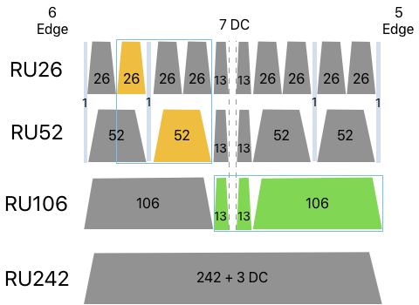
Small-size RU combination
There are only two sizes of small-size combined RU:
  Propose to keep the tone plan of each individual RU (including number and position of the pilot tones) in the combined RU.
  RU52+RU26: 78 total tones with 72 data tones and 6 pilot tones.
  RU106+RU26: 132 total tones with 126 data tones and 6 pilot tones.
Propose to allow BCC on RU/combinted RUs <=242 tones.
Define new BCC interleaver and LDPC tone mapper for the 2 new sizes of the combined small RU.
  Limited complexity for just 2 new sizes.
  No RU parser needed.
Same modulation level across the combined
small-size RU
  Different modulation may not bring gain for RU
  within a small BW.

Slide 4
Large-size RU aggregation
There are many new sizes for aggregated large-size RUs.
  Within 80MHz frequency subblock: RU242 + RU484,
  Within 160MHz: RU242 + RU484 + RU996, RU484 + RU996,
  Within 240MHz: RU484 + RU996 + RU996, RU996 + RU996
  Within 320MHz: RU996 + RU996 + RU996, RU484 + RU996 + RU996 + RU996
Propose only support LDPC on RU/combined RUs of >242 tones.
Not practical to define new tone mapper for all new sizes.
  RU parser + reuse some of existing tone mappers is a better option.
  In some modes, RU parser becomes complicate when too many RUs with different sizes are aggregated. For example: RU242+RU484+RU996.
  Frequency subblock parser + per frequency subblock tone mapper could be a more balanced solution.
    There is only one new size for large-size RU aggregation within 80MHz frequency subblock. Possible to define a new LDPC mapper for this mode.

Slide 5
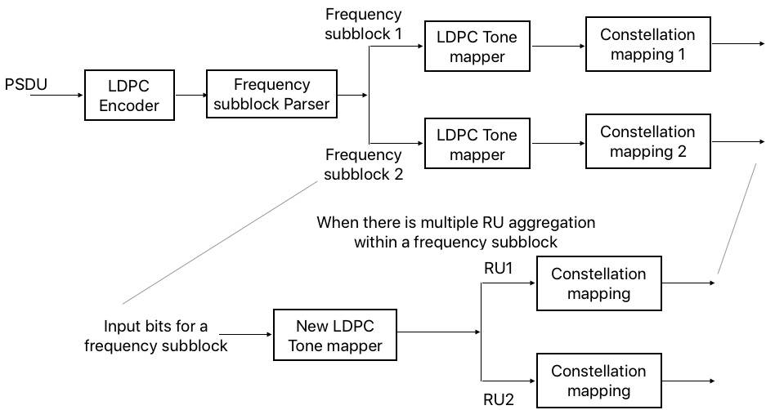
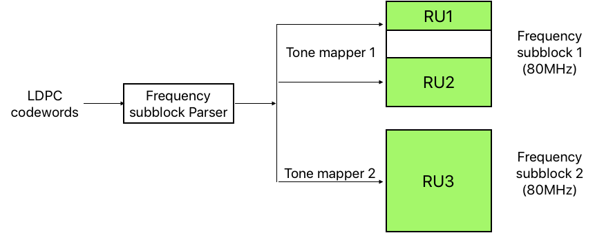
Proposal for Large-size RU aggregation
Frequency subblock parser with LDPC tone mapper within a frequency subblock
Same modulation level within one frequency subblock.
Open question: Should we allow different modulation levels for different frequency subblocks?
Example:

Slide 6
BCC Interleaver/Tone mapper parameters
Potential BCC interleaver parameters for the combined small-size RUs (RU52+RU26 and RU106+RU26)
Potential LDPC tone mapper parameters for RU52+RU26, RU106+RU26 and RU484+RU242.
All the parameters are open for
discussion.

Slide 7
Frequency subblock parser
Frequency subblock parser is similar to segment parser in 11ac/ax.
  In 11ac/ax, segment parser parse s bits to different frequency subblocks in a round robin way.
  In 11be, different frequency subblock may have different number of data tones. 11ax segment parser can’t be directly applied.
Options for 11be frequency subblock parser
  Sequential parser: sequentially parsing the coded bits to the frequency subblocks. Fill one subblock before parsing to the next.
    Simple design with less Freq diversity gain.
  Proportional round robin parser: Parse the coded bits to the frequency subblocks proportional to the number of coded bits of each freq subblock.
    Better diversity gain

Slide 8
Proportional Round Robin Parser
Example proportional round robin parser
  Parse bits to subblock l.
    Where ,
    n_{l} is number of data tones allocated to the target STA in frequency subblock l,
    N_{BPSCS_l} is N_{BPSCS} in frequency subblock l, if all freq subblocks has same modulation level, this number can be removed from the equation.
    N is the greatest common divisor of all N_{Bits_l}.
  The parser can be expressed as:
  Benefit: No excess coded bits that need special process!
  The parsing block may be bigger, but diversity gain will be similar.
    Each CW is still parsed to all subblocks and tone mapper in each subblock still randomized the location of the bits in the CW.

Slide 9
Summary
In this contribution, we discussed potential solutions for a number of problems to support multi-RU aggregation.
  For small-size RU aggregation, new BCC interleaver and LDPC tone mapper parameters need to be defined.
  For large-size RU aggregation, we propose to design:
    A frequency subblock parser for RU/aggregated RU across multiple frequency subblocks.
    Within each frequency subblock, define a new LDPC tone mapper for RU242+RU484 case.

Slide 10
Straw Poll 1
Do you agree that
  For RU and combined RU with less than or equal to 242 tones, both BCC and LDPC shall be supported
  For RU and combined RU with larger than 242 tones, only LDPC shall be supported.
  Y
  N
  A

Slide 11
Straw Poll 2
In small-size RU combination, do you support to define new BCC interleaver and LDPC tone mapper parameters for RU52+RU26 and RU106+RU26 cases?
  Detailed parameters TBD.
  Y
  N
  A

Slide 12
Straw Poll 3
In large-size RU aggregation within one frequency subblock, do you support to define new LDPC tone mapper parameters for RU242+RU484?
  Detailed parameters TBD
  Y
  N
  A

Slide 13
Straw Poll 4
Do you support to define a frequency subblock parser for RU or combined RU that across multiple frequency subblocks?
  The frequency subblock parser is a proportional round robin parser defined as below:
  Y
  N
  A

Slide 14
References
[1] Jianhan Liu, “Enhanced Resource Allocation Schemes for 11be”, IEEE 802.11-19/1126r0
[2] Bin Tian, “Preamble Puncturing and RU Aggregation”, IEEE 802.11-19/1869r3
[3] Jianhan Liu, “Multi RU combinations for EHT”, IEEE 802.11-19/1907r2
[4] Ron Porat, “Multi-RU Support”, IEEE 802.11-19/1908r4
[5] Eunsung Park, “Multiple RU aggregation”, IEEE 802.11-20/0023r2
[6] “Specification Framework for TGbe”, IEEE 802.11-19/1262r8

