Slide 1
Impact of channel blindness during ML
Date: YYYY-MM-DD
Authors:

Slide 2
Abstract
We analyse the effect of hidden node problem caused due to temporary channel blindness during ML operation at a non-STR device.

Slide 3
Introduction
When a non-STR device is transmitting on a link it is unable to do any Carrier sense on the other link.
As a result it may miss preambles, RTS-CTS etc. transmitted on the other link.
After the transmission is over, the STA may falsely detect the medium to be idle and transmit => multi-channel hidden node problem.
This presentation we analyze the impact of such hidden node and recommend some solution.
RTS (TA: STA1, RA: AP1)
CTS (RA: STA1)
DATA (TA: STA1, RA: AP1)
BA (RA: STA1)
AP 1
STA 1
Link 1
Non-AP MLD 1
AP 2
RTS (TA: STA1)
STA 2
Link 2
time
AP 2
RTS (TA: STA3)
CTS (RA: STA3)
DATA (TA: STA3, RA: AP2)
Link 3
STA 3
Non-AP MLD 2
: Not blind
: blind
Collision at AP 2
AP MLD

Slide 4
Simulation scenario
Two configs to study impact on UL and DL configs for ML with 2 links.
Config 1: Only full buffer UDP UL traffic where Rx power at EHT STA MLD from the hidden non-AP node is between ED and CS thresholds.
Config 2: Full buffer UDP UL traffic from EHT STA and full buffer DL traffic from AP to STA.
80 MHz BW, 2x2 config at EHT STA, 20dBm tx power at EHT STA.
Modes:
1. STR EHT STA MLD.
Non-STR EHT STA MLD without OTA info from AP.
Non-STR EHT STA MLD with perfect knowledge of AP MLD status.
RSSI: -62.6 dBm
RSSI: -69.8 dBm
RSSI: -63 dBm
Legacy
STA
RSSI: -46 dBm
AP
AP
RSSI: -25 dBm
EHT
STA
Legacy
STA
EHT
STA
RSSI: -51.2 dBm
Config 1
Config 2

Slide 5
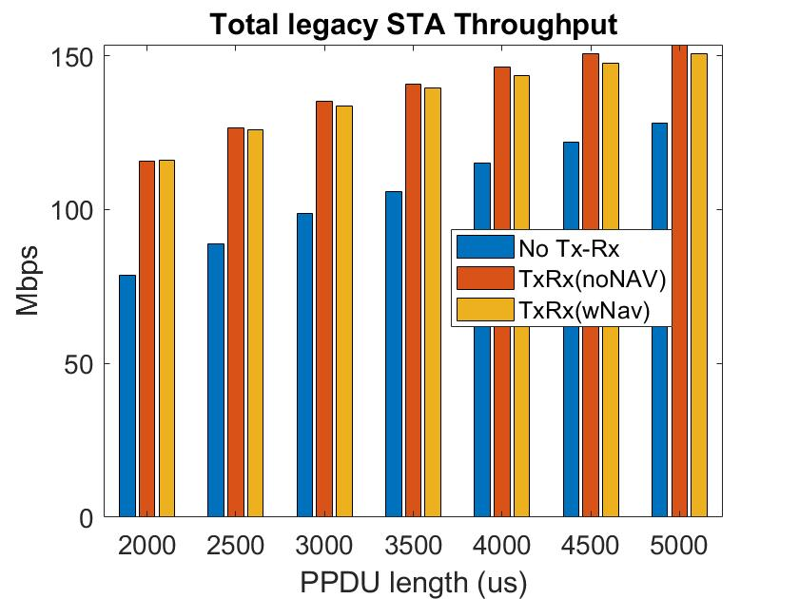
Config 1 results
Observations:
If we consider the baseline to be the case where EHT STA is STR, the legacy STA’s performance gets better when the EHT STA is non-STR.
Having additional info does not improve legacy throughput as the effect of reduced collision during hidden nodes is offset by lower chances of channel access.
Having additional info however does improve EHT STA throughput a bit as it reduces the number of events when it is self-blocking itself from transmitting on link 2 by attempting to transmit RTS to an already occupied AP on link 1.

Slide 6
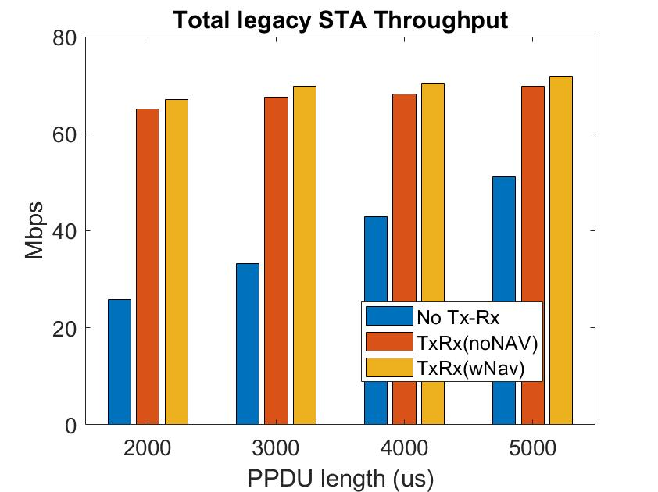
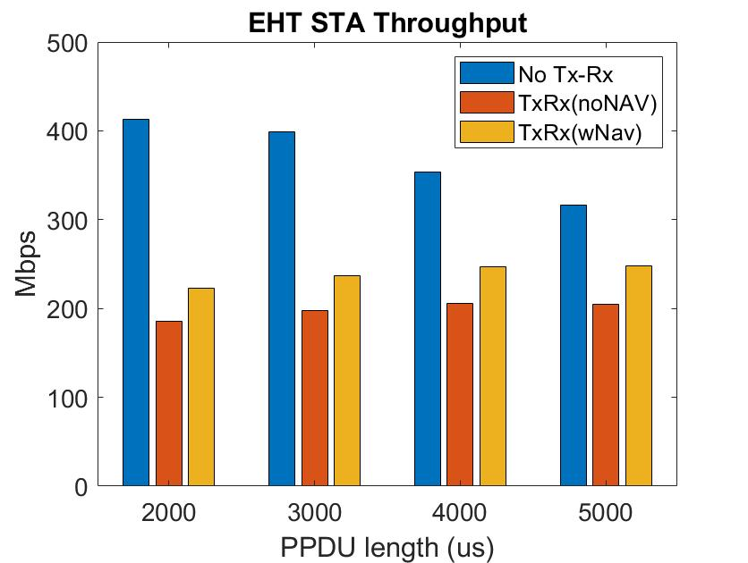
Config 2 results
Observations:
If we consider the baseline to be the case where EHT STA is STR, the legacy STA’s performance gets better when the EHT STA is non-STR.
Having additional info does not improve legacy throughput significantly as the effect of reduced collision during hidden nodes is offset by lower chances of channel access.
Having additional info however does improve EHT STA throughput a bit as it reduces the number of events when it is self-blocking itself from transmitting on link 2 by attempting to transmit RTS to an already occupied AP on link 1.

Slide 7
Conclusion and proposal
Doing nothing to solve the multichannel hidden terminal problem does not actually hurt the hidden nodes.
Doing something to prevent an EHT STA MLD from self-blocking itself (due to failed RTS transmissions) can improve EHT STA MLD performance.
Option 1: Following a transmission on a link, non-STR EHT STA MLD refrains from transmitting any packet on the other link similar to the NAVsyncdelay timer behavior as it is similar to STA coming out of Doze.
The timer duration can be pre-defined in spec or assigned by AP.
If while the timer is running it receives a frame that sets is NAV, it cancels the timer.
In order to preserve latency gains due to ML operation, the non-STR STA may be allowed to transmit upto one RTS frame to the AP while the timer is running. If a response CTS is received the timer is cancelled.
Option 2: AP transmits cross-link information in a DL frame (e.g., BA) signaling whether it is transmitting or receiving packets on the other link and/or its NAV duration on the other link.
Notes:
Does not cover when CCA on link 2 is still idle..

Slide 8
Comparison of the two options
Option 1 does not require fast cross-link information sharing among the APs in the same MLD and is mostly similar to the NAVsyncdelay operaton as defined in current spec => low complexity => prefer this to be included in R1 if we agree that it is a problem to be solved.
Need to account for latency in channel access, AP controlled parameter.
Option 2 can be considered in R2 as it requires tighter information sharing among the APs.

Slide 9
Summary
Channel blindness due to Tx-Rx constraints does not significantly affect legacy STA performance.
Prefer a low complexity solution for R1 if we indeed decide to solve this problem.

