Slide 1
Decoupling Channel Training from NSTS
Date: 2020-03-16
Authors:
Name | Affiliation | Address | Phone | Email
Abhishek Agrawal | Quantenna (ON Semiconductor Inc.) | 1704 Automation Pkwy San Jose, CA |  | Abhishek.Agrawal@onsemi.com
Sigurd Schelstraete |  |  |  | Sigurd.Schelstraete@onsemi.com
Huizhao Wang |  |  |  | Huizhao.Wang@onsemi.com

Slide 2
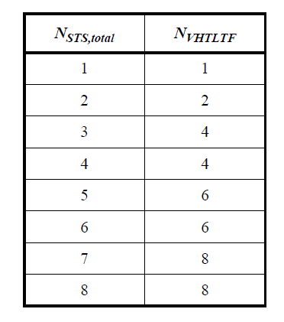
Introduction
MIMO channel training is based on dedicated training sequence (HT-LTF, VHT-LTF, HE-LTF)
Length of training sequence for a given N_{STS,tot} is fixed to minimum needed to estimate up to N_{STS,tot} channels for each Rx antenna.
Below is the table of nominal N_{LTF} as used by HT, VHT and HE training field generation:
In this contribution we evaluate decoupling channel training length from number of streams for EHT.

Slide 3
Impact of Noise in Channel Estimation
Error in detection of data symbols depends on quality of channel estimates.
Assuming same noise level during channel estimation and data reception, post-equalizer SNR is worse by 3dB compared to noise-free channel estimate.
Channel estimation noise from received training signal: ($N_{T}$ is Gaussian with variance σ²)
($\hat{N}$ is Gaussian with variance σ²)
Received data signal and Equalization:
This can be rewritten as:
$$Y_{T}=HX_{T}+N_{T}$$
$$\hat{H}=Y_{T}X_{T}^{∗}=H+N_{T}X_{T}^{∗}=H+ \hat{N}$$
$$Y=HX+N$$
$$\hat{X}=WY=\frac{{\hat{H}}^{∗}}{{\hat{H}}^{∗}\hat{H}}HX+WN$$
$$with W=\frac{{\hat{H}}^{∗}}{{\hat{H}}^{∗}\hat{H}}$$
$${SNR}_{Rx}=\frac{{\left|H\right|}^{2}}{σ^{2}}$$
$$\hat{X}=\frac{{\hat{H}}^{∗}}{{\hat{H}}^{∗}\hat{H}}\left(\hat{H}−\hat{N}\right)X+WN \\ \hat{X} = X+W\underset{\begin{aligned}noise with \\ variance {2σ}^{2} \end{aligned}}{\underbrace{(N−\hat{N}X)}}$$
3 dB SNR Loss
$${SNR}_{postEq}=\frac{{\left|H\right|}^{2}}{2σ^{2}}$$

Slide 4
CE Noise Improvement Techniques
Channel Smoothing
Not effective for precoded transmissions
Data Driven Equalizer adaptation
Not effective for early symbols
Averaging:
Requires increased training sequences
N-averaging can improve Post-Equalizer noise to $σ^{2}$(1+1/N) instead of ${2σ}^{2}$
N | Theoratical SNR improvement (dB)
2 | 1.25
4 | 2.04
8 | 2.5

Slide 5
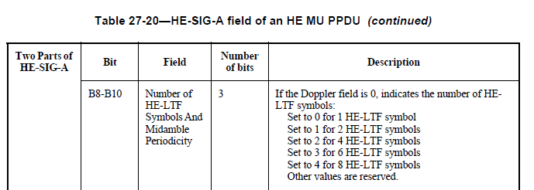
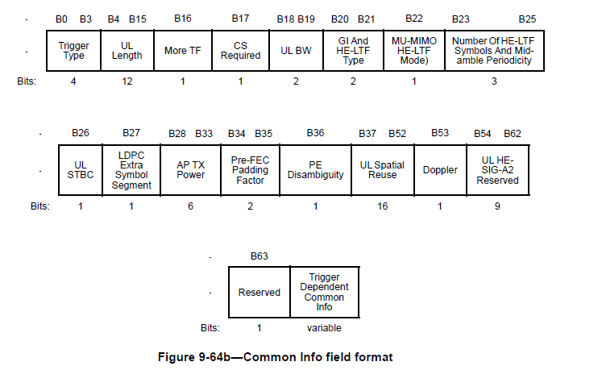
11ax Training Sequence
SU PPDU: N_{HE-LTF} is not communicated as part of packet and receiver assumes N_{HE-LTF} based on N_{STS,tot} information.
MU PPDU: N_{HE-LTF} in specified in HE-SIG-A.
TB-PPDU: AP can request specific N_{HE-LTF} in common info field of trigger frame.
But use of N_{HE-LTF} greater than nominal value is restricted to more than 1 RU transmissions.
[Reference] 802.11ax draft: section 27.3.11.10

Slide 6
Simulation Parameters
We evaluate the impact of using higher N_{LTF} through PER simulations for 3 cases:
DL SU without beamforming and channel smoothing on receiver
DL SU with beamforming
DL MU-MIMO
For each case, we compare default N_{LTF} vs maximum N_{LTF}(8) performance.
Other Simulation parameters:
Transmitter: N_Tx = 8, BF sounding NSS = 8
Receiver: N_Rx = 4, MMSE detection
Channel model = TGnD

Slide 7
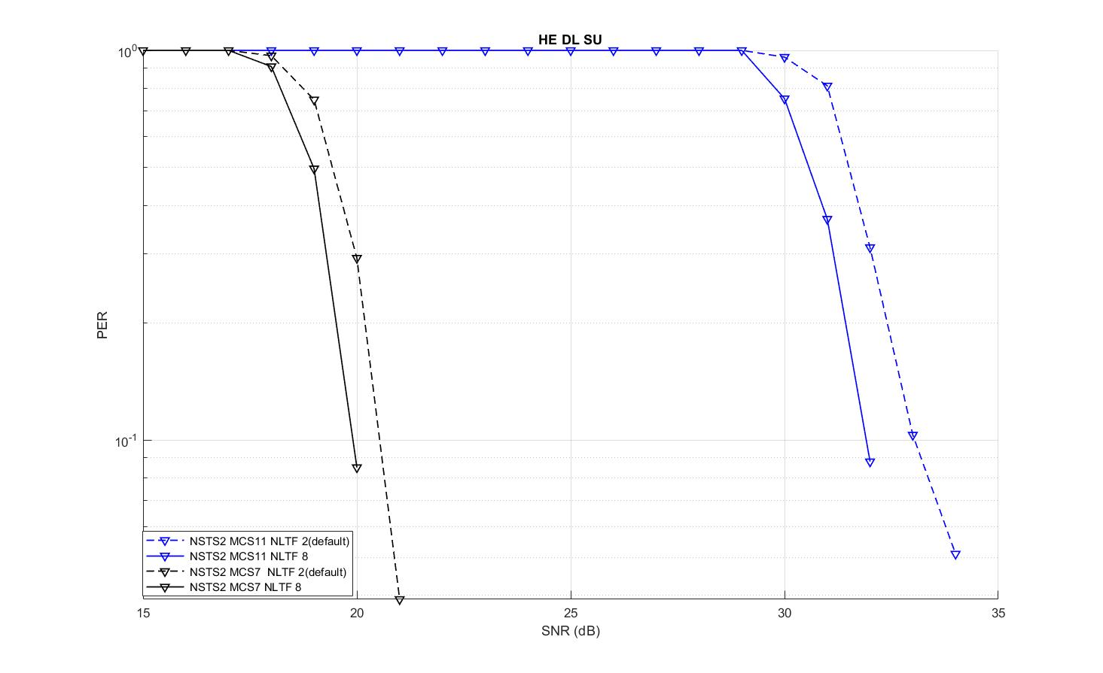
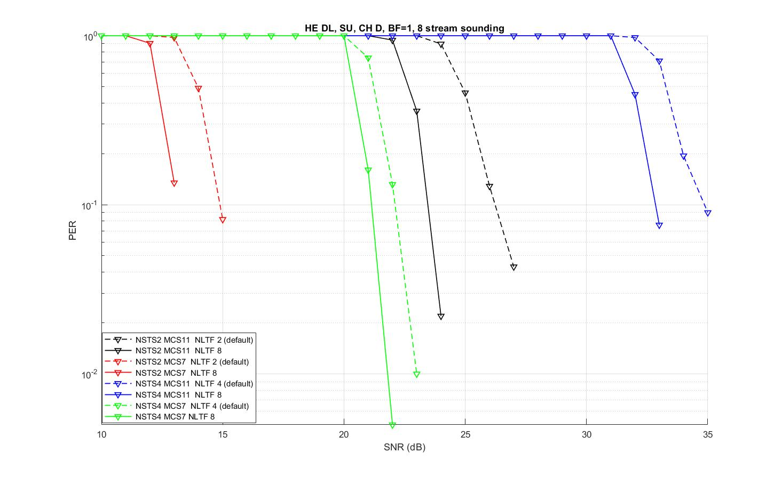
Simulation Results (1/2)
SU result for non-beamformed and beamformed cases are shown below.
For non-beamformed case, channel smoothing is performed at receiver. LTF averaging improves CS noise further and provides up to ~1 dB gain in PER.
For beamformed case, up to 2.5 dB gains in performance can be achieved with improved CE.

Slide 8
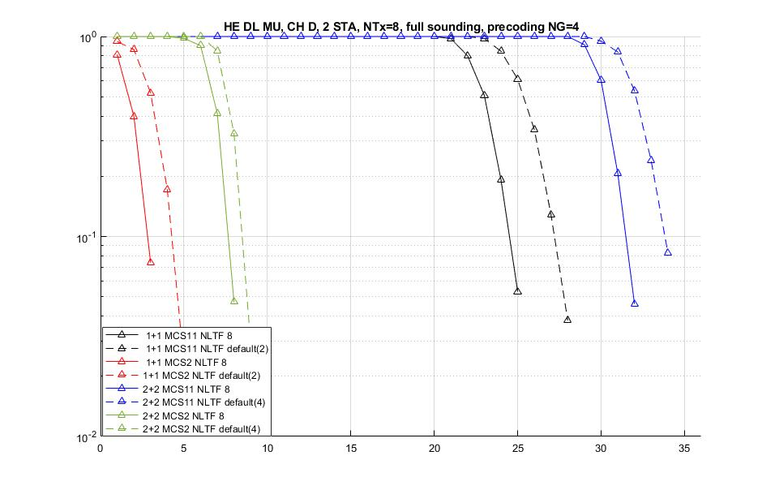
Simulation Results (2/2)
DL MU results for MCS 2 and MCS 11 are shown below.
Up to 2.5 dB gains are seen as increased training help with CE errors on receiver.

Slide 9
Conclusions
Based on these results, we propose decoupling N_{EHT-LTF} from N_{STS,tot} for all packet formats in EHT.
For SU format, current 11be SFD agrees on adding below subfields in U-SIG or EHT-SIG of an EHT PPDU sent to a single User:
MCS
NSTS
GI+EHT-LTF Size
Coding
We propose to add indication of N_{EHT-LTF} in U-SIG.
For MU and TB formats, we propose to remove multi-RU requirement for using higher number of LTF while keeping the indication of N_{EHT-LTF} in EHT-SIG fields or trigger frame (similar to 11ax).

Slide 10
Straw Polls
SP1: Do you support to include N_{EHT-LTF} in U-sig for SU packets in EHT
Y:
N:
A:
Note: There is an ongoing discussion to use same packet format for SU and MU.

Slide 11
Straw Polls
SP2: Do you support removing multi-RU restriction on using higher N_{EHT-LTF} for MU packets in EHT
Y:
N:
A:

Slide 12
Backup slides

Slide 13
802.11ax draft: section 27.3.11.10
…In an HE MU PPDU with more than one RU and in an HE TB PPDU, N_{HE-LTF} may take a value 1, 2, 4, 6 or 8 that is greater than or equal to the maximum value of the initial number of HE-LTF symbols for each RU…
…For an OFDMA HE TB PPDU N_{HE-LTF} may be 1, 2, 4, 6 or 8, which is greater than or equal to the maximum value of the initial number of HE-LTF symbols for each RU …

