Slide 1
Preamble Puncturing for PPDUs Transmitted to Multiple STAs
Date: 2020-03-24
Authors:

Slide 2
Outline
Recap
Channel utilization improvement
Option 1
Option 2
Pros & Cons
Conclusions
SPs
Appendix

Slide 3
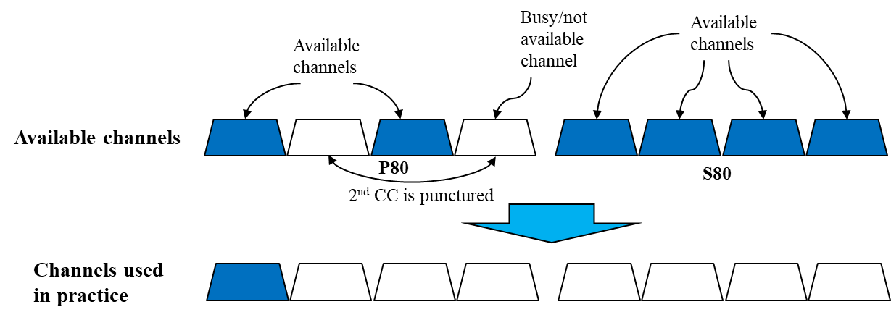
Recap: Preamble Puncturing in 11ax
Reminder to 802.11ax puncturing:
Puncturing indication exists for P80 only
If within P80 only the 40MHz BW corresponding to the content-channel that includes P20 is available, the BW is reduced to 20MHz

Slide 4
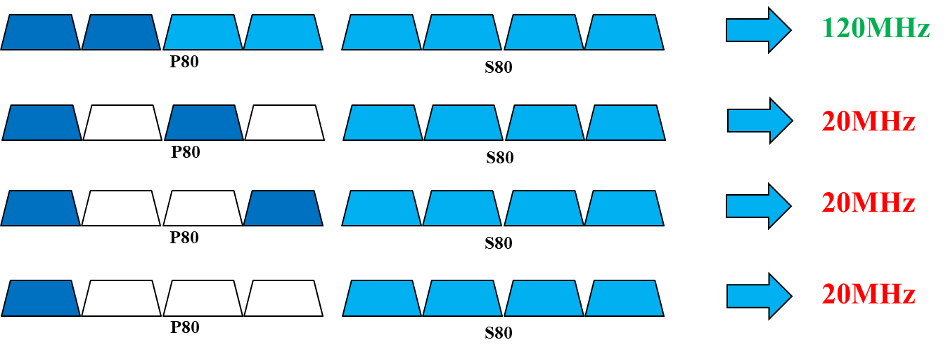
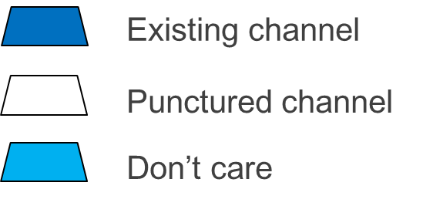
Recap: Preamble Puncturing in 11ax
Moreover, referring to the figure below and assuming PPDU transmitted to multiple STAs: we see that in scenario 1 40MHz in P80 are available and at the same time any non-punctured 20MHz sub-channel in S80 may be used (BW field =‘111’)
However in the other scenarios although 40MHz (scenarios 2-3) or 20MHz (scenario 4) in P80 are available as well, S80 is not.
In other words: if we support scenario #1 below, why won’t we support scenarios 2-4 as well?
1
2
3
4

Slide 5
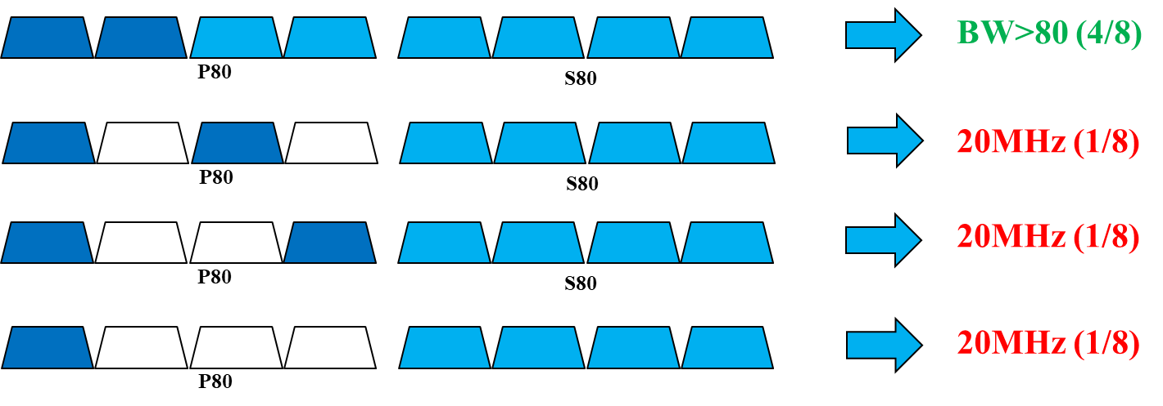
Recap: Channel Utilization Potential Gain
Another way to look at it:
Out of all cases where P20 is available and assuming any 20MHz sub-channel has an equal probability of being punctured, there is a probability of:
25% that the 2nd content channel is not available
12.5% that P80 has the structure of 1001
Assuming “dense enough” network, there is a chance of 37% that the BW will reduce to 20MHz
Simulation result that show the potential gain are given in Appendix 2

Slide 6
Channel Utilization Improvement
In order to improve the channel utilization we suggest 2 options
Covering most puncturing structures within a given 80MHz channel conditioned on the availability of two 20MHz channels in it (7/8 cases)
Covering all puncturing structures within a given 80MHz channel
Assumptions:
The size of the BW field in U-SIG that contains the puncturing structure as well will be increased
Minimal changes compared with 802.11ax
2 content channels will be supported, similar to 802.11ax
U-SIG structure is TBD
EHT-SIG structure is TBD

Slide 7
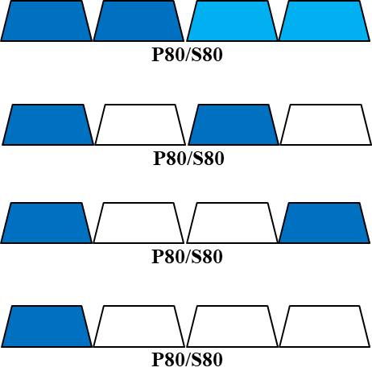
Option 1: Covering majority of puncturing structures in a given 80MHz channel
In this case we suggest to allow any puncturing structure in a given 80MHz segment conditioned on the availability of at least two 20MHz channels
Add signaling options to support structures of ‘1010’ and ‘1001’
Only the case of ‘1000’ will not be supported, in such a case the segment BW will be either reduced to 20MHz or will be non-available
This requires pre-EHT processing over 80MHz
The content channel order for ‘1010’ will need to be changed to allow both content channels to exist

Slide 8
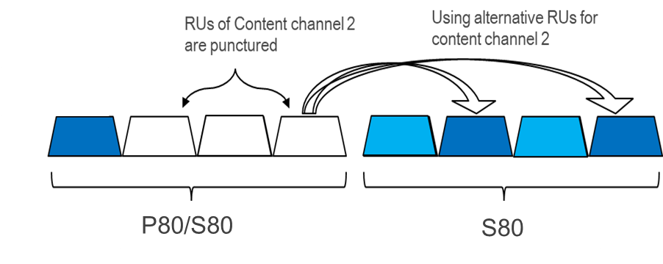
Option 2: Covering all puncturing structures within 80MHz
If we wish to support ‘1000’ as well then we suggest to add puncturing indication about another 80MHz
In this case, as shown in the figure below, in order to have the allocation map in the 2nd CC, the corresponding channels in the other 80MHz channel (within the same 160MHz channel) may be used
Applicable for devices that support BW>80MHz and will require pre-EHT processing over 160MHz
80MHz-only devices and other devices that prefer to process pre-EHT on only 80MHz will coexist with the above devices (although they will be limited in RU assignment when the 2nd CC is unavailable)
P160 or S160

Slide 9
Pros & Cons of Both Options
 | Pros | Cons
Option 1 (covering the majority of puncturing structures) | Improves channel utilization respective to 802.11ax by supporting more preamble puncture cases | For 160/240/320MHz operating devices, when ‘1000’ puncturing exist the channel utilization is reduced to 20MHz
 | Allow per-80MHz U-SIG and/or EHT-SIG signaling
Option 2 (covering all the puncturing structures) | Improves channel utilization even more (when ‘1000’ puncturing exists) | Requires pre-EHT processing over 160MH
 | Minor changes required to U-SIG and EHT-SIG respective to 802.11ax | Requires at least per-160MHz U-SIG and/or EHT-SIG signaling, hence overhead is increased respective to option 1

Slide 10
Conclusions
We introduced a puncturing method for 802.11be that is based on 802.11ax
The main motivation is to overcome some restrictions in 802.11ax that limit the channel BW utilization
We suggested 2 options:
Covering the majority of puncturing cases in a given 80MHz
Covering all puncturing cases in a given 80MHz
The additional overhead in U-SIG (BW field) is minimal: probably only 1 (or 2) additional bit(s) respective to 802.11ax, which yields significant gain in channel utilization
This additional overhead is anyway required in order to support BW>160

Slide 11
Straw Poll 1
Do you agree to allow puncturing structure 1001 in a given 80MHz segment for OFDMA PPDUs transmitted to STAs operating at BW>=80MHz?
Assuming 2 content channels are used
Puncturing signaling may be different for different 80MHz channels
In 802.11ax in such cases the BW drops to 20MHz
Y/N/A xx/xx/xx

Slide 12
Straw Poll 2
Do you agree to allow puncturing structure 1010 in a given 80MHz segment for OFDMA PPDUs transmitted to STAs operating at BW>=80MHz?
Assuming 2 content channels are used
Puncturing signaling may be different for different 80MHz channels
In 802.11ax in such cases the BW drops to 20MHz
Y/N/A xx/xx/xx

Slide 13
Straw Poll 3
Do you agree that U-SIG may include puncturing signaling/info about both 80MHz channels within each 160MHz channel?
Will be used only by devices that can decode pre-EHT on 160MHz
Will NOT affect the operation of STAs that decode pre-EHT on 80MHz
Applicable for BW=160,320MHz. For BW=240MHz applicable for P160 only
Signaling content is TBD
Y/N/A xx/xx/xx

Slide 14
Appendix 1 - 160MHz Rx Implications
There were some claims regarding the requirement for reception over 160MHz, mostly saying that it would significantly increase the power consumption.
More specifically, there were concerns that a STA Rx would have to operate digitally over 160MHz to decode EHT-SIG (and all preceding fields as well) only to realize that in most cases the PPDU is destined to different STAs
After thoroughly reviewing this issue we came to the conclusion that the increase of power consumption is negligible
The Power-Save mechanism (see next slide for further explanation) ensures that a STA opens its digital reception circuits to 160MHz (or any other BW) only when a PPDU of such BW may be transmitted to it, otherwise it operates either in sleep mode or in 20MHz (the primary channel) – similar to how it is done in 802.11ax.
This means that a STA shall not process any PPDU with BW>20MHz unless it has received a specific indication from the AP that the following PPDUs include payload destined to it using a higher BW

Slide 15
Appendix 1 - 160MHz Rx Implications
How Power save works?
Power-management schemes places a client in sleep mode when no activity occurs
The PS mode includes the following steps:
Before a STA goes into the doze state, it request PS from the AP by sending a frame (usually NDP)
Once STA indicate PS, the AP buffers all frames destined to the station
When the STA change to awake state, it sends a frame to the AP to indicate it is active and ready to receive DL frames
Prior to sending data to the STA, the AP sends a management frame over the primary 20MHz (e.g. RTS) to the STA indicating (among other) the BW that will be used for further data transmission
Only at this point, the STA changes its reception BW to the required one (e.g. 160MHz)
When AP has finished sending data to the STA, the STA returns to doze state

Slide 16
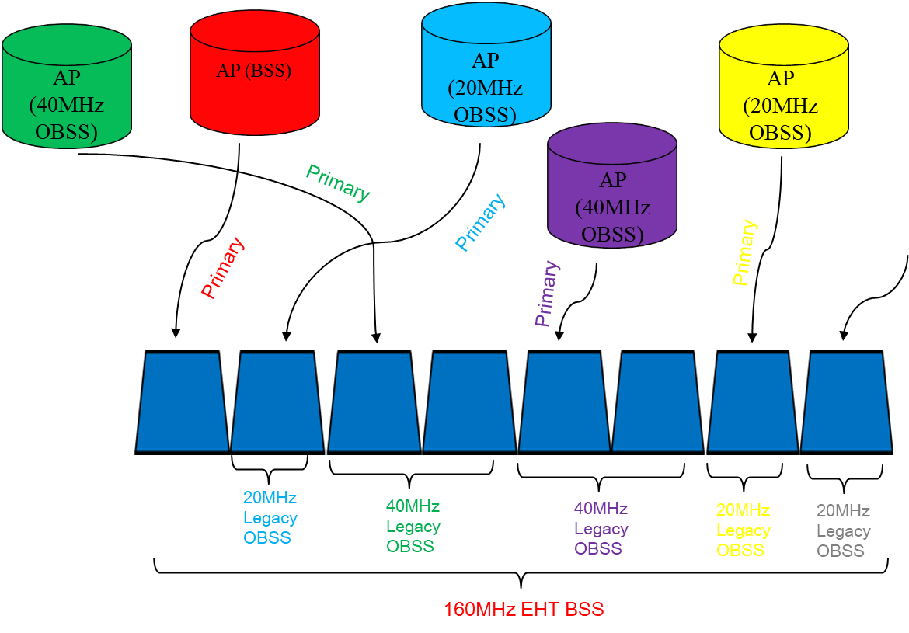
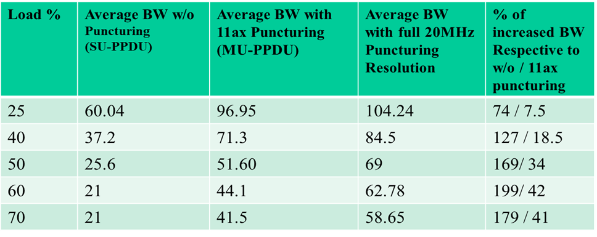
Appendix 2: Channel Utilization Potential Gain
Overcoming the above limitation yields significant channel utilization improvement as shown in [1] and [2]
Simulation Results
Up to 42% improvement in channel utilization for MU transmission
The simulation results show the BW utilization gain when allowing using BW that is not allowed in 802.11ax due to puncturing restrictions

Slide 17
References
[1] 11-19-1190-00-00be-improved-preamble-puncturing-in-802-11be (Oded Redlich et al, Huawei)
[2] 11-19-1606-00-00be-Preamble Puncturing and SIG-B Signaling (John Son et al, Wilus Inc)

