Slide 1
Segment parsing for punctured transmissions
Date: 2020-03-16
Authors:

Slide 2
Introduction
Several “large RU” puncturing modes were agreed for 80 MHz and bandwidths > 80 MHz
In 11ac and 11ax, PPDUs with BW > 80 MHz use segment parsing
The output of the stream parser is split into 80 MHz segments
Half of the bits are multiplexed into each segment
Each segment goes through separate interleaving or LDPC tone mapping
For 160 MHz, the two segments are later de-parsed

Slide 3
Segment parsing with puncturing
In 11ax, puncturing only applies to RUs smaller than 160 MHz
Segment parsing and puncturing are never combined
In 11be, puncturing has been defined for BW > 80 MHz
If we continue to use segment parsing for BW > 80 MHz in 11be, not all 80 MHz segments will have the same number of bits
How to define segments parsing for cases like this?

Slide 4
How does segment parsing work in 11ax?
The N_{CBPSS} bits are split into two sets of N_{CBPSS}/2 bits by splitting the N_{CBPSS} bits into groups of s bits and round-robin assignment of the bits to the different segments

Slide 5
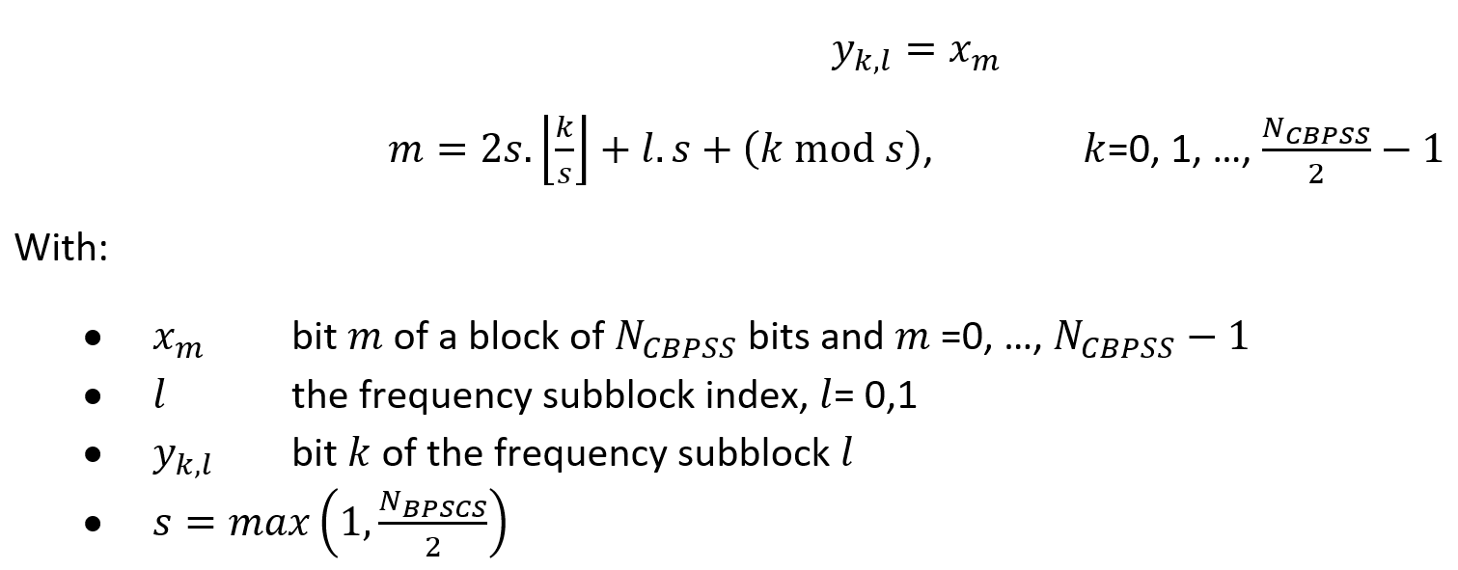
Formal definition
This assignment does not work when the two segments have different number of bits

Slide 6
Segment parsing for simple ratios
If the number of bits in the different segments have simple ratios, the round-robin scheme can easily be generalized to this case
E.g. for a ratio 2:1 (say 80 MHz + 40 MHz)

Slide 7
In formulas
With R₀:R₁ the ratio of the numbers of bits in the two segments
This expression is only practical for simple ratios (e.g. 2:1, 4:3)
Note that for R₀:R₁ =1:1, this reduces to the known segment parsing

Slide 8
Punctured modes in EHT
Unfortunately, none of the punctured modes in EHT have simple ratios between the number of bits in the different segments
For instance:
RU996 + RU484 (40 MHz puncturing)
Ratio 980:468 = 245:117
RU 996 + (RU 484 + RU 242) (20 MHz puncturing)
Ratio 980:702 = 490:351
Parsing can be slightly modified to accommodate those ratios as well

Slide 9
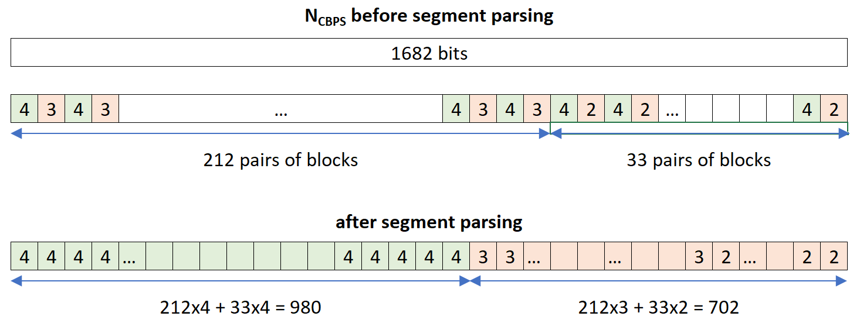
Example
20 MHz puncturing:
RU 996 in one 80 MHz segment
RU 242 + RU 484 in other 80 MHz segment
s=1 (980 + 702 = 1682 bits)

Slide 10
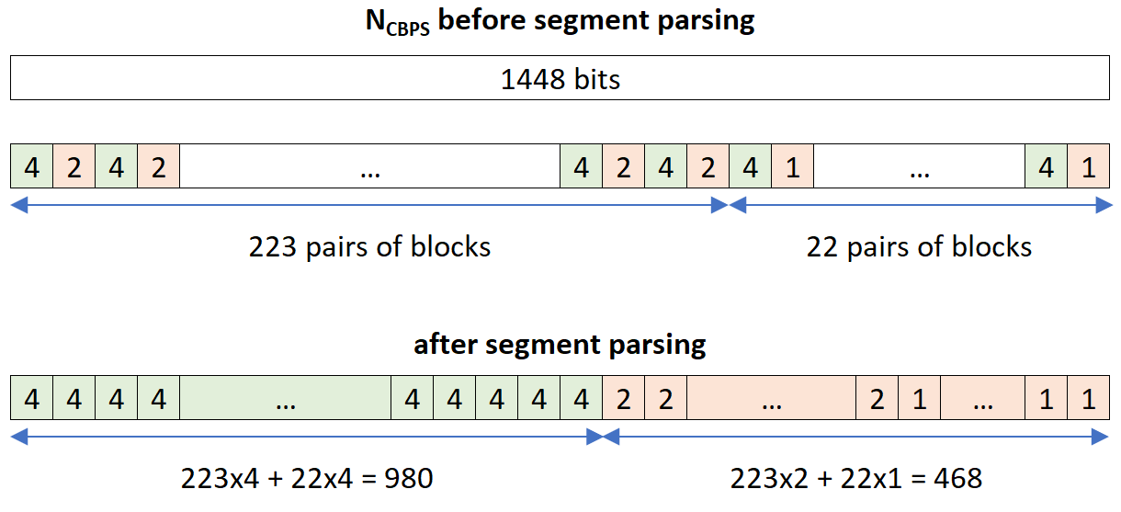
A second example
40 MHz puncturing:
RU 996 in one 80 MHz segment
RU 484 in other 80 MHz segment
980 + 468 = 1448 bits

Slide 11
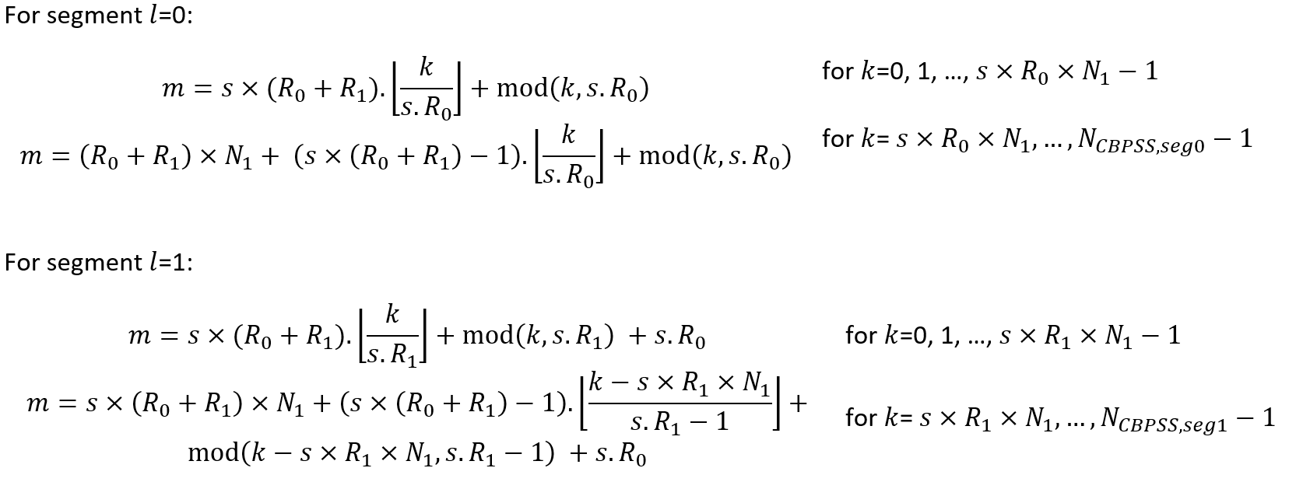
Modified segment parsing
Round-robin assignment in two phases:
Parsing with one simple ratio for the first N₁ blocks
Parsing with second simple ratio for the subsequent N₂ blocks
In formulas:

Slide 12
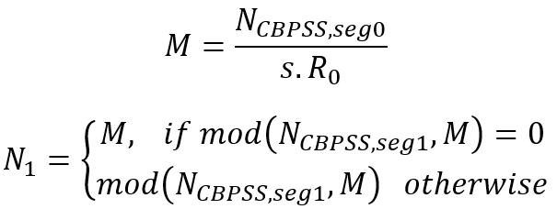
Parameters
N₁ given by:
R₀:R₁ the approximate ratio of the numbers of bits in the two segments
R₀:R₁ = 2:1 for 40 MHz puncturing
R₀:R₁ = 4:3 for 20 MHz puncturing
$N_{CBPSS,seg0}$ and $N_{CBPSS,seg1}$ are the number of bits in the first and second segment respectively

Slide 13
Conclusion
We have presented a segment parsing scheme that is suitable for segments with unequal numbers of bits
As would e.g. be found in punctured transmissions
The proposed scheme can accommodate any ratio in the number of bits of the various segments
The proposed parsing reduces to the known segment parsing for segments with equal numbers of bits
The proposed scheme generalizes the round-robin parsing used before
Reduces to known scheme for segments with equal number of bits
Extension to more than two segments is possible

Slide 14
Straw Poll
Do you support the definition of segment parsing for puncture transmissions as shown on slides 9-12?
Y:
N:
A:

Slide 15
References
[1] Specification Framework for TGbe, IEEE 802.11-19/1262r8

