Slide 1
Remarks on the content channels
Date: 2020-03-14
Authors:

Slide 2
Abstract
This contribution discusses the coding of the content channels
It is shown that applying erasure codes results in both an increase of spectrum efficiency and more flexibility in the RU puncturing patterns, while the cost in terms of encoding/decoding complexity is very slight

Slide 3
Recap
The HE-SIG-B field comprises one or two HE-SIG-B content channels. Each HE-SIG-B content channel conveys user allocation for one or more 20 MHz subchannels
An HE MU PPDU with bandwidth greater than 20 MHz has two HE-SIG-B content channels
The content channels are duplicated when the PPDU bandwidth exceeds 40 MHz

Slide 4
Content channels in EHT
EHT will support larger bandwidths and more RU combinations than HE
EHT will also support up to 16 SS → there could be more users in one EHT MU PPDU than in one HE MU PPDU
Therefore, the EHT content channels are expected to consume more bandwidth than the HE content channels
Hence, it is highly desirable to make the design of the EHT content channels more spectrally efficient than the design of the HE content channels, as well as more flexible to support more RU combinations

Slide 5
Low complexity erasure codes
Erasure codes with very low encoding and decoding complexity (e.g. RDP codes and their extensions [1]) have been developed for applications such as Redundant Arrays of Inexpensive Disks (RAID).
Low complexity erasure codes could also be applied in order to recover data erased due to preamble puncturing
Low complexity erasure codes could be applied to the EHT content channels, instead of duplication, to increase both the flexibility in puncturing patterns and the spectrum efficiency

Slide 6
Example 1: Increased flexibility in the puncturing patterns (1)
We illustrate, by means of an example, how low complexity erasure codes can be used to increase the flexibility in the allowed puncturing patterns.
Consider the example presented in great detail in [2]:
In this case the bandwidth of an HE MU PPDU can’t exceed 20 MHz

Slide 7
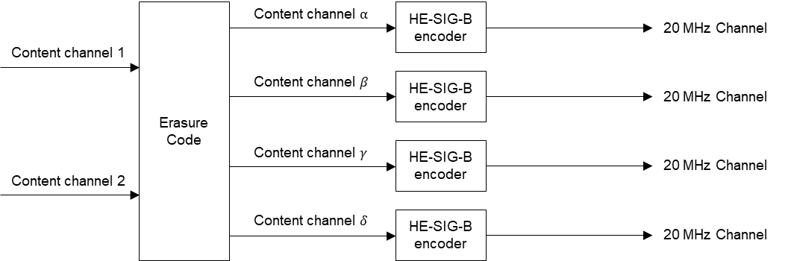
Example 1: Increased flexibility in the puncturing patterns (2)
A low complexity erasure code with rate ½ may be applied as shown in the figure:

Slide 8
Example 1: Increased flexibility in the puncturing patterns (3)
Further, the content channels are repeated on the 80 MHz secondary:
→ with erasure encoding an EHT MU PPDU could have 120 MHz bandwidth and support puncturing of any pair of 20 MHz channels
Complexity of erasure code:
Encoding: 0.5 XORs per bit. Decoding: 1 XOR per bit (see Appendix A)

Slide 9
Example 2: Increased spectrum efficiency (1)
We illustrate, by means of an example, how low complexity erasure codes can be used to increase the spectrum efficiency of the content channels.
Consider an 80 MHz HE MU PPDU:

Slide 10
Example 2: Increased spectrum efficiency (2)
HE supports the following puncturing patterns for 80 MHz MU PPDUs:

Slide 11
Example 2: Increased spectrum efficiency (3)
EHT: Increase the number of content channels from 2 to 3 (50% increase)
Apply a low complexity, rate 2/3 erasure code to the nonprimary channels (see Appendix B)
An 80 MHz EHT MU PPDU could support the same puncturing as an 80 MHz HE MU PPDU but the spectrum efficiency of the content channels could be increased by 50%

Slide 12
Summary
It has been shown, by means of relevant examples, that erasure codes can be applied to the EHT content channels in order to
Allow more RU combinations without increasing the bandwidth of the content channels
Increase the spectrum efficiency of the EHT content channels
Furthermore, erasure codes with very low encoding/decoding complexity (e.g. RDP codes[1]) are well known

Slide 13
References
[1] Mario Blaum, “A Family of MDS Array Codes with Minimal Number of Encoding Operations” 2006 IEEE International Symposium on Information Theory (https://ieeexplore.ieee.org/document/4036480)
[2] Oded Redlich et al., “IEEE 802.11/20-0058-00-00be Preamble puncturing for transmission to multiple STAs in 802.11be”, Jan 2020.

Slide 14
Straw poll
Do you agree that TGbe should consider the use of low complexity erasure codes in the design of the content channels?
Y:
N:
A:

Slide 15
Appendix A
RDP codes and their extensions (see e.g. [1]) have low encoding and decoding complexity.
The content channels could be encoded as shown in the figure

Slide 16
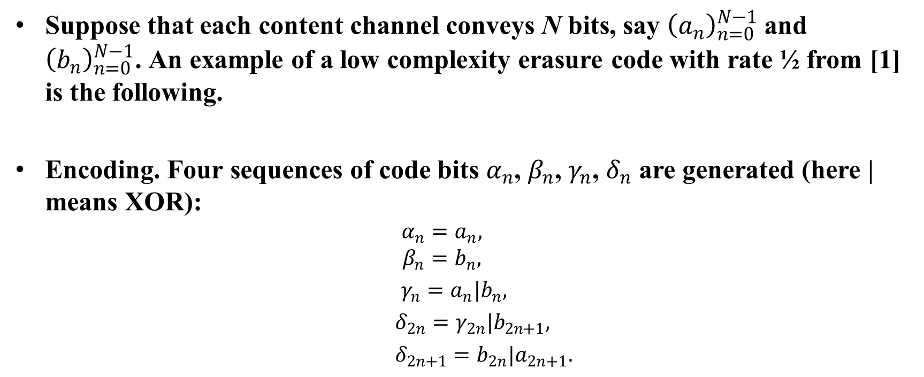
Appendix A (cont.)
Suppose that each content channel conveys N bits, say ${\left(a_{n}\right)}_{n=0}^{N−1}$ and ${\left(b_{n}\right)}_{n=0}^{N−1}$. An example of a low complexity erasure code with rate ½ from [1] is the following.
Encoding. Four sequences of code bits $α_{n}$, $β_{n}$, $γ_{n}$, $δ_{n}$ are generated (here | means XOR):
  $$α_{n}=a_{n},$$
  $$β_{n}=b_{n},$$
  $γ_{n}=a_{n}|b_{n},$
  $δ_{2n}=γ_{2n}|b_{2n+1},$
  $δ_{2n+1}=b_{2n}|a_{2n+1}.$

Slide 17
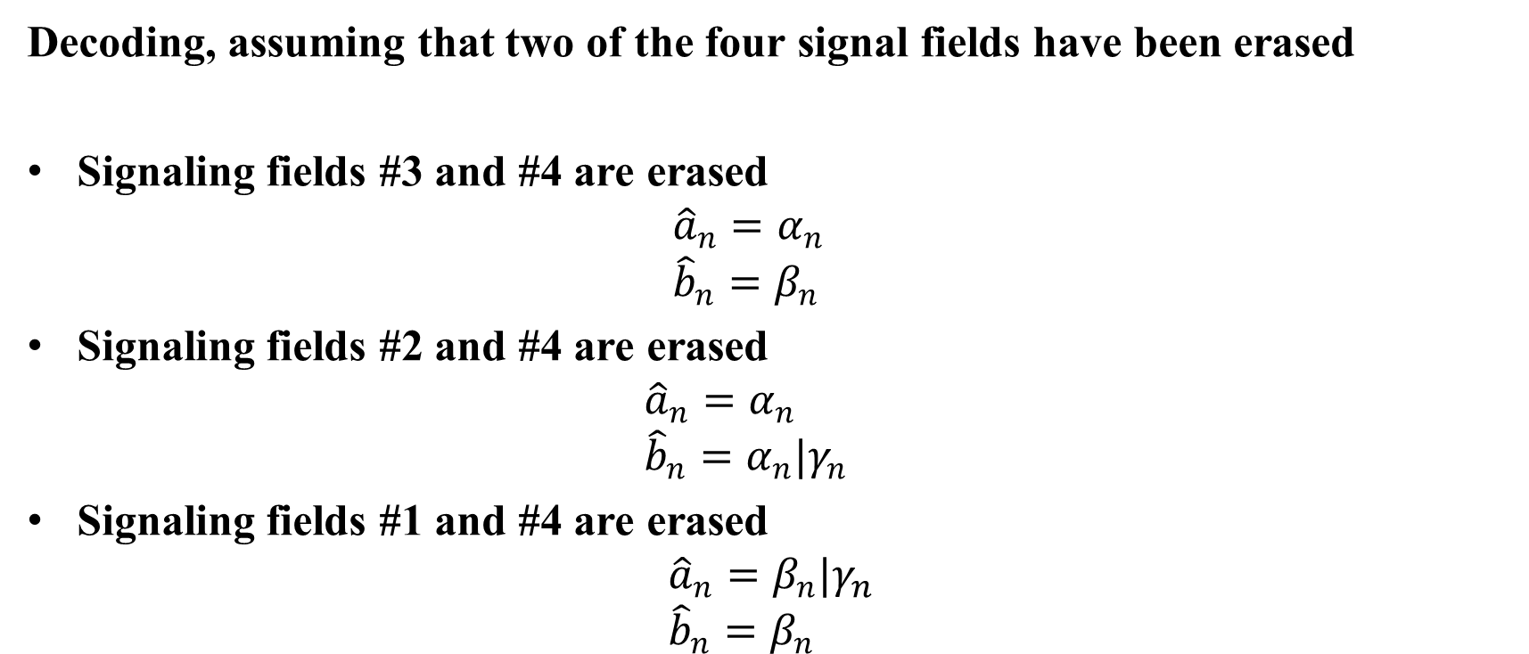
Appendix A (cont.)
Decoding, assuming that two of the four signal fields have been erased
Signaling fields #3 and #4 are erased
${\hat{a}}_{n}=α_{n}$
${\hat{b}}_{n}=β_{n}$
Signaling fields #2 and #4 are erased
${\hat{a}}_{n}=α_{n}$
${\hat{b}}_{n}={α_{n}|γ}_{n}$
Signaling fields #1 and #4 are erased
${\hat{a}}_{n}=β_{n}|γ_{n}$
${\hat{b}}_{n}=β_{n}$

Slide 18
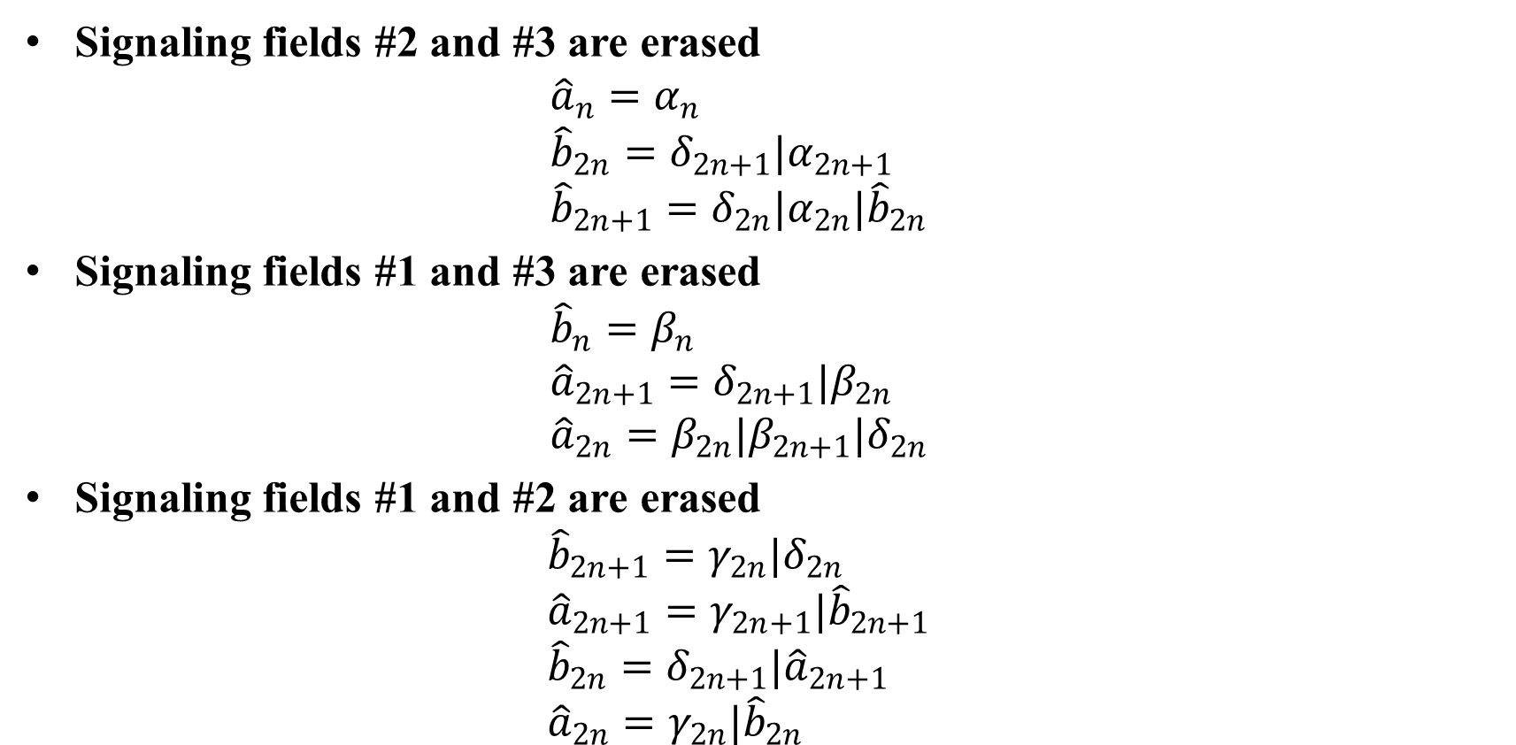
Appendix A (cont.)
Signaling fields #2 and #3 are erased
${\hat{a}}_{n}=α_{n}$
${\hat{b}}_{2n}={δ_{2n+1}|α}_{2n+1}$
${\hat{b}}_{2n+1}={δ_{2n}|α}_{2n}|{\hat{b}}_{2n}$
Signaling fields #1 and #3 are erased
${\hat{b}}_{n}=β_{n}$
${\hat{a}}_{2n+1}={δ_{2n+1}|β}_{2n}$
${\hat{a}}_{2n}={β_{2n}|β}_{2n+1}|δ_{2n}$
Signaling fields #1 and #2 are erased
${\hat{b}}_{2n+1}={γ_{2n}|δ}_{2n}$
${\hat{a}}_{2n+1}=γ_{2n+1}|{\hat{b}}_{2n+1}$
${\hat{b}}_{2n}=δ_{2n+1}|{\hat{a}}_{2n+1}$
${\hat{a}}_{2n}=γ_{2n}|{\hat{b}}_{2n}$

Slide 19
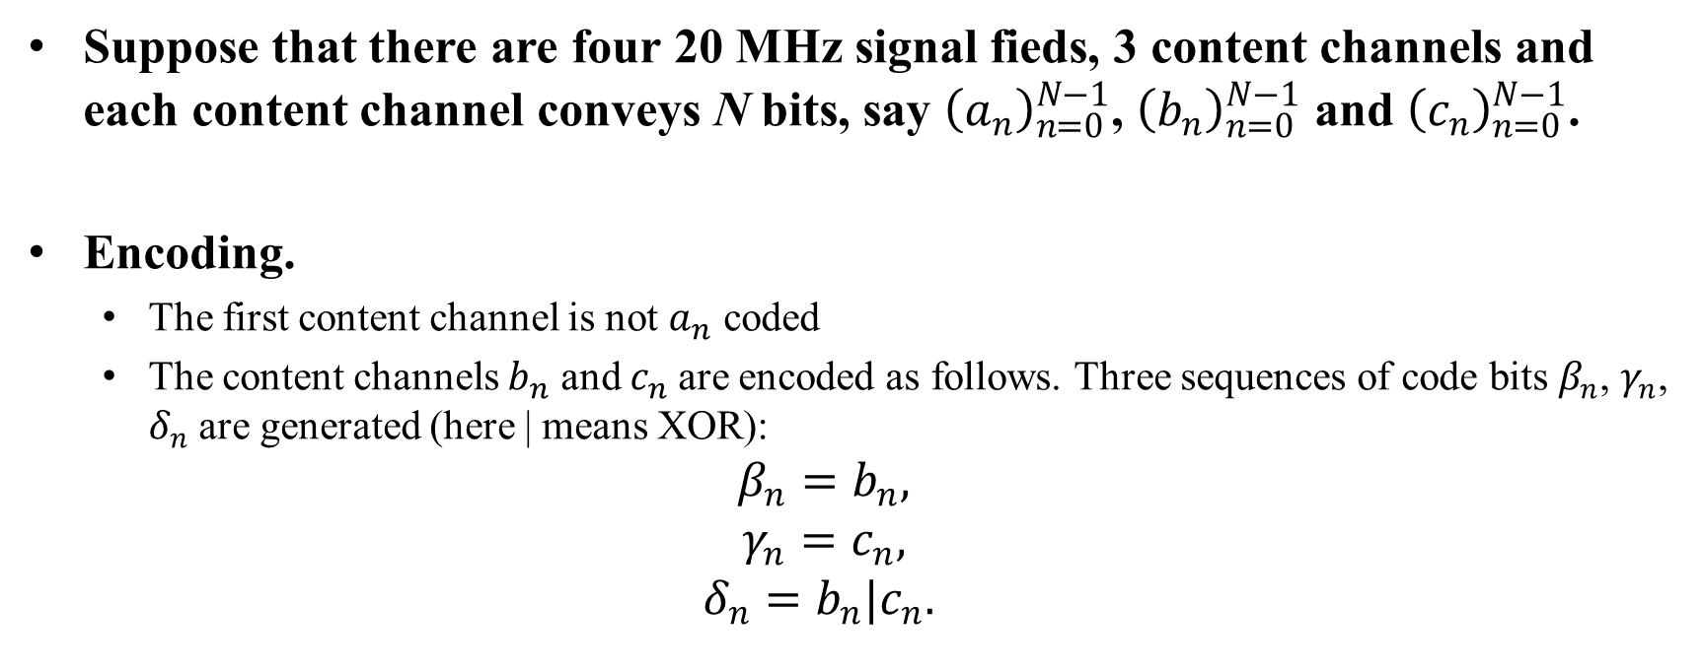
Appendix B
Suppose that there are four 20 MHz signal fieds, 3 content channels and each content channel conveys N bits, say ${\left(a_{n}\right)}_{n=0}^{N−1}$, ${\left(b_{n}\right)}_{n=0}^{N−1}$ and ${\left(c_{n}\right)}_{n=0}^{N−1}$.
Encoding.
  The first content channel is not $a_{n}$ coded
  The content channels $b_{n}$ and $c_{n}$are encoded as follows. Three sequences of code bits $β_{n}$, $γ_{n}$, $δ_{n}$ are generated (here | means XOR):
$$β_{n}=b_{n},$$
$$γ_{n}=c_{n},$$
$$δ_{n}=b_{n}|c_{n}.$$

Slide 20
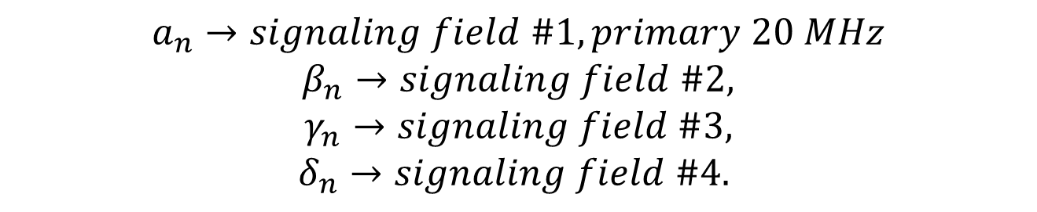
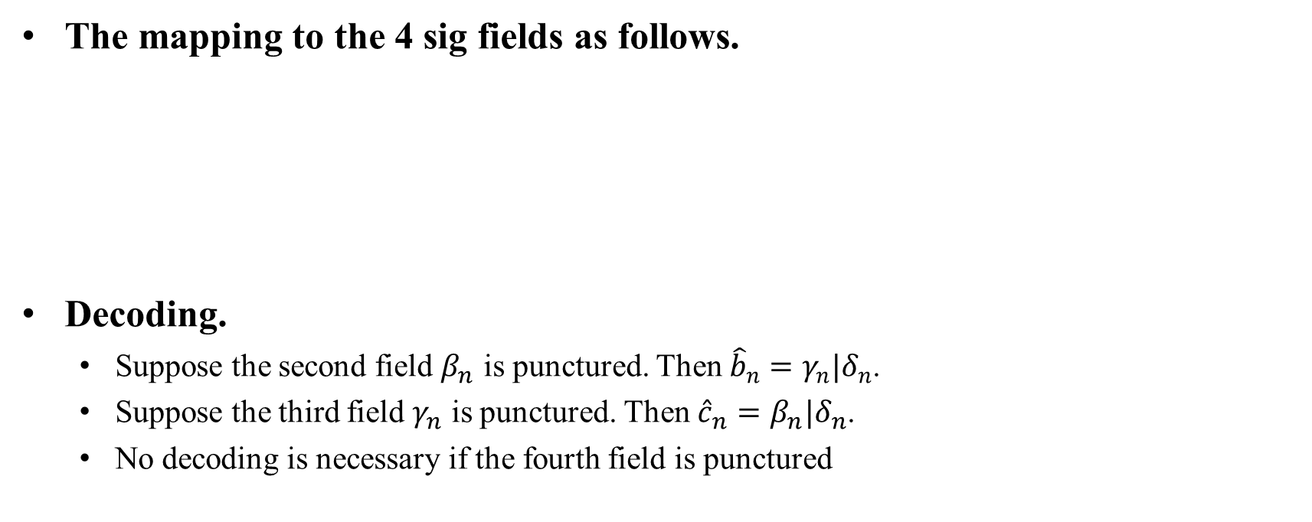
Appendix B (cont.)
The mapping to the 4 sig fields as follows.
Decoding.
  Suppose the second field $β_{n}$ is punctured. Then ${\hat{b}}_{n}=γ_{n}|δ_{n}$.
  Suppose the third field $γ_{n}$ is punctured. Then ${\hat{c}}_{n}=β_{n}|δ_{n}$.
  No decoding is necessary if the fourth field is punctured
$$a_{n}→signaling field \#1, primary 20 MHz$$
$$β_{n}→signaling field \#2,$$
$$γ_{n}→signaling field \#3,$$
$$δ_{n}→signaling field \#4.$$

