Slide 1
Impact of Multiple RU Allocation on PAPR
Date: 10-03-2020
Authors:

Slide 2
Introduction
802.11be introduces a new type of allocation where multiple RUs may be assigned to the same STA(s) or group of STAs
The aggregated RU may be contiguous or non-contiguous in frequency
Multi-RU (MRU) introduces new issues and challenges that need to be addressed in 802.11be
In this presentation we are focusing on the PAPR issue, which might be reexamined with respect to larger BW, puncturing and especially MRU – see also [1], [2]
We will show the PAPR impact caused by an MRU allocation; we examine the problem and provide a summary of possible solutions
Note: in this revision we address comments that raised during presentation of r0 (specifically PA model and phase continuity for contiguous MRU allocations)

Slide 3
Problem Formulation
LTF/STF sequences are designed and optimized for the entire BW, especially in terms of PAPR, while each RU is a subset of the main sequence
If in case of MRU allocation type a sub-sequence (portion) of EHT-LTF is transmitted in each RU, (e.g. reusing of existing HE-LTF sequences), the resulting PAPR might be increased (compared with the PAPR of a single RU)
It can be explained theoretically as a superposition of two transmitted waveforms, where the high peaks of each of them may be located at the same time samples and thus result in a higher peak
1st
RU
1st
RU
MRU
2nd
RU
2nd
RU
Frequency
High Peak
Time

Slide 4
Impact on PAPR
In the figures below we show the impact of MRU on PAPR of HE-LTF, where we use HE-LTF sequences of 11ax per each RU within an MRU
We show an example for specific RU sizes over all the possible MRUs (x-axes represents indexes of RUs in an MRU, i.e. 1₅ in figure of 106+26 means 1st 106-tone RU and 5th 26-tone RU)
We can see the PAPR is increased by 1.5-2dB in case of large RUs and 1.5-3dB in case of small RUs

Slide 5
Why is PAPR on EHT-LTF an Issue?
We also checked the impact of PAPR on data portion in case of an MRU
As we can see in the figure below, the PAPR of the data portion is increased by 0.5-1dB which is a significantly smaller impact than on the PAPR of the EHT-LTF
It means that higher backoff may be required
  If impact on CHEST is significant, back-off will be mandated by the EHT-LTF PAPR

Slide 6
Impact of EHT-LTF MRU PAPR on PER
The higher PAPR associated with the EHT-LTF sequences of an MRU impact the channel estimation and hence the demodulation performance
This issue is especially problematic for devices with simple/low complexity PA design, which for example do not include a DPD
We checked the impact of higher MRU EHT-LTF PAPR on the PER by simulating the same scenarios with random sequences with different PAPR based on RAPP model of power amplifier

Slide 7
Short (Temporary) Summary
We’ve shown that for an MRU allocation there is an impact on PAPR, especially on the EHT-LTF, thus any transmission allocated on partial BW may suffer from performance degradation:
  UL MRU
  NDP reflecting MRU allocation (similar to punctured NDP)
  DL MRU (especially non-OFDMA transmissions)
Back-off adjustment that is usually used in order to minimize non-linear components due to high PAPR is not an optimal solution in this case (impact on data portion is much smaller than the impact on EHT-LTF)
Thus we would like to provide a solution where the PAPR in case of MRU is minimized with additional focus on the following two metrics:
  Small number of EHT-LTF sequences (similar to 11ax)
  Simple definition in spec (few changes)
  Reasonable implementation complexity
In the next slides we will list several solutions and examine them in terms of PAPR reduction and the two metrics above

Slide 8
Straight-Forward Solution
The straight-forward way to overcome this problem is to design new EHT-LTF sequences that minimize the PAPR in case of MRU
We can see in the figure below that this indeed may significantly reduce PAPR (different sequences achieved minimal PAPR in different MRU combinations)
However, this method has several drawbacks:
  Specific sequence should be designed for each
  MRU combination (same RU within different
  RU combination cause different PAPR and thus
  same sequence can not be applied for all the
  cases)
  Different EHT-LTF sequences will be used for
  MRU and single RU transmissions –
  increases implementation and memory complexity
Every solution based on a single EHT-LTF sequence can not be optimal for all the MRU combinations and requires a different solution for MRU and single RU
1.2dB

Slide 9
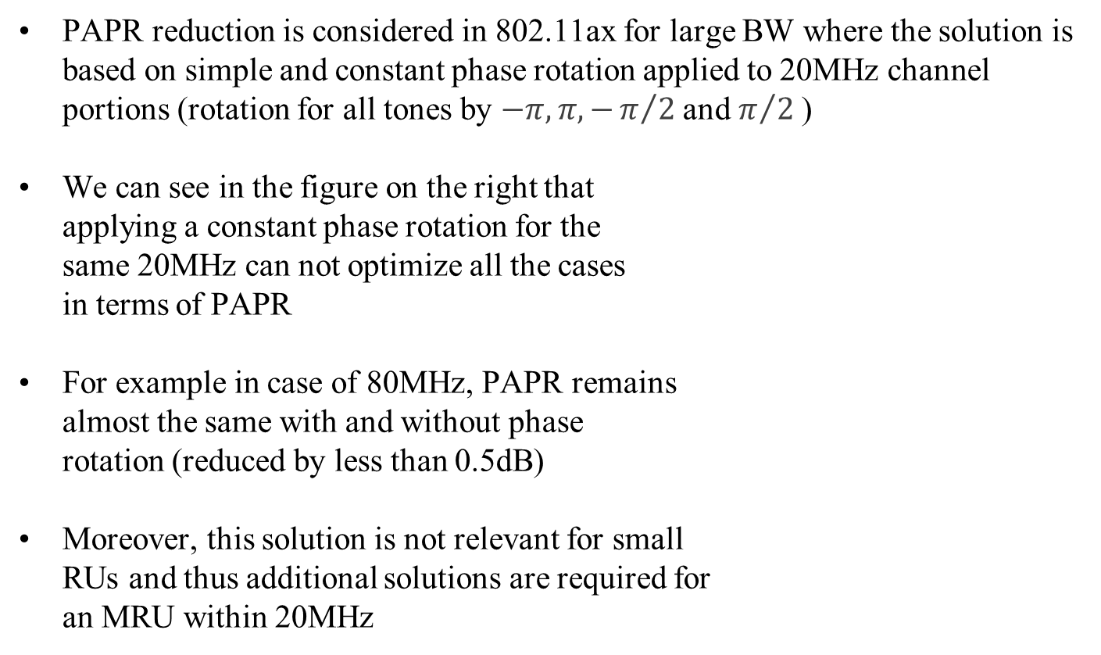
Reusing 802.11ax Solution
PAPR reduction is considered in 802.11ax for large BW where the solution is based on simple and constant phase rotation applied to 20MHz channel portions (rotation for all tones by $−π, π, −π/{2 }$and $π/{2 }$)
We can see in the figure on the right that
applying a constant phase rotation for the
same 20MHz can not optimize all the cases
in terms of PAPR
For example in case of 80MHz, PAPR remains
almost the same with and without phase
rotation (reduced by less than 0.5dB)
Moreover, this solution is not relevant for small
RUs and thus additional solutions are required for
an MRU within 20MHz
0.5dB

Slide 10

Extended 802.11ax Solution
We can extend 11ax solution by applying constant phase rotation per RU where phase value is selected with larger granularity to optimize every MRU independently ( e.g. from some predefined range, $\{−π,−π/∆, …,π/{∆, }π\}$ )
We can see that for most of the examined cases PAPR is reduced by 0.5dB or less where we used 9 possible phase values (only three of all the examined combinations showed PAPR reduction of ~1dB)
0.5dB

Slide 11

Linear Phase
As explained before, higher PAPR peaks are produced by
combination of multiple waveforms, thus if we shift the
waveforms in time domain (cyclically) we may possibly
spread the high peaks in time and thus reduce the PAPR
This is equivalent to applying different linear phase for each
RU in frequency domain, (k-th tone of i-th RU will be multiplied by $e^{j2πθ_{i}k}$)
We can see in figures below that this method reduces the PAPR by 1-2dB (linear phase and phase offset with granularity of $\frac{π}{64}$ and $\frac{π}{4}$ respectively )
High Peak
Time
Cyclic Shift in Time Domain
Time
1dB

Slide 12

Linear Phase with Offset
Different linear phase in frequency domain implies different cyclic shift while phase rotation implies non-coherent combination of the waveforms
We can combine both solutions, i.e. k-th tone of i-th RU will be multiplied by ${e^{jφ_{i}}e}^{j2πθ_{i}k}$, where $φ_{i}$ is a phase offset and $θ_{i}$ is a linear phase
We can see that combining linear phase with phase offset provides additional PAPR reduction of 0.2-0.5dB in some cases
1.1dB

Slide 13
Comparison of Different Solutions
Here we show a figure summarizing all the possible solutions for case of MRU 242+484
We can see that the highest reduction in PAPR is achieved by new EHT-LTF sequences (different sequence per each MRU combination) whereas linear phase with phase offset achieves second best PAPR reduction (~0.1-0.6dB gap from new sequence)
242+484 Comb | 2/2 | 1/2 | 4/1 | 3/1
Single RU484 | 5.86 | 5.86 | 5.86 | 5.86
MRU PAPR | 7.03 | 7.93 | 7.65 | 7.8
New Sequence | 6.29 | 6.68 | 6.68 | 6.28
Constant Phase | 6.96 | 7.42 | 7.65 | 7.23
Linear Phase | 6.95 | 6.95 | 6.87 | 7.16
Linear Phase + Offset | 6.71 | 6.85 | 6.82 | 6.9

Slide 14
Summary
In the table below we summarize the reviewed solutions and compare them in terms of PAPR reduction and also design and implementation aspects
It is clear that the linear phase method combined with phase offset yields good results with reasonable design and implementation complexity
Two last methods require similar implementation complexity while additional memory is required to store phase offset values per MRU (moreover those method are applicable for 2X and 1X LTF formats with no additional design)
Solution | PAPR Reduction | Design/Spec Complexity | Implementation Complexity | Backward Compatibility
New Sequnce Design | High | High - A lot of sequences to define | High - large memory required | None
Reuse 11ax Phase Rotation | Very low | None | None | Full
Constant Phase Rotation | Low | Medium | Low | Full (by setting phase to zero)
Linear Phase | Medium | Meidum | Low | Full (by setting phase to zero)
Linear Phase with Phase Offset | High | Medium | Low | Full (by setting phase to zero)

Slide 15

Spec Aspects
A set of Linear Phase and Phase Offset values need to be defined in the spec (similar to CSD definition)
For each MRU combination a specific value from the defined set will be applied while both Tx and Rx sides will use the same value when a specific MRU is allocated (no need for additional signaling per packet)
We checked the PAPR with different granularity
of linear phase and phase offset it appears
that 32 values are enough to be
defined (see figure on the right)
$\left\{−π, −π\frac{15}{16}, …,π\frac{15}{16},π \right\}$
Phase offset may be defined with smaller
granularity as a subset of the same set thus no
additional definition is required
For each RU in specific MRU combination, a specific linear phase and phase offset values will be defined from the set above (e.g. by indices from the set)

Slide 16
Phase Continuity
In some MRU combinations two or more RUs occupy contiguous bandwidth hence we would like to ensure phase continuity over the allocated tones
Thus we rechecked the case of MRU combined of 52RU and 26RU where two RUs are contiguous in frequency
We added a restriction on Linear Phase to be
continuous on the edges of two RUs (we
actually restricted our solution to zero phase
at the end and at the beginning of two RUs)
We can see on the figure on the right that at all
the simulated MRU combinations the gap
between general linear phase and linear phase
with phase continuity restriction is negligible
Linear Phase
26RU
52RU
Frequency

Slide 17
Conclusion
PAPR is increased in case of MRU transmission and need to be reduced in order to minimize an impact on channel estimation and PER
The main issue in solving PAPR problem is required optimization per MRU – single sequence design can not be optimal for all the cases
The trade-off between PAPR reduction and design/implementation complexity is a main issue in solving this problem
Several approaches are reviewed while linear phase with phase offset method is a preferred solution in terms of PAPR reduction and design complexity
Further investigation may be done to study PAPR aspects in general case of punctured BW transmissions

Slide 18
References
[1] 11-19-1925-02-00be-consideration-of-eht-ltf
[2] 11-20-0117-01-00be-eht-ltfs-design-for-wideband

Slide 19
SP1
Do you support that 802.11be will define a solution which minimizes PAPR of EHT-LTF field for all MRU combinations?

Slide 20
SP2
Do you support that 802.11be will define a linear phase and phase offset values for minimizing PAPR of EHT-LTF for MRU allocations?

