Slide 1
Small Size MRU with Different MCS and BCC
Date: 2020-03-16
Authors:
Name | Affiliation | Address | Phone | Email
Junghoon Suh | Huawei |  |  | junghoon.suh@huawei.com
Yan Xin |  |  |  | yan.xin@huawei.com
Osama Aboul-Magd |  |  |  | osama.aboulmagd@huawei.com
Ross Jian Yu |  |  |  | ross.yujian@huawei.com
Edward Au |  |  |  | edward.ks.au@huawei.com

Slide 2
Background
802.11be shall allow more than one RUs to be assigned to a single STA [1]
  Small-size RUs can only be combined with small-size RUs and the large-size RUs can only be combined with the large-size RUs [2]
  Small-size RUs shall not cross 20 MHz channel boundary and the only allowed small-size RU combinations are RU106+RU26 and RU52+RU26 [2]
  For LDPC encoding, each PSDU only uses one encoder [3], but there is no decision on BCC yet
  For LDPC coding, for combined RUs sent to a user with RU size less than 242-tone, a single tone mapper shall be used [5]
We want to evaluate the impact of the freq. selective channels when the multiple RUs are far apart with each other
  Especially, for small RU cases, we evaluated how to implement the BCC encoder, Interleaver and QAM mapper

Slide 3
Channel Impact on Far-apart RUs (1)
Two MRU cases under test with IEEE ChanD without any interferences
We observed the RX average signal energy per tone for each RU with the sum of signal energy per tone divided by the number of tones per each RU
  For 20 MHz, 52-RU 1 is about 1.74 dB higher than 26-RU 9
  For 80 MHz, 242-RU 1 is about 9.67 dB higher than 242-RU 4
The RX average signal energy per tone for each RU above purely indicates the channel gain difference between two RUs
20 MHz
80 MHz
26-RU
1
2
3
4
5
6
7
8
9
242-RU
1
2
3
4
52-RU
1
2
3
4

Slide 4
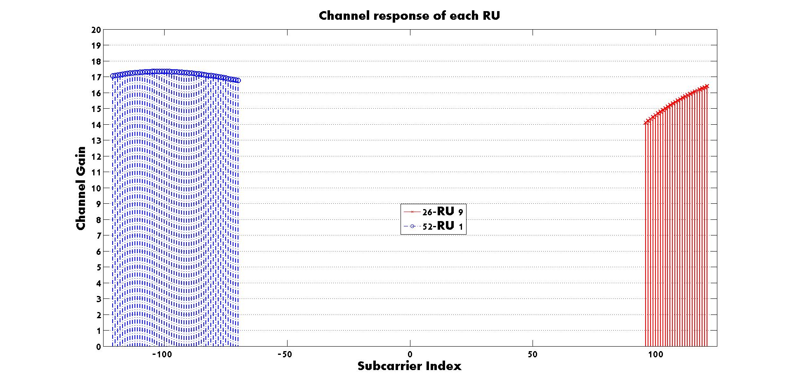
Channel Impact on Far-apart RUs (2)
One symbol of Long Training Sequence (LTS) is used
For 20 MHz, the LTS is oversampled by 5 times in time domain to align with the 10 nsec PDP Tap Spacing [4] before passing through the channel
For 80 MHz channel, first we generate the channel D parameters and run 4x interpolation to make the channel parameters 2.5 nsec PDP Tap spacing, and then, the LTS is oversampled by 5 times in time domain to align with the 400 MHz sampling rate of the channel parameters [4] before passing through the channel
1.74 dB

Slide 5
Evaluation Option 1 for 20 MHz PPDU,
MRU with Different MCS vs. the Same MCS
Interleaver
Constellation
Mapper
RU-A
Interference
MAC
PSDU
BCC
Encoder
Parser
Interleaver
Constellation
Mapper
RU-B
RU-A (26-RU 9) is scheduled with MCS 5, and RU-B (52-RU 1) is scheduled with MCS 7 for the different MCS case
RU-A (26-RU 9) is scheduled with MCS 7, and RU-B (52-RU 1) is scheduled with MCS 7 for the same MCS case
BCC Encoder needs to change the puncturing pattern in the middle of each OFDM symbol according to the MCS changes
  Significant change necessary in the current encoder implementation
Current 802.11 Interleaver can still be used
  The separate interleaver should be used even for the same MCS case
    Performance drop takes place in case the same MCS is applied to RU-A and RU-B
  New interleaver design is necessary if we want to apply the common interleaver for both RU-A and RU-B

Slide 6
We can choose the MCSs with the same code rate but different modulation to avoid the possible changes in the BCC encoder implementation
  e.g. MCS 6 – 4, MCS 4 – 2, etc
  The goodput gain with the different MCS disappears due to the limited MCS selections
Goodput is defined as the number of correctly decoded information bits per packet divided by the total air time per packet
The SINR is measured at the RX across the entire 20 MHz band (but TX power is not boosted for small RU transmission in the simulation)
As seen from the next slides, we can observe the gain when we apply the different MCSs to multiple RUs based on the channel quality in a full flexible manner, that is, we should be able to apply any set of MCSs to multiple RUs
MCS | Modulation | Code Rate
0 | BPSK | ½
1 | QPSK | ½
2 | QPSK | ¾
3 | 16-QAM | ½
4 | 16-QAM | ¾
5 | 64-QAM | 2/3
6 | 64-QAM | ¾
7 | 64-QAM | 5/6
8 | 256-QAM | ¾
9 | 256-QAM | 5/6

Slide 7
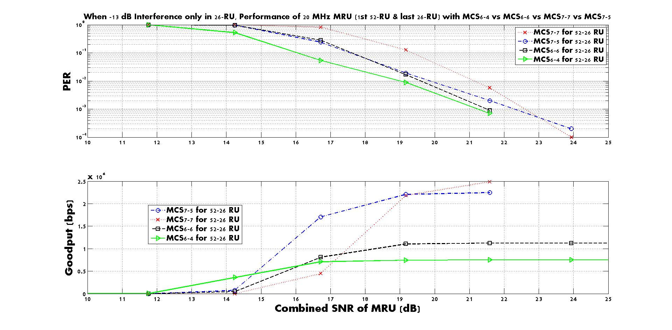
-13 dB Interference is added only to RU-A (26-RU 9) with various MCS combinations

Slide 8
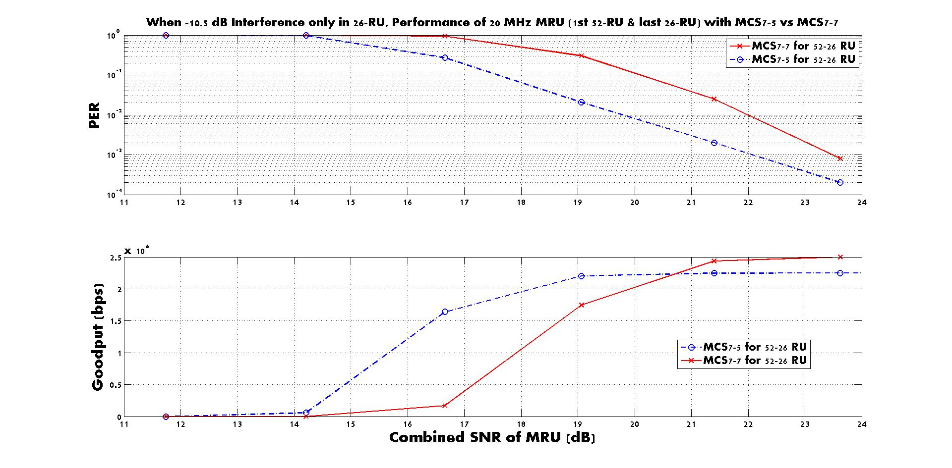
-10.5 dB Interference is added only to RU-A (26-RU 9)

Slide 9
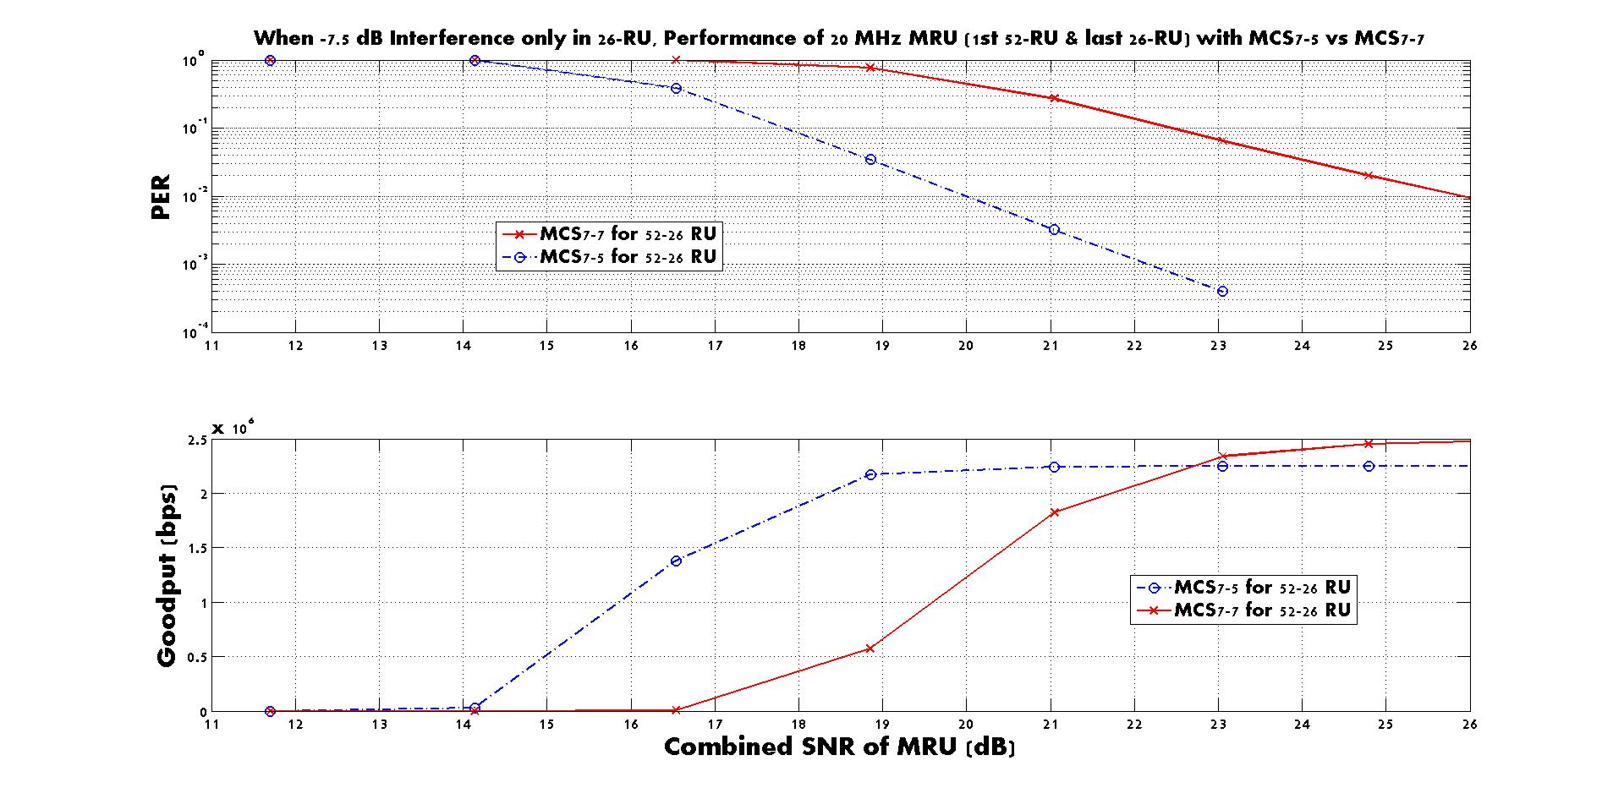
-7.5 dB Interference is added only to RU-A (26-RU 9)

Slide 10
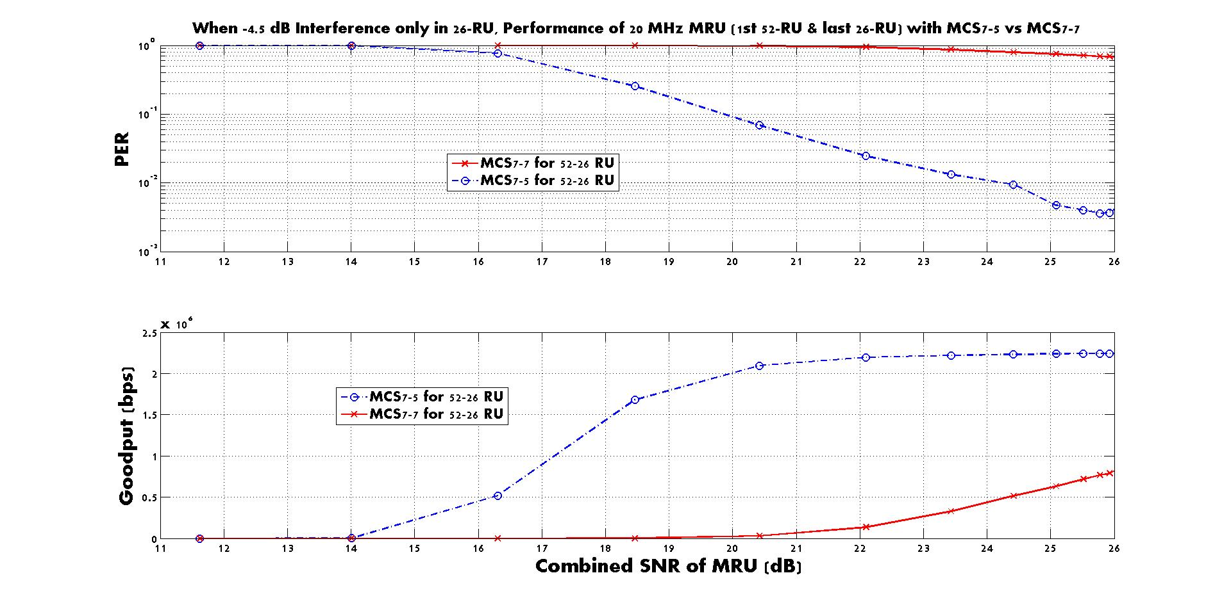
-4.5 dB Interference is added only to RU-A (26-RU 9)

Slide 11
Observation so far
If we keep the common BCC encoder for both RUs, a significant performance drop is inevitable in case of the same MCS applied to both RUs
If we keep the common BCC encoder for both RUs, a significant change in the implementation of BCC encoder is necessary in case of the different MCS applied to each RU
It is not an option to apply only the MCS set with the same code rate but with the different modulation, due to the Goodput degradation
Hence, we propose the following Option 2 as an alternative to Option 1 to attain the gain but to minimize the implementation impact

Slide 12
Option 2
Apply the different BCC encoder and Interleaver to each RU when the multiple RUs are scheduled, so that the flexible MCS can be applied to each RU
Performance of Option 2 is similar to Option 1, while only the separate encoder is used for each RU to avoid the significant change in the implementation of BCC encoder
BCC
Encoder
Interleaver
Constellation
Mapper
RU-A
MAC
PSDU
Encoder
Parser
BCC
Encoder
Interleaver
Constellation
Mapper
RU-B

Slide 13
Evaluation Option 3 for 20 MHz PPDU with a common Interleaver as well as a common BCC encoder
In case we decide to apply the same MCS for MRU, a common interleaver for MRU may help reduce the performance degradation due to the different interference level and channel gain
Apply the common BCC encoder and Interleaver to both RUs in order to achieve the freq. diversity gain
  New Interleaver design (Detail TBD) is necessary
  The same MCS between two RUs is applied
RU-A
MAC
PSDU
BCC
Encoder
Interleaver
Constellation
Mapper
Parser
RU-B

Slide 14
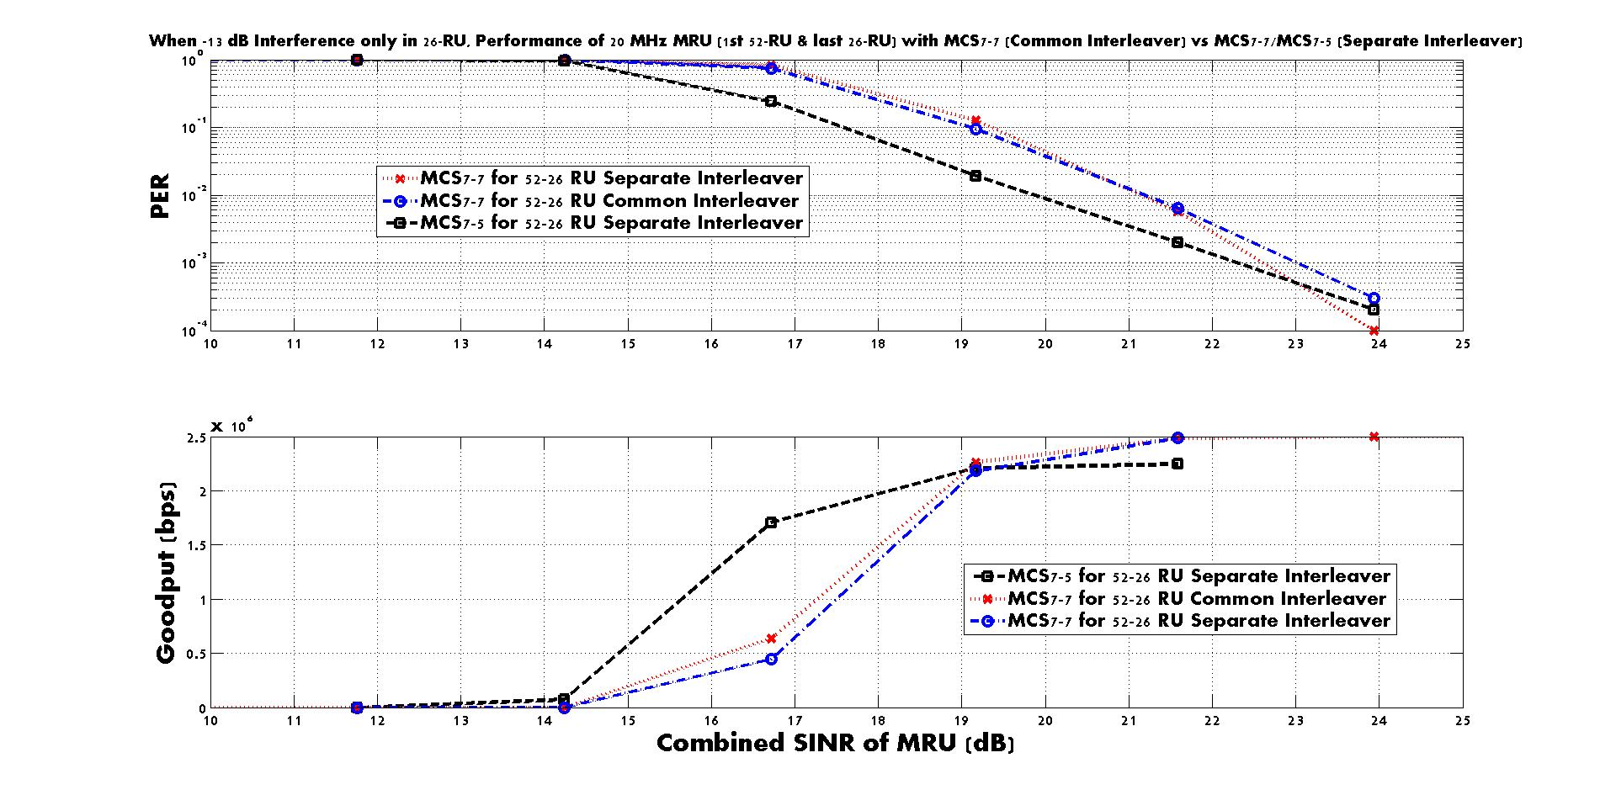
-13 dB Interference is added only to RU-A (26-RU 9) for Option 3
We can observe the common interleaver shows a little frequency diversity gain when a common interleaver is applied to the small size MRU

Slide 15
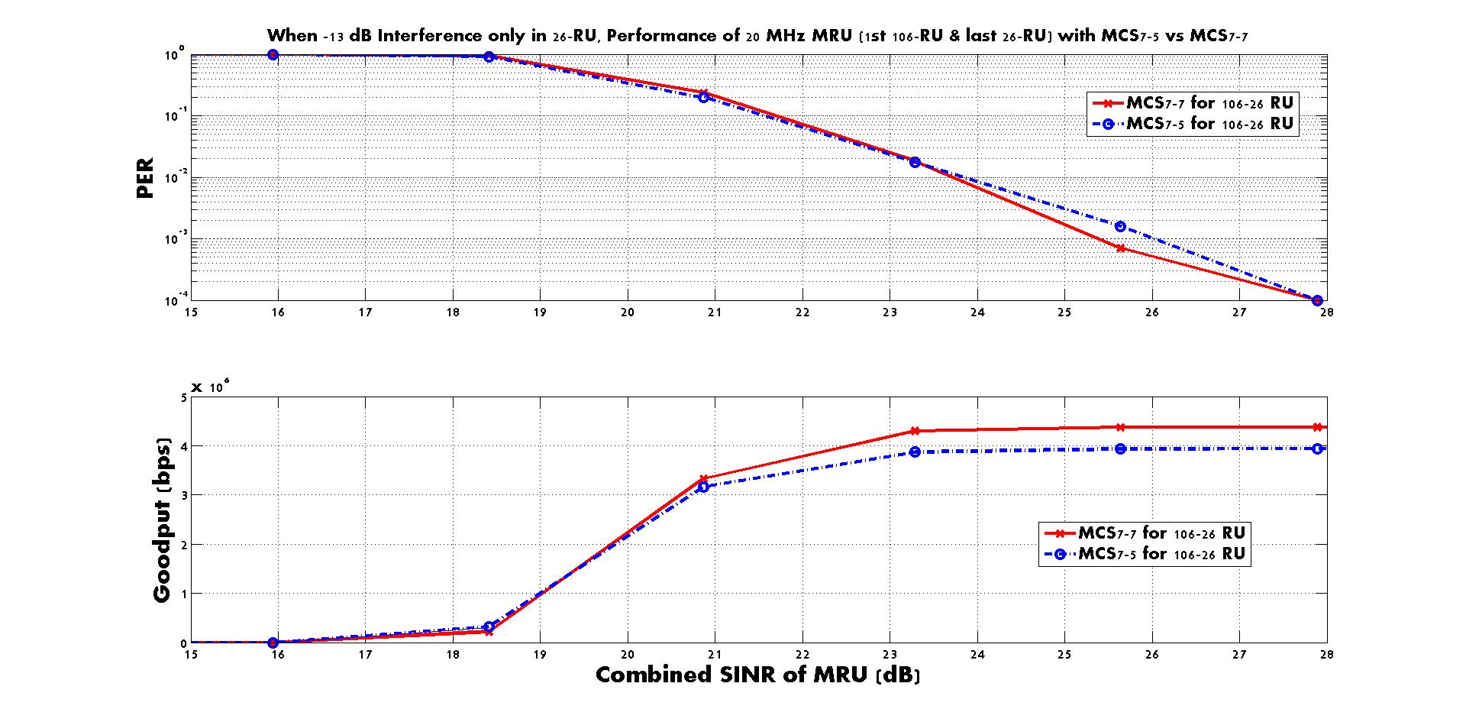
-13 dB Interference is added only to RU-A (26-RU 9), and RU-B is 106-RU 1 for Option 3

Slide 16
Summary
 | Pros | Cons
Option 1 | Aligned with LDPC TX flow (excluding interleaver) Throughput enhancement with the flexible MCS applied to MRU | Change in the BCC encoder architecture
Option 2 | Throughput enhancement with the flexible MCS applied to MRU Keep using the same 802.11 BCC encoder and Interleaver | Not aligned with LDPC TX flow
Option 3 | Aligned with LDPC TX flow Keep using the same 802.11 BCC encoder | New interleaver design is necessary Freq. diversity gain is little for small size RU

Slide 17
Reference
[1] Jianhan Liu (MediaTek), “Enhanced resource allocation schemes for 11be,” 19/1126r1, September 2019
[2] Jianhan Liu (MediaTek), “Multiple RU combinations for EHT,” 19/1907r2, January 2020
[3] Bin Tian (Qualcomm), “Preamble puncturing and RU aggregation,” 19/1869r2, January 2020
[4] Jianhan Liu (MediaTek), “TGbe channel model document,” 19/719r1, July 2019
[5] Ross Yu (Huawei), “Multiple RU discussion,” 19/1914r4, January 2020.

Slide 18
SP 1
Do you agree that, for a single RU less than or equal to 242 tones, the BCC can be supported?
  Mandatory or Optional for BCC, TBD

Slide 19
SP 2
Do you agree that, for the combined multiple RU with the combined RU size less than 242 tones, the BCC can be supported?
  Mandatory or Optional for BCC, TBD

Slide 20
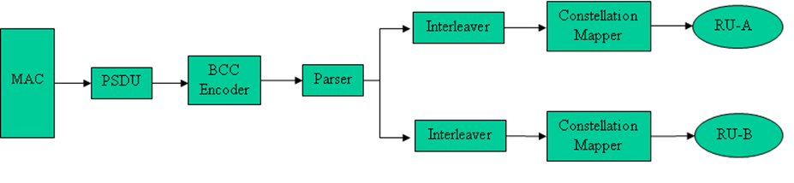
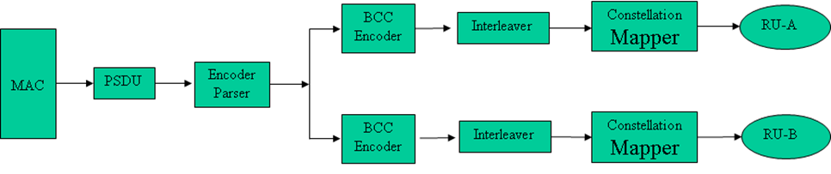
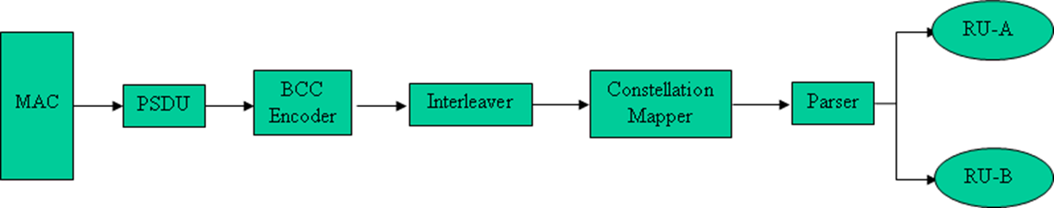
SP 3
In case of small size MRU transmission, which option do you support?
Option 1: common BCC encoder but separate Interleaver
Option 2: separate BCC encoder and Interleaver for the multiple RUs
Option 3: common BCC encoder and Interleaver for the multiple RUs

