Slide 1
Discussion on
Coordinated Spatial Reuse Operation
Date: 2020-3-26
Authors:
Name | Company | Address | Phone | Email
Kosuke Aio | Sony Corporation |  |  | Kosuke.Aio@sony.com
Yusuke Tanaka |  |  |  | Yusuke.YT.Tanaka@sony.com
Ryuichi Hirata |  |  |  | Ryuichi.Hirata@sony.com
Thomas Handte |  |  |  | Thomas.Handte@sony.com
Dana Ciochina |  |  |  | Dana.Ciochina@sony.com
Mohamed Abouelseoud |  |  |  | Mohamed.Abouelseoud@sony.com
Liangxiao Xin |  |  |  | Liangxiao.Xin@sony.com

Slide 2
Introduction
Coordinated Spatial Reuse (CSR) is one of Multi-AP coordination schemes for TGbe.
  CSR is a simpler coordination scheme than Joint transmission and Coordinated Beamforming (Sync and CSI collection are unnecessary).
  Previous contributions including ours showed that CSR would achieve significant performance improvement, e.g. higher throughput than 11ax SR (OBSS_PD), etc.[1-4].
This contribution proposes a possible CSR procedure and evaluates the proposed procedure.

Slide 3
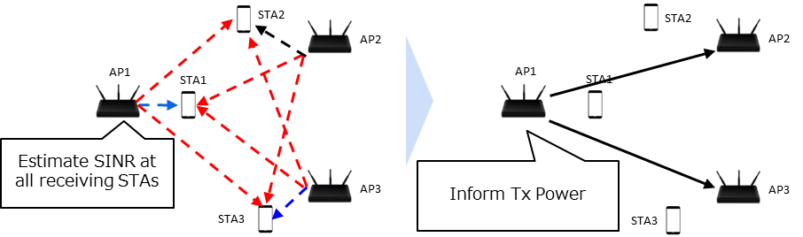
Recap: Coordinated SR in [1]
Procedure
  One AP collects link information
  The AP calculates Tx power of all APs by using the collected information so as to maximize sum of throughputs of the APs
  The AP indicates calculated Tx power to the other APs.

Slide 4
Further Discussion Points
Which AP to calculate Tx power of all APs
  No method to determine AP was proposed in [1]
How to assure a certain degree of performance for every STAs
  [1] applied “maximization of sum of throughputs of the APs” to the constraint of Tx power calculation.
  No consideration of per-STA performance

Slide 5
Overview of Our Proposals
Which AP to calculate Tx power of all APs
  Adopt “Sharing AP/Shared AP” concept proposed in [5]
    Sharing AP: an AP that obtained TXOP. Sharing AP collects link information between all APs and all STAs.
    Shared AP: an AP that is allowed by Sharing AP to start transmission in the TXOP.
How to assure a certain degree of performance for every STAs
  New constraint: to satisfy target SINR of each STA to the extent feasible.
Notes:
シンプルにしました

Slide 6
Proposed CSR Operation (1/3)
Sharing AP performs backoff and obtains TXOP.
Sharing AP collects information from potential Shared APs.
  Information is for instance;
    AIDs of STAs which potential Shared APs intend to transmit data to
    Target SINR of those STAs
Trigger frame
Sharing AP
DATA
time
DATA
Shared AP1
time
Shared AP2
DATA
time

Slide 7
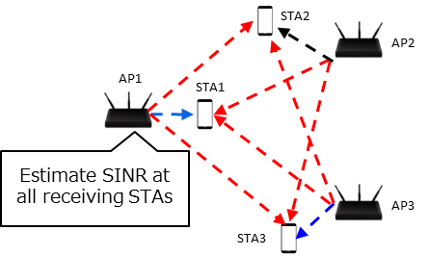
Proposed CSR Operation (2/3)
Sharing AP estimates SINR of all receiving STAs and calculates “coordinated Tx power” for each AP.
  Two potential constraints:
    (A) A constraint as an objective in optimization problem (same as [1])
    To maximize sum of throughputs of the APs
    (B) New proposed constraint
    First, to satisfy target SINR of at least a STA which Sharing AP intends to serve.
    Then, to satisfy SINR of STAs in the TXOP to the extent feasible

Slide 8
Proposed CSR Operation (3/3)
Sharing AP transmits a Trigger frame to Shared APs to allow transmission, where a Trigger frame includes;
  “coordinated Tx power” of Shared APs.
  Tx power of Sharing AP (to be used by Shared APs to set optimal MCS)
Sharing AP and Shared APs transmit data SIFS after the Trigger frame.“
  Shared APs can set indicated its “coordinated Tx power”.
  Shared APs can set optimal MCS by estimating SINR of the STA with the indicated Tx Power information of all APs.
Trigger frame
Sharing AP
DATA
time
DATA
time
Shared AP1
Shared AP2
DATA
time
Slide 8

Slide 9
Simulation Setup
Metrics
  Sum of throughput of all STAs
  Throughput per STA
    Considering only data payload. (not including MAC and PHY preamble overhead)
    Optimal MCS based on theoretical PER and SINR per STA
Following four schemes are compared
    TDD
      One AP transmits data with max Tx power. The Shared APs don’t transmit data.
    11ax SR (OBSS_PD)
      One AP transmits data with max Tx power. (The AP is selected randomly)
      The Shared APs transmit data with Tx power calculated by OBSS_PD equation. [6]
      OBSS_PD_{min} = -82dBm/20MHz, OBSS_PD_{max} = -62dBm/20MHz
    CSR Opt.1 (Constraint (A) in Slide.7/Step.3)
    CSR Opt.2 (Constraint (B) in Slide.7/Step.3)

Slide 10
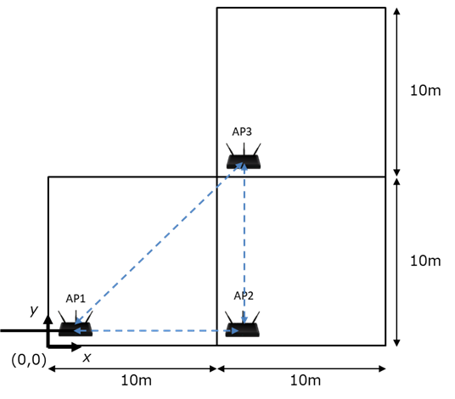
Simulation Scenario
<Layout of Nodes>
Home Mesh Scenario based on [6]
  Layout
    3APs are deployed as shown in the right figure.
    One STA per room is dropped randomly to be associated
    with an AP in the same room.
  Assumption
    DL only. Each AP transmits data to one associated-STA
    APs obtain TXOP in turn with every probability.
  Parameter
Frequency, Bandwidth | 5180MHz, 80MHz
Max Tx Power | 21dBm per AP
NF | 7dB
Tx/Rx Ant | (AP, STA) = (4, 2)
Stream | 1/STA
MCS | 0 - 11
Fading Model | TGac_D NLOS for all the links
Pathloss Model | Eq.(1)
Shadowing | 5dB log-normal for all link
PPDU | HE PPDU with 0.8us GI
Eq.(1) : PL(d) = 40.05 + 20*log10(freq/2.4)+ 20*log10(min(Dis, bp))
+ (Dis > bp) .* (35*log10(Dis/bp)) + Wn * 10dB
(“freq” = 5.18GHz, “Dis” = Tx/Rx distance, “bp” = 5m, “Wn” : Num. of wall)

Slide 11
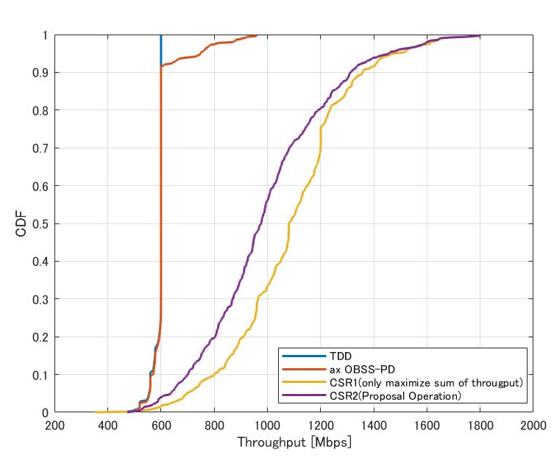
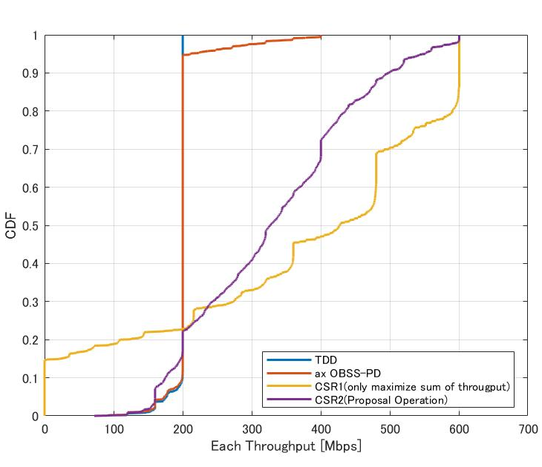
Simulation Result
Sum of throughput
Throughput per STA
Throughput Gain
compared to TDD at cdf=0.9
- ax SR : x1.0
- Opt1 : x2.4
- Opt2 : x2.2
Throughput Gain
compared to TDD at cdf=0.05
- ax SR : x1.0
- Opt1 : x0.0
- Opt2 : x1.0
    Only CSR (Opt2) achieves the significant gain in sum of throughput of STAs
    (over x2.0) while no decreasing 5%-tile Per-STA throughput.

Slide 12
Summary
New CSR procedure was proposed
  Adopt “Sharing AP/Shared AP” concept proposed in [5]
    Sharing AP: an AP that obtained TXOP. Sharing AP collects link information between all APs and all STAs.
    Shared AP: an AP that is allowed by Sharing AP to start transmission in the TXOP.
  New constraint for Tx power calculation:
    to satisfy target SINR of each STA to the extent feasible.
Proposed CSR procedure achieves the significant gain in sum of throughput while no decreasing 5%-tile Per-STA throughput in Home Mesh AP scenario.

Slide 13
Reference
[1] 11-19-1534-01-00be-coordinated-spatial-reuse-performance-analysis
[2] 11-20-0073-00-00be-on-coordinated-spatial-reuse-in-11b
[3] 11-20-0107-00-00be-multi-ap-coordination-for-spatial-reuse
[4] 11-20-0033-01-00be-coordinated-spatial-reuse-operation
[5] 11-19-1582-01-00be-coordinated-ap-time-and-frequency-sharing-in-a-transmit-opportunity-in-11be
[6] 11-20-0032-00-00be-consideration-on-multi-ap-home-mesh-scenario

Slide 14
SP 1
Do you agree that Sharing AP transmits a frame including Tx power information to allow Shared APs to start transmission.
  Tx power information includes “coordinated Tx power” of Shared APs.
  Tx power information includes Tx power of the AP.
  Yes
  No
  Abstain

Slide 15
SP 2
Do you agree that Sharing AP calculates Tx power of all Shared APs to satisfy target SINR of at least a STA it intends to transmit to?
  How to decide target SINR is TBD.
  Yes
  No
  Abstain

