Slide 1
On RU/Segment Parser and Tone Interleaver for 11be
Date: 2020-03-02
Authors:
Name | Affiliations | Address | Phone | Email
Jianhan Liu | Mediatek | 2840 Junction Ave. San Jose, CA, 95134 |  | jianhan.liu@mediatek.com
Shengquan Hu
Thomas Pare

Slide 2
Introduction
To improve spectral usage, 11be allows more than one RUs to be assigned to a single station (STA) [1].
Small-size RU aggregation and large-size RU aggregation
To improve throughput, 240MHz/320MHz PPDU are introduced to 11be.
We studied RU and segment parsers and tone interleave schemes for aggregated RU and 240MHz/320MHz PPDU.
Evaluate the performance of RU/Segment parser and tone interleaver
Our principle is to reuse 11ax segment parser and tone interleaver if there is no performance loss.

Slide 3
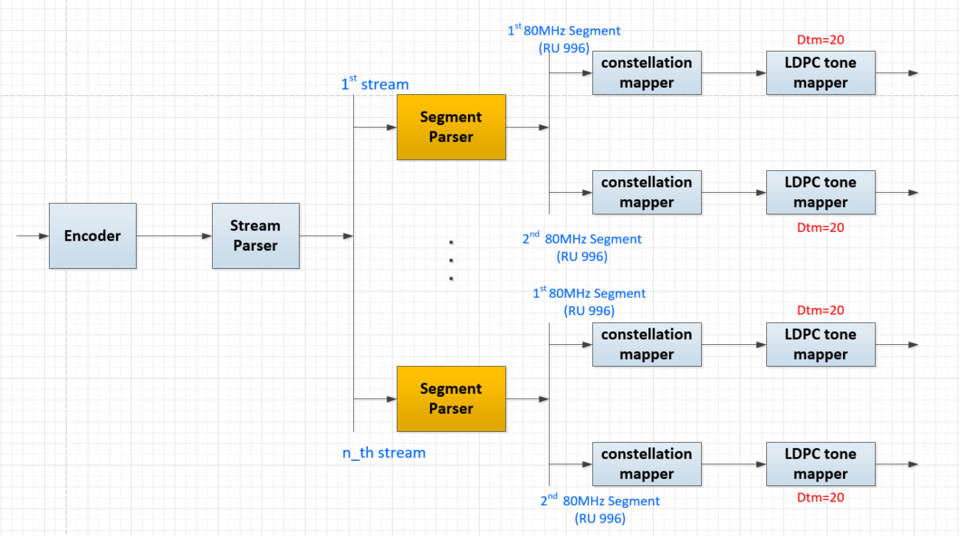
11ax segment parser and LDPC tone mapper for 160/80+80MHz
In 11ax, separate tone interleaves are applied on 80MHz frequency segments.
Within each 80MHz, just one tone interleaver.

Slide 4
Tone interleave schemes for RU Aggregations
We proposed the following tone interleave schemes for RU aggregations:
One joint tone interleaver is applied to combined multiple RUs within one 80MHz frequency segment;
Separate tone interleaves are applied on RUs or aggregated RUs in different 80MHz frequency segments.
Reasons:
Following the tone interleaver scheme defined in 11ac/11ax.
For some RU aggregations, such as RU484+RU996, no good DTM can be found for joint tone interleaver schemes.
Our simulations show that joint tone interleaver crossing 80MHz segment with optimal DTM have same performance as separated tone interleave.

Slide 5
Joint Interleave v.s. Separated Tone Interleaver
For RU aggregation crossing 80MHz segments and 160/240/320MHz PPDU, we compared the performance of joint tone interleave and separate tone interleave.
To get optimal DTM, we allow some tones (Ndrop) are not interleaver.
DTM for joint tone interleave crossing 80MHz segment
RU combine | vNsd | Dtm | Ndrop
484+996 | 1448 | 38 or (32) or (36) or (30) | 4 or (8) or (8) or (8)
(242+484)+996 | 1682 | 41 or (40) or (29) or (35) | 1 or (2) or (0) or (2)
484+2*996 | 2428 | 55 (or 44) | 8 (or 8)
484+3*996 | 3408 | 71 (or 48) | 0 (or 0)
2*996 | 1960 | 40 | 0
3*996 | 2940 | 60 or (49) | 0 or (0)
4*996 | 3920 | 80 or (70) or (56) | 0

Slide 6
Example for 484+996 in 160MHz
484+996-tone RU Aggregation
tone interleaved within 80MHz

Slide 7
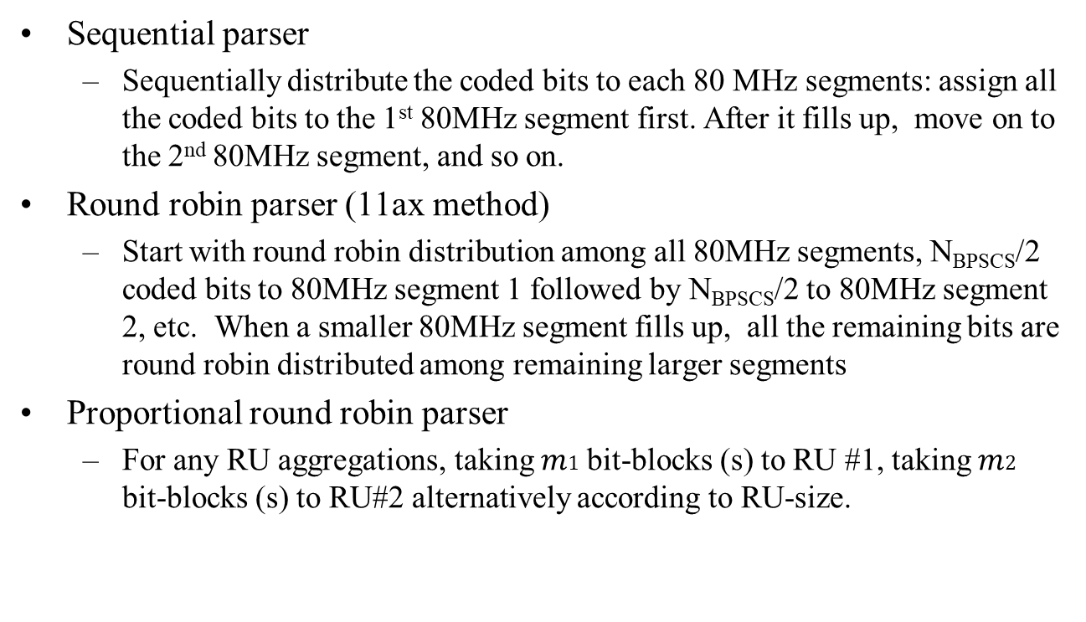
Options for Segment Parser
Sequential parser
Sequentially distribute the coded bits to each 80 MHz segments: assign all the coded bits to the 1st 80MHz segment first. After it fills up, move on to the 2nd 80MHz segment, and so on.
Round robin parser (11ax method)
Start with round robin distribution among all 80MHz segments, N_{BPSCS}/2 coded bits to 80MHz segment 1 followed by N_{BPSCS}/2 to 80MHz segment 2, etc. When a smaller 80MHz segment fills up, all the remaining bits are round robin distributed among remaining larger segments
Proportional round robin parser
For any RU aggregations, taking $m1$ bit-blocks (s) to RU #1, taking $m2$ bit-blocks (s) to RU#2 alternatively according to RU-size.

Slide 8
Proposed RU/Segment Parser
Two factors to evaluate:
How $m1$ and $m2$ affect the performance?
How left-over bits affect the performance?
Proposed ratio m1:m2:m3:m4 for proportional round robin parser
RU Aggregation | Nsd_total | Proportional Ratio (m1:m2:m3:m4) | Leftover bits (per symbol)
484+996 | 1448 | 1s:2s | 44*Nbpscs on ru996
(242+484)+996 | 1682 | 3s:4s | 44*Nbpscs on ru996
484+2*996 | 2428 | 1s:2s:2s | 44*Nbpscs on ru996
484+3*996 | 3408 | 1s:2s:2s:2s | 44*Nbpscs on ru996
2*996 | 1960 | 1s:1s | 0
3*996 | 2940 | 1s:1s:1s | 0
4*996 | 3920 | 1s:1s:1s:1s | 0
Where:

Slide 9
Effect of Proportional Ratio
Key Observations:
Simulations show that the smallest proportion provides the best performance.

Slide 10
The effect of m1 and m2 on RU996+996
Note: the largest step-size corresponds to sequential parser

Slide 11
The effect of m1 and m2 on RU484+996
Note: the largest step-size corresponds to sequential parser

Slide 12
The effect of m1 and m2 on RU(242+484)+996
Note: the largest step-size corresponds to sequential parser

Slide 13
Joint Interleave vs. Separate Interleave
Observation:
Joint tone interleaver crossing 80MHz segment with optimal DTM have same performance as separated tone interleave.
Proportional round robin outperforms round robin by 0.2~0.5dB.

Slide 14
Joint Tone Interleaver Across 80M segment vs Per-80M Segment Tone Interleaver

Slide 15
RU484+996, MCS9, 2x1, BF off, B-LOS

Slide 16
Simulation Results: RU484+996, MCS7, 2x1, BF on, B-LOS

Slide 17
Simulation Results: RU(242+484)+996, MCS7, 4x2, BF on, B-LOS

Slide 18
Simulation Results: RU484+2*996, MCS5, 2x1, BF on, B-LOS

Slide 19
Simulation Results: RU484+3*996, MCS5, 1x1, BF off, B-LOS

Slide 20
Treatments of left-over tones
1. Sequentially Distribute the leftover bits over last 44 tones on each RU996
To 1st RU996
To 2nd RU996
Leftover bits
2. Proportional Distribute the leftover bits over last 44 tones between RU996
To 1st RU996
To 2nd RU996
Leftover bits
3. Evenly Distribute the leftover bits over each RU996
N iterations
Extra m2, m3
N iterations
Extra m2, m3
Every N iterations, get one more extra m2 s-blk for 1st RU996, and m3 s-blk for 2nd RU996

Slide 21
Simulation Results: RU484+3*996, MCS9, 1x1, BF off, B-LOS

Slide 22
Simulation Results: RU484+996, MCS10, 2x1, BF on, B-LOS

Slide 23
Simulation Results: RU484+996, MCS9, 4x2, BF on, B-LOS

Slide 24
Summary
We evaluate the performance of joint tone interleave and separate tone interleave for each 80MHz segment.
We evaluate the different segment parser for multi-RU aggregation and large BW.
Conclusions:
Joint tone interleave crossing 80MHz segment has almost the same performance as proportional round robin.
Joint tone interleave crossing 80MHz segment requires significant architecture change.
Proportional round robin outperforms round robin by 0.2~0.5dB.
Different treatments for left-over bits for some RU aggregations have no impact on performance. To make it simple, same proportional round robin is applied to left-over bits.

Slide 25
Straw Poll #1
Do you agree the following LDPC tone interleaver scheme for multi-RU aggregation in 11be?
One joint tone interleaver is applied to aggregated RUs within one 80MHz frequency segment.
For aggregated RUs and PPDU BW crossing 80MHz segment boundary, separate tone interleaver is applied in each 80MHz.

Slide 26
Straw poll #2
Do you agree that 11be uses 80HMz segment parser with the following proportional round robin scheme?
RU Aggregation | Nsd_total | Proportional Ratio (m1:m2:m3:m4) | Leftover bits (per symbol)
484+996 | 1448 | 1s:2s | 44*Nbpscs on ru996
(242+484)+996 | 1682 | 3s:4s | 44*Nbpscs on ru996
484+2*996 | 2428 | 1s:2s:2s | 44*Nbpscs on ru996
484+3*996 | 3408 | 1s:2s:2s:2s | 44*Nbpscs on ru996
2*996 | 1960 | 1s:1s | 0
3*996 | 2940 | 1s:1s:1s | 0
4*996 | 3920 | 1s:1s:1s:1s | 0
Where:

Slide 27
Straw Poll #3
Do you agree the same proportional round robin is applied to left-over bits?
The same ratios are used in the entire segment parsing process except the ratios of those already filled segment becomes 0.
To 1st RU
To 2nd RU
Leftover bits

