Slide 1
Multi-link Secured Retransmissions
Date: 2020-03-11
Authors:
Name | Company | Address | Phone | Email
Rojan Chitrakar | Panasonic Corporation | 202 Bedok South Avenue 1, #02-11 Singapore 469332 |  | rojan.chitrakar@sg.panasonic.com
Lei Huang
Yanyi Ding
Yoshio Urabe

Slide 2
Introduction
Security aspects of Multi-link transmissions have been raised in [1], [2], [3].
In this contribution, we focus on the issues related to retransmission of protected frames (CCMP/GCMP) and present a proposal to simplify the retransmission of protected frames.

Slide 3
Security keys
The following has been captured in the SFD [4]:
  After multi-link setup between two MLDs, different GTK/IGTK/BIGTK in different links with different PN spaces are used
    GTK/IGTK/BIGTK in different links can be delivered in one 4-way handshake.
There seems to be consensus on the following:
  A single PMK is negotiated between an AP MLD and non-AP MLD. PTK are derived from the same PMK for different links.
Its also been agreed that a single PTK is used for all links.

Slide 4
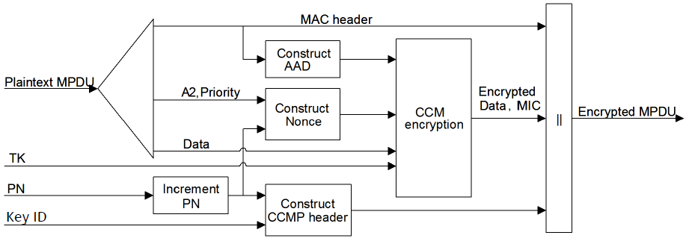



Legacy (single link) Retransmission Rules
Protected frames are retransmitted without re-performing cryptographic encapsulation. [5]
MPDU header fields that may change when retransmitted are muted by being masked to 0 when calculating the AAD. E.g. Retry subfield, Power Management (PM) subfield, More Data subfield etc.
CCMP Nonce
AAD
GCMP Nonce

Slide 5
Multi-link Retransmissions
It’s been agreed in SFD that:
  The MAC address of each affiliated AP within an AP MLD shall be different from each other (except that if the affiliated APs cannot perform simultaneous TX/RX operation, its TBD).
  The value of the RA/TA fields sent over-the-air in the MAC header of a frame is the MAC address of the STA affiliated with the MLD corresponding to that link. [4]
If the A1 and/or A2 of the AAD and Nonce are different for different links, even if a single PTK is used for all links, a protected frame needs to be cryptographically encapsulated again before retransmission on a link that is different from the link used for the initial transmission.
If the A2 (TA) is the same for different links, re-use of the same PN for the encapsulation of the frame for retransmission on a different link will lead to violation of “CCM requires a unique nonce value for each frame protected by a given temporal key.”
  PN should be the same to avoid out-of-order PN received after SN re-ordering

Slide 6
Proposal
During initial cryptographic encapsulation:
  The MLD MAC address of the recipient MLD is used as the A1 field for the AAD construction.
  The MLD MAC address of the transmitting MLD is used as the A2 field for the AAD and Nonce construction.
  If the Address 3 field of the protected frame carries the BSSID (e.g. in Data frames with “To DS” = ‘From DS” = 0), the MLD MAC Address of the AP MLD is used as the A3 field for the AAD construction. Otherwise, the Address 3 field of the protected frame is used for A3 (legacy rule).
Upon re-transmission on a link that is different from the link used for the initial transmission, protected frames are retransmitted without re-performing cryptographic encapsulation.

Slide 7
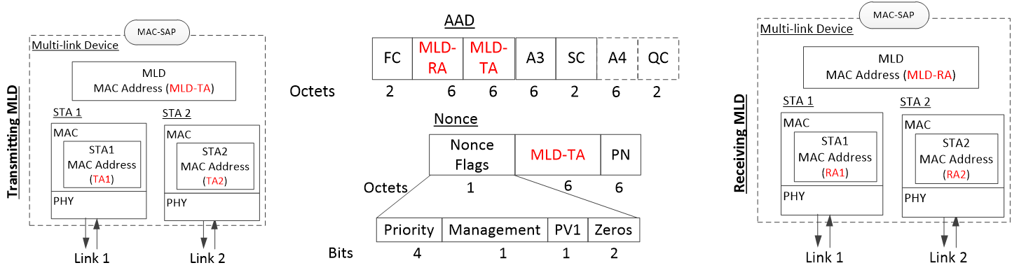
Proposal
During cryptographic decapsulation:
  Instead of the Address 1 field of the received MPDU, the MLD MAC address of the recipient MLD is used as the A1 field for the AAD construction.
  Instead of the Address 2 field of the received MPDU, the MLD MAC address of the transmitting MLD is used as the A2 field for the AAD and Nonce construction.
  If the Address 3 field of the protected frame carries the BSSID (e.g. in Data frames with “To DS” = ‘From DS” = 0), the MLD MAC Address of the AP MLD is used as the A3 field for the AAD construction. Otherwise, the Address 3 field of the protected frame is used for A3.

Slide 8
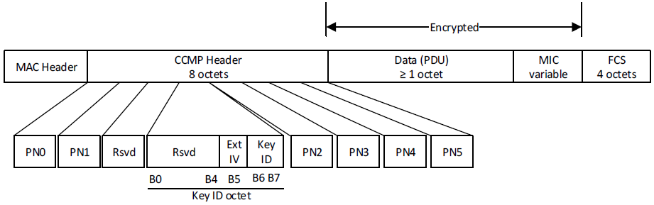
Usage options
One reserved bit in the CCMP/GCMP Header can be used to indicate whether the Address fields of the MAC Header or the MLD MAC addresses are used for AAD and Nonce constructions. E.g.:
  0: Use the Address fields of the MAC Header (Legacy rule)
  1: Use the MLD MAC addresses

Slide 9
Pros and Cons
Pros:
  Since the cryptographic encapsulation need only be performed during initial transmission of a protected frame, retransmission rules are similar to legacy rules, regardless of the link used for retransmission.
  The same PN can be used for re-transmissions regardless of A2 being same or different across links.
Cons:
  Slight increase in AAD and Nonce construction logics.
  Address 1, 2 (and 3 if applicable) of the MAC Header are not protected by the MIC, however since the MIC will only pass if the MLD MAC addresses match, the integrity of the frame is still preserved. Note that similar method is also used for PV1 frames in 802.11ah (MAC Address corresponding to a 2-octets SID field is used for AAD and Nonce construction instead of the SID field carried in the PV1 frame).

Slide 10
Conclusion
We discussed the issues related to retransmission of protected frames (CCMP/GCMP) and presented a proposal to simplify the retransmission of protected frames.
We proposed to use the MLD MAC Addresses instead of the Address fields in the MAC Header of protected frames for the construction of the AAD and Nonce fields during the cryptographic encapsulation and decapsulation process.

Slide 11
Reference
[1] IEEE 802.11-19/1822r4 - Multi-link Security Consideration (Intel)
[2] IEEE 802.11-19/1900r3 - MLA Security Considerations (Qualcomm)
[3] IEEE 802.11-19/1963r0 - Multi-Link Security And Aggregation Operations (Quantenna)
[4] IEEE 802.11-19/1262r8 - Specification Framework for TGbe
[5] Draft P802.11REVmd_D3.0

Slide 12
Straw Poll 1
Do you agree to revise Motion 61 of the 11be SFD as follows:
  The established block ack agreement allows the QoS Data frames of the TID, aggregated within the A-MPDUs, to be exchanged between the two MLDs on any available link.
  Note – QoS Data frames that are not fragments might be retransmitted on any available link.
  Y/N/A

Slide 13
Straw Poll 2
Do you support to add the following to the 11be SFD:
  If different links of an MLD use the same MAC address as the Transmitter Address (TA), during the CCMP/GCMP cryptographic encapsulation and decapsulation of a protected frame transmitted by the MLD to another MLD:
    The MLD MAC address of the recipient MLD is used as the A1 field for the AAD construction.
    The MLD MAC address of the transmitting MLD is used as the A2 field for the AAD and Nonce construction.
    If the Address 3 field of the protected frame carries the BSSID, the MLD MAC Address of the AP MLD is used as the A3 field for the AAD construction. Otherwise, the Address 3 field of the protected frame is used.
  Y/N/A

Slide 14
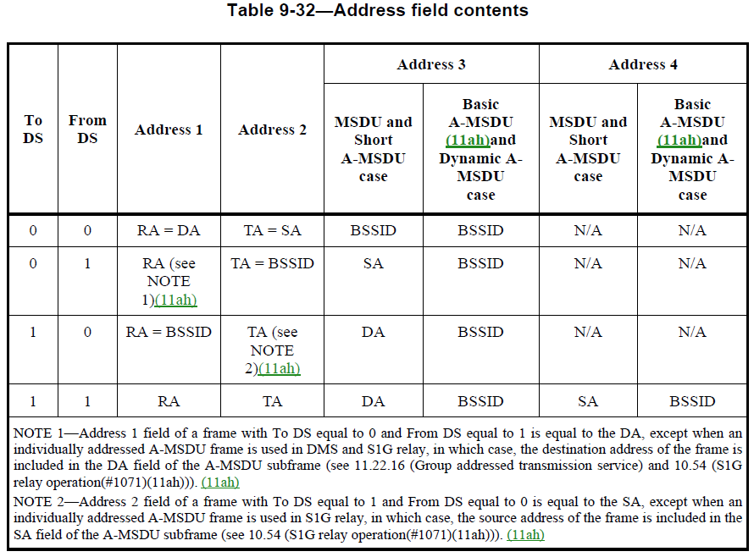
Appendix

