Slide 1
Multi-link Secured Retransmissions
Date: 2020-03-11
Authors:
Name | Company | Address | Phone | Email
Rojan Chitrakar | Panasonic Corporation | 202 Bedok South Avenue 1, #02-11 Singapore 469332 |  | rojan.chitrakar@sg.panasonic.com
Lei Huang
Yanyi Ding
Yoshio Urabe

Slide 2
Introduction
Security aspects of Multi-link transmissions have been raised in [1], [2], [3].
In this contribution, we focus on the issues related to retransmission of protected frames (CCMP/GCMP) and present a proposal to simplify the retransmission of protected frames.

Slide 3
Security keys
The following has been captured in the SFD [4]:
  After multi-link setup between two MLDs, different GTK/IGTK/BIGTK in different links with different PN spaces are used
    GTK/IGTK/BIGTK in different links can be delivered in one 4-way handshake.
There seems to be consensus on the following:
  A single PMK is negotiated between an AP MLD and non-AP MLD. PTK and GTK/IGTK are derived from the same PMK for different links.
Whether a single PTK is used for all links, or each link uses a separate PTK is under discussion.

Slide 4
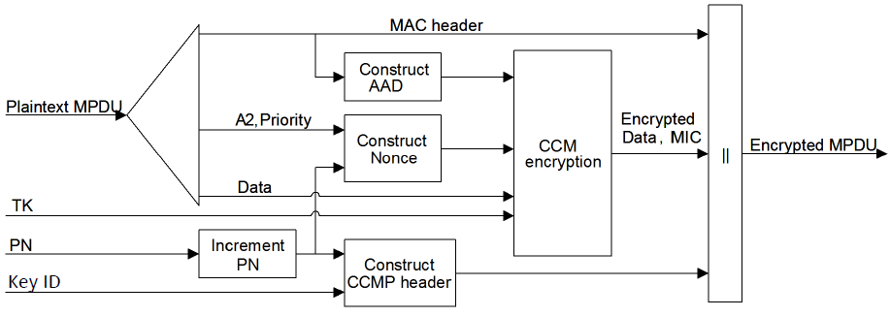



Legacy (single link) Retransmission Rules
Protected frames are retransmitted without re-performing cryptographic encapsulation. [5]
MPDU header fields that may change when retransmitted are muted by being masked to 0 when calculating the AAD. E.g. Retry subfield, Power Management (PM) subfield, More Data subfield etc.
CCMP Nonce
AAD
GCMP Nonce

Slide 5
Multi-link Retransmissions
It’s been agreed in SFD that:
  The MAC address of each affiliated AP within an AP MLD shall be different from each other (except that if the affiliated APs cannot perform simultaneous TX/RX operation, its TBD).
  The value of the RA/TA fields sent over-the-air in the MAC header of a frame is the MAC address of the STA affiliated with the MLD corresponding to that link. [4]
=> Since the A1 and/or A2 of the AAD and Nonce are different for different links, even if a single PTK is used for all links, a protected frame needs to be cryptographically encapsulated again before retransmission on a link that is different from the link used for the initial transmission.
Assumption: Retransmission on the same link used for the initial transmission follows legacy rules i.e. protected frames are retransmitted without re-performing cryptographic encapsulation.

Slide 6
Proposal
During initial cryptographic encapsulation:
  The MLD MAC address of the recipient MLD is used as the A1 field for the AAD construction.
  The MLD MAC address of the transmitting MLD is used as the A2 field for the AAD and Nonce construction.
  If the Address 3 field of the protected frame carries the BSSID (e.g. in Data frames with “To DS” = ‘From DS” = 0), the MLD MAC Address of the AP MLD is used as the A3 field for the AAD construction. Otherwise, the Address 3 field of the protected frame is used for A3 (legacy rule).
Upon re-transmission on a link that is different from the link used for the initial transmission, protected frames are retransmitted without re-performing cryptographic encapsulation.

Slide 7
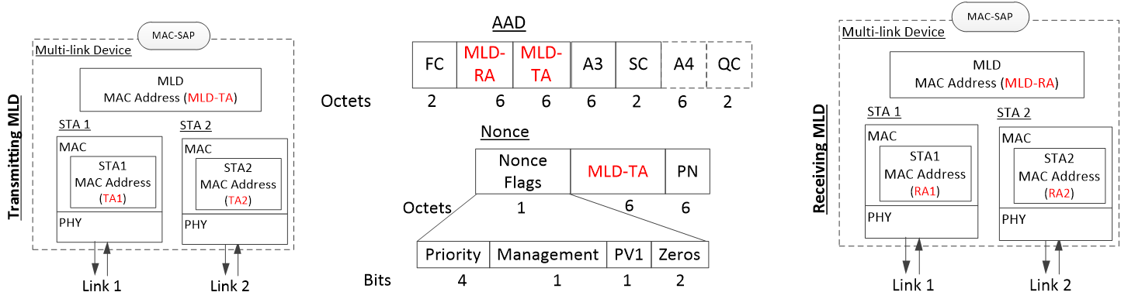
Proposal
During cryptographic decapsulation:
  Instead of the Address 1 field of the received MPDU, the MLD MAC address of the recipient MLD is used as the A1 field for the AAD construction.
  Instead of the Address 2 field of the received MPDU, the MLD MAC address of the transmitting MLD is used as the A2 field for the AAD and Nonce construction.
  If the Address 3 field of the protected frame carries the BSSID (e.g. in Data frames with “To DS” = ‘From DS” = 0), the MLD MAC Address of the AP MLD is used as the A3 field for the AAD construction. Otherwise, the Address 3 field of the protected frame is used for A3.

Slide 8
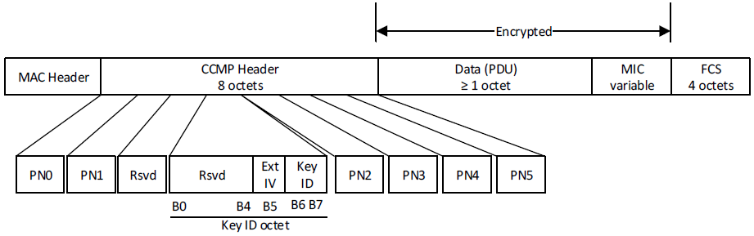
Usage options
If a Single PTK is used for all the links, the MLD MAC addresses are used as the default option for AAD and Nonce constructions.
However, if the option of separate PTKs for different links is also allowed in 11be, one reserved bit in the CCMP/GCMP Header can be used to indicate whether the Address fields of the MAC Header or the MLD MAC addresses are used for AAD and Nonce constructions. E.g.:
  0: Use the Address fields of the MAC Header (Legacy rule)
  1: Use the MLD MAC addresses

Slide 9
Pros and Cons
Pros:
  Since the cryptographic encapsulation need only be performed during initial transmission of a protected frame, retransmission rules are similar to legacy rules, regardless of the link used for retransmission.
  Retransmission on a different link does not consume Packet Numbers (PN).
Cons:
  Slight increase in AAD and Nonce construction logics.
  Address 1, 2 (and 3 if applicable) of the MAC Header are not protected by the MIC, however since the MIC will only pass if the MLD MAC addresses match, the integrity of the frame is still preserved.

Slide 10
Conclusion
We discussed the issues related to retransmission of protected frames (CCMP/GCMP) and presented a proposal to simplify the retransmission of protected frames.
We proposed to use the MLD MAC Addresses instead of the Address fields in the MAC Header of protected frames for the construction of the AAD and Nonce fields during the cryptographic encapsulation and decapsulation process.

Slide 11
Reference
[1] IEEE 802.11-19/1822r4 - Multi-link Security Consideration (Intel)
[2] IEEE 802.11-19/1900r3 - MLA Security Considerations (Qualcomm)
[3] IEEE 802.11-19/1963r0 - Multi-Link Security And Aggregation Operations (Quantenna)
[4] IEEE 802.11-19/1262r8 - Specification Framework for TGbe
[5] Draft P802.11REVmd_D3.0

Slide 12
Straw Poll 1
Do you support to use the MLD MAC Addresses instead of the Address fields in the MAC Header of protected frames for the construction of the AAD and Nonce fields during the CCMP/GCMP cryptographic encapsulation and decapsulation process?
  Y/N/A

Slide 13
Straw Poll 2
Do you support that during the CCMP/GCMP cryptographic encapsulation and decapsulation process for a protected frame :
  The MLD MAC address of the recipient MLD is used as the A1 field for the AAD construction.
  The MLD MAC address of the transmitting MLD is used as the A2 field for the AAD and Nonce construction.
  If the Address 3 field of the protected frame carries the BSSID, the MLD MAC Address of the AP MLD is used as the A3 field for the AAD construction. Otherwise, the Address 3 field of the protected frame is used for A3.
  Y/N/A

Slide 14
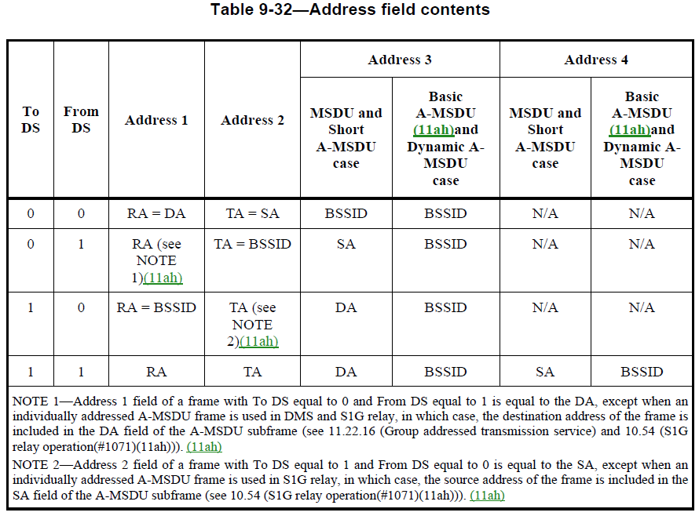
Appendix

