Slide 1
PPDU alignment in STR constrained multi-link
Date: 2020-03-15
Authors:
Name | Affiliations | Address | Phone | Email
Yunbo Li | Huawei | Shenzhen, China |  | liyunbo@Huawei.com
Yuchen Guo
Yifan Zhou
Guogang Huang
Yiqing Li
Ming Gan
Notes:
September 2012

Slide 2
Motivation
When a MLD has STR constrain on two links, the PPDUs transmitted on the two links need to do time synchronization to avoid simultaneous transmit and receive on different links;
The synchronization in Data/BA procedure is discussed in presentation 19/1305, but the sync requirements of Trigger/TB PPDU procedure hasn’t been discussed;
ED carrier sensing is needed before TB PPDU transmission, it is quite different from BA response which doesn’t require ED carrier sensing;
The sync requirements in Trigger/TB PPDU procedure are discussed in this document.

Slide 3
Example
The cross link power leakage during SIFS doesn’t affect the BA response, but will blocks the ED carrier sensing before TB PPDU;
SIFS
cross link leakage will be ignored
Link 1
A-MPDU1
BA
Link 2
A-MPDU2
BA2
SIFS
SIFS
cross link leakage will blocks the ED CS for TB PPDU
Link 1
A-MPDU1 with Trigger frame
TB PPDU
Link 2
A-MPDU2
BA2
SIFS

Slide 4
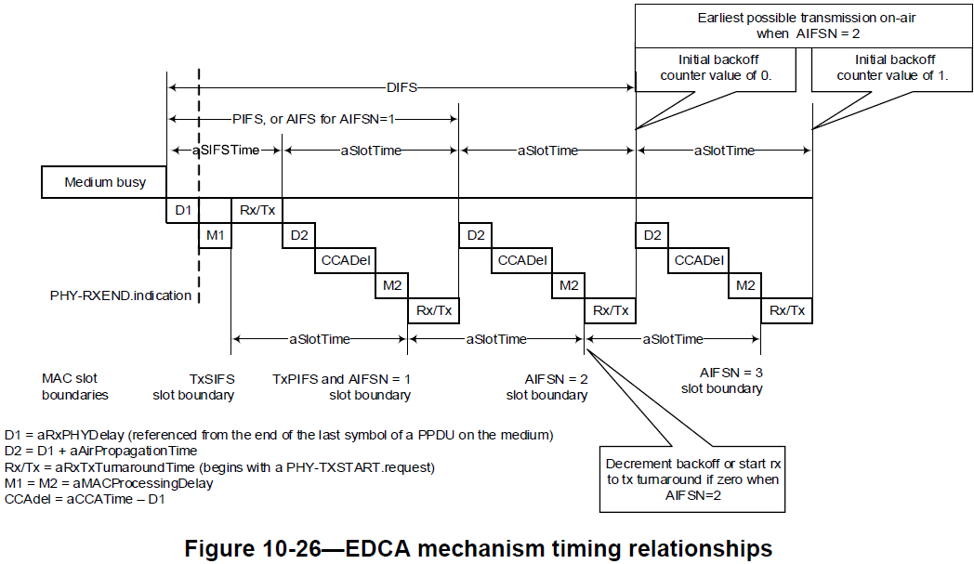
Recap: SIFS
SIFS time = D1 + M1 + Rx/Tx;
D1 and M1 periods are used for PHY and MAC process, which can do ED carrier sensing in parallel;
ED carrier sensing can not be performed during Rx/Tx period.

Slide 5
Sync for TB PPDU in One link
The starting time of BA2 can not be earlier than Rx/Tx time before TB PPDU, otherwise ED CS will be blocked in link 1;
In other words, the ending time of PPDU2 can not be earlier than Rx/Tx time before ending time of PPDU1
Similar as Data/BA case, the ending time of PPDU2 can not be later than the ending time of PPDU1 plus SIFS, otherwise the reception of PPDU2 will be blocked by power leakage of TB PPDU in link 1.
Link 1
PPDU1 carries Trigger frame
SIFS
TB PPDU
D1
M1
Rx/Tx
Link 2
PPDU2
SIFS
BA2
Link 2
PPDU2
SIFS
BA2
Earliest ending time
Latest ending time

Slide 6
Sync for TB PPDU in One link
A margin of 10%×aSlotTime considers the SIFS accuracy of the IEEE 802.11-2016 spec;
Considering the margin of 10%×aSlotTime, the rules will be
the ending time of PPDU2 can not be earlier than (Rx/Tx- 10%×aSlotTime) before ending time of PPDU1;
The ending time of PPDU2 can not be later than the ending time of PPDU1 plus (SIFS- 10%×aSlotTime).
Link 1
PPDU1 carries Trigger frame
SIFS
TB PPDU
D1
M1
Rx/Tx
Link 2
PPDU2
SIFS
BA2
Link 2
PPDU2
SIFS
BA2
Earliest ending time
Latest ending time

Slide 7
Sync for TB PPDUs in Two Links
When both links are expected to receive TB PPDUs
The difference between the ending times of PPDU1 and PPDU2 shall be less than or equal to Rx/Tx
Considering the margin of 10%×aSlotTime, the rule will be
The difference between the ending times of PPDU1 and PPDU2 shall be less than or equal to (Rx/Tx- 10%×aSlotTime) ;
Link 1
PPDU1 carries Trigger frame
SIFS
TB PPDU1
D1
M1
Rx/Tx
Link 2
PPDU2 carries Trigger frame
SIFS
TB PPDU2
D1
M1
Rx/Tx
Link 2
PPDU2 carries Trigger frame
SIFS
TB PPDU2
D1
M1
Rx/Tx
Earliest ending time
Latest ending time

Slide 8
Rx/Tx time
The length of Rx/Tx duration is implementation related, how to determine it in the equations?
Opt 1: common Rx/Tx
A fixed value for Rx/Tx (e.g. called Rx/Tx0) is used for all STAs, it could be defined in standard;
Opt 2: individual Rx/Tx
Each STA report its own Rx/Tx value to AP, e.g. report during association procedure.
Opt 1 is preferred.

Slide 9
Clarification for TRS control
When a TB PPDU is solicited by a frame containing a TRS control subfield, CS MU CS is not required, so the discussed alignment rules for TB PPDU is not apply to a frame containing a TRS control;
One of the conditions to response a TB PPDU frame in IEEE 802.11ax draft 6.0
The CS Required subfield in the Trigger frame is 1 and the UL MU CS condition described in 26.5.2.5 (UL MU CS mechanism) indicates the medium is idle, or the CS Required subfield in a Trigger frame is 0 or the response was solicited by a frame containing a TRS Control subfield.

Slide 10
Summary 1
When a MLD1 transmit PPDU1 and PPDU2 in link 1 and link 2 respectively to a MLD2 which is STR constrained, if PPDU1 and PPDU2 has time domain overlapping, and PPDU1 carries a Trigger frame with CS Requirement subfield set to 1, then
the ending time of PPDU2 can not be earlier than (Rx/Tx- 10%×aSlotTime) before ending time of PPDU1;
The ending time of PPDU2 can not be later than the ending time of PPDU1 plus (SIFS- 10%×aSlotTime).
When a MLD1 transmit PPDU1 and PPDU2 in link 1 and link 2 respectively to a MLD2 which is STR constrained, if PPDU1 and PPDU2 has time domain overlapping, and both PPDU1 and PPDU2 carry Trigger frames with CS Requirement subfield set to 1, then
The difference between the ending times of PPDU1 and PPDU2 shall be less than or equal to (Rx/Tx- 10%×aSlotTime) ;

Slide 11
Summary 2
If a fixed value Rx/Tx0 is used, 10%×aSlotTime can also count into Rx/Tx0. Then the synchronization requirements will be:
When a MLD1 transmit PPDU1 and PPDU2 in link 1 and link 2 respectively to a MLD2 which is STR constrained, if PPDU1 and PPDU2 has time domain overlapping, and PPDU1 carries a Trigger frame, then
the ending time of PPDU2 can not be earlier than Rx/Tx0 before ending time of PPDU1;
The ending time of PPDU2 can not be later than the ending time of PPDU1 plus (SIFS- 10%×aSlotTime).
When a MLD1 transmit PPDU1 and PPDU2 in link 1 and link 2 respectively to a MLD2 which is STR constrained, if PPDU1 and PPDU2 has time domain overlapping, and both PPDU1 and PPDU2 carry Trigger frames, then
The difference between the ending times of PPDU1 and PPDU2 shall be less than or equal to Rx/Tx0;

Slide 12
Straw Poll 1
Do you support to introduce synchronization rules for transmission of PPDUs which carry Trigger frame(s) in synchronous multi-link?
Yes
No
Abstain

Slide 13
Straw Poll 2
Do you support below synchronization requirement?
When a MLD1 transmit PPDU1 and PPDU2 in link 1 and link 2 respectively to a MLD2 which is STR constrained, if PPDU1 and PPDU2 has time domain overlapping, and PPDU1 carries a Trigger frame with CS Required subfield set to 1, then
the ending time of PPDU2 can not be earlier than T1 time before ending time of PPDU1;
The ending time of PPDU2 can not be later than the ending time of PPDU1 plus (SIFS- 10%×aSlotTime).
Note 1: T1 equals to (Rx/Tx- 10%×aSlotTime) or Rx/Tx0
Note 2: How to determine T1 is TBD
Yes
No
Abstain

Slide 14
Straw Poll 3
Do you support below synchronization requirement?
When a MLD1 transmit PPDU1 and PPDU2 in link 1 and link 2 respectively to a MLD2 which is STR constrained, if PPDU1 and PPDU2 has time domain overlapping, and both PPDU1 and PPDU2 carry Trigger frames with CS Required subfield set to 1, then
The difference between the ending times of PPDU1 and PPDU2 shall be less than or equal to T2;
Note 1: T2 equals to (Rx/Tx- 10%×aSlotTime) or Rx/Tx0
Note 2: How to determine T2 is TBD
Yes
No
Abstain

Slide 15
Straw Poll 4
Which option do you prefer to determine the value of Rx/Tx in synchronization requirements for STR constrained multi-link?
Opt 1: common Rx/Tx
Define a fixed value for Rx/Tx (e.g. called Rx/Tx0) for all STAs in the standard;
Opt 2: individual Rx/Tx
Each STA reports its Rx/Tx value to AP, e.g. report during association procedure.
Other methods.

Slide 16
Backup

Slide 17
Constrained Multi-link TUA
So, when the AP sends to the STA a PPDU containing the Trigger frame with the CS Required field set to 1, the AP should meet the following additional requirement.
The time difference between the ending time of the soliciting DL PPDU that is lastly sent and the starting time of the solicited TB PPDU that is firstly sent is greater than or equal to aCCATime (TBD).
aCCATime (e.g., 4μs, 8μs) can be predetermined in the spec.
Or, each STA can signal its aCCATime requirement to the AP.
The time difference between the last DL PPDU and the first TB PPDU is greater than or equal to aCCATime.
AP
Trigger (CS Required = 1)
MAC Padding
PHY Padding
PE
6GHz
STA
SIFS
EHT TB PPDU
AP
Trigger
(CS Required = 1)
MAC Padding
PHY Padding
PE
5GHz
STA
SIFS
EHT TB PPDU

