Slide 1
QoS Management framework in 802.11be
Date: 2020-06-24
Authors:

Slide 2
Introduction
This presentation proposes a QoS management framework to enable multiple applications with requirements of low worst case latency, jitter, reliability, priority in 802.11be
  In view of the recent developments, the original contribution title was updated to reflect a broader QoS management capability
This presentation builds on the straw poll in contribution 20-697r3 on QoS provisioning
Proposed QoS framework:
  An11be QoS framework that leverages new 11be capabilities (e.g. ML operation) to enable low latency services
  QoS management enhancements including
    ML discovery and management with QoS support
    QoS negotiation requirements
    Enhanced traffic classification, prioritization and channel access

Slide 3
Low Latency Reliable Service Definition
A service provided to a higher layer traffic stream that prioritizes and delivers MSDUs within a worst case latency budget with a given reliability/packet delivery ratio (PDR) and low jitter
  Example (not actual target): 99.9% of the packets are delivered within a 2 msec latency
Requirements for using and providing the service:
  QoS management and negotiation to discover, request and confirm the service
  The decision on whether the service can be supported/advertised is implementation specific
  The service may be terminated if the traffic stream does not conform with the QoS profile provided during service negotiation

Slide 4
Motivation for a Low Latency Reliable Service in 11be
802.11 has no clear definition of a Low Latency Reliable Service interface
  802.11 defines QoS negotiation procedures, but there are no data delivery expectations including worst case latency and reliability
URLLC is a clear (explicit) mode available for low latency services in 5G:
  There is no upfront guarantee that a 5G UE can receive URLLC service, but the capability to negotiate the service exists in 5G
  QoS negotiation is required and implementation specific algorithms (e.g. scheduling) are needed
  There is also a “perception” in the general public, that only 5G URLLC can provide low latency services and that 802.11 is not suitable for these applications
Defining a LLRS in 802.11be will enable implementations to decide whether such service can be provided depending on the deployment and use cases

Slide 5
Low Latency Reliable Service (LLRS) - use case example
LLRS traffic stream QoS parameters (example):
Min Service Interval: requested minimal periodicity of service or min MSDU interarrival time
Latency bound: Maximum time required for successful delivery of the MSDU/A-MPDU (from MAC-SAP to MAC-SAP)
PDR (Reliability): Expected packet delivery ratio within the latency bound (from MAC-SAP to MAC-SAP)
Jitter: Expected variation in latency
The 802.11 RTA TIG report documented requirements from various applications:
See 11-0065r6 and 11-2009r6
A flexible QoS framework is needed given the variety of requirements
The service can be used by different low latency applications: gaming, AR/VR, Industrial IOT, emergency services, …

Slide 6
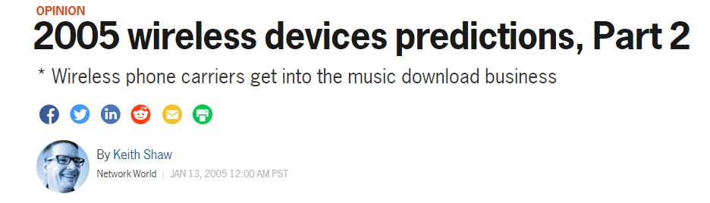
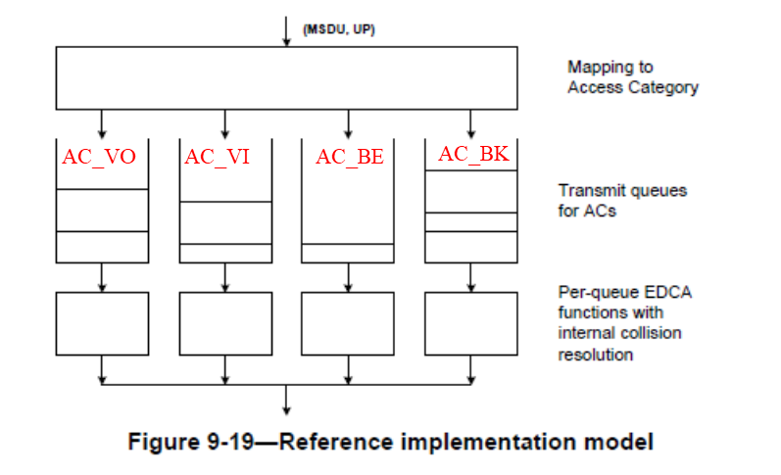

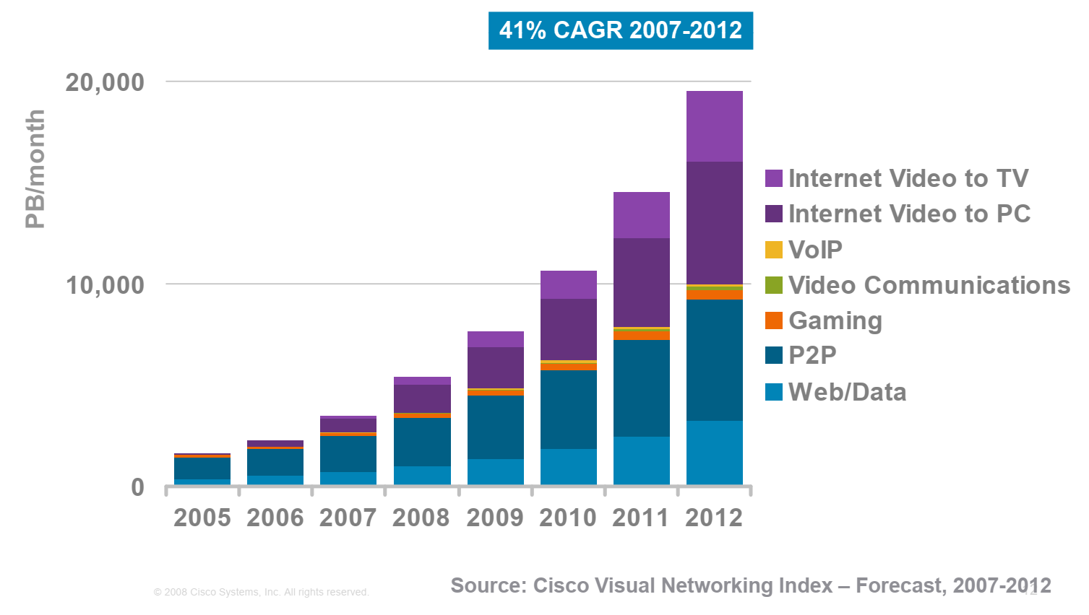

802.11 QoS management is a key capability to LLRS
802.11e QoS (2005)
Voice, video, and mobile were the future in 2005 and are the main traffic today
  EDCA and HCCA
  EDCA is the main mechanism for traffic prioritization today

Slide 7

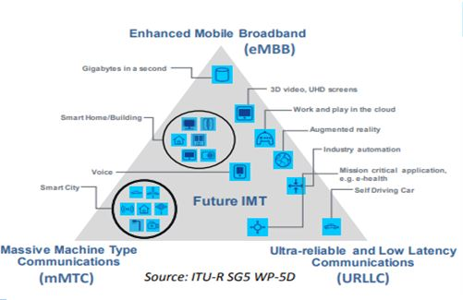



Is 802.11 QoS management ready for the next 15 years?
Combined with enhancements in throughput, security and other performance vectors, the 802.11e EDCA model has worked well so far
What is coming in the next 15 years?

Slide 8
Tiered Approach to QoS Management in 11be
We propose to define QoS management in every tier of the device system architecture once it receives packets at its host interface
Tier 1 (Host): Stream / flow classification of MSDUs
  New access and QoS policies (low latency, reliability, frame rate)
    Device-centric and network-centric
Tier 2 (MAC SAP): AP MLD or non-AP scheduling/mapping of MSDUs
  TIDs 8-15 to be allowed over EDCA
    Enable mapping of TIDs 8-15 to ACs
  TID-link mapping as appropriate QoS (e.g. LLRS) including dynamic link-set per MLD
  Stream QoS negotiation for multi-link QoS priorities
    Stream/flow-to-link assignment among Segments / VAPs
Tier 3 (MAC): Prioritized channel access
  Protected/priority access periods for queued traffic with TIDs 8-15
Data
AR/VR
Gaming
Stream /flow classification
Video
TSN
MAC SAPs
VAP 2
(Video)
VAP 3
(Gaming)
MLD scheduling/mapping
VAP3
(Data)
VAP 2
(AR/VR)
VAP 1
(TSN)
AC 1
AC 2
AC 3
AC 4
VAP 1
(TSN)
AP 1
(BE/VO/VI)
AP 2
(BE/VO/VI)
5 GHz
6 GHz
Prioritized channel access

Slide 9
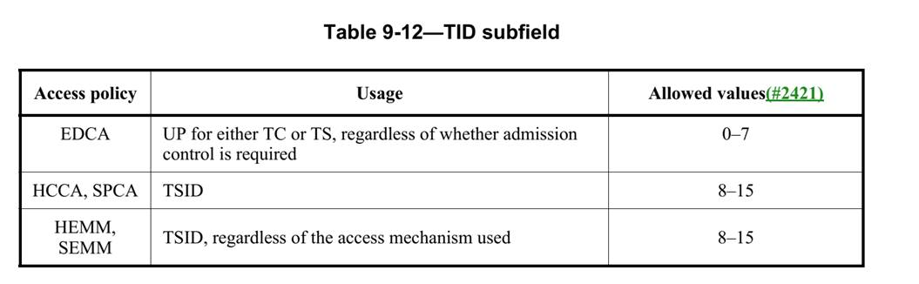
Current 802.11 QoS and traffic classification limitations
Application Data
Traffic Classification
TIDs 0 -7 are the only TIDs allowed with EDCA
Only 2 TIDs per AC
Used mainly as traffic classes (no traffic streams)
No QoS parameters that enable a LLRS
TIDs (Traffic Stream IDs) 8-15 are defined for HCCA and DMG QoS, but NOT allowed in 802.11ax
Network Processor
Flow-based
DSCP
OS
Driver
MSDUs
MAC SAP
Traffic Classes and Traffic Streams
Tx buffers with MPDUs in 4 ACs
UP=TID
MAC-PHY
Channel access over wireless medium

Slide 10
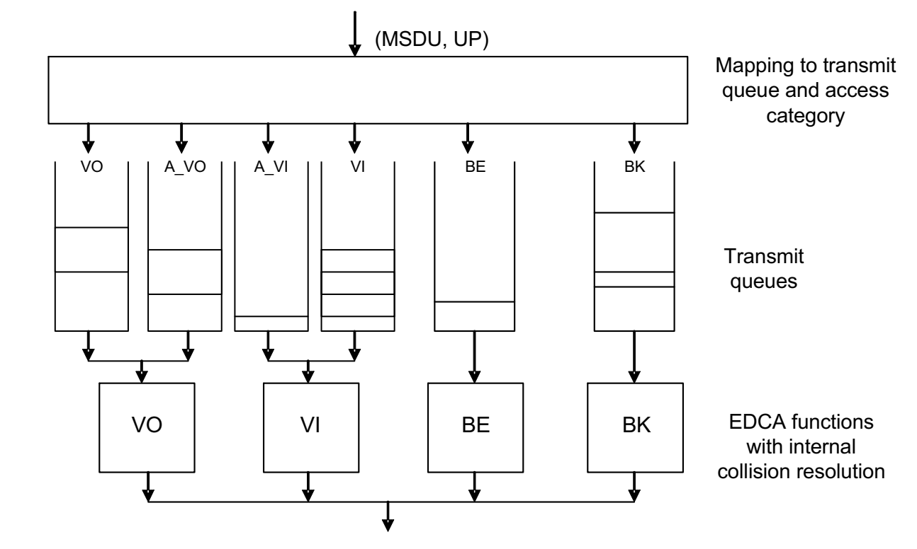
Alternate EDCA capability & limitations
MSDU(s) from the queue with the higher UP are selected with a higher probability than from the queue with the lower UP
If AC_VO is used for LLRS streams, only one additional stream with new QoS parameters can be supported when voice traffic is present
Several streams with different QoS requirements (e.g. deadlines) may be simultaneously active in the same BSS/device, e.g.
voice, gaming, AV (VR) in a home network
Industrial PLCs (multiple control cycles per device) in an enterprise network
2 TIDs per AC is NOT a scalable solution for supporting multiple LLRS streams simultaneously with voice and video traffic

Slide 11
Tier 1. QoS Capability in ML Discovery and Operation
Define device-centric and network-centric access and QoS policies (e.g., low latency, reliability, frame rate)
Broadcast of new QoS capabilities that allow non-AP MLD to pick a particular AP MLD that satisfies its requirements
New AP MLD signals
  QoS management (LLRS) supported and QoS negotiation required
  LLRS/QoS capability may be supported in a dynamic subset of available links
  Other information may be added to help STAs select the AP MLD, such as BSS Load, link latency statistics

Slide 12
Tier 2. Traffic classification and prioritization to meet new QoS
Traffic classification for multiple streams with potentially different QoS metrics (e.g. gaming, AR/VR, proAV, Industrial IOT, emergency services, …)
  0-7 TIDs and existing inter-AC priorities do not provide the required flexibility
  TIDs 8 to 15 can be reused to identify new QoS streams and associated requirements (e.g. enables queuing and intra-AC prioritization more efficient and scalable)
TID 15
TID 10
TID 9
TID 8
TID 7
TID 6
Note:
11ax has already used TIDs 14, 15 in M-BA for acknowledging MMPDUs, but not for data frames
11be SP passed unanimously on using TID >7 for frames with NS/EP characterization
The proposed QoS mechanism enables generic LLRS services/applications and is compatible with other uses
MLD can classify traffic streams with different QoS requirements (e.g. mapped to AC_VO) in the same device.
VO
VI
BE
BK
Traffic can be prioritized based on new metrics for TIDs 8 – 15 (e.g. latency bound/deadlines)

Slide 13
Tier 2. Traffic stream QoS description and negotiation for MLO
New QoS information exchange between a non-AP MLD and AP MLD for QoS negotiation and stream classification over the air
  Upper layer traffic classification capabilities can be re-used (e.g. TCLAS)
  New QoS traffic description can be associated to streams identified by the TIDs 8 – 15
  New TIDs 8 – 15 can be dynamically mapped to ACs (enabled by QoS negotiation)
Define new traffic description with min. set of parameters to describe a stream
  Examples: Max MSDU size, Min Service Interval, arrival (start) time, burst size (within SI), latency bound, jitter, PDR (packet delivery ratio)
Meeting the negotiated QoS
  Once a traffic stream is negotiated and can be classified (using TIDs 8 -15), the stream is prioritized in the 802.11 MAC to meet its requirements (e.g. worst case latency with a given PDR) by using
    Existing tools (e.g. scheduling)
    New tools offered by 11be Multi-link framework: TID-link-mapping, redundancy, limiting load/traffic on some links, EDCA parameters per link, general latency benefits from MLO
  If the network cannot meet the requirements, it can terminate the negotiated service

Slide 14
Scope of QoS Management Framework in 11be
EHT STAs discover which APs support the required QoS and start QoS negotiation
No QoS negotiation required for regular STAs that don’t implement new QoS capabilities, but they must follow AP MLD rules for traffic classification/prioritization

Slide 15
Channel access enhancements to support LLRS (R2)
EDCA is simple/scalable, but AC_VO and AC_VI access categories only do not represent well the broad range of new applications that need LLRS
  Many other applications will need more strict latency and reliability QoS than voice and video
802.11be can adapt the 802.11 EDCA QoS to model to make it future proof:
  New AC could be defined for LLRS that uses the newly defined TIDs 8 - 15
  Enable mapping to a wider range of applications/requirements
  Enable capabilities so that packets can be individually prioritized based on hard time deadlines (worst case latency vs. average latency) and protected from other traffic

Slide 16
Simulation scenario 1
Single BSS: 6 STAs (2 Low Latency, 4 BE - 6 Mbps), 20 MHz channel
  LL traffic streams: 10Mpbs streaming video DL, Periodic 100 Byte every 4 ms UL
LLS: low latency traffic using AC_VO + protected windows
  1 ms windows every 5 ms
VO: low latency streams using AC_VO
Channel access: EDCA + Protected window for LLRS traffic

Slide 17
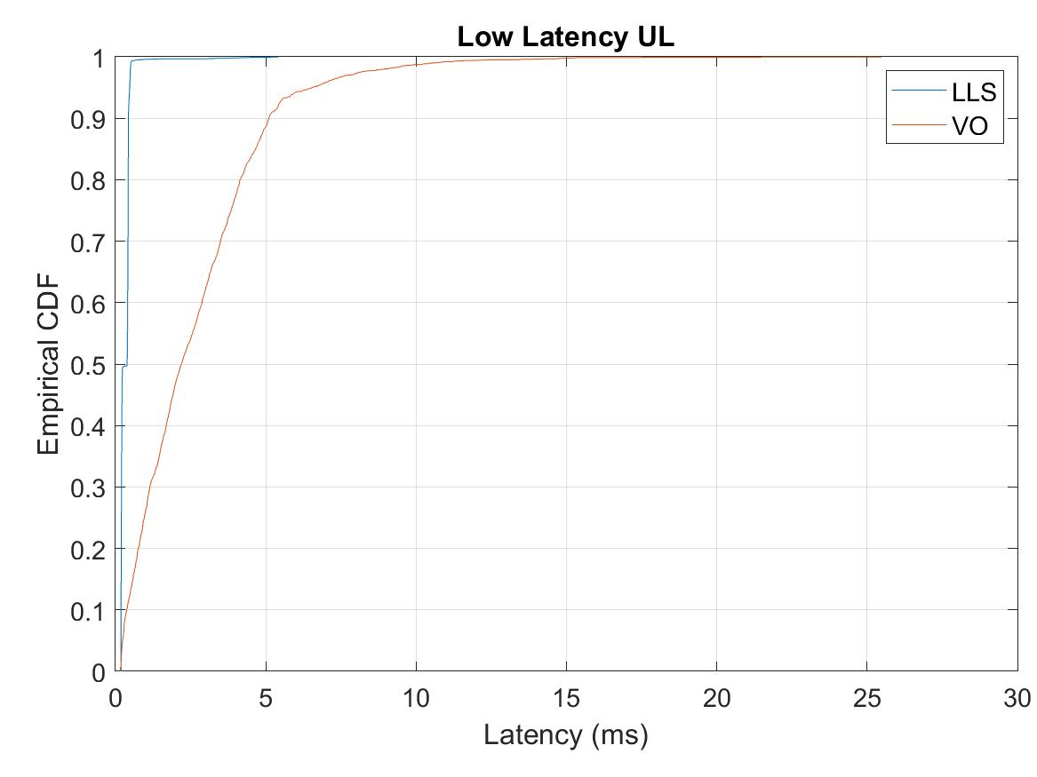
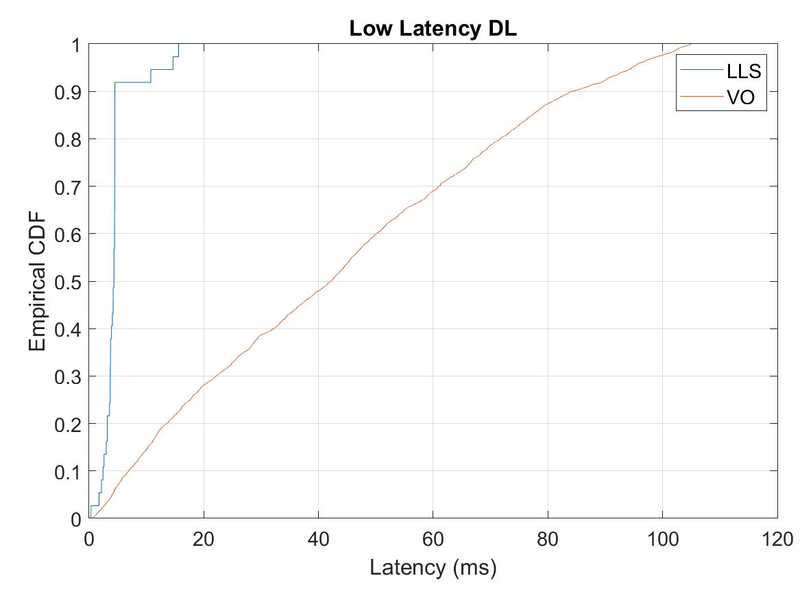
Scenario 1 - Results (20 MHz)
LLS: low latency streams with protected windows
VO: low latency as AC_VO (no protected windows)

Slide 18
Conclusions
The QoS management enhancements will enable 802.11be solution providers to offer an important and required Low Latency Reliable Service
  It’s an important capability to ensure that 802.11 is ready for emerging applications
Main QoS provisioning enhancements
  Announce new QoS capabilities (e.g. LLRS) in ML Discovery and Operation
  Enable Traffic stream QoS description and negotiation for QoS ML-operation
  Traffic classification and lightweight prioritization to enable new QoS metrics

Slide 19
Straw Poll 1
Do you support defining a QoS mechanism so that the AP MLD and non-AP MLD can:
  Announce new QoS capabilities (for LLRS) of the MLD
  Provide traffic stream QoS description to enable classification across the MLD
  Use TIDs 8 - 15 to indicate a new class of QoS data streams (e.g. LLRS streams) mapped to EDCA ACs with associated QoS parameters (as defined in item 2.)
    Note: the TID values are signaled in the QoS Control field of corresponding Data frames
    Note: if an AP is not part of an AP MLD (legacy AP), the same mechanism would be used between the AP and a non-AP STA

Slide 20
backup

Slide 21
QoS traffic description for low latency reliable service
Parameters to describe a LLRS traffic stream:
  Max MSDU Size: Maximum size of MSDU
  Burst size: Maximum aggregate size MSDUs that arrive within a service interval
  Min Service Interval: requested minimal periodicity of service or min MSDU interarrival time
  Latency bound: Maximum time required for successful delivery of the MSDU/A-MPDU (from MAC-SAP to MAC-SAP)
  PDR (Reliability): Expected packet delivery ratio within the latency bound.
  Jitter: expected variation in latency

Slide 22
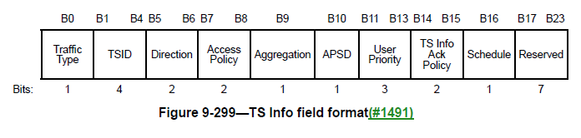
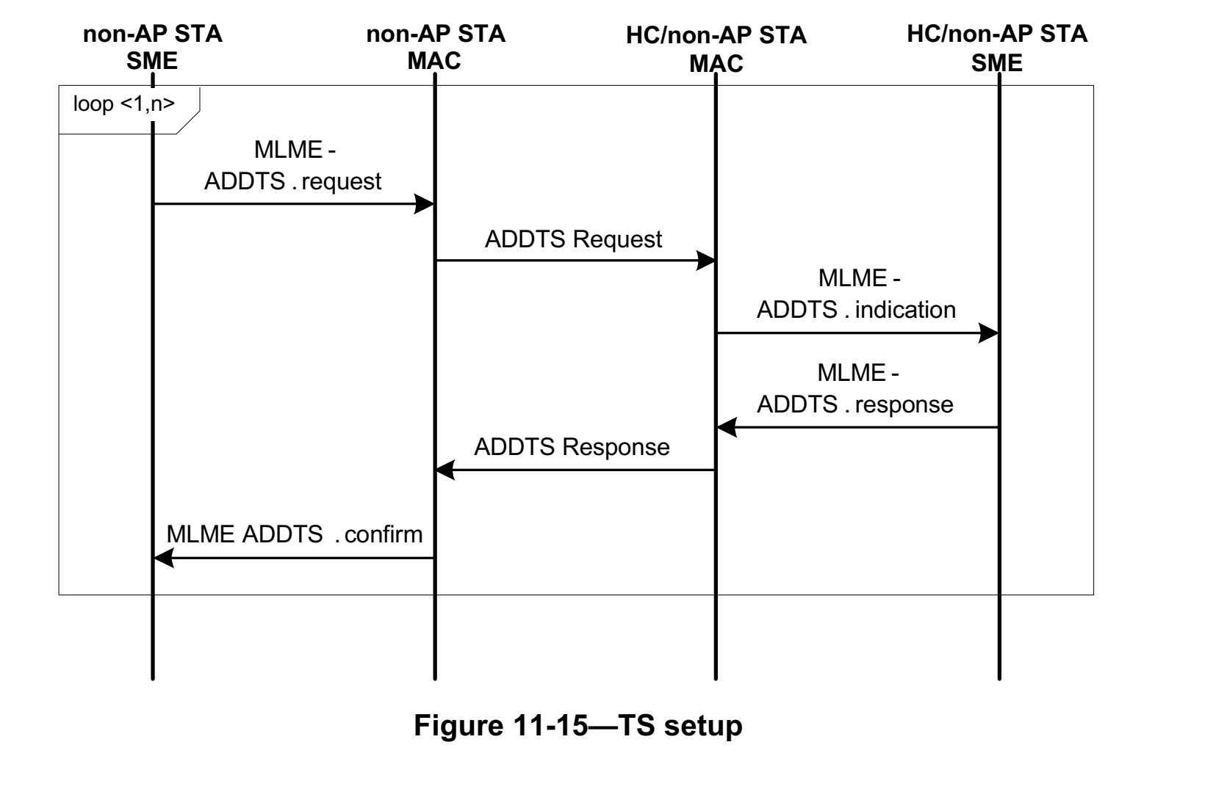
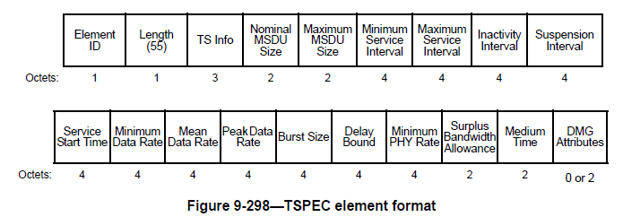
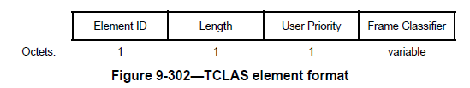
Existing Traffic Stream and TSPEC Capabilities
STA ➔AP: ADDTS Request[TSPEC, TCLAS]
AP ➔ STA : ADDTS Response[Status, TSPEC, TCLAS]
(Accept/Reject)
Once a TS is set up using ADDTS Request/Response with TSPEC+TCLAS, the frames can be classified and inserted in the corresponding EDCA queues.
The current TSPEC has more parameters than required, and misses a few important parameters
Definition of parameters may also need to clarifications/updates, WMM vs IEEE TSPEC

Slide 23
Further MAC enhancements for LLS
Ultimately, the AP decides if and how the LLS can be delivered
  802.11be features that reduce latency can be leveraged to implement the service more efficiently, e.g., wider bandwidth, multi-link/channel, multi-AP, etc.
  TSN features can help provide accurate time-aware delivery and integrate with Ethernet TSN
OBSS considerations
  In managed scenarios, OBSS should have minimal impact on the service
  The AP should monitor the BSS/channel activities and decide whether OBSS may impact the service
  The AP may choose to terminate the service or adapt the BSS operation to minimize the impact of OBSS (all is implementation specific)

Slide 24
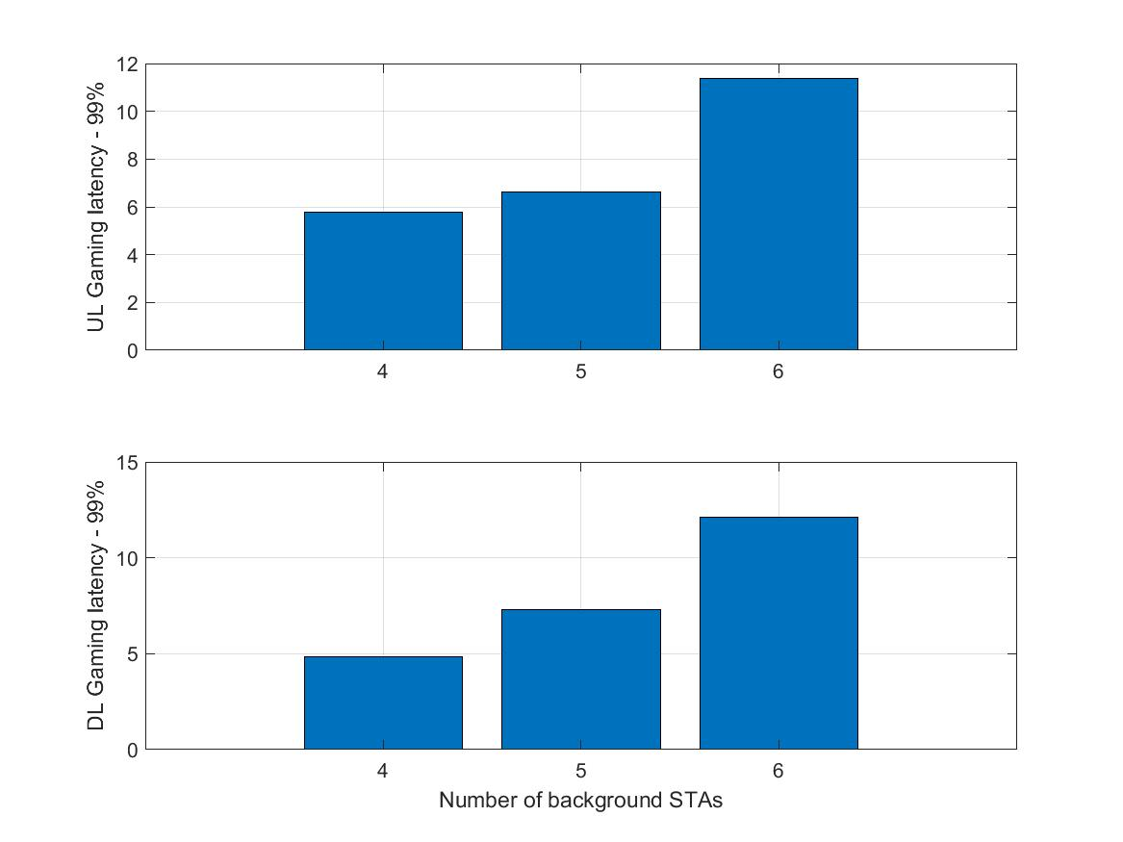
Low Latency Reliable Service under OBSS
Latency (99th percentile) for gaming traffic with background traffic and OBSSs
Assumptions:
802.11ax trigger based access with traffic classification and priority scheduling for LLS packets
5 BSS (neighboring townhouses – two story) – 2 gaming STAs in the central house
Single AP (80 MHz) per BSS (SISO)
2 channels are used with BSS coloring
Traffic:
  Real cloud game traffic: UL (game control) +DL streaming (10 Mbps)
  Background: 2 Mbps CBR per STA
99% of the gaming packet are delivered under 10 msec (mostly around 5-6 msec) with up to 5 Background STAs
The BSS can decide if the service is feasible given its capabilities, deployment, and network conditions
(msec)
(msec)

Slide 25
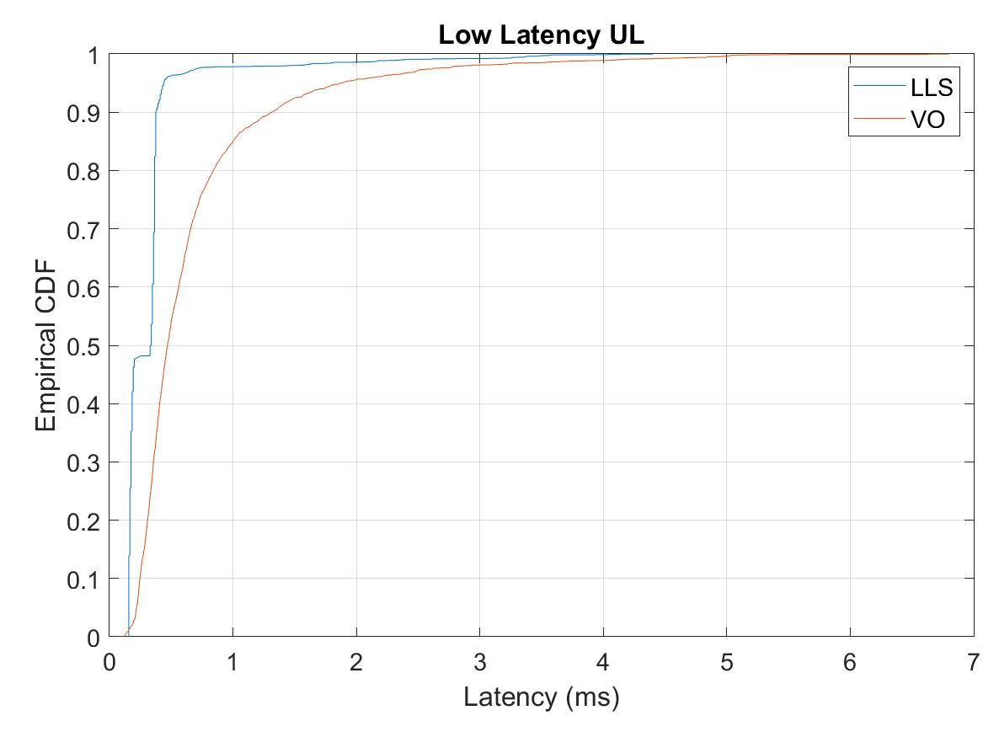
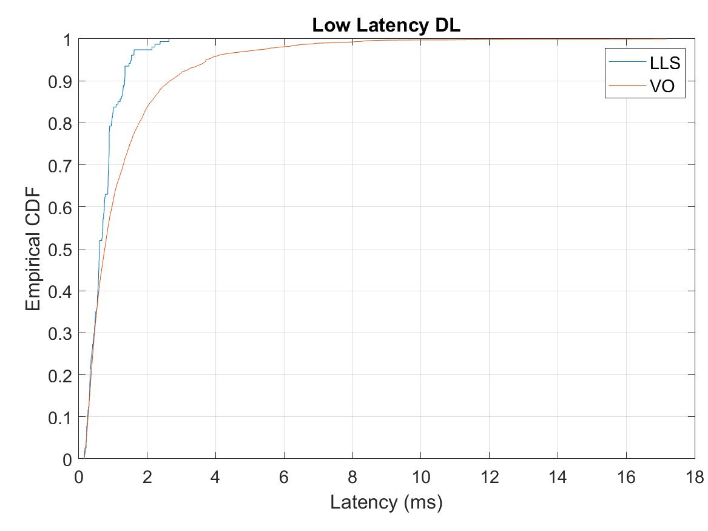
Scenario 1 - Results (80 MHz)
LLS: low latency streams with protected windows
VO: low latency as AC_VO (no protected windows)

Slide 26
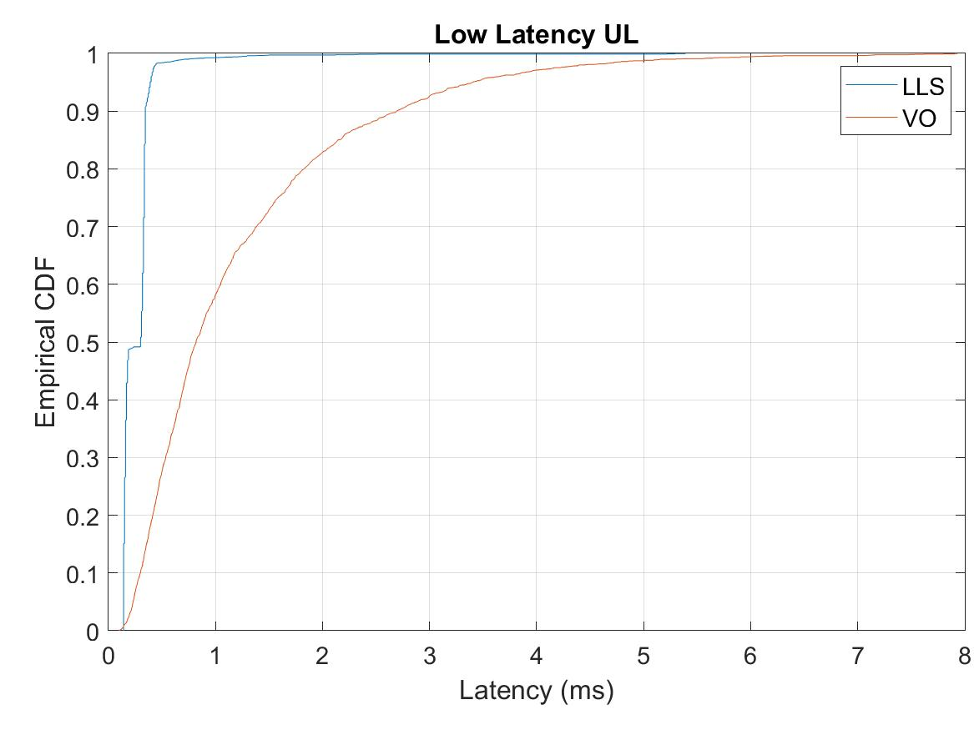
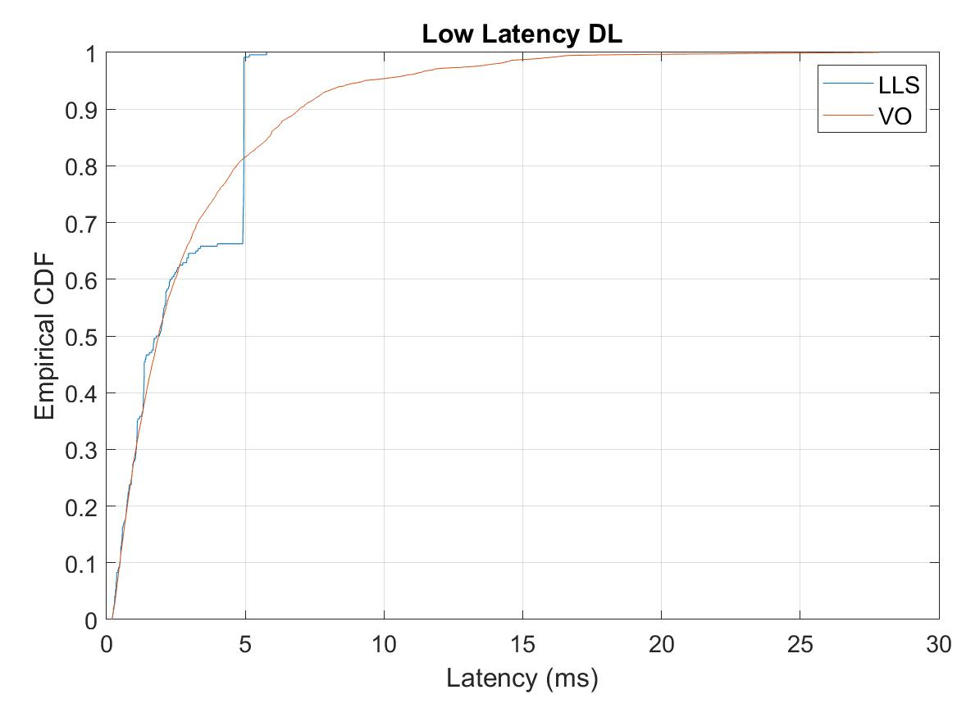
Scenario 1 - Results (40 MHz)
LLS: low latency streams with protected windows
VO: low latency as AC_VO (no protected windows)

Slide 27
Simulation scenario 2
Single BSS: 6 STAs (2 Low Latency, 4 BE - 6 Mbps), 20 MHz channel
  LL traffic streams: 100Bytes every 4 ms
LLS: low latency traffic using AC_VO + protected windows
  500 microseconds windows every 4 ms
VO: low latency traffic using AC_VO
Case 1: EDCA in protected window (AP and STAs contend)
Case 2: Trigger based in protected window

Slide 28
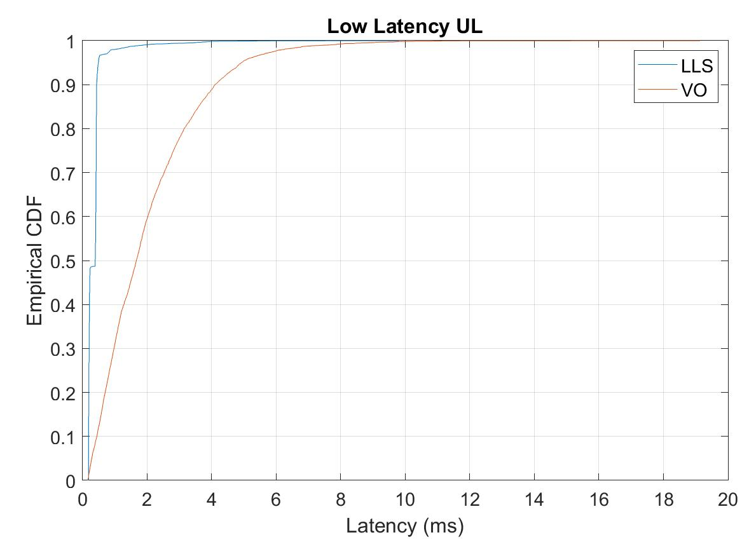
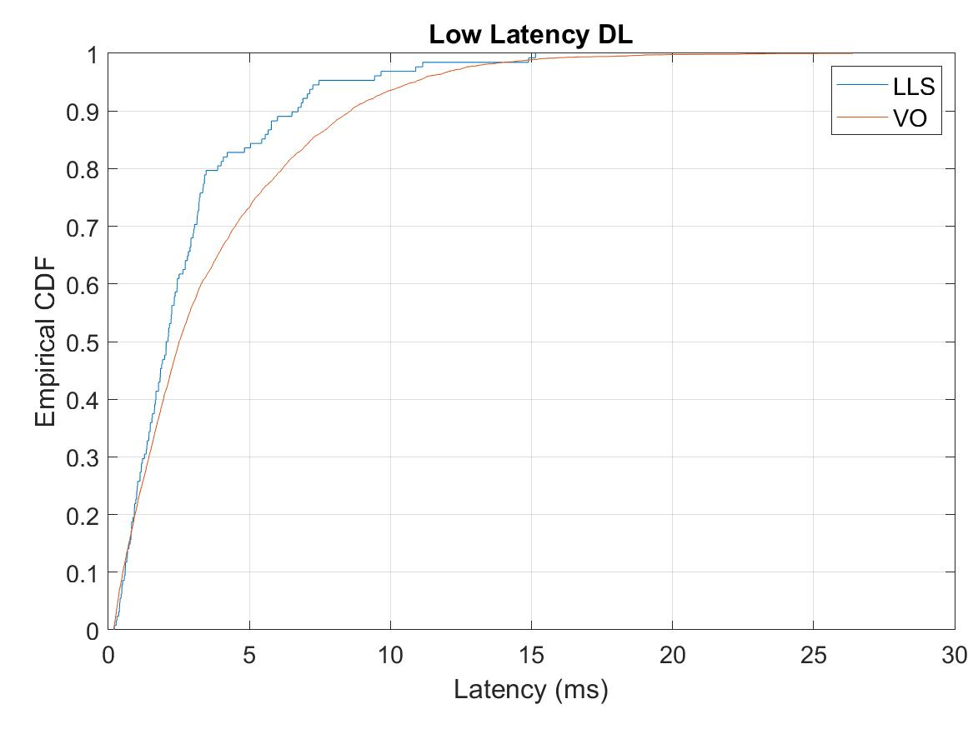
Scenario 2- Case 1 Results
LLS: low latency stream with protected windows
VO: low latency as AC_VO (no protected windows)

Slide 29
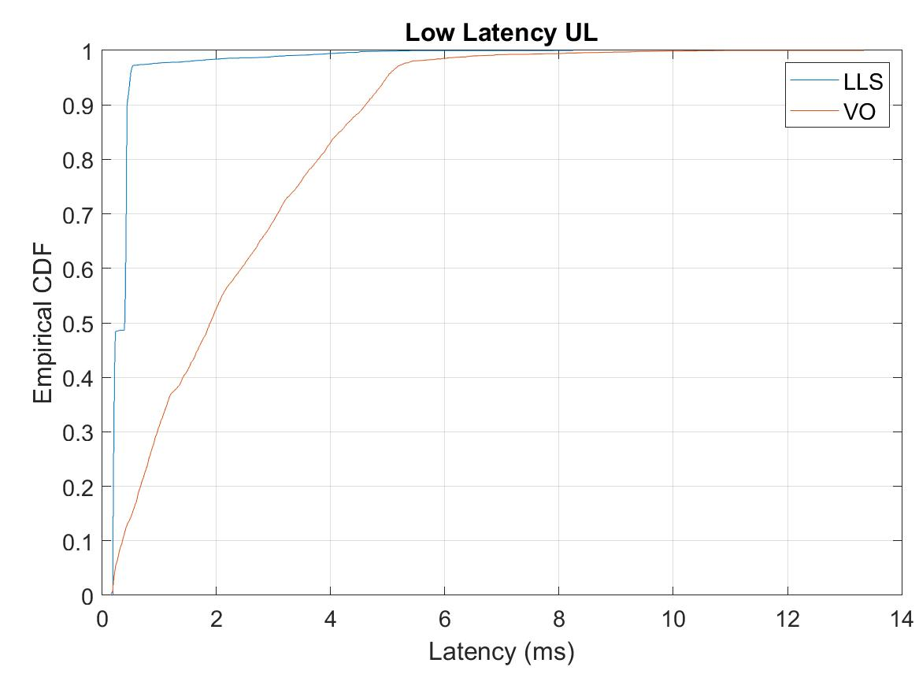
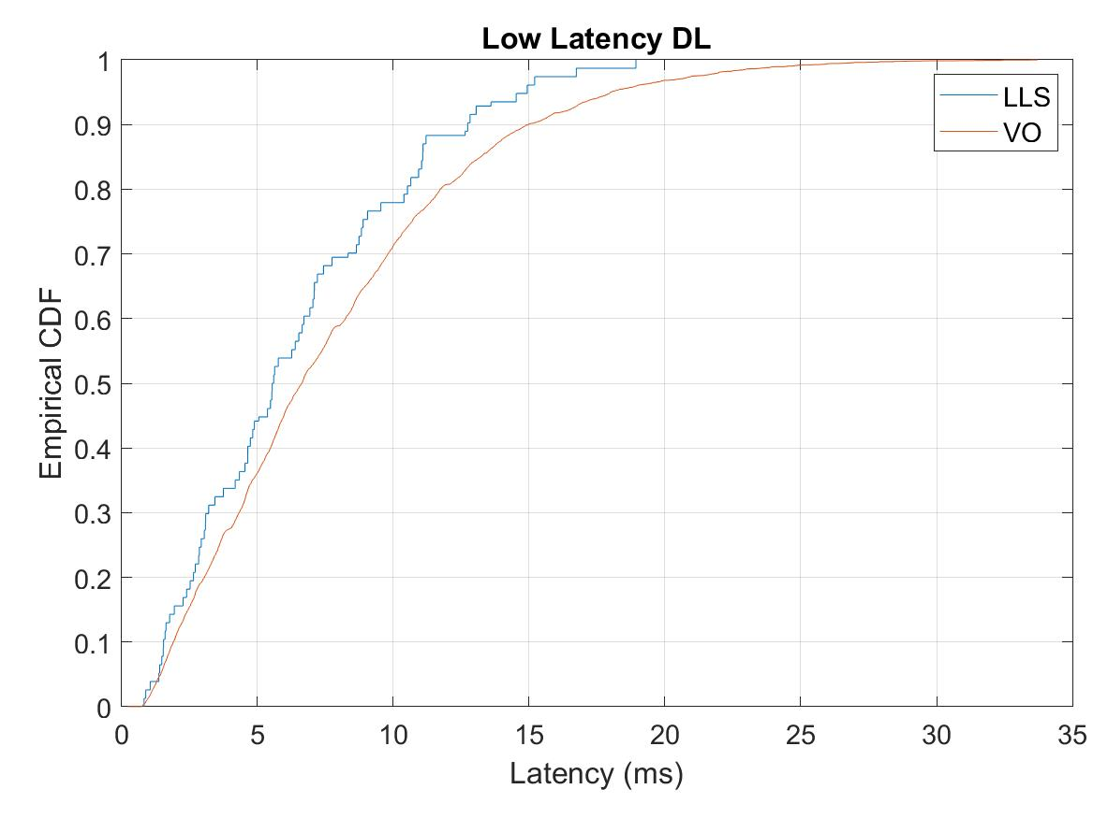
Scenario 2 - Case 2 Results
LLS: low latency stream with protected windows
VO: low latency as AC_VO (no protected windows)

