Slide 1
Low latency service in 802.11be
Date:
Authors:

Slide 2
Introduction
This presentation proposes a framework to enable a low worst case latency service in 802.11be
Proposed approach and scope:
  11be can define a low latency service that provides controlled worst case latency and jitter for the packets belonging to admitted time-sensitive traffic streams
  Existing and/or new features (e.g. triggered access, multi-link, multi-channel) can be used to deliver the service
  This proposal does not depend on specific features, but focuses on minimal requirements and spec changes to make the low latency service available in 802.11be

Slide 3
Low Latency Service Definition
A service provided to a higher layer traffic stream that prioritizes and delivers MSDUs within a worst case latency budget with a given packet delivery ratio (PDR)
  e.g. 99.9% of the packets are delivered within a 2 msec worst case latency
Requirements for using and providing the service:
  In order to use the service, the higher layer must provide the low latency traffic specification during service negotiation
    E.g. Max packet size, inter-arrival time, burst size, jitter, and expected PDR
  802.11 admission control must be used to request and accept/deny the service
  The decision on whether the service can be supported is implementation specific
  The service may be terminated if the traffic stream does not conform with the profile provided during service negotiation

Slide 4
Low Latency Service (use case example)
Gaming applications (STAs) trigger a low latency service request with their requirements
The AP decides whether it can serve the traffic streams according to the requested traffic stream
If accepted, the gaming traffic is classified, prioritized and receives a low latency experience
 | Max MSDU | SI | LB | Reliability
UL | 30B | 30 ms | 10 ms | 99.9%
DL | 500B | 30 ms | 10 ms | 99.9%

Slide 5
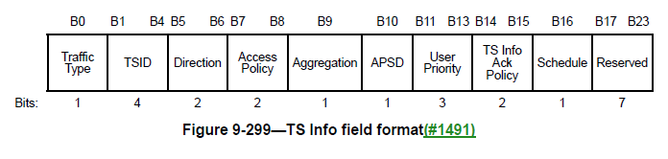
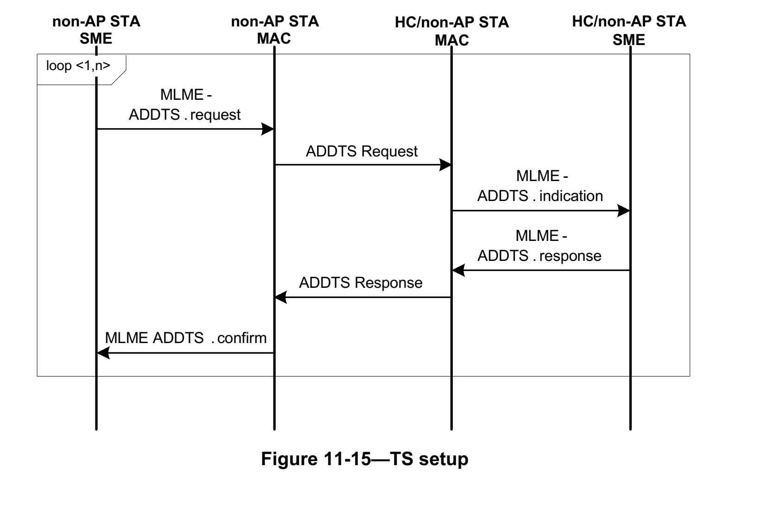
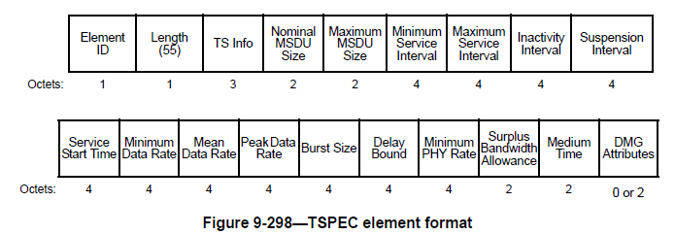
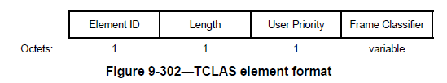
Existing ADDTS Request/Response + TCLAS
STA ➔AP: ADDTS Request[TSPEC, TCLAS]
AP ➔ STA : ADDTS Response[Status, TSPEC, TCLAS]
(Accept/Reject)
Once a TS is set up using ADDTS Request/Response with TSPEC+TCLAS, the frames can be classified and inserted in the corresponding EDCA queues.
The current TSPEC has more parameters than required
A TSPEC with minimal requirements for a low latency service could be defined

Slide 6
Spec changes required for the low latency service
New ADDTS primitives in the context of a low latency service and requirements for delivering the service
  Once a traffic stream is admitted, the traffic stream is prioritized to meet requirements (e.g. worst case latency with a given PDR)
  If the network cannot meet the requirements, it can terminate the service
  It is implementation specific what capabilities are used to deliver the service
TSPEC definition can be enhanced with minimal set of parameters to describe a low latency service request
  Max MSDU size, burst size, Min SI, latency bound, jitter, PDR (packet delivery ratio)
  TCLAS can be reused for traffic classification

Slide 7
Low latency traffic requirements
Low latency parameters to describe a traffic stream:
  Max MSDU Size: Maximum size of MSDU
  Burst size: Maximum aggregate size MSDUs that arrive within a service interval
  Min Service Interval: requested minimal periodicity of service or min MSDU interarrival time
  Latency bound: Maximum time required for successful delivery of the MSDU/A-MPDU (from MAC-SAP to MAC-SAP)
  PDR (Reliability): Expected packet delivery ratio within the latency bound.
  Jitter: expected variation in latency

Slide 8
Further MAC enhancements for Low Latency Service
Ultimately, the AP decides if and how the low latency service can be delivered
  802.11be features that reduce latency can be leveraged to implement the service, e.g., wider bandwidth, multi-link/channel, multi-AP, etc.
  TSN features can help provide accurate time-aware delivery and integrate with Ethernet TSN
OBSS considerations
  In managed scenarios, OBSS should have minimal impact on the service
  The AP should monitor the BSS/channel activities and decide whether OBSS may impact the service
  The AP may choose to terminate the service or adapt the BSS operation to minimize the impact of OBSS (all is implementation specific)

Slide 9
Feasibility of a 802.11 low latency service
Low worst case latencies for deterministic time-sensitive traffic can be provide with high reliability using existing 802.11 capabilities under managed network deployments
  Simulations in [19-1287r1] show that 1msec worst case latency and 99.999% can be achieve with a 802.11ax triggered based access, 20 MHz channel in a managed network
New features in 802.11be can potentially improve worst case latency
  E.g. higher bandwidth, multi-link, multi-channel, TSN features (time-aware scheduling, preemption) …

Slide 10
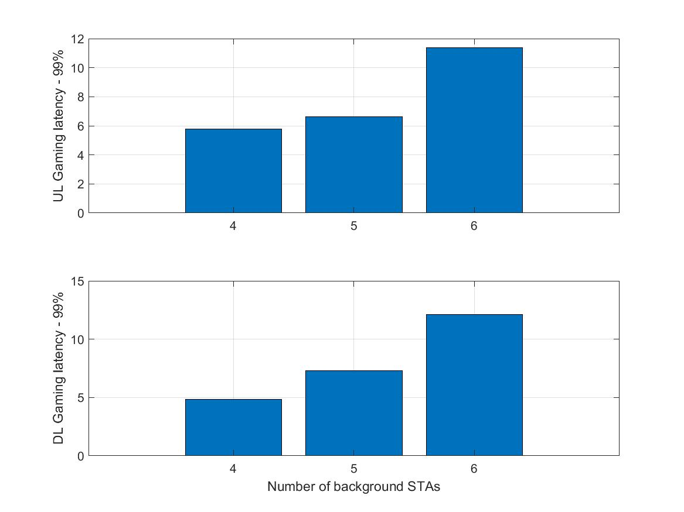
Low latency service under OBSS
Latency (99th percentile) for gaming traffic with background traffic and OBSSs
Assumptions:
802.11ax trigger based access with traffic classification and priority scheduling for low latency service packets
5 BSS (neighboring townhouses – two story) – 2 gaming STAs in the central house
Single AP (80 MHz) per BSS (SISO)
2 channels are used with BSS colloring
Traffic:
  Real cloud game traffic: UL (game control) +DL streaming (10 Mbps)
  Background: 2 Mbps CBR per STA
99% of the gaming packet are delivered under 10 msec (mostly around 5-6 msec) with up to 5 Background STAs
The BSS can decide if the service is feasible given its capabilities, deployment, and network conditions

Slide 11
Motivation for a low latency service interface
802.11 has no clear definition of a low latency service
  802.11 defines admission control procedures (e.g. ADDTS Request/Response), but
  there are no data delivery expectations including worst case latency and reliability (PDR)
5G URLLC mode has a clear message on how low latency services are required and provided:
  There is no upfront guarantee that a 5G UE can receive URLLC service for a given latency/reliability
  Admission control is required and implementation specific algorithms (e.g. scheduling) are needed
  But there is a perception in the general public, that only 5G URLLC can provide a low latency service
Defining a low latency service in 802.11be will enable implementation to decide whether such service can be provided depending on the deployment and use cases

Slide 12
Conclusions
This presentation describes a low latency service for 802.11be
The proposed low latency service can include
  Requirements for accessing the service (e.g. traffic profile specification and policing)
  Minimal spec requirements for providing the service
    Admission control enhancements and traffic stream classification
The low latency service will enable 802.11be solution providers to offer an important and required service for time-sensitive applications

Slide 13
Straw Poll (1)
Do you agree that 802.11be shall define a low latency service including:
  Low latency traffic stream requirement specification as input
  Admission control and traffic classification requirements for providing the service
  Decision on whether the service can be provided is implementation dependent
  The low latency service may be provided with any combinations of MAC/PHY capabilities that help ensure low worst case latency and jitter

