Slide 1
Multi-link Aggregation: Synchronized PPDUs on Multiple Links
Date: 2020-03-16
Authors:
Name | Affiliation | Address | Phone | Email
Insun Jang | LG Electronics | 19, Yangjae-daero 11gil, Seocho-gu, Seoul 137-130, Korea |  | insun.jang@lge.com
Jinsoo Choi |  |  |  | js.choi@lge.com
Jeongki Kim |  |  |  | jeongki.kim@lge.com
Sungjin Park |  |  |  | allean.park@lge.com
Taewon Song |  |  |  | taewon.song@lge.com
Namyeong Kim |  |  |  | namyeong.kim@lge.com

Slide 2
Introduction
Some contributions have addressed the concept of multi-link aggregation [1]-[8], i.e., Transmission of Synchronized PPDUs on multiple links
In this contribution, we discuss why and how non-AP MLDs should transmit synchronized PPDUs and announce relevant capability
  Especially, the capability is generalized to the sharing capability within MLD

Slide 3
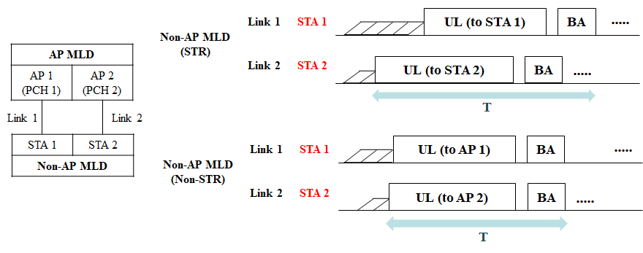
Overview of Multi-link Aggregation
Multi-link Aggregation is a way to increase per-MLD throughput as well as decrease per-MLD latency as the most important requirements in 11be
  Basically, we can observe the aggregation in case of simultaneous TX/RX (STR) and non-STR
    STR means that to transmit and receive simultaneously is allowed on multiple links
    Non-STR means STR is restricted due to several reasons (e.g., power leakage)
Synchronized PPDUs

Slide 4
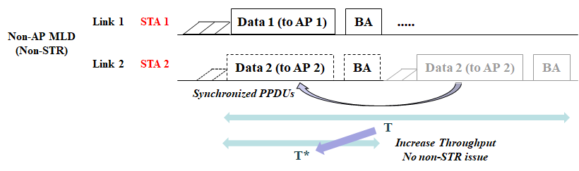
Why Synchronized PPDUs?
Synchronized PPDUs can be a solution to increase per MLD throughput, especially in case of non-STR
  It also can resolve issues of non-STR on some level
Even for STR, it may be good by mitigating the randomness of back-off

Slide 5
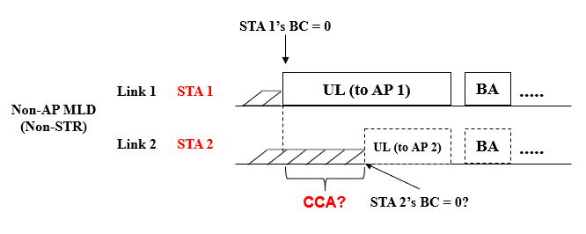
How to Aggregate on Non-AP MLD Side
Considering independent EDCA on each link
  After obtaining a TXOP on a link, what does happen on the other link(s)?
We have several issues,
  ED-based CCA on link 2 is proper?
    On link 2, other transmissions (e.g., OBSS) as well as self-interference
      EDCA wouldn’t be meaningful, eventually indicating always like BUSY channel
    Can STA 2 know self-interference channel/power level?
      If so, it already may be STR
      It is hard to distinguish between the self-interference and other signals
    Consequently, STA 2 just suspends EDCA (including CCA)

Slide 6
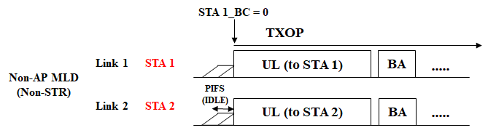
How to Aggregate on Non-AP MLD Side
(Cont’d)
Some contributions [1]-[7] already have proposed how to transmit synchronized PPDUs quickly on multiple links
Mainly, on non-AP MLD side, xIFS-based Aggregation (e.g., PIFS)
  It is motivated by wide channel access [9] in legacy system; therefore, it can transmit synchronized PPDUs quickly to increase throughput
    The PPDUs may have a certain margin for starting/ending times [8]
  However, we need to consider several issues, i.e.,
    An STA (STA 1) needs to trigger the transmission of other STAs (STA 2) in the same MLD tightly/quickly
    It ignores BCs (STA 2) for other links (link 2), which may impact on single-link STAs operating on the links (link 2)

Slide 7
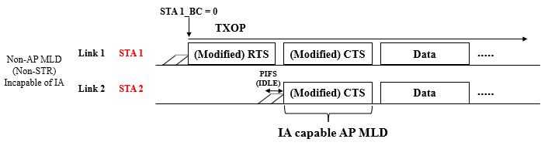
Aggregation Capability Announcement
If an STA of an MLD can trigger the transmission of other STAs in the MLD immediately after the STA obtains a TXOP, we consider it as the STA capable of Immediate Aggregation (IA)
MLD with IA Capa. can be helpful to MLDs incapable of IA
  For example, a non-AP MLD incapable of IA can request AP MLD IA [4]
  Non-AP MLD needs to know if AP MLD has IA capability
Therefore, we propose “an MLD can announce whether it is capable immediate aggregation”

Slide 8
Generalizing IA Capability
First of all, IA capability is the capability based on whether STAs of an MLD can share PHY/MAC status (e.g., TXOP/PPDU length) with each other
Some other operations already agreed/to be agreed also need the information sharing between STAs of MLD (e.g., acknowledgement of other link(s), PPDU end alignment)
Consequently, as a high-level concept, the sharing capability needs to be announced and then negotiated in order to use the operations correctly
  Therefore, we propose “an MLD can announce whether STAs of an MLD can share TBD information with each other”

Slide 9
How to Support Immediate Aggregation
We discuss methods to mitigate the impact of aggregation “Before and After aggregation”
Before Aggregation,
  We may restrict the aggregation
  For example, MLDs can negotiate the maximum number or a set of links to be aggregated, during setup or in the beginning of TXOP, or decrease a TXOP limit
After Aggregation
  We may adjust the remaining BC or current CW
    For example, maintaining BC/CW [2] regardless of successful transmission
In the end, IA could be applied under TBD restricted condition

Slide 10
Summary
In this contribution, we discussed why and how non-AP MLDs should transmit synchronized PPDU and announce relevant capability
  Synchronized PPDUs can be a solution to increase per MLD throughput, especially in case of non-STR
To transmit synchronized PPDUs, we can use xIFS-based Aggregation (similar to wide channel access)
  We need to consider several issues, i.e.,
    Announcement of Immediate aggregation (IA) capability
    How to mitigate the impact on single-link STAs
We also generalized about the IA capability, i.e., sharing capability
  Whether STAs of an MLD can share the information (e.g., PHY/MAC status) with each other

Slide 11
SP #1
Do you agree that 11be shall allow the following multi-link operation?
  When at least one STA of non-AP MLD with constraints transmits a PPDU, the other STA(s) defers (defer) the channel access without performing CCA during the transmission of PPDU
Y/N/A

Slide 12
SP #2
Do you agree that an MLD can inform a peer MLD of the capability of whether STAs of the MLD can exchange the information?
Y/N/A

Slide 13
SP #3
Do you agree that 11be shall allow the following multi-link operation?
  When an STA of an MLD obtains a TXOP, it triggers the transmission of other STA(s) of the MLD based on CCA during an interval of xIFS (e.g., PIFS) immediately preceding the start of the TXOP
    Condition of applying the operation is TBD
Y/N/A

Slide 14
SP #4
Do you agree that an MLD can announce the following capability?
  When an STA of an MLD obtains a TXOP, it can trigger the transmission of other STA(s) of the MLD based on CCA during an interval of xIFS (e.g., PIFS) immediately preceding the start of the TXOP
Y/N/A

Slide 15
References
[1] 802.11-19/1144r6 Channel Access for Multi-link Operation
[2] 802.11-19/1505r2 Multi-link TXOP Aggregation Considerations
[3] 802.11-19/1927r1 Multi-Link Operation Simulation Methodology
[4] 802.11-20/0026r0 MLO: Sync PPDUs
[5] 802.11-20/0081r1 MLO-Synch-Transmission
[6] 802.11-20/0291r0 MLO Asynchronize and synchronize operation discussions
[7] 802.11-20/0487r0 Multiple Link Operation Follow Up
[8] 802.11-19/1305r0 Synchronous Multi-Link Transmission
[9] IEEE P802.11REVmd/D3.0

