Slide 1
Multi-link Aggregation: Synchronized PPDUs on Multiple Links
Date: 2020-03-16
Authors:
Name | Affiliation | Address | Phone | Email
Insun Jang | LG Electronics | 19, Yangjae-daero 11gil, Seocho-gu, Seoul 137-130, Korea |  | insun.jang@lge.com
Jinsoo Choi |  |  |  | js.choi@lge.com
Jeongki Kim |  |  |  | jeongki.kim@lge.com
Sungjin Park |  |  |  | allean.park@lge.com
Taewon Song |  |  |  | taewon.song@lge.com
Namyeong Kim |  |  |  | namyeong.kim@lge.com

Slide 2
Introduction
Some contributions have addressed the concept of multi-link aggregation [1]-[4], i.e., Transmission of Synchronized PPDUs on multiple links
In this contribution, we discuss why and how MLDs should transmit synchronized PPDU

Slide 3
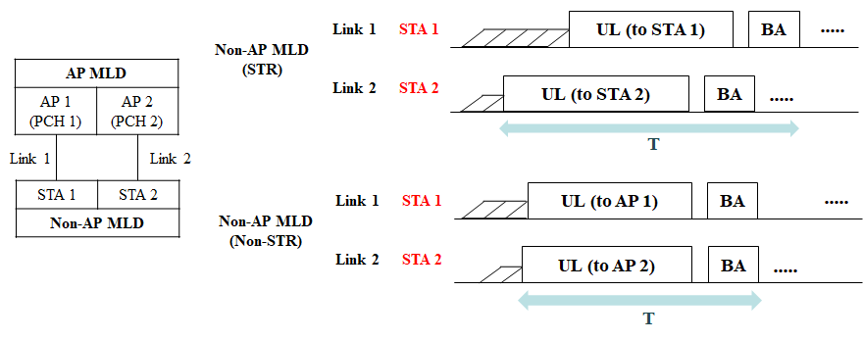
Overview of Multi-link Aggregation
Multi-link Aggregation is a way to increase per-MLD throughput as well as decrease per-MLD latency as the most important requirements in 11be
Basically, we can observe the aggregation in case of simultaneous TX/RX (STR) and non-STR
STR means that to transmit and receive simultaneously is allowed on multiple links
Non-STR means STR is restricted due to several reasons (e.g., power leakage)
Synchronized PPDUs

Slide 4
Why Synchronized PPDUs?
Synchronized PPDUs can be a powerful solution to increase per MLD throughput, especially in case of non-STR
It also can resolve issues of non-STR on some level
Even for STR, it may be good by mitigating the randomness of back-off

Slide 5
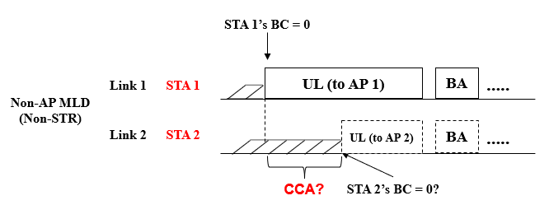
How to Aggregate
Assuming independent EDCA,
We have several issues,
ED-based CCA on link 2 is proper?
On link 2, other transmissions (e.g., OBSS) as well as self-interference
Can STA 2 know self-interference channel/power level?
If not, STA 2 can just suspend EDCA

Slide 6
How to Aggregate (Cont’d)
Some contributions [1]-[4] already have proposed how to transmit synchronized PPDUs quickly on multiple links
xIFS-based Aggregation (e.g., PIFS)
It is motivated by wide channel access [5] in legacy system; therefore, it can transmit synchronized PPDUs quickly to increase throughput
The PPDUs may have a certain margin for starting/ending times [6]
However, we need to consider several issues, i.e.,
An STA (STA 1) needs to trigger the transmission of other STAs (STA 2) in the same MLD tightly/quickly
It ignores BCs (STA 2) for other links (link 2), which may impact on single-link STAs operating on the links (link 2)

Slide 7
Aggregation Capability Announcement
If an STA of an MLD can trigger the transmission of other STAs in the MLD immediately after the STA obtains a TXOP, we consider it as the STA capable of Immediate Aggregation (IA)
MLD with IA Capa. can be helpful to MLDs incapable of IA [4]
For example, Using modified RTS/CTS if a non-AP MLD is incapable of IA [4]
Non-AP MLD needs to know if AP MLD has IA capability
Therefore, we propose “an MLD can announce whether it is capable immediate aggregation”

Slide 8
How to Support Immediate Aggregation
We discuss methods to mitigate the impact of aggregation “Before and After aggregation”
Before Aggregation,
We may restrict the aggregation
For example, MLDs can negotiate the maximum number or a set of links to be aggregated, during setup or in the beginning of TXOP, or decrease a TXOP limit
After Aggregation
We may adjust the remaining BC or current CW
For example, maintaining BC/CW [2] regardless of successful transmission
Notes:
TXOP안에 Aggregation 수? TXOP limit?

Slide 9
Summary
In this contribution, we discussed why and how MLDs should transmit synchronized PPDU
Synchronized PPDUs can be a powerful solution to increase per MLD throughput, especially in case of non-STR
To transmit synchronized PPDUs, we can use xIFS-based Aggregation (similar to wide channel access)
We need to consider several issues, i.e.,
Immediate aggregation capability
How to mitigate the impact on single-link STAs

Slide 10
SP #1
Do you agree that 11be shall allow the following multi-link operation?
When an STA of an MLD obtains a TXOP, it triggers the transmission of other STA(s) of the MLD under TBD condition
xIFS
Specific!
Y/N/A

Slide 11
SP #2
Do you agree that an MLD that supports multiple links can announce the following capability?
When an STA of the MLD obtains a TXOP, it can trigger the transmission of other STA(s) of the MLD immediately
Y/N/A

Slide 12
References
[1] 802.11-19/1144r6 Channel Access for Multi-link Operation
[2] 802.11-19/1505r2 Multi-link TXOP Aggregation Considerations
[3] 802.11-19/1927r1 Multi-Link Operation Simulation Methodology
[4] 802.11-20/0026r0 MLO: Sync PPDUs
[5] IEEE P802.11REVmd/D3.0
[6] 802.11-19/1305r0 Synchronous Multi-Link Transmission

