Slide 1
Method for Handling Constrained MLD
Date: 2020-03-16
Authors:
Name | Affiliation | Address | Phone | Email
Insun Jang | LG Electronics | 19, Yangjae-daero 11gil, Seocho-gu, Seoul 137-130, Korea |  | insun.jang@lge.com
Jinsoo Choi |  |  |  | js.choi@lge.com
Jeongki Kim |  |  |  | jeongki.kim@lge.com
Sungjin Park |  |  |  | allean.park@lge.com
Taewon Song |  |  |  | taewon.song@lge.com
Namyeong Kim |  |  |  | namyeong.kim@lge.com

Slide 2
Introduction
Many contributions [1]-[9] have handled the operation of Non-AP MLD with constraints
  The constraints mean that simultaneous transmission and reception (STR) is restricted over multiple links
    We call the constraints non-STR
In this contribution, we propose methods which can prevent non-AP MLD from experiencing constraint-related issues on the non-AP MLD side
  Assuming that an AP MLD does not have the constraints

Slide 3
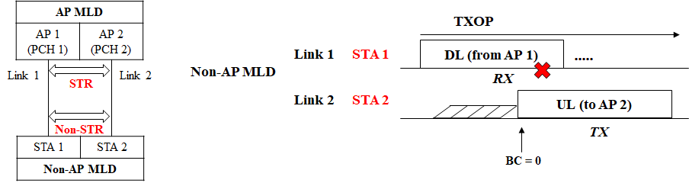
Recap: Non-AP MLD’s Operation with Constraint [2]
If STA 2 transmits any frame on link 2 while RX (DL) on a link 1, the DL frames on link 1 cannot be received correctly
Example of Operation
  If a non-AP MLD can ensure that a receiving frame is intended to itself on a link, the non-AP MLD does not transmit a frame on the other link; Otherwise, the non-AP MLD can transmit a frame on its link
    How to ensure can be TBD or implementation issue

Slide 4
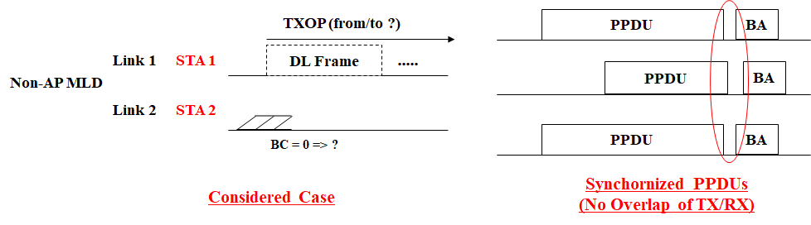
Discussion on a Case
Before making sure of the TXOP holder/responder of DL frame on link 1, the non-AP MLD may obtain a TXOP on link 2
  Is it Common or Rare case?
Option 1: If the case is rare and trivial, we can ignore the issue
  It may be an implementation issue
Option 2: If not (e.g., common or important), we need to handle the issue
  According to option 2, we propose the concept of primary link (refer to slide 10/11)
Regardless of Option 1/2, we need to find ways for the transmission synchronized PPDUs on ML due to non-STR [3]-[9]
  That will be focused on

Slide 5
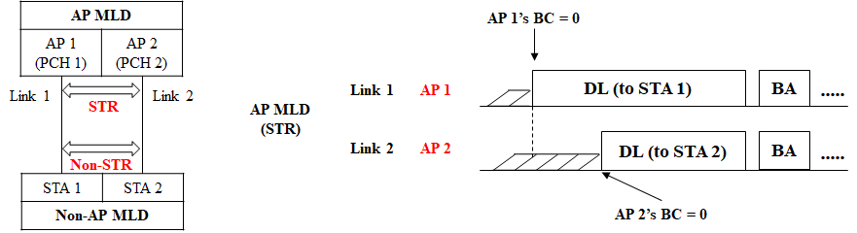
Methods on AP MLD Side
Basically, an AP MLD performs independent EDCA channel access on each link without Non-STR
After obtaining on a TXOP on at least a link for a constrained non-AP MLD
  If an AP MLD obtains a TXOP and intends to transmit (schedule) a frame to the constrained non-AP MLD on the other link(s), it aligns the end of frame with the end of transmitting frame (maybe with margin [3])
It seems to be straightforward for avoiding overlapped TX/RX, but other solutions can be designed (e.g., Delayed BA)

Slide 6
Methods on Non-AP MLD Side
Likewise, a non-AP MLD performs independent EDCA channel access on each link with Non-STR
  Unlike AP MLD, it is difficult for non-AP MLD to control the constraints (transmit synchronized PPDUs) (e.g., end alignment)
We need to design methods to control the constraints 1) by itself (called Non-AP initiated) and 2) with assistance of AP MLD (called AP-assisted)
  It is important to increase UL throughput even for non-STR as 11be requirements by using multiple links simultaneously

Slide 7
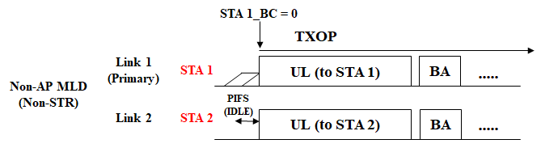
Non-AP-Initiated Method
Unlike AP MLD, it is difficult for non-AP MLD to transmit synchronized PPDUs
  Because while TX on a link, EDCA (including CCA) would be blocked (suspended) due to the self-interference
Therefore, Non-AP initiated method can use xIFS-based aggregation, motivated by wide channel access [10] in legacy
  It requires the immediate triggering and CCA inside the non-AP MLD
  It may impact on several points such as regulation, fairness; therefore, it needs to be allowed under TBD condition (i.e., restricted environments)
If a non-AP MLD cannot use this method, it can use the AP-assisted to synchronize PPDUs (next slide)

Slide 8
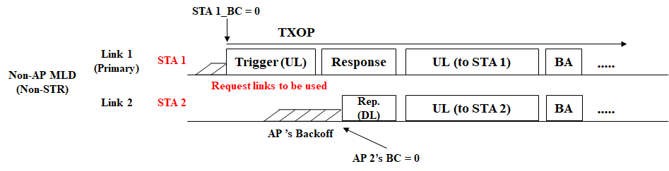
AP-assisted Method
Basically, AP doesn’t have the constraints; therefore a non-AP MLD can utilize the STR capability of AP MLD
  In other words, an STA of non-AP MLD may trigger the assistance of AP MLD in order to transmit synchronized PPDUs on its link and the requested other link(s)
Basic Operation: Sync. Request + Response (RTS/CTS-like)
  Non-AP MLD requests (triggers) the assistance of AP MLD including the information of links it wants to use
  AP MLD responds to the request on links possible among requested links
    It seems to be end alignment in DL (slide 5)
  The UL trigger can include requested links and TXOP on link 2 (AP 2)

Slide 9
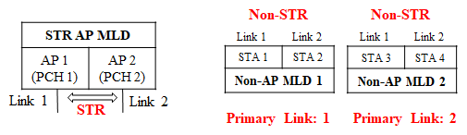
Handling the Option 2
Several proposals have addressed the issues
  Sharing Information and/or Suspending EDCA to identify a receiving frame [1], [2]
  If non-AP MLD is not capable of such sharing, those cannot be used
We can consider another approach not to make such situations in the first place, i.e., the concept of primary link performing EDCA
Basically, a primary link is assigned to each non-AP MLD
  An AP MLD does not have any primary link
  Primary link of each non-AP MLD can be different
  Especially, it is much more effective for a non-AP MLD incapable of sharing PHY/MAC status between STAs of the MLD

Slide 10
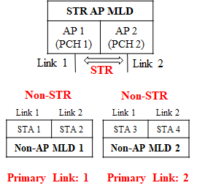
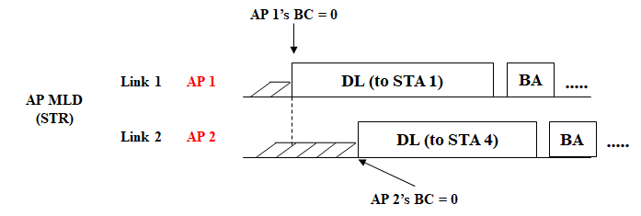
Discussion on Primary link
If we allow a non-AP MLD to have a primary link, it performs EDCA back-off on the assigned primary link only
  It can avoid the issue of option 2, completely, even for no sharing capability
  Non-AP MLD just obtains a TXOP on its primary link only; therefore, all methods mentioned previously can be applied
In addition, we need a rule: When obtaining on a TXOP on any links
  It does not transmit (schedule) a frame to a constrained non-AP MLD of which primary link is not the link
  Up to the scheduling of AP MLD

Slide 11
Summary
We proposed methods which can prevent non-AP MLD from experiencing constraint-related issues on the non-AP MLD side
In terms of AP MLD
  It can align the end frames in case of transmitting frames to the same non-AP MLD with constraints on multiple links
    Other solutions can be also used
In terms of Non-AP MLD
  It can use non-AP MLD initiated (e.g., xIFS based) and/or AP-assisted (utilizing AP’s STR capability)
We also propose the concept of primary link on non-AP MLD side if we’d like to avoid the non-STR issue, completely
  Especially, it is much more effective for a non-AP MLD incapable of sharing PHY/MAC status between STAs of the MLD

Slide 12
SP #1
Do you agree that 11be shall allow the following multi-link operation?
  When an STA of non-AP MLD with non-STR obtains a TXOP on a link, the STA can request an AP MLD the utilization of the other operating link(s) in order to transmit synchronized PPDUs using the requested links
    Detailed procedures and frames for the operation are TBD
Y/N/A

Slide 13
SP #2
Do you agree that 11be shall allow the following multi-link operation?
  When an STA of an MLD obtains a TXOP, it triggers the transmission of other STA(s) of the MLD based on CCA during an interval of xIFS (e.g., PIFS) immediately preceding the start of the TXOP
    Condition of applying the operation is TBD
Y/N/A

Slide 14
SP #3
Do you agree that 11be shall allow the following multi-link operation?
  A non-AP MLD with non-STR set one of the operating links to a primary link on which it performs a channel access
    The operation is performed under TBD condition (e.g., when the STAs of non-AP MLD cannot share PHY/MAC status between them)
Y/N/A

Slide 15
References
[1] 802.11-19/1405r7 Multi-Link Operation Channel Access Discussion
[2] 802.11-20/0014r1 Operation of Non-AP MLD with Constraints
[3] 802.11-19/1305r2 Synchronous Multi-Link Operation
[4] 802.11-20/0026r2 MLO: Sync PPDUs
[5] 802.11-20/0081r1 MLO-Synch-Transmission
[6] 802.11-20/0106r4 Follow up of discussion on multi-link operation
with leakage on non-AP MLD
[7] 802.11-20/0275r2 MLO: Need for sync PPDUs
[8] 802.11-20/0291r0 MLO Asynchronize and synchronize operation discussions
[9] 802.11-20/0487r0 Multiple Link Operation Follow Up
[10] IEEE P802.11REVmd/D3.0

