Slide 1
Method for Handling Constrained MLD
Date: 2020-03-16
Authors:
Name | Affiliation | Address | Phone | Email
Insun Jang | LG Electronics | 19, Yangjae-daero 11gil, Seocho-gu, Seoul 137-130, Korea |  | insun.jang@lge.com
Jinsoo Choi |  |  |  | js.choi@lge.com
Jeongki Kim |  |  |  | jeongki.kim@lge.com
Sungjin Park |  |  |  | allean.park@lge.com
Taewon Song |  |  |  | taewon.song@lge.com
Namyeong Kim |  |  |  | namyeong.kim@lge.com

Slide 2
Introduction
Some contributions [1]-[4] have handled the operation of Non-AP MLD with constraints
The constraints mean that simultaneous transmission and reception (STR) is restricted over multiple links
We call the constraints non-STR
In this contribution, we propose a method which can prevent non-AP MLD from *** constraint-related issues on the non-AP MLD side

Slide 3
Recap: Non-AP MLD’s Operation with Constraint
Constraint-related issue
If STA 2 transmits any frame on link 2 while RX (DL) on a link 1, the DL frames on link 1 cannot be received correctly
For example, if a non-AP MLD can ensure that a receiving frame is intended to itself on a link, the non-AP MLD does not transmit a frame on the other link; Otherwise, the STA can transmit a frame on its link
Several proposals have addressed the issues
Sharing Information and/or Suspending EDCA to identify a receiving frame [1], [2]
Aggregating multiple links or frame end alignment [3], [4]

Slide 4
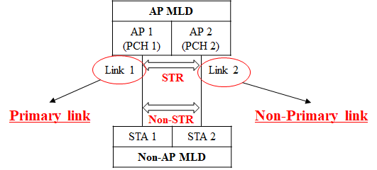
Another Approach
We can consider another approach not to make such situations in the first place
While an AP MLD (with STR) performs asynchronous channel access on enabled links [], a non-AP MLD with non-STR considers one link of the links as a primary link performing EDCA back-off
We call Links not primary link non-primary link

Slide 5
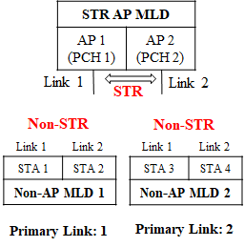
Primary Link on Non-AP MLD Side
Basically, a primary link is assigned to each non-AP MLD
An AP MLD does not have a primary link
Primary link of each non-AP MLD can be different
그림 추가
Non-AP MLD performs EDCA back-off on the assigned primary link only

Slide 6
Channel Access Rules
Basically,
AP MLD Side
Scheduling
Non-AP MLD Side
Existing approach

Slide 7
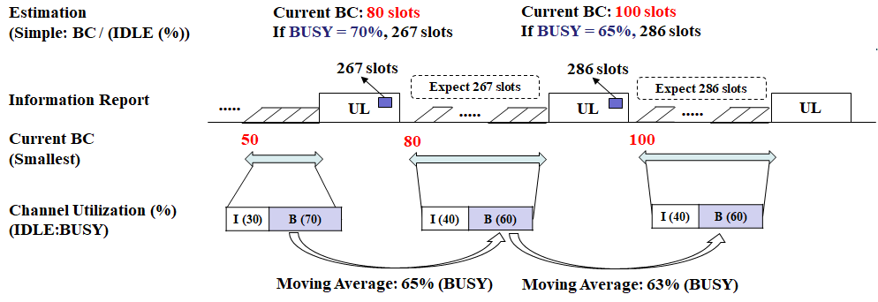
Discussion (Compensation)
Non-AP MLD estimates the remaining number of slots until the next UTT based on the currently smallest BC and channel utilization, and transmits the information to AP MLD
We use a BUSY ratio during the back-off for current transmission as Channel utilization
BUSY ratio is updated by using the moving average

Slide 8
Summary
We proposed an information report which can be helpful to avoid happening of constraint-related issues as much as possible
The reported information can include
Current Back-off count (BC) and Channel Utilization at non-AP STA side, if an AP MLD estimates UL transmission time (UTT)
Information of estimated UTT, if a non-AP MLD estimates UTT
The information is reported by STAs of non-AP MLD with constraint only via solicited or unsolicited method

Slide 9
SP #1
Do you support that 11be defines mechanism(s) for a non-AP MLD to report the information for handling constraints to simultaneously transmit and receive on a pair of links
Specific information and method(s) to report are TBD
Y/N/A

Slide 10
References
[1] 802.11-19/1405r7 Multi-Link Operation Channel Access Discussion
[2] 802.11-20/0014r1 Operation of Non-AP MLD with Constraints
[3] 802.11-20/0026r0 MLO: Sync PPDUs
[4] 802.11-20/0081r1 MLO-Synch-Transmission
[5] 802.11-19/1918r0 UL MU Efficiency Enhancement Using Multi-link
[6] IEEE P802.11REVmd/D3.0
[7] IEEE P802.11ax/D6.0

