Slide 1
Discussion on EHT Trigger based UL MU
Date: 2020-03-16
Authors:
Name | Affiliation | Address | Phone | Email
Insun Jang | LG Electronics | 19, Yangjae-daero 11gil, Seocho-gu, Seoul 137-130, Korea |  | insun.jang@lge.com
Jinsoo Choi |  |  |  | js.choi@lge.com
Jeongki Kim |  |  |  | jeongki.kim@lge.com
Sungjin Park |  |  |  | allean.park@lge.com
Taewon Song |  |  |  | taewon.song@lge.com
Namyeong Kim |  |  |  | namyeong.kim@lge.com

Slide 2
Introduction
Trigger-based UL MU is one of main features in 11ax
Also, 11be TG has agreed to allow main PHY features such as 320MHz / Multi-RU Aggregation as well as main MAC features such as multi-link
In this contribution, we focus on Trigger based UL MU supporting 240/320MHz and Multi-RU Aggregation

Slide 3
Features To Be Considered
We focus on enabling and enhancing trigger based UL MU by supporting the following expansion (11ax -> 11be)
Feature | 11ax | 11be
Max. Bandwidth (Focus) | 160MHz | 240/320MHz
Max. Spatial Stream | 8 | 16
RU Assignment to an STA (Focus) | Only One RU | One or more RU(s)
Number of Links | Only Single Link | One or more Link(s) (with STR*/non-STR*)
*Simultaneous TX/RX (STR)
To transmit and receive simultaneously are allowed on multiple links
If not allowed, we call it non-STR

Slide 4
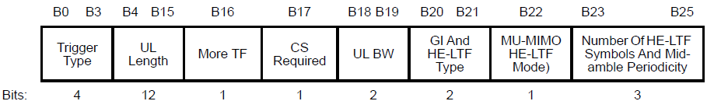
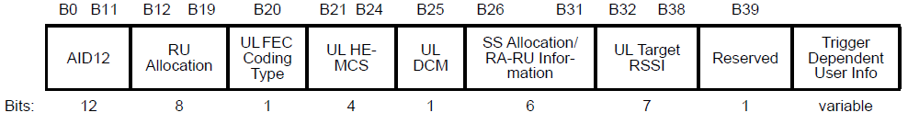
Design of EHT Trigger Frame
We can expand/modify a existing HE Trigger Frame in order to design an EHT Trigger frame supporting 240/320MHz and Multi-RU aggregation
  Example of Expansion from 11ax Trigger frame
240/320MHz
240/320MHz
16SS

Slide 5
UL Bandwidth and RU Allocation
To support 240/320MHz, the size of UL BW field and RU Allocation field needs to increase
  UL BW in Common info field: 2 bits -> 3 bits (+1bit to indicate 240/320MHz)
  RU Allocation in User info field: 8 bits -> 9 bits, (+1bit to indicate the locations of additional secondary channels including 80MHz segments)
Example
UL BW Value | Description
0 | 20 MHz
1 | 40 MHz
2 | 80 MHz
3 | 80+80 MHz or 160 MHz
4 | 80+160 MHz or 240MHz
5 | 160 + 160 MHz or 320MHz
6-7 | Reserved
RU Allocation (1st/2nd bit) Value | Description
00 | P80
00, 01 | P80, S80
00, 01, 10 | P80, S80, S80-1*
00, 01, 10, 11 | P80, S80, S80-1*, S80-2**
*Secondary 160’s upper 80MHz, **Secondary 160’s lower 80MHz

Slide 6
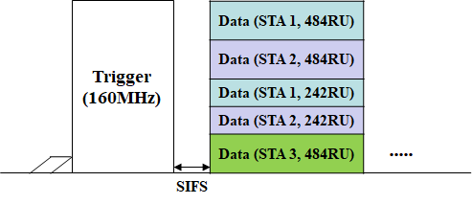
Multiple RU Allocation for UL MU
Multiple RU allocated to an STA for UL may impact on the following
  Signaling for RU allocation
  CCA based UL MU Response (almost for Large RU aggregation)
CCA (if required)

Slide 7
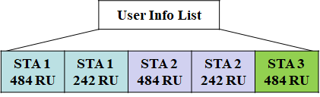
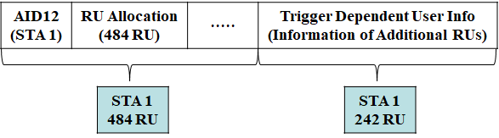
  Signaling for Multiple RU allocation
Option 1: Consecutive indication for Same STA
  Can reduce decoding overhead, Simple
  However, if there are many information in common, high signaling overhead
    For example, same MCS/SS for 484RU, 242RU allocated to STA 1
Option 2: Using Trigger Dependent User Info
  Information of additional RUs is included
  Can reduce signaling overhead for common information

Slide 8
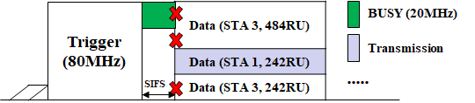
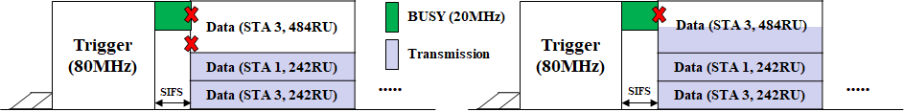
UL MU Response
Like 11ax, ED-based CCA can be performed for 20MHz sub-channels regarding allocated RUs
Option 1: Follow the rules of 11ax (Preferred)
  Simple, but depending on environments, the allocated RUs can be wasted
Option 2: Provide More flexibility
  However, Additional information needs to be added to EHT TB PP여
  High implementation complexity

Slide 9
Summary
  We discussed Trigger based UL MU supporting the EHT PHY/MAC features, especially, i.e.,
  240/320MHz
  Multiple RU aggregation
In terms of 240/320MHz, we focused on
  UL BW subfield
  RU Allocation subfield
In term of multiple RU aggregation, we focused on
  Signaling for RU allocation
  CCA based UL MU Response

Slide 10
SP #1
Do you agree to add the following to SFD?
  EHT Trigger frame carries a 4 bits UL BW subfield and 9 bits RU Allocation subfield
    Bit 0 and Bit 1 of RU Allocation subfield indicates the allocated RU is located at which 80MHz segment
Y/N/A

Slide 11
SP #2
Do you agree to add the following to SFD?
  EHT Trigger frame carries an indication of allocating multiple RUs to an STA using TBD method
Y/N/A

Slide 12
SP #3
Do you agree to add the following to SFD?
  When required to sense the medium before its UL MU transmission in response to an EHT trigger frame, if an STA detects the 20MHz channels containing one or more allocated UL RU(s) are not all idle, the STA shall not transmit anything in the allocated UL RU(s)
Y/N/A

Slide 13
References
[1] 802.11-19/1144r6 Channel Access for Multi-link Operation
[2] 802.11-19/1405r7 Multi-Link Operation Channel Access Discussion
[3] 802.11-20/0014r1 Operation of Non-AP MLD with Constraints
[4] 802.11-20/0026r0 MLO: Sync PPDUs

