Slide 1
MLO: Link Switching method
Date: 2020-03-09
Authors:
Name | Affiliations | Address | Email
Namyeong Kim | LG Electronics | LG Seocho R&D Campus, Korea | namyeong.kim@lge.com
Jeongki Kim |  |  | jeongki.kim@lge.com
Insun Jang |  |  | insun.jang@lge.com
Taewon Song |  |  | taewon.song@lge.com
Sungjin Park |  |  | allean.park@lge.com
Jinsoo Choi |  |  | js.choi@lge.com

Slide 2
Overview
Some contributions have discussed about Link switching.
Link switch operation would be one of solutions to avoid traffic congestion in multi-link [1].
AP can provide cross-link information to assist single radio STA MLDs that are transitioning to another link for efficient load balancing [2].
If a STA of non-AP MLD switches to an AP of AP MLD, the STA may perform link re-setup process with the AP of associated AP MLD.
NOTE: We only consider the link switching case where a STA moves to collocated AP of associated AP MLD.
In this contribution, we discuss link re-setup and provide available link re-setup processes after link switching.

Slide 3
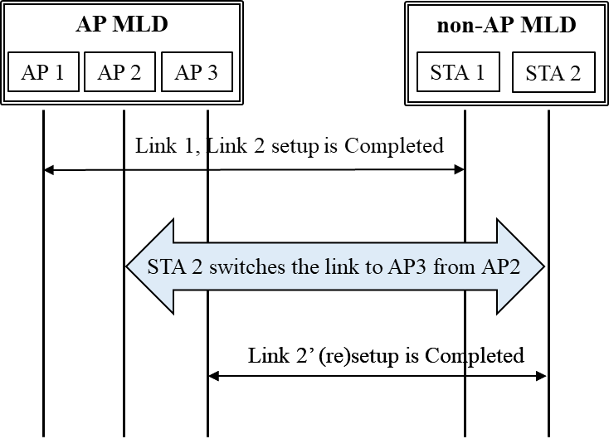
Link switching process
STA of non-AP MLD may switch the own operating link to another AP of associated AP MLD.
To improve more performance, the STA may select new operating link to switch considering cross-link condition (e.g. BSS load).
The frame for link switching is TBD. The frame may carry link identifier or TID mapping info, so on.

Slide 4
Link re-setup process after link switching
When a STA of non-AP MLD switches its own operating link to another AP of associated AP MLD, the STA may perform link re-setup process.
In existing spec., a STA which changes the own operating link (re)associates with new AP for link re-setup.
In this contribution, we propose available link re-setup processes after link switching.

Slide 5
Link re-setup process: Case 1
The link re-setup using reassociation frame after link switching.
After frame exchange for link switching, the STA can exchange the all attributes for link re-setup with the new selected AP of associated AP MLD.
NOTE: the frame for link switching can carry link identifier, TID mapping info, and so on.
In this case, the STA may perform link re-setup after link switching without additional consideration.

Slide 6
Link re-setup process: Case 2
The link re-setup with link switching using reassociation frame
A STA can request to switch the operating link using reassociation frame.
For this, we need to add some element or field regarding link switching (e.g. Link identifier, TID mapping info, etc.)in reassociation frame.
Compared to Case 1, link switching as well as link re-setup can be performed through a single exchange (i.e. reduced frame overhead for link switching).
However, this case requires to define new element or field in the reassociation frame for link switching and use of the reassociation frame may include unnecessary information that already is exchanged.

Slide 7
Link re-setup process: Case 3 (1/2)
The link re-setup with link switching without reassociation frame
A STA can perform link re-setup with link switching process without exchange reassociation frame.
NOTE: the frame for link switching can carry information for requesting link re-setup as well as link switching (e.g. link identifier, TID mapping info, etc.).
On receiving the request for link switching, the AP sends a link switching response with minimum link re-setup information.
The minimum link re-setup information can be information that needs to be reconfigured (e.g. TWT info) after link switching.

Slide 8
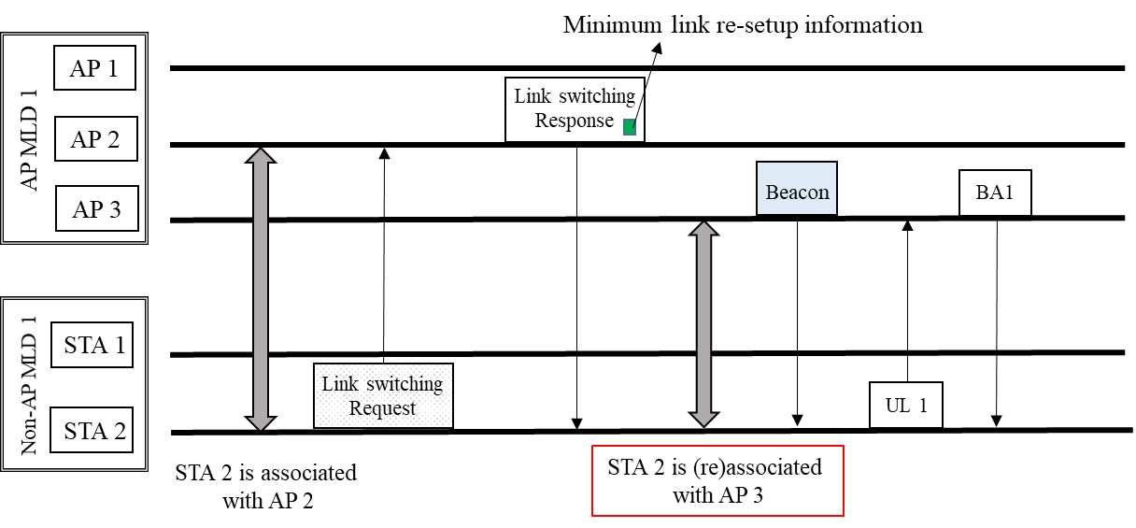
Link re-setup process: Case 3 (2/2)
The link re-setup with link switching without reassociation frame
Compared to Case 1, the overhead of reassocation frame can be reduced and avoid the unnecessary information.
However, this case requires to define new frame for link switching.

Slide 9
Conclusion
We have discussed link re-setup process after link switching and provide available link re-setup processes.
When a STA switches a own operating link to another AP of associated AP MLD, the STA may perform link re-setup process with the another AP.
In this contribution, we provide 3 cases of link re-setup processes that we can consider.

Slide 10
Reference
[1]: 11-19-1943-03-00be-multi-ink-management
[2]: 11-19-1930-03-00be-ap-assited-multi-link-operation

Slide 11
SP #1
Do you support that 802.11be allows the following operation for link management:
When a STA switches a own operating link to another AP of associated AP MLD, the STA should exchange information for link re-setup with the another AP.
The signaling for exchange the information is TBD.

Slide 12
SP #2
Which option do you prefer for link re-setup process after link switching?
Option 1: The link re-setup using reassociation frame after link switching (Case 1)
Option 2 : The link re-setup with link switching using reassociation frame (Case 2)
Option 3 : The link re-setup with link switching without reassociation frame (Case 3)

