Slide 1
MLO: Information Exchange for Link switching
Date: 2020-03-16
Authors:
Name | Affiliations | Address | Email
Namyeong Kim | LG Electronics | LG Seocho R&D Campus, Korea | namyeong.kim@lge.com
Jeongki Kim |  |  | jeongki.kim@lge.com
Insun Jang |  |  | insun.jang@lge.com
Taewon Song |  |  | taewon.song@lge.com
Sungjin Park |  |  | allean.park@lge.com
Jinsoo Choi |  |  | js.choi@lge.com

Slide 2
Overview
We agreed that 802.11be defines a multi-link setup signaling exchange executed over one link initiated by a non-AP MLD with an AP MLD as follows [1]:
Capability for one or more links can be exchanged during the multi-link setup.
After multi-link setup, a STA may request an AP to switch the operating link to improve the performance.
For example, there are the cases where the STA is to avoid channel congestion or interference, and so on.
In this contribution, we does not focus on link switching process (e.g. the detail of link switching operation may be replaced with TID-to-link mapping procedure).
To select a suitable switching link, the STA should know current information of other APs.
For this, the STA needs the method to obtain up-to-date information.

Slide 3
The constraints on obtaining information
A STA can periodically acquire the information of other APs from Beacon frame, but there may be some constraints on link switching in the following cases.
Case 1: the lack of information
Beacon frame can provide partial information of other APs to avoid bloating, which may not provide information needed for link switching.
Case 2: the out-of-date information
A STA can have too long listen interval to get the latest information about link.
Note that the STA which supports constrained battery may have long beacon interval.
The previously obtained link information from the beacon frame may be different from the current link information
In this contribution, we propose the method for a STA to obtain additional information (e.g., other AP’s capability, BSS parameters, etc.) after multi-link setup.

Slide 4
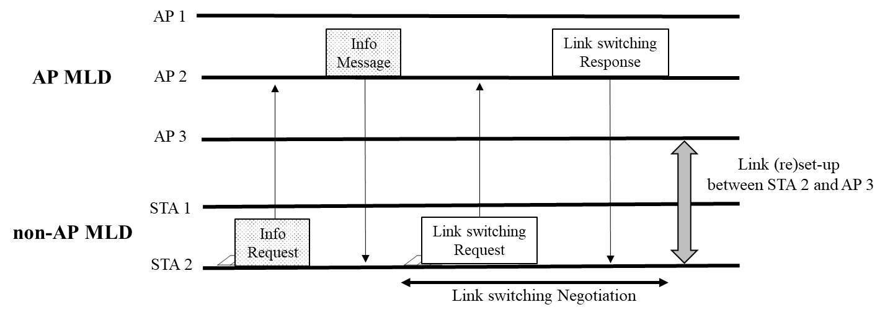
Proposal 1: The solicited method to obtain additional information
A STA of non-AP MLD can request an AP of AP MLD the specific information of one or more APs of AP MLD after multi-link setup.
On receiving the request frame, the AP sends a response frame including the information required by the STA.
For example, when STA 2 requests the BSS load of all APs affiliated with AP MLD, the AP 2 sends a response frame including BSS load of AP 1, 2, 3 to STA 2.

Slide 5
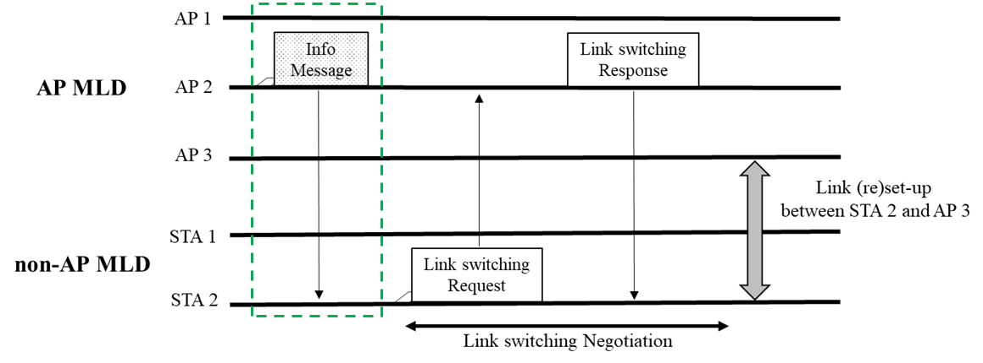
Proposal 2: The unsolicited method to obtain additional information
An AP can provide information of other APs affiliated with AP MLD to a STA without requesting by the STA.
An AP of AP MLD can send a STA of non-AP MLD a frame to provide information (e.g. updated other AP’s capabilities, operation element, BSS parameters) after multi-link setup.
The signaling for notifying specific information is TBD (e.g., FILS Discovery frame, Broadcast Probe response, etc.).
The AP may send this information periodically (e.g., 20 us).
For example, an AP 2 announces a message to STA 2 to provide changed STR capability information of AP MLD.

Slide 6
Conclusion
Considering the cases where a STA of non-AP MLD does not have enough information to determine the suitable switching link, we propose the method for the STA to obtain additional information.
A STA of non-AP MLD can request specific information of one or more APs not acquired through a beacon to associated AP MLD.
For example, the information can be BSS load of other APs of the associated AP MLD.
Also, an AP of AP MLD can provide the updated information of APs affiliated with AP MLD to STA which is associated with the AP MLD without request from STA.
For example, the information can be STR capability of the associated AP MLD.

Slide 7
Reference
[1]: 11-19-1262-08-00be-specification-framework-for-tgbe
[2]: 11-19-1526 Multi-link power save

Slide 8
Recap: Proposal
A STA of a non-AP MLD can request a peer AP of AP MLD a part of complete information of other APs of the same AP MLD.
Using this method, the STA can request only a part of information for other APs currently required.
The STA can request any information of other APs (e.g. information which is not included on beacon frame sent from the peer AP) without monitoring other links.
The STA can request specific information of other APs (e.g. only updated BSS parameters) before switching/waking up to avoid service disruption.
This can be one of the solutions for beacon bloating issue and it will be able to reduce frame overhead by requesting only required information and save more power.

Slide 9
SP #1
Do you agree to define the following mechanism:
A STA of a non-AP MLD can request a peer AP of AP MLD a part of complete information of other APs of the same AP MLD.
The signaling for requesting the part of complete information is TBD.
NOTE: As an example, the part of complete information may be information that is not included on the beacon frame sent from the peer AP.

