Slide 1
MLO: Information Exchange for Link switching
Date: 2020-03-16
Authors:
Name | Affiliations | Address | Email
Namyeong Kim | LG Electronics | LG Seocho R&D Campus, Korea | namyeong.kim@lge.com
Jeongki Kim |  |  | jeongki.kim@lge.com
Insun Jang |  |  | insun.jang@lge.com
Taewon Song |  |  | taewon.song@lge.com
Sungjin Park |  |  | allean.park@lge.com
Jinsoo Choi |  |  | js.choi@lge.com

Slide 2
Overview
We agreed that 802.11be defines a multi-link setup signaling exchange executed over one link initiated by a non-AP MLD with an AP MLD as follows [1]:
Capability for one or more links can be exchanged during the multi-link setup.
After multi-link setup, a STA may request an AP to switch the operating link to improve the performance
For example, there are the cases where the STA is to avoid channel congestion or interference, and so on.
To select a suitable switching link, the STA should know current cross-link information (i.e., the information of other APs/links)
For this, the STA needs the method to obtain up-to-date information.

Slide 3
The constraints on obtaining information
A STA can periodically acquire the information of other APs from Beacon frame, but there may be some problems on link switching in the following cases.
Case 1: the lack of information
Beacon frame can provide partial information of other APs to avoid bloating, which may not provide information needed for link switching.
Case 2: the out-of-date information
A STA can have too long Beacon interval to get the latest information about link.
Note that the STA which supports constrained battery may have long beacon interval.
The previously obtained link information from the beacon frame may be different from the current link information
In this contribution, we propose the method for a STA to obtain additional information for link switching.

Slide 4
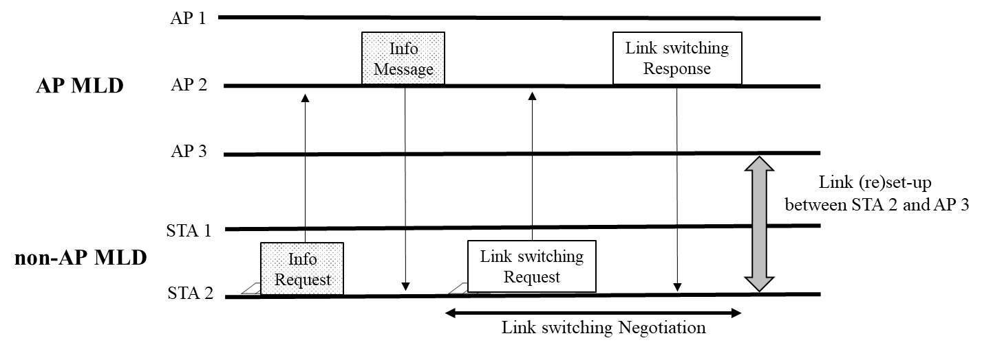
Proposal 1: The solicited method to obtain additional information
A STA of non-AP MLD can request an AP of AP MLD the specific information of one or more APs of AP MLD after multi-link setup.
On receiving the request frame, the AP sends a response frame including the information required by the STA.
For example, when STA 2 requests the BSS load of all APs affiliated with AP MLD, the AP 2 sends a response frame including BSS load of AP 1, 2, 3 to STA 2.

Slide 5
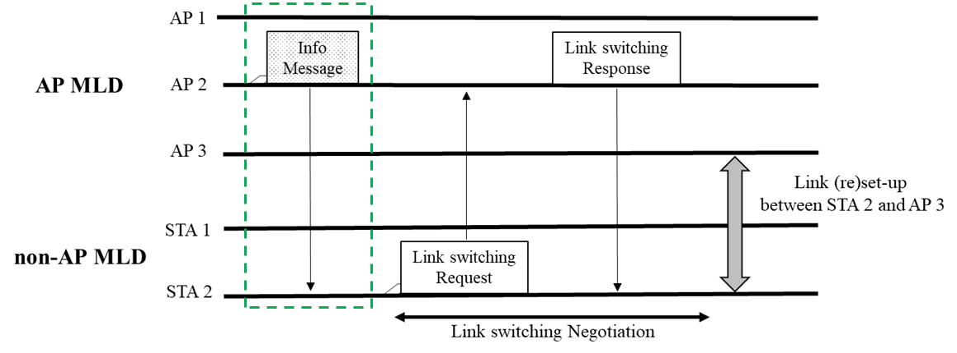
Proposal 2: The unsolicited method to obtain additional information
An AP can provide information of other APs affiliated with AP MLD to a STA without requesting by the STA.
An AP of AP MLD can send a STA of non-AP MLD a separate frame to provide information after multi-link setup.
The AP can announce the information of specific AP affiliated with AP MLD or the all APs affiliated with AP MLD. The details of the information to be notified are TBD.
The signaling for notifying specific information is TBD.
For example, an AP 2 announces a separate message to STA 2 to provide changed STR capability information of AP MLD.

Slide 6
Conclusion
Considering the cases where a STA of non-AP MLD does not have enough information to determine the suitable switching link, we propose the method for the STA to obtain additional information.
A STA of non-AP MLD can request specific information of one or more APs not acquired through a beacon to associated AP MLD.
For example, the information can be BSS load of other APs of the associated AP MLD.
Also, an AP of AP MLD can provide the updated information of APs affiliated AP MLD to STA which is associated with the AP MLD without request from STA.
For example, the information can be STR capability of the associated AP MLD.

Slide 7
Reference
[1]: 11-19-1262-08-00be-specification-framework-for-tgbe
[2]: 11-19-1526 Multi-link power save

Slide 8
SP #1
Do you support that 802.11be allows the following operation :
A STA of non-AP MLD can send an AP of AP MLD a request frame to obtain information of other APs of associated AP MLD after multi-link setup.
NOTE 1: The detail in the information is TBD.
NOTE 2: The request frame is TBD.
On receiving the request frame from the STA, the AP can send the STA a response frame including the requested information.

Slide 9
SP #2
Do you support that 802.11be allows the following operation :
A STA of non-AP MLD can request an AP of AP MLD the specific information of one or more APs of AP MLD after multi-link setup.
NOTE 1: The signaling for indicating the specific information is TBD.
NOTE 2: The request frame is TBD.
On receiving the request frame from the STA, the AP can send the STA a response frame including the requested information.

Slide 10
SP #3
Do you support that 802.11be allows the following operation :
An AP of AP MLD can send a STA an announcement frame* including information after multi-link setup.
NOTE 1: The detail in the information is TBD.
NOTE 2: The announcement frame is TBD.

