Slide 1
MLO: Information Exchange for Link switching
Date: 2020-03-16
Authors:
Name | Affiliations | Address | Email
Namyeong Kim | LG Electronics | LG Seocho R&D Campus, Korea | namyeong.kim@lge.com
Jeongki Kim |  |  | jeongki.kim@lge.com
Insun Jang |  |  | insun.jang@lge.com
Taewon Song |  |  | taewon.song@lge.com
Sungjin Park |  |  | allean.park@lge.com
Jinsoo Choi |  |  | js.choi@lge.com

Slide 2
Overview
We agreed that 802.11be defines a multi-link setup signaling exchange executed over one link initiated by a non-AP MLD with an AP MLD as follows [1]:
Capability for one or more links can be exchanged during the multi-link setup
After multi-link setup completion, a STA may request an AP to switch the operating link to improve the performance
For example, there are the cases where the STA is to avoid channel congestion or interference, so on
To select a suitable switching link, the STA should know current cross-link information (e.g. BSS load, STR capability, etc.)
For this, the STA needs the method to obtain up-to-date information.

Slide 3
The constraints on obtaining information
A STA may periodically acquire multi-link information from beacon frame, but there may be some problems in cases.
Case 1: the lack of information
The case where the beacon frame does not provide information for link switching
Optional information (e.g. cross-link information) may not be included in the beacon frame
Case 2: the out-of-date information
The case where the STA has too long Beacon interval to get the latest information about link
The previously obtained link information from the beacon frame may be different from the current link information
In this contribution, we propose the method for a STA to obtain additional information for link switching

Slide 4
Proposal 1: The solicited method to obtain additional information
To obtain additional information for (re)selecting the operating link, a STA can request the information to an AP before requesting link switching
A STA can send an AP a request frame to obtain information for multi-link switching
The STA can request the all cross-link information or the designated information (e.g. information for the specified link or information for the specified parameter) to the AP
For example, the information can be BSS load, STR capability, so on. The detail in the information is TBD
On receiving the request frame from the STA, the AP can send the STA a response frame including the information for multi-link switching

Slide 5
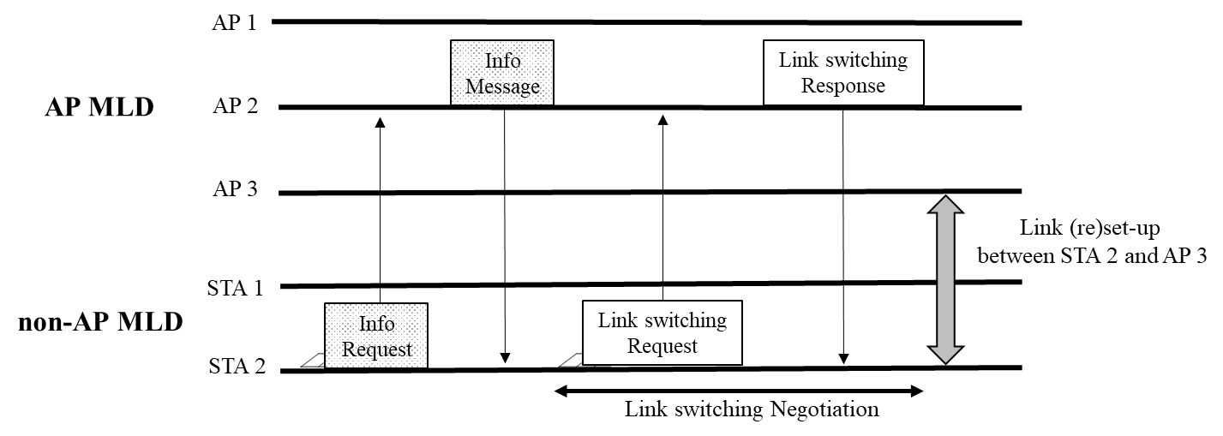
Example 1: Proposal 1
When STA 2 requests the multi-link information to AP 2, the AP 2 sends a response message including cross-link information (e.g. BSS load) to STA 2

Slide 6
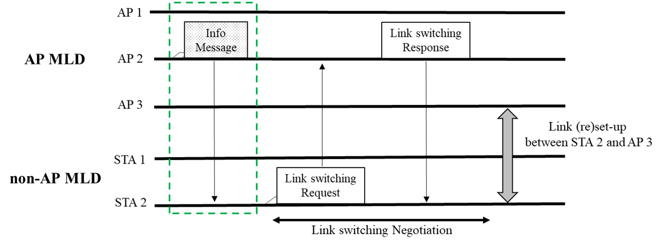
Proposal 2: The unsolicited method to obtain additional information
An AP may provide information for link switching to a STA without requesting by the STA
An AP can send a STA a separate frame including information for multi-link switching
For example, the information can be BSS load, STR capability, so on. The detail in the information is TBD
Example
An AP 2 announces a separate message to STA 2 to provide information for cross-link

Slide 7
Conclusion
Considering the cases where the STA does not have enough information to determine the suitable switching link, we propose the method for a STA to obtain additional information
Through the proposed method, the STA can select the suitable operating link improving performance regardless of beacon frame reception

Slide 8
Reference
[1]: 11-19-1262-08-00be-specification-framework-for-tgbe
[2]: 11-19-1526 Multi-link power save

Slide 9
SP #1
Do you support that 802.11be allows the following operation :
A STA can send an AP a request frame to obtain information for multi-link switching
For example, the information can be BSS load, STR capability, so on. The detail in the information is TBD
The STA can request the all cross-link information or the designated information (e.g. information for the specified link or information for the specified parameter) to the AP
On receiving the request frame from the STA, the AP can send the STA a response frame including the information for multi-link switching

Slide 10
SP #2
Do you support that 802.11be allows the following operation :
An AP can send a STA an announcement frame* including information for multi-link switching
For example, the information can be BSS load, STR capability, so on. The detail in the information is TBD
*Announcement frame: the exact name is TBD

