Slide 1
Coordinated Spatial Reuse Procedure
Date: 2020-03-16
Authors:
Name | Affiliation | Address | Phone | Email
Sungjin Park | LG Electronics | 19, Yangjae-daero 11gil, Seocho-gu, Seoul 137-130, Korea |  | allean.park@lge.com
Jeongki Kim |  |  |  | jeongki.kim@lge.com
Suhwook Kim |  |  |  | suhwook.kim@lge.com
Insun Jang |  |  |  | insun.jang@lge.com
Taewon Song |  |  |  | taewon.song@lge.com
Namyeong Kim |  |  |  | namyeong.kim@lge.com
Jinsoo Choi |  |  |  | js.choi@lge.com

Slide 2
Introduction
The Coordinated Spatial Reuse (CSR) operation can be one of the Multi-AP transmission schemes with relatively low complexity.
Before the CSR transmission, the STA participating in CSR needs measurement phase to know the path loss from OBSS APs.
  Solicited method (by NDP sounding)
  Unsolicited method (by ongoing packet)
This contribution proposes the CSR procedure based on unsolicited method.

Slide 3
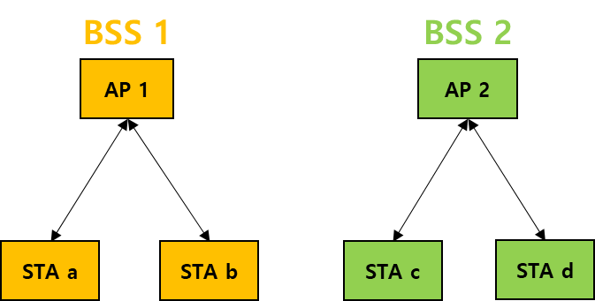
Topology of CSR
We consider the following environments.
  Each AP can establish its own BSS
  STA “a” and STA “b” are associated with AP 1 in BSS 1.
  STA “c” and STA “d” are associated with AP 2 in BSS 2.
  APs are connected each other with wireless backhaul.
  APs which are hearable each other can participate in the CSR transmission.

Slide 4
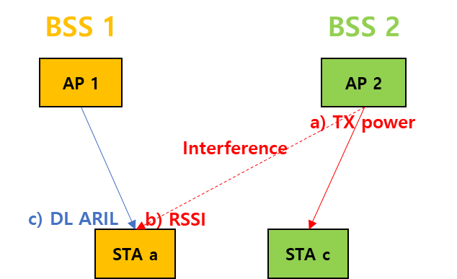
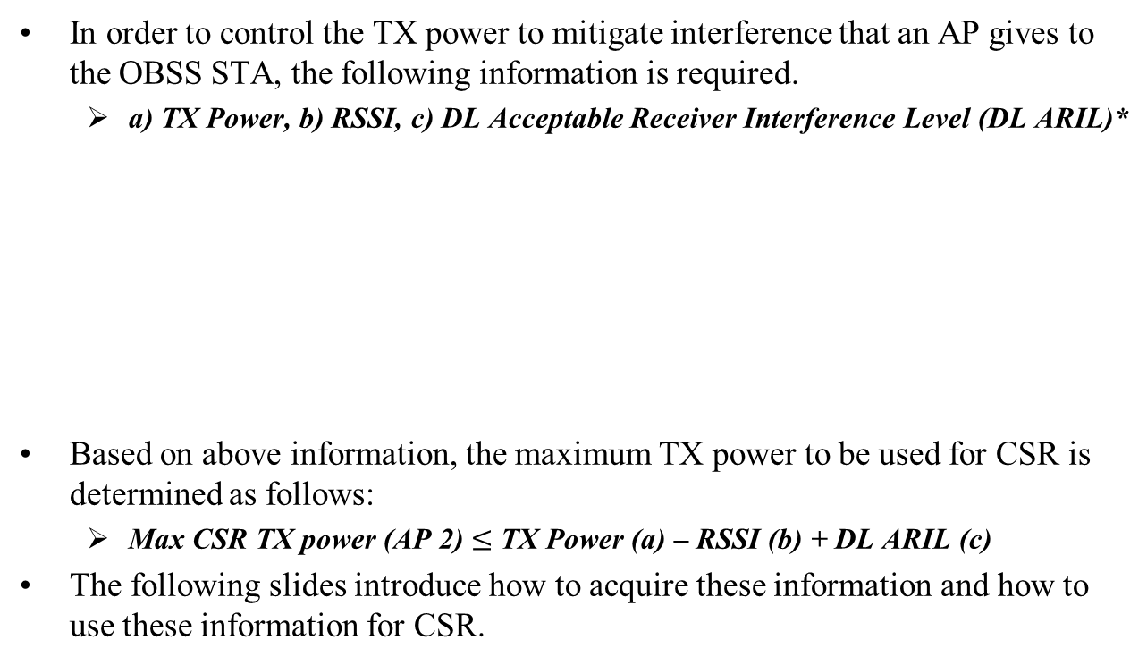
Necessary information for CSR
In order to control the TX power to mitigate interference that an AP gives to the OBSS STA, the following information is required.
  a) TX Power, b) RSSI, c) DL Acceptable Receiver Interference Level (DL ARIL)*
Based on above information, the maximum TX power to be used for CSR is determined as follows:
  Max CSR TX power (AP 2) $≤$ TX Power (a) – RSSI (b) + DL ARIL (c)
The following slides introduce how to acquire these information and how to use these information for CSR.
*DL ARIL: the value of the DL RSSI (AP 1 to STA a) minus the minimum SNR value that yields ≤ 10% PER for the highest MCS of the ensuing DL PPDU, minus a safety margin value not to exceed 5 dB as determined by the AP.

Slide 5
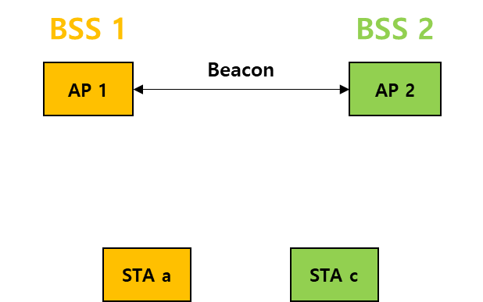
CSR capability announcement
APs can discover each other by receiving Beacon frame or management frames sent by neighboring APs.
When the AP sends Beacon frame or management frame, the neighboring AP should be informed that there is a capability and an intention to participate in CSR operation. [1]
APs know which of neighboring APs is hearable and has CSR capability and intention.

Slide 6
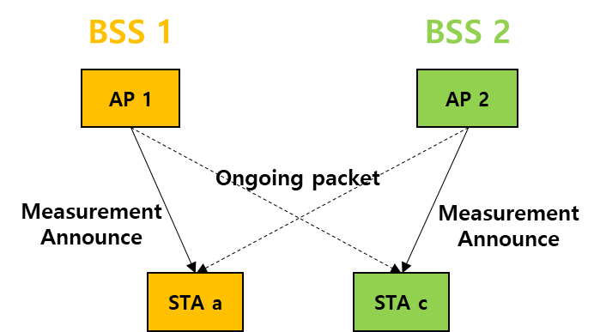
Measurement announcement
The AP gives the list of neighboring APs to the STA(s) associated with itself.
  The AP may compose the list with only a few of neighboring APs which have capability and intention to participate in the CSR.
A STA that received the list of neighboring APs starts to measure RSSI from neighboring APs in the list.
  The STA measures the RSSI by using ongoing packet transmitted by the neighboring APs in the list.
  The STA may update the average RSSI value when ongoing packet is received.

Slide 7
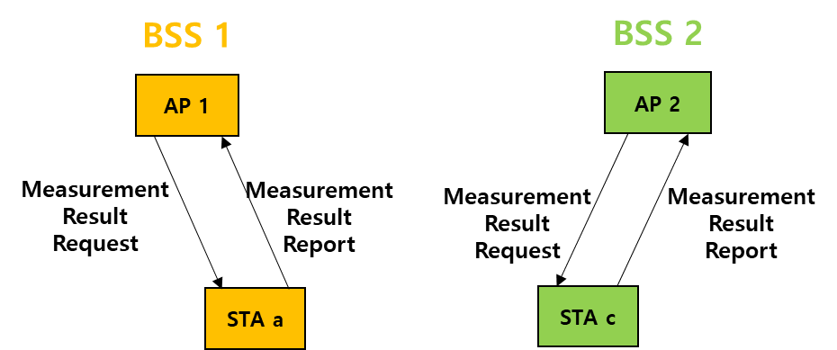
Measurement result request & report
The AP requests the own STA(s) to report the measured RSSI from the neighboring APs and the associated AP.
The STA reports the following information to its associated AP:
  Measured RSSI from the neighboring APs
  Measured RSSI from the associated AP
The AP computes the DL Acceptable Receiver Interference Level (DL ARIL) based on the Measured RSSI from the associated AP.

Slide 8
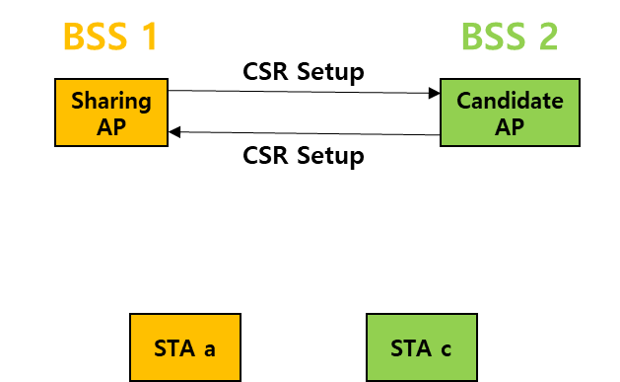
CSR setup
The AP which obtains TXOP to send data to the “STA a” can be the Sharing AP. [1]
The Sharing AP selects the candidate AP and informs as follows:
  For DL TX (Data)
  Measured RSSI (candidate AP → STA a)
  DL ARIL (Sharing AP → STA a)
The candidate AP responds to the Sharing AP if the channel state is idle. [2]

Slide 9
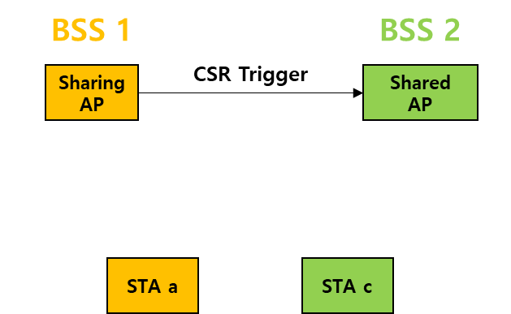
CSR trigger
The Sharing AP finally selects which candidate AP is the Shared AP.
The Sharing AP triggers the Shared AP and informs as follows:
  For DL TX (Data)
  Available DL TX time for the Shared AP
  For UL TX (ACK)
  Resource allocation where Shared AP will receive the ACK frame in response to DL data (Shared AP will allocate RU to own STA within this resource allocation)
  The start time to send the ACK frame

Slide 10
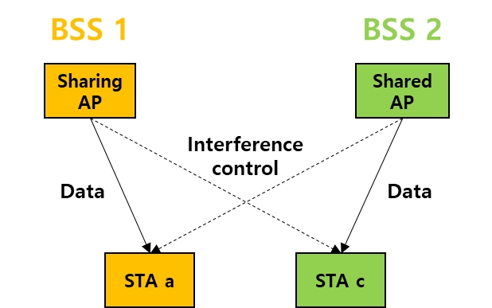

CSR data transmission
The Sharing AP sends data to the “STA a” and the Shared AP sends data to the “STA c” concurrently.
The Shared AP should determine max TX power as follows:
  max CSR-TX power $≤$ ${\text{TX} \text{power}}^{∗}$of Shared AP – ${\text{RSSI} }^{∗}$(Shared AP → STA a) + DL ARIL (Sharing AP → STA a)
The Shared AP selects the “STA c” if it is satisfied with following condition:
  ${\text{Updated} \text{DL} \text{ARIL}}^{∗∗}$(Shared AP → STA c) $≥$ ${\text{RSSI} }^{∗}$(Sharing AP → STA c)
* TX power & RSSI: it can be set to the average value measured
** Updated DL ARIL: DL ARIL value can be changed when “max CSR-TX power” is determined and then
“min SNR(10% PER)” is determined according to the “max CSR-TX power”.
(Updated DL ARIL = max CSR-TX power – path loss – min SNR(10% PER) – safety margin)
Notes:
ARIL = target RS냐* – SNR (highest MCS. 10>PER)

Slide 11
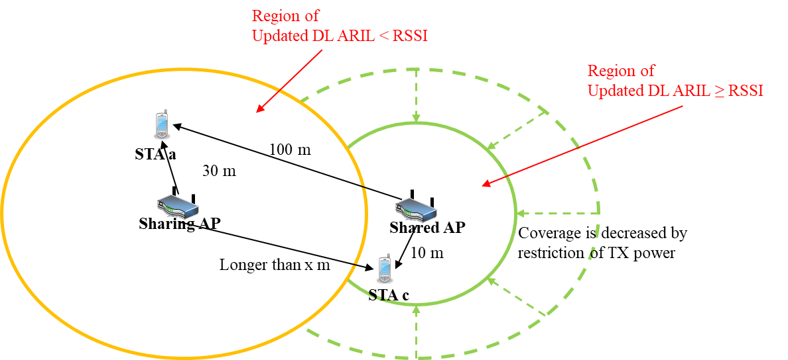
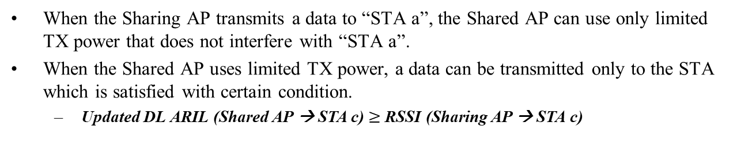
Example of CSR data transmission
DL ARIL of STA a: TX power of Sharing AP – path loss – min SNR (10% PER)
= 24 – 88 – 23 = - 87 dBm
RSSI of STA a: TX power of Shared AP – path loss
= 24 – 106 = - 82 dBm
Max TX power of Shared AP: path loss + ARIL
= 106 – 87 = 19 dBm
Updated DL ARIL of STA c: max TX power – path loss – min SNR (10% PER)
= 19 – 70 – 32 = - 83 dBm
Min distance of x: Satisfying the condition (Updated DL ARIL ≥ RSSI )
= 105 m
: Logical coverage of Sharing AP
: Logical coverage of Shared AP
When the Sharing AP transmits a data to “STA a”, the Shared AP can use only limited TX power that does not interfere with “STA a”.
When the Shared AP uses limited TX power, a data can be transmitted only to the STA which is satisfied with certain condition.
  Updated DL ARIL (Shared AP → STA c) $≥$ RSSI (Sharing AP → STA c)
Notes:
ARIL = target RS냐* – SNR (highest MCS. 10>PER)

Slide 12

ACK transmission
The ACK transmission from the STAs received CSR data frame can be performed by UL-OFDMA.
  “STA a” sends the ACK frame to the Sharing AP through allocated RU which is indicated in the Data frame sent by Sharing AP.
  “STA c” sends the ACK frame to the Shared AP through allocated RU which is indicated in the Data frame sent by Shared AP.
    The Shared AP includes the RU allocation in the Data frame as the Sharing AP indicates through the trigger frame.

Slide 13
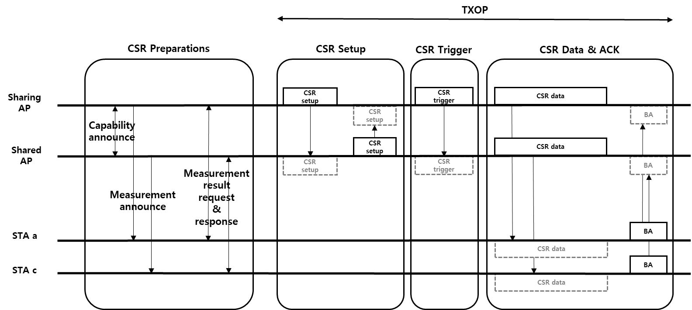
Summary of CSR procedure
The RSSI measurement by using ongoing packets to acquire path loss is performed in the CSR preparations.
The phases of CSR Setup, CSR Trigger, CSR Data & Ack are performed within single TXOP after the Sharing AP obtains TXOP.

Slide 14
Conclusion
The Coordinated Spatial Reuse (CSR) operation can be supported with relatively low complexity by using ongoing packet from OBSS.
  It doesn’t necessarily need the NDP sounding operation which is to acquire CSI between the APs and STAs which is not associated with those APs.
  Relatively low requirement of synchronization compared to Joint TX scheme, Coordinated BF scheme.
This contribution proposes the CSR procedure based on unsolicited method.

Slide 15
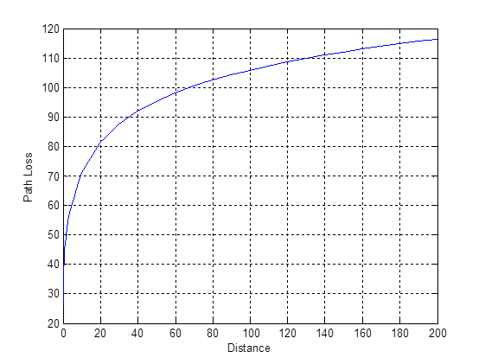
Appendix 1
Path loss (5GHz, TGnD)

Slide 16
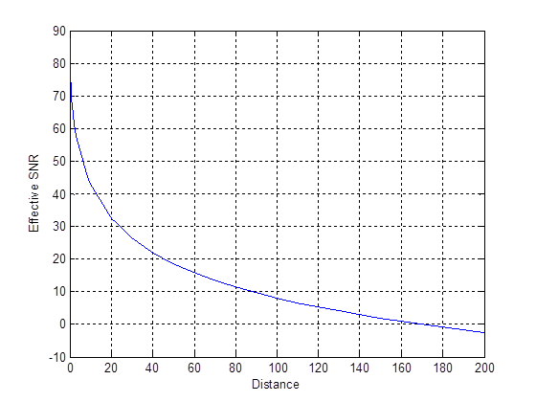
Appendix 2
Effective SNR (TX power: 24dBm, 80MHz, Noise Figure 5dB)

Slide 17
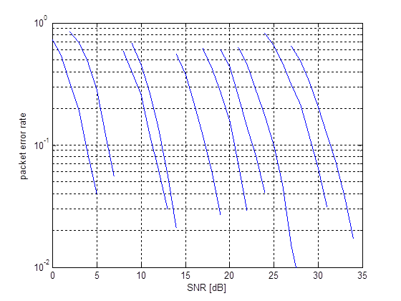
Appendix 3
PER (MCS 0~9, SISO, 1000bits, 80MHz, TGnD)

Slide 18
Straw Poll 1
Do you agree to add the following text to the TGbe SFD:
An AP informs the list of neighboring APs which have capability to participate in Coordinated Spatial Reuse (CSR) to the STA(s) associated with itself and requests the STA(s) to measure the RSSI from the neighboring APs in the list.

Slide 19
Straw Poll 2
Do you agree to add the following text to the TGbe SFD:
The STA which is requested to measure RSSI value reports the measured RSSI value from the neighboring APs to the associated AP.

Slide 20
Straw Poll 3
Do you agree to add the following text to the TGbe SFD:
Sharing AP sends a frame including the information of RSSI and DL Acceptable Receiver Interference Level (DL ARIL) to Shared AP.
RSSI: the value measured by a STA associated with the Sharing AP by using ongoing packets transmitted by the Shared AP
DL ARIL*: the value measured by a STA associated with the Sharing AP by using a packet transmitted by the Sharing AP
* DL ARIL: the value of the DL RSSI minus the minimum SNR value that yields ≤ 10% PER for the highest MCS of the ensuing DL PPDU, minus a safety margin value not to exceed 5 dB as determined by the AP.

Slide 21
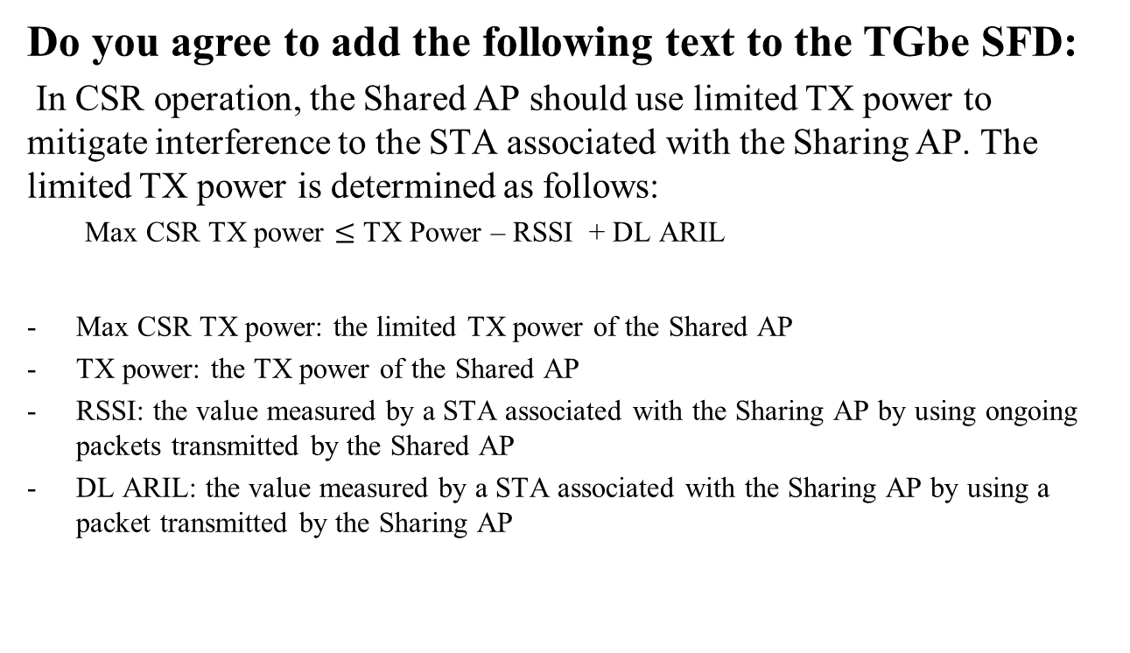
Straw Poll 4
Do you agree to add the following text to the TGbe SFD:
In CSR operation, the Shared AP should use limited TX power to mitigate interference to the STA associated with the Sharing AP. The limited TX power is determined as follows:
  Max CSR TX power $≤$ TX Power – RSSI + DL ARIL
Max CSR TX power: the limited TX power of the Shared AP
TX power: the TX power of the Shared AP
RSSI: the value measured by a STA associated with the Sharing AP by using ongoing packets transmitted by the Shared AP
DL ARIL: the value measured by a STA associated with the Sharing AP by using a packet transmitted by the Sharing AP

Slide 22
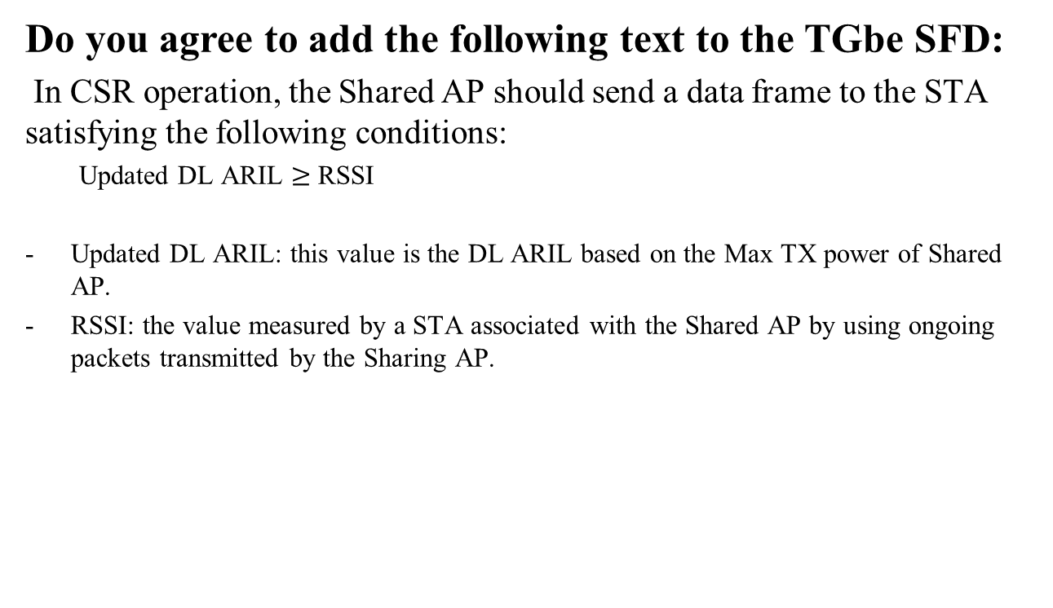
Straw Poll 5
Do you agree to add the following text to the TGbe SFD:
In CSR operation, the Shared AP should send a data frame to the STA satisfying the following conditions:
  Updated DL ARIL $≥$ RSSI
Updated DL ARIL: this value is the DL ARIL based on the Max TX power of Shared AP.
RSSI: the value measured by a STA associated with the Shared AP by using ongoing packets transmitted by the Sharing AP.

Slide 23
Straw Poll 6
Do you agree to add the following text to the TGbe SFD:
In CSR operation, the STA that received CSR data frame may send ACK or BA frame to the associating AP by using UL OFDMA.

