Slide 1
Multi-RU Combination and Signaling
Date: 2020-03-16
Authors:
Name | Affiliations | Address | Phone | email
Mengshi Hu | Huawei |  |  | humengshi@huawei.com
Ross Jian Yu | Huawei |  |  | ross.yujian@huawei.com
Ming Gan | Huawei
Oded Redlich | Huawei
Shimi Shilo | Huawei
Genadiy Tsodik | Huawei

Slide 2
Introduction
Multi-RU
  Multi-RU means more than one RU can be assigned to a single STA [1][2].
  11ax does not support multi-RU combination and assignment
  11be shall support multi-RU for higher spectral efficiency
Considerations on multi-RU combination
  Completely flexible combination [3]
  The number and positions of combined RUs are flexible
  Limited combination [4][5]
  There are some restrictions on the number and positions of combined RUs. For example, the maximum RU number allocated to one STA is two.

Slide 3
Design of multi-RU signaling
Indication in User Specific field
  Option 1 (completely flexible combination): All User fields corresponding to multiple RUs assigned to a STA contain same STA ID [4]
Pros: less specification impact if we only use the same STA ID
Cons: A multi-RU user needs more than one User field
Some other methods can be designed on the basis of this format, pros and cons need be further considered.
Indication before User Specific field
  Option 2 (limited combination): Indicate multi-RU combinations in Common field after each RU Allocation subfield or after the last RU Allocation subfield
  Pros: One STA only needs one User field
  Cons: some changes in specification
  Option 3 (limited combination): Reconstruct the RU Allocation subfield
  Pros: One STA only needs one User field
  Cons: some changes in specification

Slide 4
Changes in User Specific field (Opt 1)
  Option 1: User fields corresponding to multiple RUs assigned to a STA contain same STA ID
  The order of User fields is not changed. Thus the position of a User field can indicate its corresponding RU.
  To improve energy efficiency, the position information can be added to some of the User fields allocated to multi-RU users.
  A multi-RU user needs more than one User field.

Slide 5
Problem in MU-MIMO (Opt 1)
If we simply use same STA ID for the user fields allocated to the same user, a problem will occur in MU-MIMO cases:
  When the 106-tone RU is combined with the contiguous 26-tone RU
  if the combined RUs need to have the same STA ID, the 26-tone RU can not have 3 STA IDs at the same time
  if we choose to use one STA ID of the first 3 users in the 26-tone RU, the other 2 users will not be able to find this 26-tone RU
  Thus, the content of this 26-tone RU needs to be reconsidered.

Slide 6
Solutions for MU-MIMO problem (Opt 1)
Two solutions are given here to solve this problem
  Solution 1: The combined 26-tone RU could use the STA ID of the first user in MU-MIMO allocation. When the users in 106-tone RU find that the STA ID of an RU is their first user’s STA ID, the combination can be determined.
  Solution 2: Use a specific STA ID or indication in the 26-tone RU to show it is an combined RU. The position information of MU-MIMO users can be contained in the 26-tone RU.

Slide 7
Changes before User Specific field (Opt 2)
  Option 2: Indicate multi-RU combinations in Common field after each RU Allocation subfield
  Add a combination indication after each RU Allocation subfield. This indication (2bits for example) could show the combination information on the basis of its corresponding RU allocation subfield.
  One STA only needs one User field, because it already knows the information of RU position in Common field.
  For 320MHz and 16 RU Allocation subfields, only 2*16 more bits are needed.

Slide 8
Details of Opt 2
2-bit indication | Combination Indication (When its corresponding RU Allocation subfield allocates small RUs) | Combination Indication (When its corresponding RU Allocation subfield allocates a large RU)
00 | No combination | No combination
01 | Left 52+26/106+26 | Corresponding to combination group 1/4/…
10 | Right 52+26/106+26 | Corresponding to combination group 2/5/…
11 | Both the left and right combinations exist | Corresponding to combination group 3/6/…
  Small RU Combination
  A 2-bit indication after each RU Allocation subfield can support 52+26 and 106+26 for each RU Allocation subfield. For example, 00 means no combination, 01 means the left 52+26 or the left 106+26, 10 means the right 52+26 or the right 106+26, and 11 represents that both the left and right combinations exist. Note that whether it is a 52+26 or 106+26 combination is decided by the corresponding RU Allocation subfield.
  Large RU combination
  A 2-bit indication can also work well. For example, 00 means the corresponding RU is not combined, 01, 10 and 11 are used to differentiate between the different combinations.
  For example, the below indications mean that there exists a 242+242+996 and a 484+242

Slide 9
Example for Opt 2
2-bit indication | Combination Indication (When its corresponding RU Allocation subfield allocates small RUs) | Combination Indication (When its corresponding RU Allocation subfield allocates a large RU)
00 | No combination | No combination
01 | Left 52+26/106+26 | Corresponding to combination group 1/4/…
10 | Right 52+26/106+26 | Corresponding to combination group 2/5/…
11 | Both the left and right combinations exist | Corresponding to combination group 3/6/…
In large RU combination, 01, 10 and 11 can be reused to indicate different groups. For example, 01 can be reused after 11 to indicate another group.
Large RU combination: 242+242+996, 484+242
Small RU combination: 106+26, 52+26

Slide 10
Changes before User Specific field (Opt 2)
  Compared to the indication after each RU Allocation subfield, the combination indications can also be after the last RU Allocation subfield

Slide 11
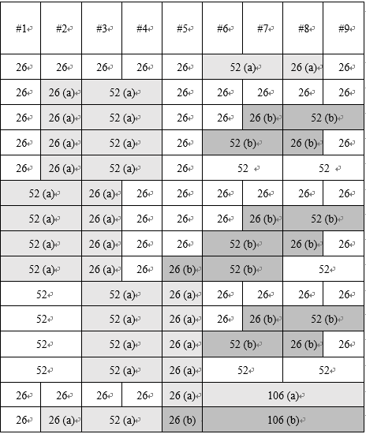
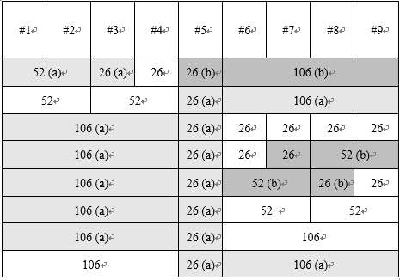
Changes before User Specific field (Opt 3)
  Option 3: Reconstruct the RU Allocation subfield to include combination information. For example, using the reserved entries or expanding the 8-bit RU Allocation subfield to 9 bits.
  Within 20MHz, add some entries of 52+26 and 106+26
  The above figure shows some examples of combination. Each row is corresponding to one RU allocation subfield. (a) and (b) indicate the supported configurations.
  Note: Here we only discuss the combinations of RUs. The MU-MIMO case need also be considered when we reconstruct the subfield.

Slide 12
Changes before User Specific field (Opt 3)
Table. Some possible combinations crossing 20MHz
Combination | Equivalent Bandwidth
242+242 | 40MHz
242+484 | 60MHz
242+242+996 | 120MHz
484+996 | 120MHz
242+484+996 | 140MHz
996+996 | 160MHz
484+996+996 | 200MHz
242+484+996+996 | 220MHz
996+996+996 | 240MHz
484+996+996+996 | 280MHz
… | …
  Crossing 20MHz
  The above table shows some possible combinations crossing 20MHz. To achieve these combinations, we can also reconstruct the RU allocation subfield.
  For example, adding additional combination entries to RU Allocation subfield can show the large-RU combination.

Slide 13
Summary
Options | Pros | Cons
Option 1 Repeat STA ID | 1. Less specification impact if we only use the same STA ID | 1. Has problems in MU-MIMO case (This can be solved, but more specification impact) 2. A multi-RU user needs more than one User field (High overhead)
Option 2 (Preferred) Combination indication after each RU Allocation subfield or after the last RU Allocation subfield | 1. One STA only needs one User field | 1. Some changes in specification
Option 3 (Preferred) Reconstruct RU Allocation subfield | 1. One STA only needs one User field | 1.Some specification impact

Slide 14
Straw Poll #1
Which option do you prefer for the indication of multi-RU combination in OFDMA cases
Opt1/2/3/None/Abstain
Options | Description
Option 1 | Repeat STA ID
Option 2 | Combination indication after each RU Allocation subfield or after the last RU Allocation subfield
Option 3 | Reconstruct RU Allocation subfield

Slide 15
References
[1] IEEE 802.11-19/1126r1 Enhanced Resource Allocation Schemes for 11be
[2] IEEE 802.11-19/1914r1 Multiple RU Discussion
[3] IEEE 802.11-19/1968r1 Signaling Support for Multi-RU Assignment
[4] IEEE 802.11-19/1907r0 Multiple RU Combinations for EHT
[5] IEEE 802.11-19/1908r0 Multi-RU Support

Slide 16
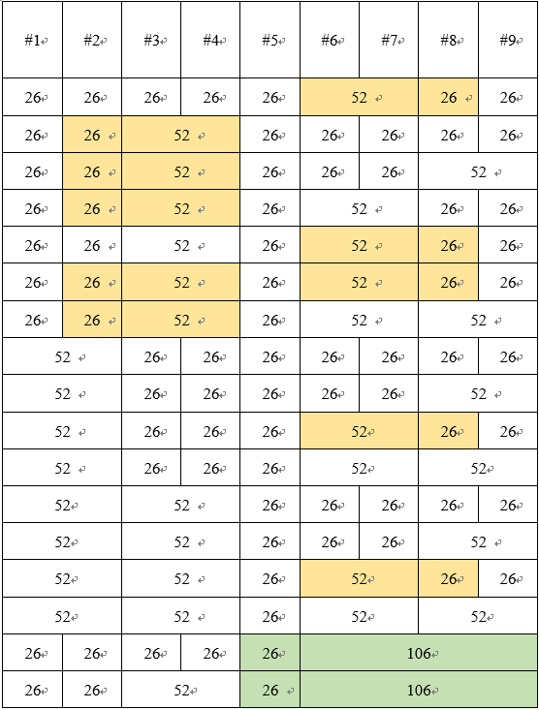
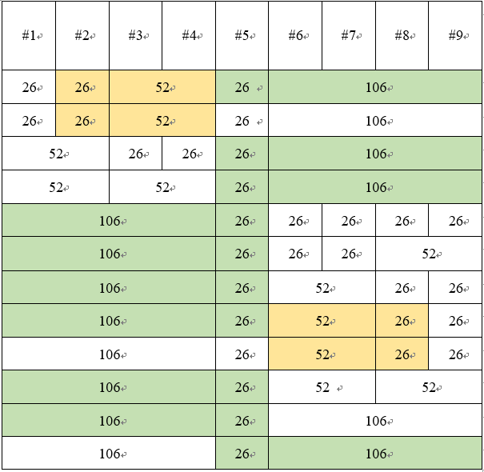
Appendix 1: Entries Needed for Small RU Combination
  To support limited small-RU combinations, we can expand the RU Allocation subfield. Here is an analysis of the entries needed for small-RU combinations.
  Only consider the combinations which have passed the motions (See the orange and green colors, and MU-MIMO is considered)
  If we do not consider MU-MIMO, the total number of entries is 23.
Number of Entries
1
1
1
1
1
1
1
0
0
1
0
0
0
1
0
8
8
Number of Entries
8
1
8
8
8
8
8
8
1
8
64
64
Total number of entries:
11+80+64+64=219
The number of entries needed for large RU combinations can be from a dozen to over a hundred, which is decided by the entry designs.

Slide 17
Appendix 2: Entries Needed for Large RU Combination
  Here we give a method which only needs 9 newly added entries to indicate the large RU combination (See the table below). MU-MIMO is also supported by these 9 entries.
  Passed motions in OFDMA transmission: 484+242 in 80MHz, 484+996 in 160MHz
  This method also supports 484+2*996, 484+3*996
Newly added entries in RU Allocation subfield | Number of entries
Belongs to an MRU; contributes zero User fields to the User Specific field in the same EHT-SIG content channel as this RU Allocation subfield | 1
Belongs to an MRU; contributes one User fields to the User Specific field in the same EHT-SIG content channel as this RU Allocation subfield | 1
… | …
Belongs to an MRU; contributes eight User fields to the User Specific field in the same EHT-SIG content channel as this RU Allocation subfield | 1
9 entries
  We use N(x) to indicate the newly added entries with x user fields.
CC1 | else | N(1) | N(0) | N(0) | else | N(0) | else | else
CC2 | else | N(0) | N(0) | N(0) | N(1) | N(0) | else | else

