Slide 1
Multi-Link Discovery – Part 2
Date: 2020-2-13
Authors:

Slide 2
Objectives
In part 1, we talked about the information that is carried in beacons and probe responses
Especially looking at the minimum information that will be mandated to be included in beacons/probes, and the natural use of RNR for this purpose
Define a way to probe an AP that is part of an AP MLD to collect the complete information on all the APs of the AP MLD

Slide 3
Including complete information in beacons/probes
If we agree with the previous concepts:
Beacons/probe responses always include RNR
Some probe responses (MLD probing) will also include complete information for APs for the same MLD
Beacon may also include complete information for APs for the same MLD
If beacons/probes responses include the complete information for APs from the same MLD, we need a way to carry those information (Neighbor report, Multi-band element, new element), having in mind that we already have an RNR that is already included in most if not all the cases
It would be useful to find solutions to not have to duplicate the information already present in the RNR (14 Bytes: TBTT offset, BSSID, short SSID, BSS parameters, Operating Class/Channel)
We could use the concept of Link ID for different APs within an MLD, the same way we use BSSID-index for different APs within a multiple BSSID set

Slide 4
Use of this ML element
In the vast majority of cases, only basic information will be provided in the RNR in beacons/probe responses of AP that are part of AP MLDs, in order not to unnecessarily bloat the beacon. In the rare case where the AP wants to provide the complete information, the ML element can be used in complement of the RNR
This element would be used more frequently in probe response when the probe request contains a specific indication (MLD request) that it wants the complete information on all APs of the AP MLD
Probe responses sent in response to a probe request directed to an AP of the AP MLD would only contain information on the AP and basic information of AP MLD through RNR
The element can also be used for a non-AP MLD (or an AP MLD) to describe the different non-AP STAs (or AP STAs) on different link during the multi-link setup phase.

Slide 5
ML element
We propose to define a new Multi-Link element to describe the different APs of an AP MLD, which follows a similar structure as the Multiple BSSID element.
It includes multiple “AP profile” subelements or fields (one for each reported AP of the AP MLD) that contains a list of elements:
All the elements included in beacons/probe responses can be included in the AP profile
The AP in the AP profile is identified by its unique Link ID in the AP MLD (equivalent here of the multiple BSSID-index)
We propose to reuse the inheritance concept from multiple BSSID element
Use the Non-Inheritance element
If any of the elements carried in the Probe Response frame or Beacon frame of the reporting AP are not present in an AP profile of a multilink element describing a reported AP, the values to use for the reported AP are the values of the corresponding element of the reporting AP unless the element is listed in the Non-Inheritance element (if included) in the AP profile for that BSS.

Slide 6
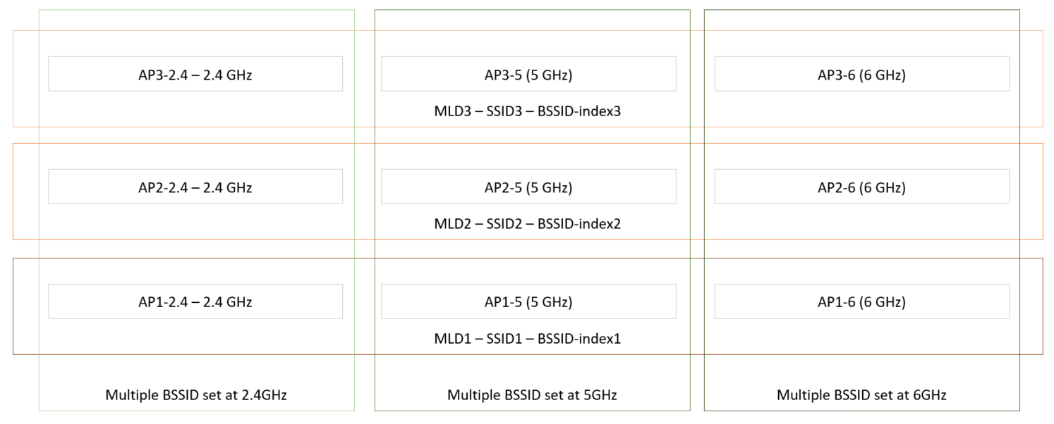
ML element and Multiple BSSID
ML element can be included in a nontransmitted BSSID profile of a multiple BSSID set to describe the APs of the same MLD as the AP with the corresponding BSSID-Index
Everything should work fine, including inheritance, if we do it as proposed in previous slide and assume that the reference for inheritance is the non-transmitted BSSID
Inheritance when ML element is included in a nontransmitted BSSID profile
The reference for inheritance of the AP in the AP profile is the nontransmitted BSSID
Notes:
Highlight the use case

Slide 7
Use case:
In multi-link setup: there shouldn’t be Multiple BSSID element
In beacon or unsolicited probe response, this could happen if an AP provides complete information for other APs in the MLD, and does not limit itself to RNR
In MLD probe response in response to a directed probe request to a non-transmitted BSSID, the transmit BSSID sends it on behalf of the non-transmitted BSSID, and include a Multiple BSSID element with a non-transmitted BSSID profile, which would include an ML element if part of an MLD

Slide 8
Spec text for inheritance when ML element is included in Non-transmitted BSSID profile
If an element is not carried in the AP/STA profile, describing a reported AP, of a multilink element included in the non-transmitted BSSID profile, describing a non-transmitted BSSID, of a multiple BSSID element included in a beacon or probe response frame by a reporting AP, then the values to use for the reported AP are:
the values of the corresponding element in the non-transmitted BSSID profile of the non-transmitted BSSID, if both of the 2 following conditions are true:
the corresponding element is present in the non-transmitted BSSID profile of the non-transmitted BSSID
either the element is not listed in the Non-Inheritance element included in the AP profile of the reported AP or the Non-Inheritance element is not included in the AP profile of the reported AP.
the values of the corresponding element in the beacon/probe response frame of the reporting AP, if all the three following conditions are true:
the corresponding element is not included in the non-transmitted BSSID profile of the non-transmitted BSSID,
either the element is not listed in the Non-Inheritance element included in the AP profile of the reported AP or the Non-Inheritance element is not included in the AP profile of the reported AP.
either the element is not listed in the Non-Inheritance element included in the non-transmitted BSSID profile of the non-transmitted BSSID or the Non-Inheritance element is not included in the non-transmitted BSSID profile of the non-transmitted BSSID.

Slide 9
Straw polls
SP1
Do you agree to define a new Multi-Link element (MLE) to report/describe multiple STAs of an MLD with at least the following characteristics?
MLD-level information may be included
A STA profile subelement is included for each reported STA (if any) and is made of a variable number of elements describing this STA

Slide 10
Straw polls
SP2
Do you support that, for the ML element, we define an inheritance model to prevent frame bloating when advertising complete information of other links?
Define the inheritance mechanism, similar to 11ax, so that the value of an element of a reported STA that is not present in a STA profile of a ML element in a frame sent by a reporting STA is the same as the element of the reporting STA, present elsewhere in the frame.
Define the inheritance mechanism, similar to 11ax, so that the value of an element of a reported STA that is not present in a STA profile of a ML element included in a non-transmitted BSSID profile of a non-transmitted BSSID in a multiple BSSID element in a frame sent by a reporting STA is the same as the element of the non-transmitted BSSID, present elsewhere in the frame or as the element of the reporting STA, present elsewhere in the frame.
Note: an “element of a STA” refers in the text above to the instance of the element describing the capabilities/operation/functionalities of that STA, in a frame where multiple instances of the element can be found for other STAs.
Note: some elements may not be inherited, signaling TBD

Slide 11
Neighbor report
Neighbor report allows discovery of neighbor APs (ANQP NRs, BTM, …) and is used as part of MBO (multi-band operation)
It is unlikely that we’ll use Neighbor report to report collocated APs within the same AP MLD
Neighbor report will however likely be used to report on neighboring AP MLDs, or APs that are part of neighboring AP MLDs
We need a way to identify that an AP reported in a NR is part of an AP MLD
Indication that it is an EHT AP (if we mandate that all EHT APs are AP MLDs)
Indication that it is part of an AP MLD
Probably good to also have a way to report all the APs of an AP MLD, with a way to know that these reported APs are all part of the same AP MLD

Slide 12
Straw polls
SP3
Do you agree to include in the BSSID Information field of the NR a way to indicate that the AP is part of an AP MLD?
Do you agree to be able to report all the APs of an AP MLD in a BTM frame, with a way to know that these reported APs are all part of the same AP MLD?

