Slide 1
Multi-Link Discovery – part 1
Date: 2020-3-15
Authors:

Slide 2
Objectives
Before being able to do multi-link setup with an AP MLD, a non-AP MLD has to discover the AP MLD.
We focus on 2 different discovery scenarios:
  Discover basic information (full scan): discover APs around, evaluate what would be the closest AP…
  Discover all information right before doing multi-link setup
We focus on the information that is carried in beacons and probe responses

Slide 3
Definitions
Basic information: only a subset of information that describe a reported AP
Complete information: all the elements that are currently included in beacons/probe responses that describe the reporting AP

Slide 4
Basic discovery (1/2)
Basic discovery is done by listening to beacons or probe responses (unsolicited, …) or sending probes
We propose that each AP of an AP MLD provides basic information about the AP MLD (about other APs affiliated with the MLD)
  Not all the information (capabilities, operation elements, …) need to be included in each beacons, as this would bloat the beacons (as each AP may have different capabilities…): we need to define what is the minimum mandatory information to carry
  We can also of course define ways to optionally include more information
Most APs that are part of an MLD will also be 11ax APs and will already be mandated to include RNR describing all the other co-located APs (requirement in 11ax):
  Including Operating Class/Channel, BSSID, Short SSID, TBTT offset, BSS parameters
RNR has been designed to be forward compatible
  11ax devices read a TBTT Info field of length higher than 12 as follows:
    Treat first 12 Bytes as if TBTT Info field length is 12
    Ignore the remaining Bytes

Slide 5
Basic discovery (2/2)
We propose to mandate the following:
  all APs that are part of the same MLD as the reporting AP and that are collocated with the reporting AP shall be reported in the RNR element in beacons and broadcast probe responses transmitted by the reporting AP
  Note: non-collocated APs may also be reported
We propose to also include in the RNR:
  At least an indication that the reported AP is part of the same MLD as the reporting AP

Slide 6
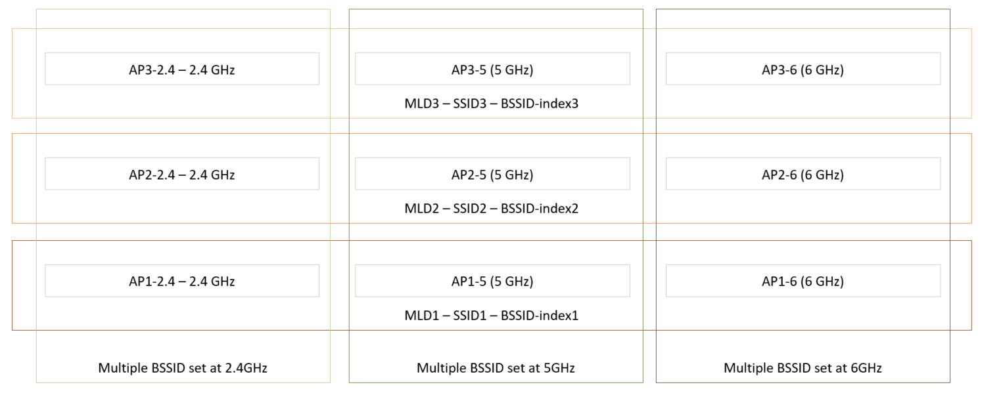
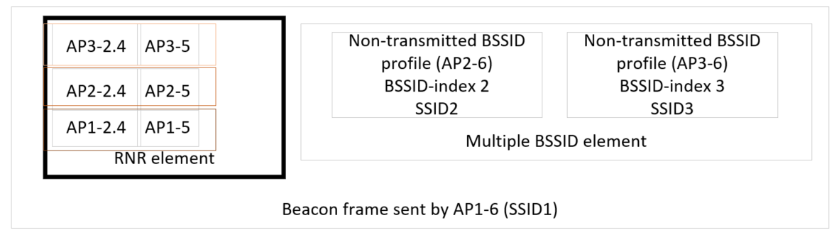
RNR with multiple BSSID
We agreed in 11ax that in case of multiple BSSID set, the RNR is not included in the non-transmitted BSSID profile of the multiple BSSID element, but in the core of the beacon
There is therefore only one RNR, and it includes all the reported APs
In our example: multiple BSSID set of 3 APs (3 SSIDs), and each AP is part of an MLD on 3 links (2.4/5/6 GHz)
  The RNR sent by one AP in its beacon therefore has to report all 6 collocated APs (all collocated APs from same MLD for all APs in the multiple BSSID set
We therefore need a way in the RNR to identify which reported APs is in which MLD
  Field to include that it is part of the same MLD as the reporting AP is not sufficient here
  We propose to include the BSSID-index in the TBTT Info field of a reported AP

Slide 7
Probing before multi-link setup
Following current behaviors, non-AP MLDs will want to have the complete information on an AP MLD (on each APs of the AP MLD) before doing multi-link setup
As beacons/probe responses from each AP will provide mainly their complete information, and only the basic information for the other APs of the same MLD, a non-AP MLD will have to go and scan all the APs of the MLD before doing multi-link setup
We believe that it would be very beneficial to define a way for a STA to collect the complete information for all the APs (at least the co-located ones) of a particular MLD from one of the APs of the AP MLD

Slide 8
Straw polls
SP1
  Do you agree that all APs that are part of the same MLD as the reporting AP and that are collocated with the reporting AP shall be reported in the RNR element that is included in the beacons and the broadcast probe responses transmitted by the reporting AP
    Note: an AP is not included if it is not discoverable
    Note: RNR provides basic information (operating class, channel, BSSID, short SSID, …)

Slide 9
Straw polls
SP2
  Do you agree to include in a TBTT Information field of the RNR, corresponding to a reported AP that is part of the same MLD as the reporting AP, an indication that the reported AP is part of the same MLD as the reporting AP?

Slide 10
Straw polls
SP3
  Do you agree to include in the TBTT Information field of the RNR the BSSID-index of the reported AP, if the reported AP is part of the same MLD as an AP from the same multiple BSSID set as the reporting AP?

Slide 11
Probing proposal
We propose to include a specific request for MLD response in a probe request frame sent to one AP of an AP MLD
  For instance: a new MLD request element
  Request to include all collocated APs, all APs, or a list of APs…
In response to that, the AP will include in the probe response the complete information for all the requested APs
  Need a way to include in the probe response the complete information for other APs
  Timestamp or TBTT offset? (surely optional for non-collocated)
If the group prefers, we can define a new frame exchange, but the simplest seems to be to use the probe request/response frames

Slide 12
Straw polls
SP4
  Do you agree to define a mechanism for a STA of a non-AP MLD to send a probe request frame to an AP belonging to an AP MLD, that enables to request a probe response from the AP that includes the complete set of capabilities, parameters and operation elements of other APs affiliated to the same MLD as the AP
    The complete information is defined as all elements that would be provided if the reported AP was transmitting that same frame (exceptions TBD)
    It’s TBD if the AP is mandated or not to respond with the requested information

