Slide 1
320 MHz BSS Configuration
Date: 2020-02-06
Authors:
Name | Affiliations | Address | Phone | Email
Po-Kai Huang | Intel
Laurent Cariou
Robert Stacey
Xiaogang Chen
Danny Alexander
Arik Klein
Daniel F Bravo
Notes:
September 2012

Slide 2
Background
320 MHz has been agreed to be one of the R1 features [1]
We discuss the required MAC support for 320 MHz BSS bandwidth configuration

Slide 3
Current BSS bandwidth configuration
The current 160 MHz configuration is based on (see backup)
5 GHz: Channel Width, CCFS0, and CCFS1 of VHT operation element or CCFS2 of HT operation element in 5 GHz
6 GHz: Channel Width, CCFS0, CCFS1 in 6 GHz Operation Information field
Example:
160 MHz (|CCFS0-CCFS1/CCFS2|=8)
80+80 MHz (|CCFS0-CCFS1/CCFS2|>16)
Primary 80 MHz
Secondary 80 MHz
5 GHz: Channel Width in VHT op: 1
6 GHz: Channel Width in HE op: 3
CCFS0
CCFS1/CCFS2
Primary 80 MHz
Secondary 80 MHz
5 GHz: Channel Width in VHT op: 1
6 GHz: Channel Width in HE op: 3
CCFS0
CCFS1/CCFS2

Slide 4
BSS operating bandwidth configuration for 320 MHz
Use additional entry like Channel Width in VHT operation element to indicate 320 MHz has interoperability issue
May not be understood by legacy non-HT, HT, VHT, and HE STAs
There is no additional entry for Channel Width in HE operation element
In 320 MHz or 160+160 MHz indication, CCFS0 and CCFS1/CCFS2 shall be based on the indication of 160 MHz to preserve backward compatibility
We propose to introduce additional fields, ideally in EHT operation element, for EHT channel width and EHT center frequency

Slide 5
BSS operating bandwidth configuration for 320 MHz
160 MHz (|CCFS0-CCFS1/CCFS2|=8), Channel Width =1/3 (VHT op/HE op), EHT Channel Width = 0
80+80 MHz (|CCFS0-CCFS1/CCFS2|>16), Channel Width =1/3 (VHT op/HE op), EHT Channel Width = 0
320 MHz (|CCFS1/CCFS2- EHT CCFS|=16), Channel Width =1/3 (VHT op/HE op), EHT Channel Width = 1
160+160 MHz (|CCFS1/CCFS2- EHT CCFS|>32), Channel Width =1/3 (VHT op/HE op), EHT Channel Width = 1
Primary 80 MHz
Secondary 80 MHz
Secondary 160 MHz
CCFS0
CCFS1/CCFS2
EHT CCFS
Primary 80 MHz
Secondary 80 MHz
Secondary 160 MHz
CCFS0
CCFS1/CCFS2
EHT CCFS

Slide 6
Conclusion
We propose to have EHT channel width field and EHT CCFS field to jointly indicate BSS operating bandwidth with indication in VHT operation element and HT operation element in 2.4/5 GHz band or HE element in 6 GHz band.
320 MHz (|CCFS1/CCFS2- EHT CCFS|=16), Channel Width =1/3 (VHT op/HE op), EHT Channel Width = 1
160+160 MHz (|CCFS1/CCFS2- EHT CCFS|>32), Channel Width =1/3 (VHT op/HE op), EHT Channel Width = 1
We propose to have EHT Channel Width field and EHT CCFS field in EHT operation element

Slide 7
Straw Poll #1
Do you support to define EHT operation element with the following fields to indicate 320/160+160 MHz BSS bandwidth?
Channel Width field
CCFS field

Slide 8
Reference
[1] 11-19/2153r4 Adopting a release framework to meet timeline

Slide 9
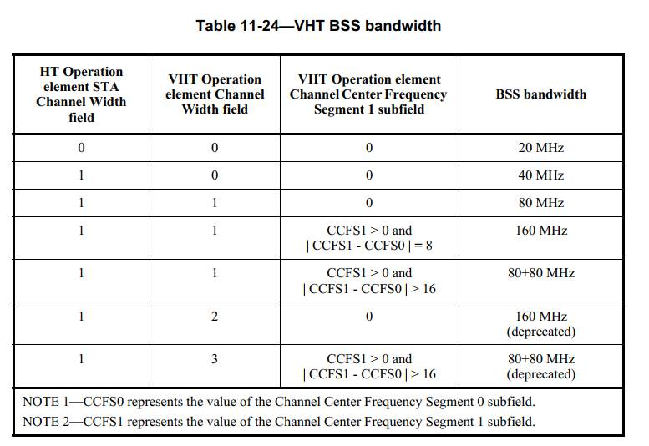
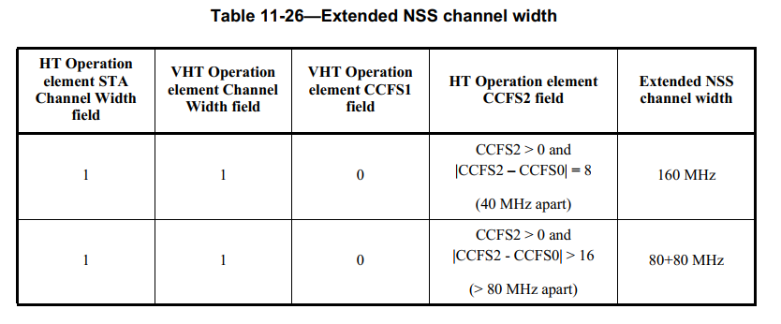
Backup

Slide 10
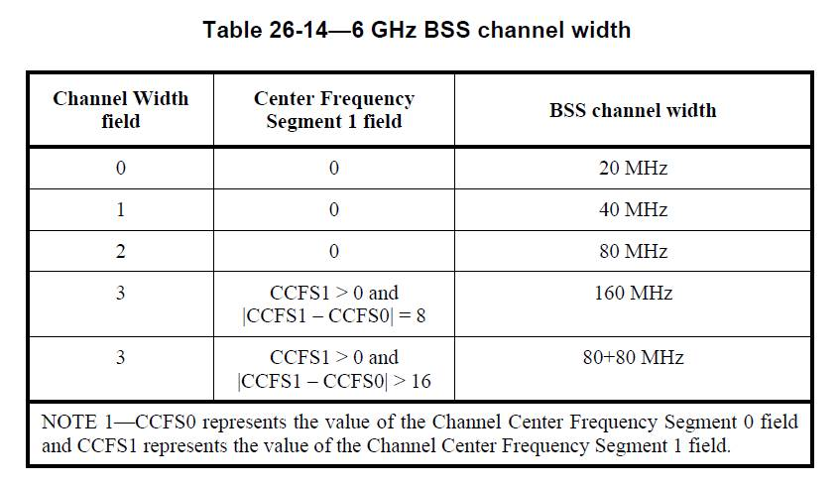
Backup

