Slide 1
Secure LTF Attacker Simulation
Date: 2020-03-03
Authors:

Slide 2
PHY Security
Attacker tries to modify the measured range
Make STA appear closer to AP to fake proximity detection
Spoof time-stamps t2 or t4 to achieve that
Focus on physical layer attack
Assume that MAC level is authenticated/encrypted
Includes time-stamps t1/t4 feedback to initiator

Slide 3
Integrity Attack Scenario
First line security
Use secure LTF (sequence unknown to attacker)
Replace Cyclic Prefix (CP) with zero-padded Guard Interval (to reduce structure)
Attack types
Replay attack: for both Cyclic Prefix or Guard Interval, attacker repeats first quarter portion of secure LTF with offset
Brute-force attack: attacker tries to guess the secure LTF
Noise only: performance in low SNR or attacker caused SINR

Slide 4
Attacker Type 1
Guard Interval (GI) Replay Attack
Attacker will listen to first quarter portion of LTF
Then try to change measured t2 or t4 by re-transmitting the first quarter with timing advance at the end
Will affect overlap-add based receiver
Waveform for channel measurement
First quarter
Timing advance
Waveform transmitted by attacker
Copy

Slide 5
Attacker Type 2
Brute Force Attack
Attacker will try to change measured t2 or t4 by guessing the secure LTF and transmitting with timing advance
Attack efficacy depends on likelihood of high cross-correlation between sequences A and B
Waveform for channel measurement
LTF Sequence A
Waveform transmitted by attacker
Timing advance
LTF Sequence B

Slide 6
Attacker Type 3
Performance in Noise
Even without an attacker the likelihood of triggering a false proximity detection increases with decreasing SNR
Attacker can send interference to artificially lower SNR
Used as a baseline to compare effectiveness of attacks
Measures of PHY security
If brute-force attack achieves no worse performance as noise-only
If replay attack achieves no worse performance than brute-force

Slide 7
Example: GI Replay Attack
Setup
40 MHz, overlap-add receiver
LTF with random QPSK symbols
True delay 250 ns
AWGN Channel
Attacker delay -33 ns
0 dB SINR
Peak appears at -6 dB
Amplitude normalized

Slide 8

Receiver FFT Processing
In practice use FFT
$$Y\left[k\right]=\frac{1}{T}\int_{0}^{T^{′}}{y\left(t\right)e^{−i2πf_{k}t}dt}=H\left[k\right]X\left(f_{k}\right)+w\left[k\right]$$
Frequency domain channel
$$H\left[k\right]=\frac{1}{T}\int_{0}^{T}{h\left(t\right)e^{−i2πf_{k}t}dt}$$
Typical frequency spacing of$f_{k} \text{are} \frac{1}{T}$
Signal observed on $T^{′}=T+T_{GI}$
Guard Interval (GI)
LTF 1
LTF 2
Tx Signal
Channel Spread
LTF 1
LTF 2
Rx Signal
Receiver
Processing
T’ = T+T_{GI}

Slide 9
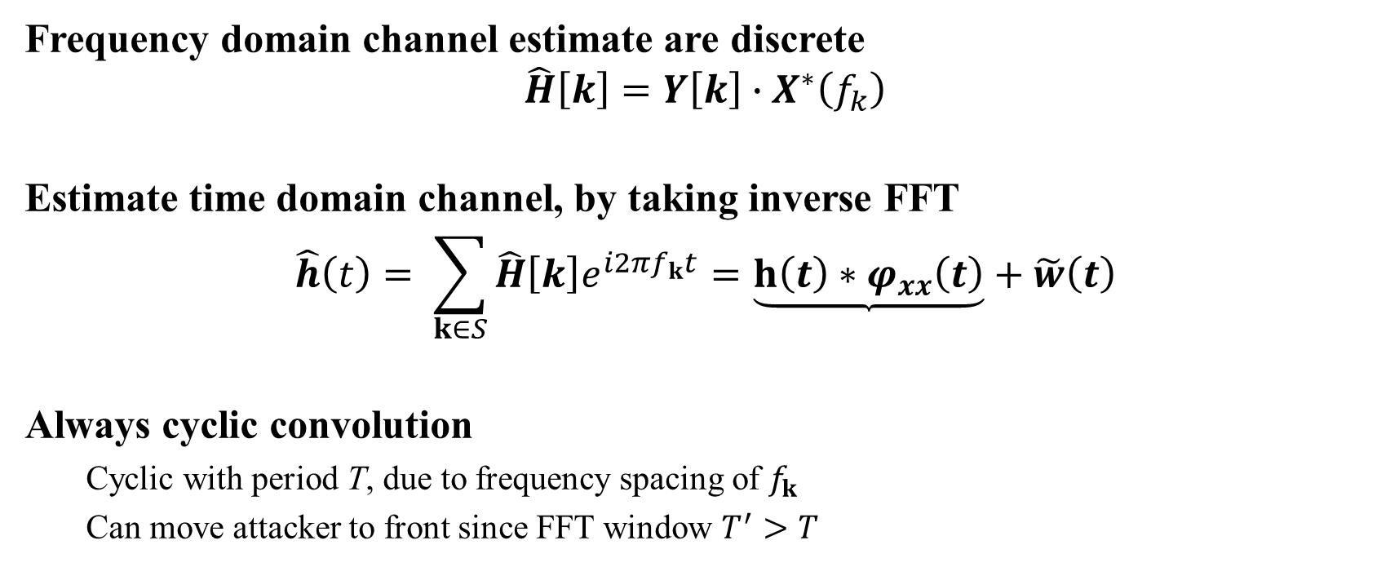
Time Domain Channel Estimates
Frequency domain channel estimate are discrete
$$\hat{H}\left[k\right]=Y\left[k\right]∙X^{∗}\left(f_{k}\right)$$
Estimate time domain channel, by taking inverse FFT
$$\hat{h}\left(t\right)= \sum_{k∈S}{{\hat{H}\left[k\right]e}^{i2πf_{k}t}}=\underbrace{h\left(t\right)∗φ_{xx}\left(t\right)}+\tilde{w}\left(t\right)$$
Always cyclic convolution
Cyclic with period T, due to frequency spacing of $f_{k}$
Can move attacker to front since FFT window $T^{′}>T$

Slide 10

Double Size Receiver FFT Processing
Need larger FFT window $T_{FFT}>T^{′}$
Easiest is double size FFT $T_{FFT}=2T>T^{′}$
Use frequency spacing of 1/(2T)
Half samples are original subcarriers
Zero
Padding
T-T_{GI}
LTF
Receiver
Processing
T’ = T+T_{GI}
FFT Window 2T

Slide 11
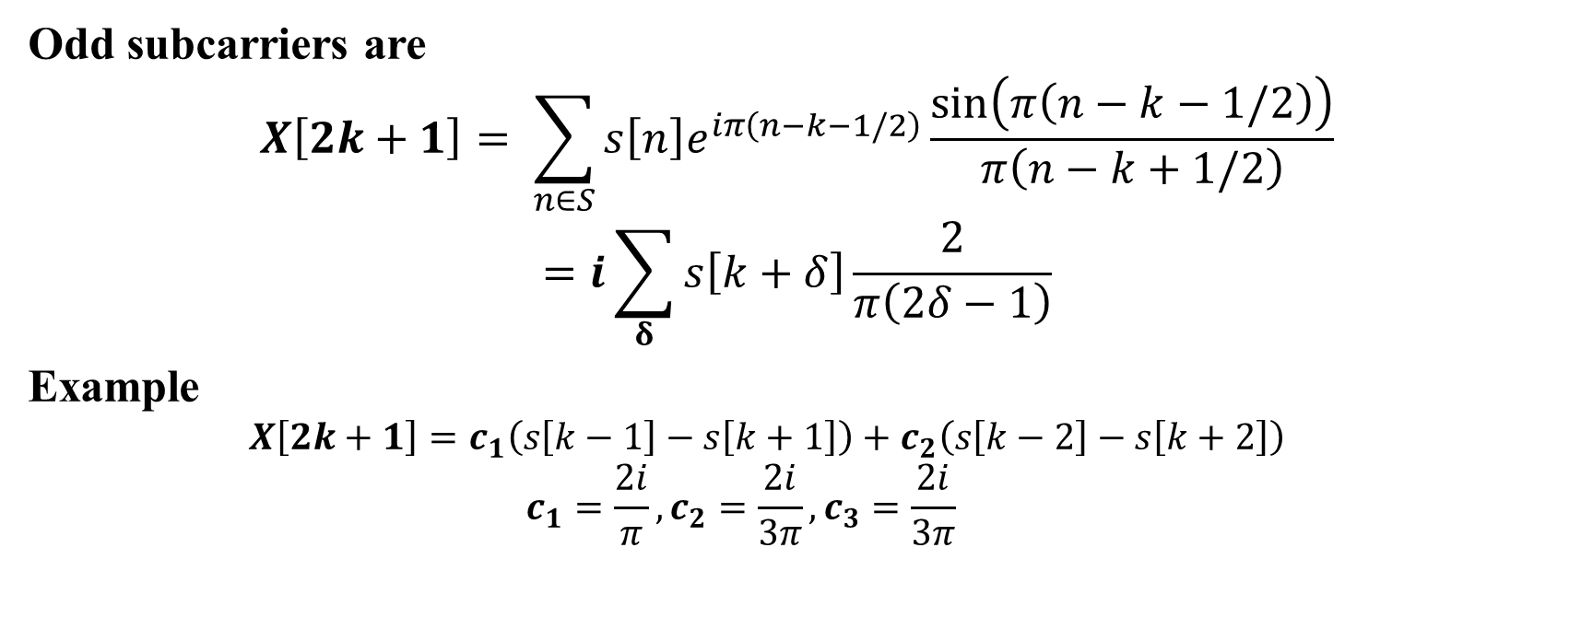
Calculation of Signal
Odd subcarriers are
$$X\left[2k+1\right]= \sum_{n∈S}{s\left[n\right]e^{iπ\left(n−k−1/2\right)}\frac{\sin\left(π\left(n−k−1/2\right)\right)}{π\left(n−k+1/2\right)}}$$
$$=i\sum_{δ}{s\left[k+δ\right]\frac{2}{π\left(2δ−1\right)}}$$
Example
$$X\left[2k+1\right]=c_{1}\left(s\left[k−1\right]−s\left[k+1\right]\right)+c_{2}\left(s\left[k−2\right]−s\left[k+2\right]\right)$$
$$c_{1}=\frac{2i}{π}, c_{2}=\frac{2i}{3π}, c_{3}=\frac{2i}{3π}$$

Slide 12
Tx Signal Spectrum
Spectrum at 1/T spaced subcarriers (QPSK)
Spectrum at 1/(2T) spaced subcarriers (QPSK)

Slide 13
Secure LTF Modulation
Power on “odd” subcarriers not uniform
Power random, depends mostly on neighboring subcarriers
Modulation affects power distribution
BPSK not shown
Poor security
π/2-BPSK unique
Less small values
QPSK fairly representative
Even π/4-QPSK similar

Slide 14
Secure LTF Channel Estimation
FFT output is not unit norm
How to best estimate the channel?
${\hat{H}}_{Corr}\left[k\right]=Y\left[k\right]∙X^{∗}\left(f_{k}\right)$
${\hat{H}}_{Inv}\left[k\right]=\left\{\begin{matrix}Y\left[k\right]∙X^{∗}\left(f_{k}\right)/{\left|X\left(f_{k}\right)\right|}^{2},\left|X\left(f_{k}\right)\right|>ε \\ {α\hat{H}}_{Inv}\left[k+1\right]+α^{∗}{\hat{H}}_{Inv}\left[k−1\right], else\end{matrix}\right.$
${\hat{H}}_{MMSE}\left[k\right]=Y\left[k\right]∙\frac{X^{∗}\left(f_{k}\right)}{\left({\left|X\left(f_{k}\right)\right|}^{2}+N_{0}\right)}$
Trade off between channel distortion and noise amplification
Does channel distortion matter?
Correlator is matched filter (SNR optimal)
Last presentation showed correlation peak is not affected
Does distortion matter for MUSIC based first path algos?

Slide 15
Secure LTF Performance Study
Use IEEE 802.11 channel model ‘D’
Generated based on underlying 2.5 ns tap quantization
Interpolated to 320 MHz channel impulse response
Simulated in complex baseband, up-sampled to 320 MHz
4x1 Channel, SNR 18 dB
Signal model/receiver
11ac signal design (pilots/dc/etc), but with GI instead of CP
Double size FFT, zero padded from T’ to 2T
Performance base line is using only “even” subcarriers, equivalent to overlap-add (OLA) processing
RTT performance
Assume symmetric ToA error distribution on both t2/t4
No attacker
Security performance simulated separately

Slide 16
Model ‘D’, NLOS, 40 MHz
Correlator has some performance loss
Little difference to QPSK

Slide 17
Model ‘D’, LOS, 40 MHz
Correlator has small performance loss
Mostly same

Slide 18
Model ‘D’, NLOS, 80 MHz
Correlator has some performance loss
Little difference to QPSK

Slide 19
Model ‘D’, LOS, 80 MHz
Correlator has some performance loss
Little difference to QPSK

Slide 20
Security Study
Use AWGN Channel
Interpolate Tx signal 4x
SINR attacker vs signal, SNR noise vs. signal
No attacker
Look at spurious peaks in noise only
SNR=0 dB
Brute-force attack
Attacker “guesses” LTF
SINR=0 dB, SNR=18 dB
Replay attack
Re-transmits first quarter of LTF
SINR=0 dB, SNR=18 dB

Slide 21
No Attacker : 40 MHz
QPSK – OLA as baseline
Double size FFT has 1 dB gain
π/2-BPSK - similar gain
Less noise amplification loss
noise
amplification
loss
full channel
processing gain

Slide 22
No Attacker : 80 MHz
Mostly similar to 40 MHz
A bit better than 40 MHz
noise
amplification
loss
full channel
processing gain

Slide 23
Brute-Force Attack : 40 MHz
QPSK brute-force match noise only
Loss for Inverse+MMSE
π/2-BPSK modulation has 2 dB loss against noise only, little noise ampl.
noise
amplification
loss
noise only
noise only
BPSK
loss

Slide 24
Brute-Force Attack : 80 MHz
Noise only and QPSK brute-force match
BPSK modulation has 2 dB loss against brute-force attack
noise
amplification
loss
noise only
noise only
BPSK
loss

Slide 25
Replay Attack : 40 MHz
Correlator almost completely suppresses attacker
Both MMSE and Inverse better than equivalent noise only
attacker
equal
to noise
unmitigated
attack
attacker
canceled

Slide 26
Replay Attack : 80 MHz
Both Inverse and MMSE better
Less improvement over 40 MHz
attacker
equal
to noise
attacker
canceled
unmitigated
attack

Slide 27
Conclusion
Presented results for secure LTF
Modulation types QPSK and π/2-BPSK
Three channel estimators, Correlator, Inverse, and MMSE
Location estimation performance
For FFT peak finding algos no significant impact in any case
For MUSIC based algos, some loss with Correlator
Attacker resilience
π/2-BPSK has 2 dB loss for brute-force attack, but less noise amplification with both inverse and MMSE
Both modulation reject replay attack below equivalent noise level

Slide 28
PAPR Study
PAPR for random QPSK modulated LTF
PAPR for Golay 8PSK modulated LTF

Slide 29
Performance of Golay Sequence
Brute force attacker, 0 dB SINR

