Slide 1
Proposals on AMPDU-BA mechanisms
Date: 2020-06-12
Authors:
Name | Affiliations | Address | Phone | Email
Sindhu Verma | Broadcom |  |  | Sindhu.vema@Broadcom.com
Shubhodeep Adhikari |  |  |  | Shubhodeep.adhikari@Broadcom.com
Matthew Fischer |  | 250 Innovation Dr, San Jose, CA 95134 |  | Matthew.fischer@Broadcom.com
Vinko Erceg |  |  |  | Vinko.erceg@Broadcom.com
Notes:
November 2012

Slide 2
Abstract
This contribution discusses possible enhancements to the existing AMPDU-BA mechanism to achieve improvements in efficiency especially related to multi-link, latency reduction, in-device-coexistence etc.

Slide 3
Limitations at AMPDU Recipient (1)
An AMPDU recipient is required to respond with BA at SIFS after the eliciting AMPDU’s PPDU
A recipient might sometimes be incapable of transmitting the BA at SIFS due to:
RX-TX switching delay
In device coexistence constraints: The recipient may have an upcoming burst of activity on another in-device technology like Bluetooth/LTE/NR which would prevent it from transmitting BA due to in-device leakage
A recipient might sometimes be incapable of receiving later MPDUs within an AMPDU due to:
Internal processing limitations (e.g. processing delay beyond SIFS, based on MCS/byte count/MPDU count, etc)
In-device coexistence constraints where an upcoming burst of activity on another technology would prevent reception due to in-device leakage

Slide 4
Limitations at AMPDU Recipient (2)
HT-immediate Block Ack Policy: Block Ack
This does not allow the originator to obtain assistance from the recipient
Minimum MPDU Start Spacing (parameter to take care of processing constraints)
It specifies the minimum spacing between any 2 MPDUs in microseconds irrespective of the MCS/bandwidth/MIMO order, etc used.
The spacing needs to be guaranteed even through padding which wastes transmission resources.
It is desirable if the solution gets exercised only if the specified maximum MPDU count/MPDU byte count are exceeded at the recipient and without wastage of resources.

Slide 5
Limitations At AMPDU Originator (1)
Implementation constraints of MLO may require some time margin for AMPDU construction
For example, this may depend on which link gains access to the channel first and with how much bandwidth
Case 1: The MLD may be prepared to transmit AMPDUs simultaneously on both the links and may have prepared transmissions accordingly with different sequence number sets. However, if one of the links wins access first or if the other link becomes busy, the earlier sequence numbers must be transmitted on the winning link especially in case of an NSTR MLD.
Case 2: If the bandwidth for which access to any link is won, is different from what was assumed while preparing disjoint sets of transmissions for the two links, the AMPDU contents may need to be assembled again.

Slide 6
Limitations At AMPDU Originator (2)
Continued...
Case 3: An STR MLD which wants to align PPDUs on 2 links, may be waiting to decode length information of a transmission from an NSTR ML device on one of the links (say link1) while it wins access to the other link (say link2).
If the STR MLD does not align the end of its link2 transmission with the end of its link1 reception, the NSTR ML device having missed the link2 preamble, may collide with the link2 transmission.
In all these cases, a time margin is beneficial.

Slide 7
Limitations At AMPDU Originator (3)
To accommodate this time margin, a short PPDU (AMPDU) could precede a longer PPDU (AMPDU)
Inserting SIFS+BA+SIFS between the two AMPDUs would lead to wastage. It might also cause a problem with synchronous MLD receivers
Transmitting without rebuilding may cause unnecessary retransmission of MPDUs or transmission of MPDUs with unnecessary gaps in sequence numbers
It helps is there is flexibility to insert a small PPDU in the beginning after which the PPDU with desired final length and contents can occur

Slide 8
Limitations of AMPDU BA Exchange (1)
The LENGTH and contents of an AMPDU cannot be adjusted once the transmission of a PPDU starts, as LENGTH is contained in the L-SIG.
However, adjustment of LENGTH and contents can be useful, for example in asynchronous operation on multi-link
Events on a link 1 might impact decisions regarding transmissions on a link 2. For e.g. the MLD might receive BA correctly on link 1 but not on link 2, and in an asynchronous manner.
In this case, the transmitter MLD may want the flexibility to prioritize retransmissions of erroneous packets from link 2 even though link 1 transmission started earlier than the end of link 2 transmission
So, the MLD could tentatively use a small PPDU at the beginning of link 1 transmission and follow it up with a larger PPDU depending on the ACK status on link 2.

Slide 9
Limitations of AMPDU BA Exchange (2)
Allowing multiple PPDUs without gaps/BA in between can also help better prioritize latency sensitive traffic and hence reduce latency
For example, this can enable the insertion of latency sensitive traffic in an ongoing transmission, rather than wait for the end of the ongoing transmission busrt
Such a transmission burst could span the entire TXOP and thus push the latency sensitive traffic to the next TXOP
When low-latency packets are anticipated, long PPDUs in a TXOP can be broken into a sequence of shorter PPDUs to allow insertion of low latency traffic

Slide 10
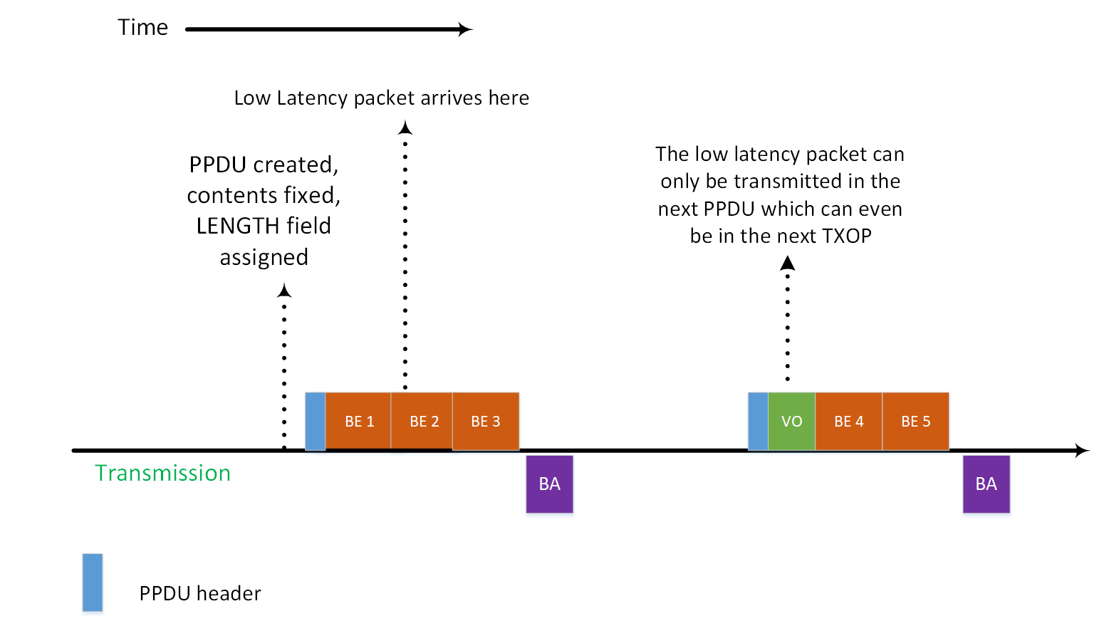
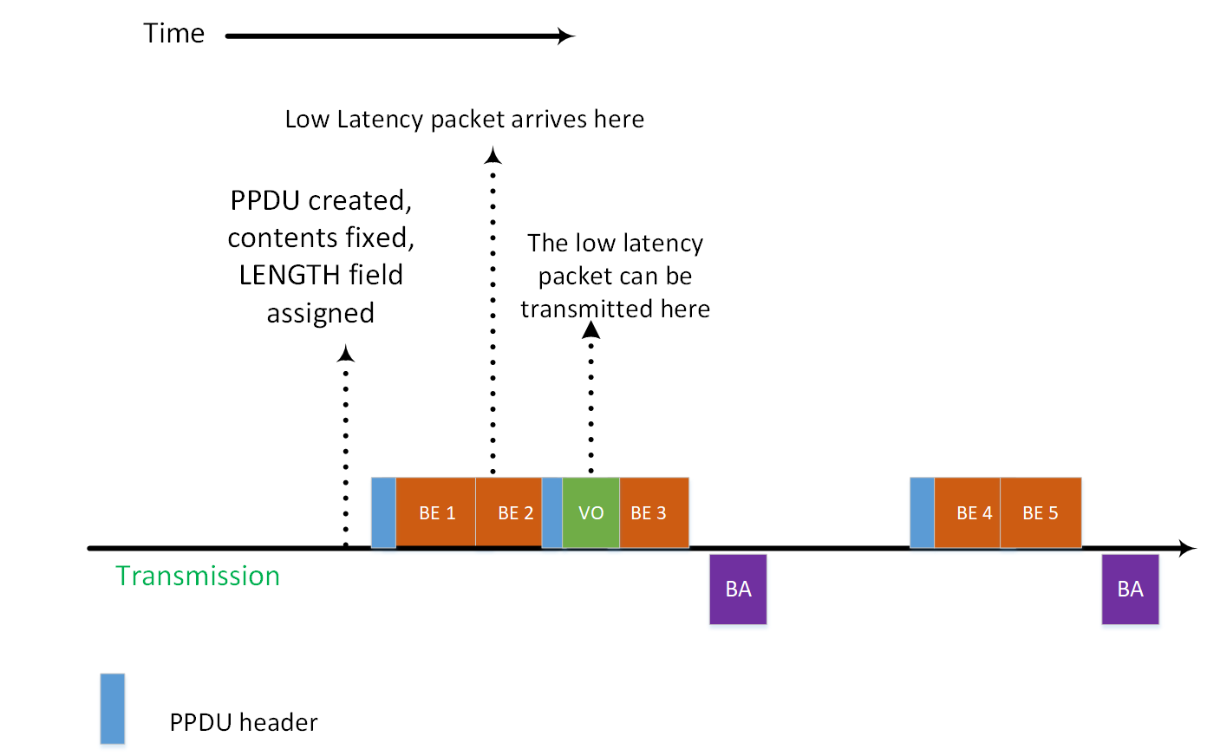
Limitations of AMPDU BA Exchange (3)
Current Scheme Proposed Scheme

Slide 11
Limitations of AMPDU BA Exchange (4)
For long AMPDUs, if the initial PHY header is missed, decoding fails for the receiving device and preamble detection fails for any device performing CCA
The problem can be alleviated if instead of a long PPDU, a sequence of shorter back-to-back PPDUs without gaps can be transmitted followed by a single composite BA.
Even if any intermediate PPDUs are in error, the remaining can be decoded
This will result in better throughput at the receiver in case of fading/dynamic channels.
This will also help collision avoidance through preamble detection especially in case of blindness in NSTR/eSR ML devices

Slide 12
Limitations of AMPDU BA Exchange (5)
Multiple MCSs/NSSs cannot be tried together and each combination must be tried one at a time followed by a corresponding feedback
Convergence of the rate control algorithm can be expedited if a composite feedback can be obtained for a back-to-back PPDU (AMPDU) sequence with multiple MCSs/NSSs.
The transmitter can pack back-to-back PPDUs each with a different MCS/NSS combination without any gap of with 16us gap
At the end of the burst, a composite BA is elicited which helps the transmitter know which MCS/NSS combination was the most successful
Not having intermediate BAs helps increase efficiency

Slide 13
Solutions for Recipient Capability Restriction (1)
Recipient scenario:
Recipient cannot transmit BA after AMPDU because:
Extended RX-TX delay due to high MCS/MPDU (byte) count, etc
In-device coexistence
Recipient solution:
Recipient indicates RX limitations to AMPDU originator
Maximum MPDU count, maximum byte count to meet SIFS
Minimum delay, maximum delay for BA transmission
In device coexistence issues if they exist.
Originator allows for delayed recipient response
Determines response parameters dynamically

Slide 14
Solutions for Recipient Capability Restriction: Originator Rules (1)
If the AMPDU originator follows the recipient’s limitations
E.g. transmits AMPDUs which fall below the RX-TX delay limits, and recipient has not signaled that coexistence issues are present
Originator interprets lack of BA within SIFS + slot as failure
Otherwise, originator interprets lack of BA as delayed BA

Slide 15
Solutions for Recipient Capability Restriction: Originator Rules (2)
In the case of delayed BA determination
When it interprets lack of BA as delayed BA
Optionally continue with TXOP (i.e. after PIFS)
Next PPDU to same recipient or other recipient(s)
Originator assumes that the missing BA will be either:
Transmitted using contention by the recipient
Triggered after negotiated minimum delay X and before a maximum delay Y. The expiry of maximum delay will lead to the assumption at the originator that the AMPDU is in error

Slide 16
Solutions for Recipient Capability Restriction: Recipient Rules
Recipient exercising delayed BA
Optionally transmits a BA with an indication of the last processed sequence number, or otherwise indicates that delayed BA is occurring
E.g. by not responding at all within SIFS
Eventually transmitted BA should be cumulative in terms of ACK information
E.g. if additional AMPDUs arrive before BA is transmitted

Slide 17
Scenario for Originator Flexibility
Originator scenario:
AMPDU originator does not want BA after SIFS
Regardless of recipient ability to respond after SIFS
E.g. to avoid destructive UL TX from recipient
Destructive to recipient’s ongoing RX on other link, OR
While testing various MCS, NSS combinations
Intends to perform consecutive DL transmissions to multiple recipients and then trigger BA in an MU fashion
Slow link-to-link communication regarding PPDU alignment information requiring short PPDU TX while awaiting alignment information

Slide 18
Solution for Originator Flexibility
Originator solution:
The originator indicates a provision/desire for delayed BA
E.g. indication in PHY header or MAC header
Only to a recipient that indicates capability
E.g. Ack Policy = Block Ack (within the HT-immediate context)
After signaling, the originator is free to transmit again after SIFS or even without any gap
The originator will elicit a BA later
E.g. using Implicit BAR, explicit BAR
Optionally allow the recipient to initiate BA transmission
E.g. within its own TXOP

Slide 19
Originator Actions
Originator decides to indicate delayed BA response
Based on originator local information
Originator wants to send SIFS or back-to-back sequence of AMPDUs
E.g. MCS exploration, medium synchronization through AMPDU-BA-AMPDU-BA sequence, latency interruption sequence
Known recipient limitations vs AMPDU contents
E.g. AMPDU exceeds recipient maximum byte count
Implicit delayed BA response
i.e. case when BA is absent SIFS after AMPDU
Originator assumes unsent BA when preceding RTS-CTS exchange was successful

Slide 20
Straw Poll 1
Do you support the inclusion of the following in the SFD:
Recipient indication of constraints
Maximum MPDU count, maximum byte count of AMPDU to meet SIFS response time for BA transmission
Minimum delay, maximum delay for BA transmission
That in-device coexistence issue might occur
Originator indication within a PPDU that a BA transmission SIFS after the PPDU is not permitted
Y/N/A

Slide 21
Straw Poll 2
Do you support the inclusion of the following in the SFD:
Transmission by the originator of PPDUs without any intervening gaps or with SIFS gap where each PPDU is allowed to have different MCS/NSS/duration
Y/N/A

Slide 22
Reference
[1] Draft P802.11REVmd_D3.4
[2] Draft P802.11ax_D6.1

