Slide 1
MAC Privacy and PMKSA Caching
Date: 2021-01-12
Authors:

Slide 2
Abstract

Slide 3
High Level Solution Description
The model for association is as follows:
  Device associates to a BSS with a random MAC address and generates a SA
  As part of the security association, a PMKID is generated.
  Device disassociates from network
  Device changes MAC address to new random address.
  Device attempts to associate to BSS with cached PMK the PMKID.
  AP recognizes the PMKID and STA establishes a new SA (and generates a new PMKID)
Note that any network state associated with the old MAC address would be lost.

Slide 4
Requirements
The AP and STA would advertise/negotiate an association with this capability.
A new PMKID will be generated for each subsequent association (to prevent tracking)
  The STA and AP generate a new PMKID (rPMKID) each association
The feature expedites the establishment of a security association – changing the MAC address will affect bridging and higher layer communications.
The solution will work for any AKM.

Slide 5
Solution
AP advertises support for rPMKSA caching in Extended RSNE
STA associates and signals intention to use rPMKSA caching
A new PMKID will be generated for each subsequent association (to prevent tracking)
  The STA and AP generate a new PMKID (rPMKID) each association
If this feature is supported by both STA and AP, the STA includes the rPMKID in the PMKID List field at Association.
NOTE: The feature expedites the establishment of a security association – changing the MAC address will affect bridging and higher layer communications.

Slide 6
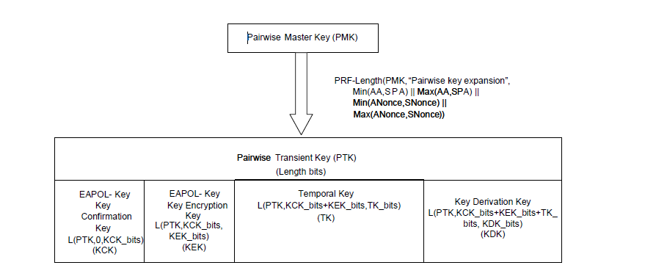
rPMKID derivation
Recently, TGaz and TGbe provided a generalized scheme for deriving new keying material from the PTK.
The rPMKID is derived from the PTK (KDK) for each association:
  (NOTE: FT and FILS have different PTK derivations)

Slide 7
rPMKID Derivation Options
Adopt an approach using the KDK based on TGba D8.0 and TGaz D2.0:
  Option 1. Using IEEE 802.11 KDF
    rPMKID = L(0, 128, HMAC-HASH(KDK, "rPMKID expansion")
  Option 2. Using IETF RFC 5869
    rPMKID-PRK = HKDF-Extract(current PMKID, KDK)
    rPMKID = HKDF-Expand(rPMKID-PRK, "rPMKID expansion", 16)

Slide 8
Next Steps
Determine which project this work fits into.
Continue to refine and produce a text submission based on this presentation and feedback received.

