Slide 1
MSDU fragmentation and aggregation in Multi-Link Operation
Date: 2020-08-17
Authors:

Slide 2
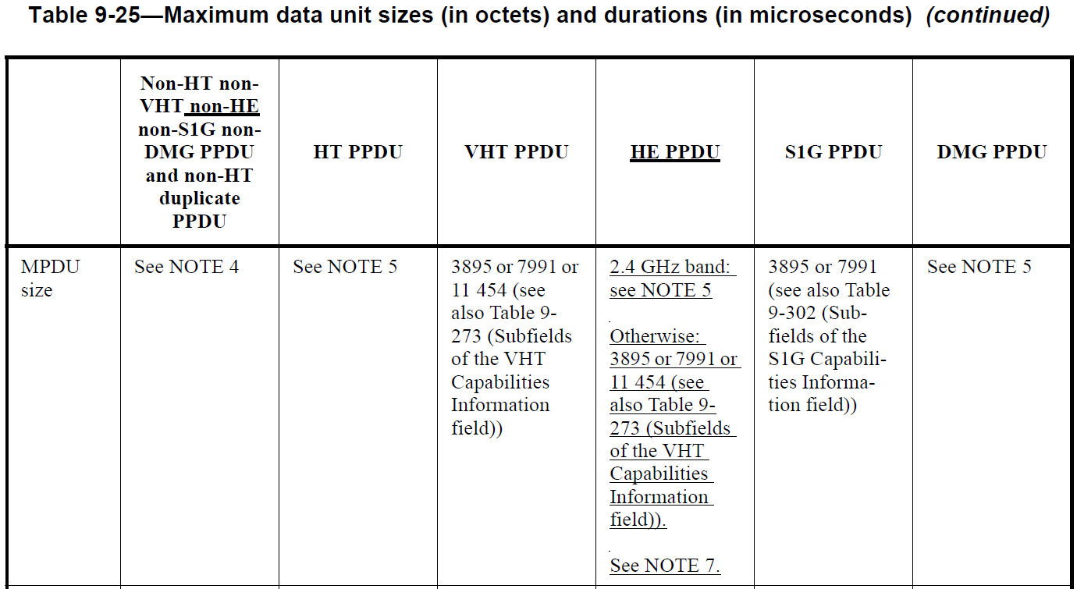
Motivation
The supported maximum MPDU length, the supported maximum number of MSDUs in A-MSDU, and other capabilities of each STA of a MLD can be different.

Slide 3
Motivation
The MSDU fragmentation or the A-MSDU aggregation is constrained by the supported maximum MPDU length, the supported maximum number of MSDUs in A-MSDU, and other capabilities of the recipient STA.
But, in the Multi-Link Operation (MLO), an issue is that the recipient STA is not determined until obtaining the TXOP and it can be also changed as a frame is retransmitted in different link.
This contribution discusses how to handle the MSDU fragmentation and the A-MSDU aggregation in the MLO.

Slide 4
MSDU fragmentation and A-MSDU aggregation in MLO
The MSDU fragmentation and the A-MSDU aggregation can be decided after a STA in the Multi-Link Device (MLD) obtains the TXOP.
In such case, the maximum MPDU length, the maximum number of MSDUs in A-MSDU, and other capabilities of the peer STA on the same link limits the MSDU fragmentation and the A-MSDU aggregation.

Slide 5
MSDU fragmentation and A-MSDU aggregation in MLO
However, when a frame is retransmitted to a different peer STA that does not support the maximum MPDU length, the maximum number of MSDUs in A-MSDU, and other capabilities supposed in the initial frame transmission, the MSDU fragmentation and the A-MSDU aggregation should be performed again.
It can cause a significant implementation complexity.

Slide 6
MSDU fragmentation and A-MSDU aggregation in MLO
Otherwise, a frame can be retransmitted only to the peer STAs that support the maximum MPDU length, the maximum number of MSDUs in A-MSDU, and other capabilities supposed in the initial frame transmission.
It is a simple solution but the performance of the MLO can be reduced.

Slide 7
MSDU fragmentation and A-MSDU aggregation in MLO
Depending on the MAC architecture, performing the MSDU fragmentation and the A-MSDU aggregation after obtaining a TXOP may not be applicable.
In such case, the MLO can define common capabilities among all enabled links for the MSDU fragmentation and A-MSDU aggregation.
Those common capabilities can defined in an explicit exchange, or an implicit manner like the below:
The minimum of the Maximum MPDU Length field values of all enabled links is used.
The minimum of the Max Number Of MSDUs In A-MSDU field values of all enabled links is used.

Slide 8
Fragment transmission in MLO
Fragments of single MSDU in the MLO can be sent through each different links.
In such case, the recipient MLD may need additional logic (e.g., common buffer) to reassemble the fragmented MSDUs which are received from each different links.
Considering more flexible design architecture, the recipient MLD should indicate whether the fragments of single MSDU can be sent through each different links.

Slide 9
Fragment transmission in MLO
When the recipient MLD supports that the fragments of single MSDU are sent through each different links, the simultaneous transmission on the multiple links should be also possible.
Because the recipient MLD delivers the MSDU to an upper layer after completely reassembling all fragmented MSDUs.
Link 2
Data [TID1, Seq1, Frag1]
ACK
Link 1
Data [TID1, Seq1, Frag0]
ACK

Slide 10
Conclusion
When STAs within a MLD have each different MAC parameters, some MAC operations like the MSDU fragmentation and the A-MSDU aggregation may need some architecture changes.
In order to minimize the implementation complexity, applying common capabilities among all enabled links for the MSDU fragmentation and A-MSDU aggregation is preferred.

Slide 11
Straw Poll 1
Do you support that each STA in a MLD has common capabilities for the maximum MPDU length and the maximum number of MSDUs in an A-MSDU?
These capabilities are carried in the EHT capabilities element

Slide 12
Straw Poll 2
Do you support that each STA affiliated to a MLD shall not transmit an MPDU that exceeds the minimum of the maximum MPDU length capabilities of all STAs affiliated to the recipient MLD?

Slide 13
Straw Poll 3
Do you support that each STA affiliated to a MLD shall not transmit an A-MSDU that includes a number of MSDUs greater than the minimum of the Max Number Of MSDUs In A-MSDU capabilities of all STAs affiliated to the recipient MLD?

