Slide 1
Shared TXOP protocol
Date: 2020-03-15
Authors:

Slide 2
Introduction
Several motions passed in January meeting on multi-AP topic [1]
An EHT AP supporting the Multi-AP coordination can send a frame (e.g., Beacon or other management frame) including capabilities of Multi-AP transmission schemes
Sharing AP
An EHT AP which obtains a TXOP (802.11 transmission opportunity) and initiates the Multi-AP coordination
Shared AP
An EHT AP which is coordinated for the Multi-AP transmission by the Sharing AP
802.11be shall define a mechanism to
determine whether an AP is part of an AP candidate set and
can participate as a shared AP in coordinated AP transmission initiated by a sharing AP
In this contribution, we focus on the AP candidate set, shared AP selection and coordination for Shared TXOP operation

Slide 3
Multi-AP Coordination – AP Candidate Set
For simplicity, we refer to
Sharing AP: AP shall have capability to initialize multi-AP Coordination
Shared AP: AP shall have capability to participate in multi-AP Coordination
Sharing AP shall advertise its multi-AP Coordination capability (e.g. in Beacons)
Accordingly, other APs can request to be part of its AP Candidate Set
Each Sharing AP maintains an AP Candidate Set
AP Candidate Set may be different for each multi-AP transmission mode supported by the Sharing AP due to requirements of BSS operation, coordination complexity, etc.
An AP can be part of AP Candidate Set of multiple Sharing APs

Slide 4
Shared TXOP operation - Recap
APs part of AP Candidate Set can request for resources from Sharing AP
Upon obtaining TXOP, Sharing AP determines if it shares TXOP with one or more APs (shared APs) from its AP candidate set.
We denote this TXOP as Shared TXOP (SH-TXOP)
Sharing AP initiates SH-TXOP by transmitting SH-TXOP Announcement frame
Announcement frame transmitted in non-HT Duplicate PPDU on every 20 MHz channel of the obtained TXOP bandwidth. Shared APs may not have primary 20 MHz coinciding with the primary 20 MHz of sharing AP
Announcement frame includes frequency resource, temporary primary channel of each shared AP, lengths, and additional TXVECTOR parameters for DL and UL transmission
Sharing AP does not allocate the RUs for the STAs associated with the shared APs
Each AP assigns RUs to its associated STAs, existing RU allocation procedures for non-associated STAs
UL and DL TX alignment may be required across APs to mitigate adjacent channel interference

Slide 5
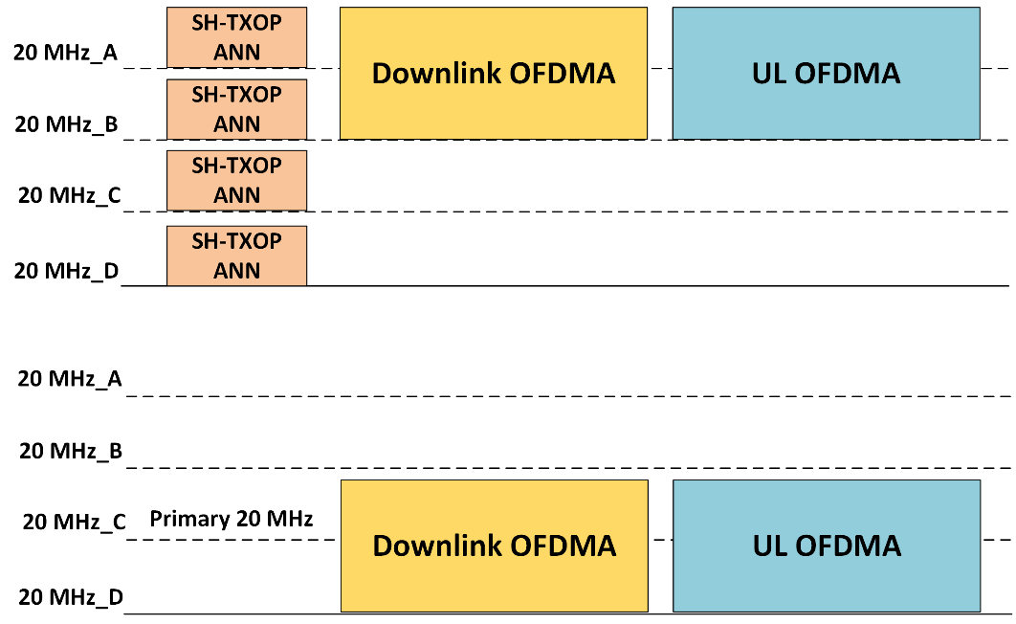
Shared TXOP operation example
Sharing AP operating on 80 MHz
Shared AP operates on the same 80 MHz on different primary 20 MHz channel
Sharing AP transmits SH-TXOP Announcement in Non-HT Duplicate PPDU format
Downlink transmissions begin after SIFS
Followed by UL OFDMA acknowledgement and data transmissions
Sharing AP
Shared AP

Slide 6
Selection Rules for AP Candidate Set and Shared AP
In previous example, if the Shared AP operated on 160 MHz instead of 80 MHz. And, its primary 20 MHz lied outside of the Sharing AP’s TXOP BW
Shared AP would not receive the SH-TXOP announcement frame
Proposed rules
Primary 20 MHz of an AP part of a Sharing AP’s AP Candidate Set shall lie within the BSS operating bandwidth of that Sharing AP.
Primary 20 MHz of a Shared AP shall lie within the SH-TXOP bandwidth.
Sharing AP shall not allocate to any Shared AP time-frequency resources beyond the duration of SH-TXOP and outside of corresponding SH-TXOP bandwidth.
AP Candidate Set should be updated when a Shared AP performs channel switch to a primary channel outside of Sharing AP’s BSS operation bandwidth.

Slide 7
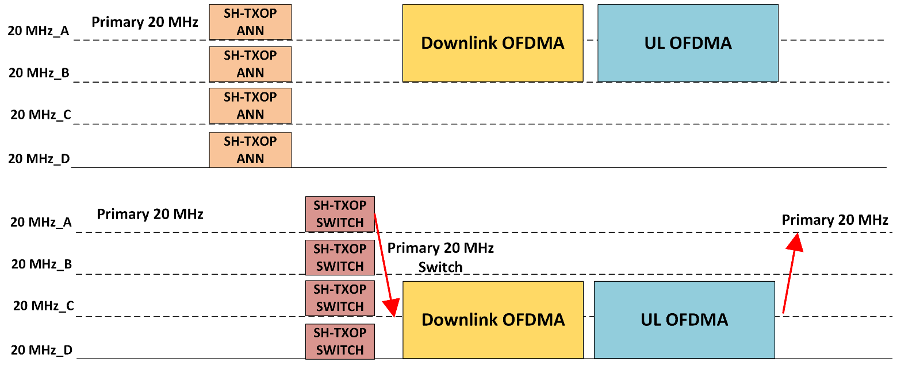
Primary Channel Switch by Shared APs
In Shared TXOP, one or more Shared APs may have to switch their primary 20 MHz channel temporarily until the end of sh-TXOP
Primary 20 MHz of shared AP coincides with that of sharing AP or other shared APs
Such Shared APs need to indicate temporary channel switch to associated EHT STAs
STAs may not hear SH-TXOP Announcement frame from Sharing AP being out of coverage
Center Frequency and BSS operating bandwidth remain the same
Sharing AP
Shared AP

Slide 8
SH-TXOP Switch Transmission and Contents Proposal
SH-TXOP Switch transmitted simultaneously by shared APs shall be identical
To avoid collision at STAs
SH-TXOP Switch transmitted in non-HT Duplicate PPDU format by Shared AP on each 20 MHz channel of its BSS operation within the SH-TXOP bandwidth
Even Shared AP not performing primary channel switch transmits SH-TXOP Switch
To retain channel access and prevent STAs from transmitting
SH-TXOP Announcement frame shall include information whether SH-TXOP Switch frame shall be transmitted
Sharing AP may not transmit SH-TXOP Switch
As its STAs hear SH-TXOP Announcement
Duration field in SH-TXOP Switch set to end of SH-TXOP for legacy STAs NAV update
SH-TXOP switch shall include only information essential for EHT STAs of shared AP(s)
Primary channel and bandwidth, more contents TBD

Slide 9
SH-TXOP Switch Example with multiple Shared APs
Sharing AP and two Shared APs operate on the same primary 20 MHz channel
Sharing AP includes the two Sharing APs in the SH-TXOP Announcement
Both the Shared APs simultaneously transmit the identical SH-TXOP Switch
Sharing AP and Shared APs conduct the DL and UL transmissions
Shared APs switch back to the primary channel prior to SH-TXOP

Slide 10
SH-TXOP Switch Frame Address and Security
STAs associated to different shared APs need to decrypt the identical SH-TXOP Switch
SH-TXOP Switch Security context establishment – Scalability issue
STAs would have have to generate temporal keys with Sharing AP
When AP joins an AP Candidate Set, each STA has to generate the keys with Sharing AP
SH-TXOP Announcement and SH-TXOP Switch can be Control frames or unprotected management frames
We prefer Control format as they are usually processed in the lower MAC
New Trigger frame type
SH-TXOP Switch MAC Header
TA includes Sharing AP’s MAC address. SH-TXOP Switch does not solicit any response!
An AP can share a priori (e.g. during association) with associated EHT STAs the MAC address of Sharing AP whose AP Candidate Set this AP is part of
EHT STAs decode the SH-TXOP Switch with TA equal to Sharing AP’s MAC address

Slide 11
Summary
Rules for AP inclusion in AP Candidate Set for Shared TXOP operation
Rules for Shared AP selection from AP Candidate Set for Shared TXOP operation
Contents of Announcement frame to initiate Shared TXOP
Frame contents for temporary primary channel switch during Shared TXOP
Security and Addressing considerations for frames enabling Shared TXOP operation

Slide 12
Straw Poll #1
Do you support the addition of following text to the TGbe SFD:
Shared TXOP (SH-TXOP): A TXOP in which Sharing AP grants time-frequency resources to Shared AP(s).
Primary 20 MHz of an AP belonging to a Sharing AP’s AP Candidate Set shall be within the BSS operating bandwidth of that Sharing AP.
Primary 20 MHz of a Shared AP shall be within the TXOP bandwidth obtained by Sharing AP.
Sharing AP shall not allocate to any Shared AP time-frequency resources beyond the duration of SH-TXOP and outside of corresponding SH-TXOP bandwidth.

Slide 13
Straw Poll #2
Do you support the addition of following text to the TGbe SFD:
In Coordinated OFDMA, primary 20 MHz of an AP belonging to Sharing AP’s AP Candidate Set may be same as primary 20 MHz of the Sharing AP.

Slide 14
Straw Poll #3
Do you support the addition of following text to the TGbe SFD:
802.11be shall define a mechanism for Shared AP to temporarily perform channel switch until the end of SH-TXOP.

Slide 15
References
[1] 11-19-1262-07-00be-specification-framework-for-tgbe
[2] 11-19-1788-01-00be-coordinated-ofdma-operation

Slide 16
Straw Poll #4
Do you support the addition of following text to the TGbe SFD:
802.11be shall define an SH-TXOP Announcement frame, a new frame type which will be transmitted by a Sharing AP to initiate a SH-TXOP.
SH-TXOP Announcement can be a new Control frame/ Trigger frame type
SH-TXOP Announcement frame contains frequency resource assigned to each shared AP, temporary primary channel of Shared AP if required, lengths and additional TXVECTOR parameters for DL and UL transmission
NOTE – SH-TXOP Announcement frame may not contain RU allocation to be performed by the Shared APs for UL and DL transmission during the Shared TXOP
NOTE – More contents of SH-TXOP announcement frame are TBD

Slide 17
Straw Poll #5
Do you support the addition of following text to the TGbe SFD:
SH-TXOP Announcement frame shall be transmitted in non-HT Duplicate PPDU on every 20 MHz channel of SH-TXOP bandwidth

Slide 18
Straw Poll #5
Do you support the addition of following text to the TGbe SFD:
802.11be shall define an SH-TXOP Switch frame, a new frame type transmitted by Shared AP to perform temporary BSS channel switch until the end of SH-TXOP as directed by SH-TXOP Announcement frame.
SH-TXOP Switch shall be transmitted by every Shared AP allocated time-frequency resource by the Sharing AP
SH-TXOP Announcement frame shall includes information whether SH-TXOP Switch frame is to be transmitted
SH-TXOP Switch shall be transmitted by a Shared AP in non-HT Duplicated PPDU format on each 20 MHz channel within the SH-TXOP bandwidth that is also part of the Shared AP’s BSS operating bandwidth

