Slide 1
MLO Constraint Indication and Operating Mode
Date: 2020-03-15
Authors:

Slide 2
Introduction
Multi-link operation is a key feature of the 802.11be standard development
Several discussions and motions on link management and in-device operation constraints
Multi-link Management
  Concept of link enable/disable
  Multi-link power saving
Operation Constraints
  MLDs with constraint to perform simultaneous transmit-receive operation (non-STR)
In this contribution, we discuss multi-link operating mode of non-AP MLD and updates under various network conditions
  Dynamic link status update and potential latency, BSS parameter updates on disabled links, link operation and constraint update for channel switching

Slide 3
Link Management– Recap [1]
By default, after multi-link setup, all TIDs are mapped to all setup links.
The TID-to-link mapping can be updated after multi-link setup through a negotiation, which can be initiated by any MLD.
  NOTE: When the responding MLD cannot accept the update, it can reject the TID-to-link mapping update
A link, that is setup as part of a multi-link setup, is defined as Enabled if that link can be used for frame exchange and at least one TID is mapped to that link.
  NOTE – Frame exchange on a link is subject to the power state of the corresponding non-AP STA.
A non-AP MLD monitors and performs basic operations (such as traffic indication, BSS parameter updates, etc.) on one or more link(s).

Slide 4
STR Constraint – Recap [1,2]
802.11be shall allow a MLD that has constraints to simultaneously transmit and receive on a pair of links to operate over this pair of links.
A MLD that supports multiple links can announce whether it can support transmission on one link concurrent with reception on the other link for each pair of links.
  NOTE 1 – The 2 links are on different channels.
  NOTE 2 – Whether to define a capability of announcing the support transmission on one link concurrent with transmission on the other link is TBD.

Slide 5
Multi-link BSS Management
AP MLD establishes BSS on multiple links distributed over multiple bands
An interested non-AP MLD can perform ML Setup on a subset of links operated by AP MLD
Among the setup links, the set of enabled links for frame exchange can update dynamically
For an associated non-AP MLD, AP MLD maintains Enabled Link Set (“TID-to-link map”)
For the Enabled Link Set, AP MLD maintains pairwise STR capability of the non-AP MLD
Simplistic snapshot of info stored at AP MLD operating on links A, B, C and D
  AP MLD has STR capability on every pair of links
Non-AP MLD | Setup Links | Enabled Link Set | STR Capability Info of non-AP MLD at AP MLD
Device 1 | {A, B, D} | {A, B} | {A-B: STR}
Device 2 | {A, B, C} | {A, B, C} | {A-B: STR, B-C: Non-STR, A-C: STR}

Slide 6
STR Capability Information
STR capability on a link pair depends on design, implementation and operation
  Channel separation, operating BW on each channel, bands of operation, antenna distribution across links (all antennas for all links, separate antennas per link, ..), etc.
Contents provided by non-AP MLD during multi-link setup can be of varying levels
Simplistic option
  Bit indication of pairwise STR capability between the specific channels used by AP MLD
Coarse-grained example
  Simple bit indication for STR Capability across multiple bands e.g. 2.4G-5G, 5G-6G, etc.
Fine-grained example
  Minimum frequency separation to be STR capable
    Dimensions: link bandwidth, transmit power

Slide 7
STR Capability Update
Questionable benefit of providing fine-grained information as the non-AP MLD’s operating mode and therefore STR capability is time-variant
Therefore, it would be beneficial to define mechanism for non-AP MLD to update STR capability of any pair of enabled/setup links even after initial multi-link setup
STR Capability update mechanism can be similar to Operating Mode indication in 802.11ax. We can define new field similar to 802.11ax OM Control
To facilitate fast transition of non-AP MLDs from STR mode to non-STR mode and vice versa and take advantage of multi-link channel access, this operating mode update of any pair of enabled/setup links by non-AP MLD shall be allowed to perform on any of the enabled links

Slide 8
Dynamic Link Enable/Disable
Non-AP MLD may enable/disable any of the setup links dynamically
  Power save
  Link switching
  Co-existence with other technologies
  In-device constraints
  Traffic changes
  Channel switch by AP STA
  Recommendation by AP MLD
  Et cetera
For simplicity, we denote the update of the set of enabled links as Enabled Link Set Update

Slide 9
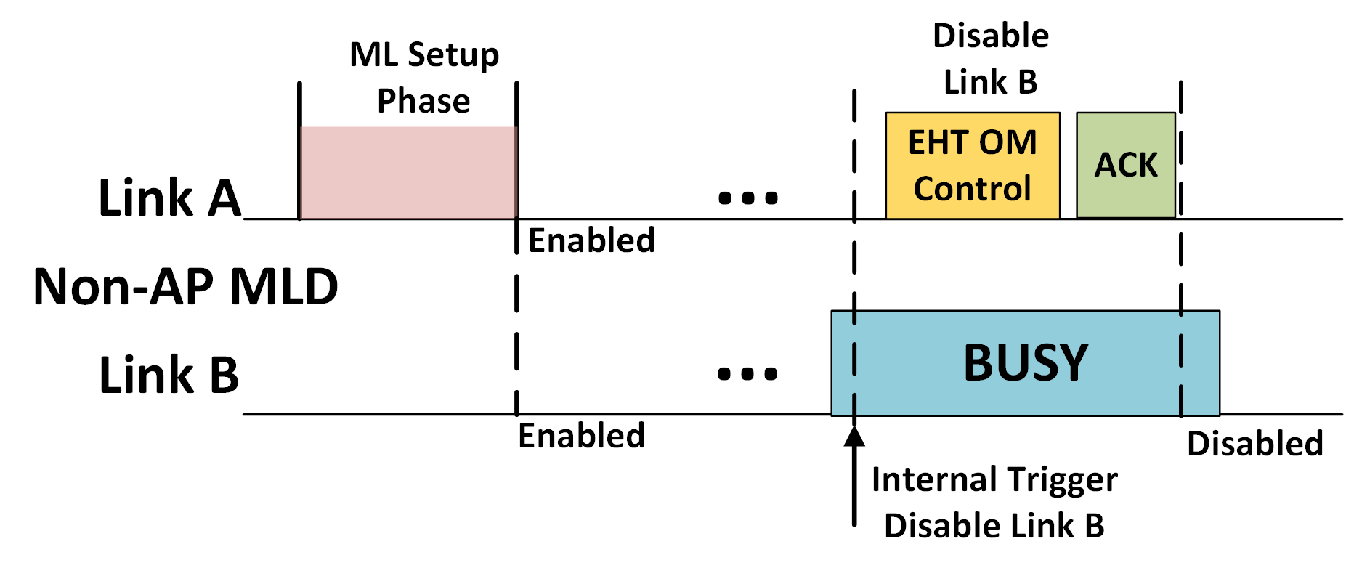
Dynamic Link Set Update Mechanism
Enabled Link Set Update mechanism can be similar to Operating Mode indication in 802.11ax. We can define new EHT Control field similar to 802.11ax OM Control.
To facilitate fast transition and take advantage of multi-link channel access, Enabled Link Set update by non-AP MLD shall be allowed to perform on any of the enabled links

Slide 10
Dynamic Link Set Update Proposed Rules
Enabled Link Set update initiated from non-AP MLD may be intended to enable or disable link(s)
Link Enabled to Disabled
  Non-AP MLD may not want or not be able to exchange frames on link temporarily
Link Disabled to Enabled
  Non-AP MLD intends to re-enable a setup link that was temporarily disabled. However, AP MLD may reject the request e.g. load balancing
AP MLD rejecting updates initiated by non-AP MLD can limit non-AP MLD’s preferred operating mode and degrade performance
AP MLD shall not reject Enabled Link Set update (TID-to-link mapping) update initiated by non-AP MLD

Slide 11
Disabling a Link with AP MLDs
Prior to the disabling of a link by non-AP MLD, AP on that link might have frames queued for the corresponding non-AP STA
  Trigger frames, data, etc.
Similar to existing problem in legacy WLANs as non-AP STA switches to PM = 1 mode
Even after non-AP MLD sends Enabled Link Set update frame indicating a link to be disabled, AP might transmit on that link
  Asynchronous multi-link operation
    Disable link A message transmitted by non-AP MLD on link B
  In-device coordination latency at AP MLD

Slide 12
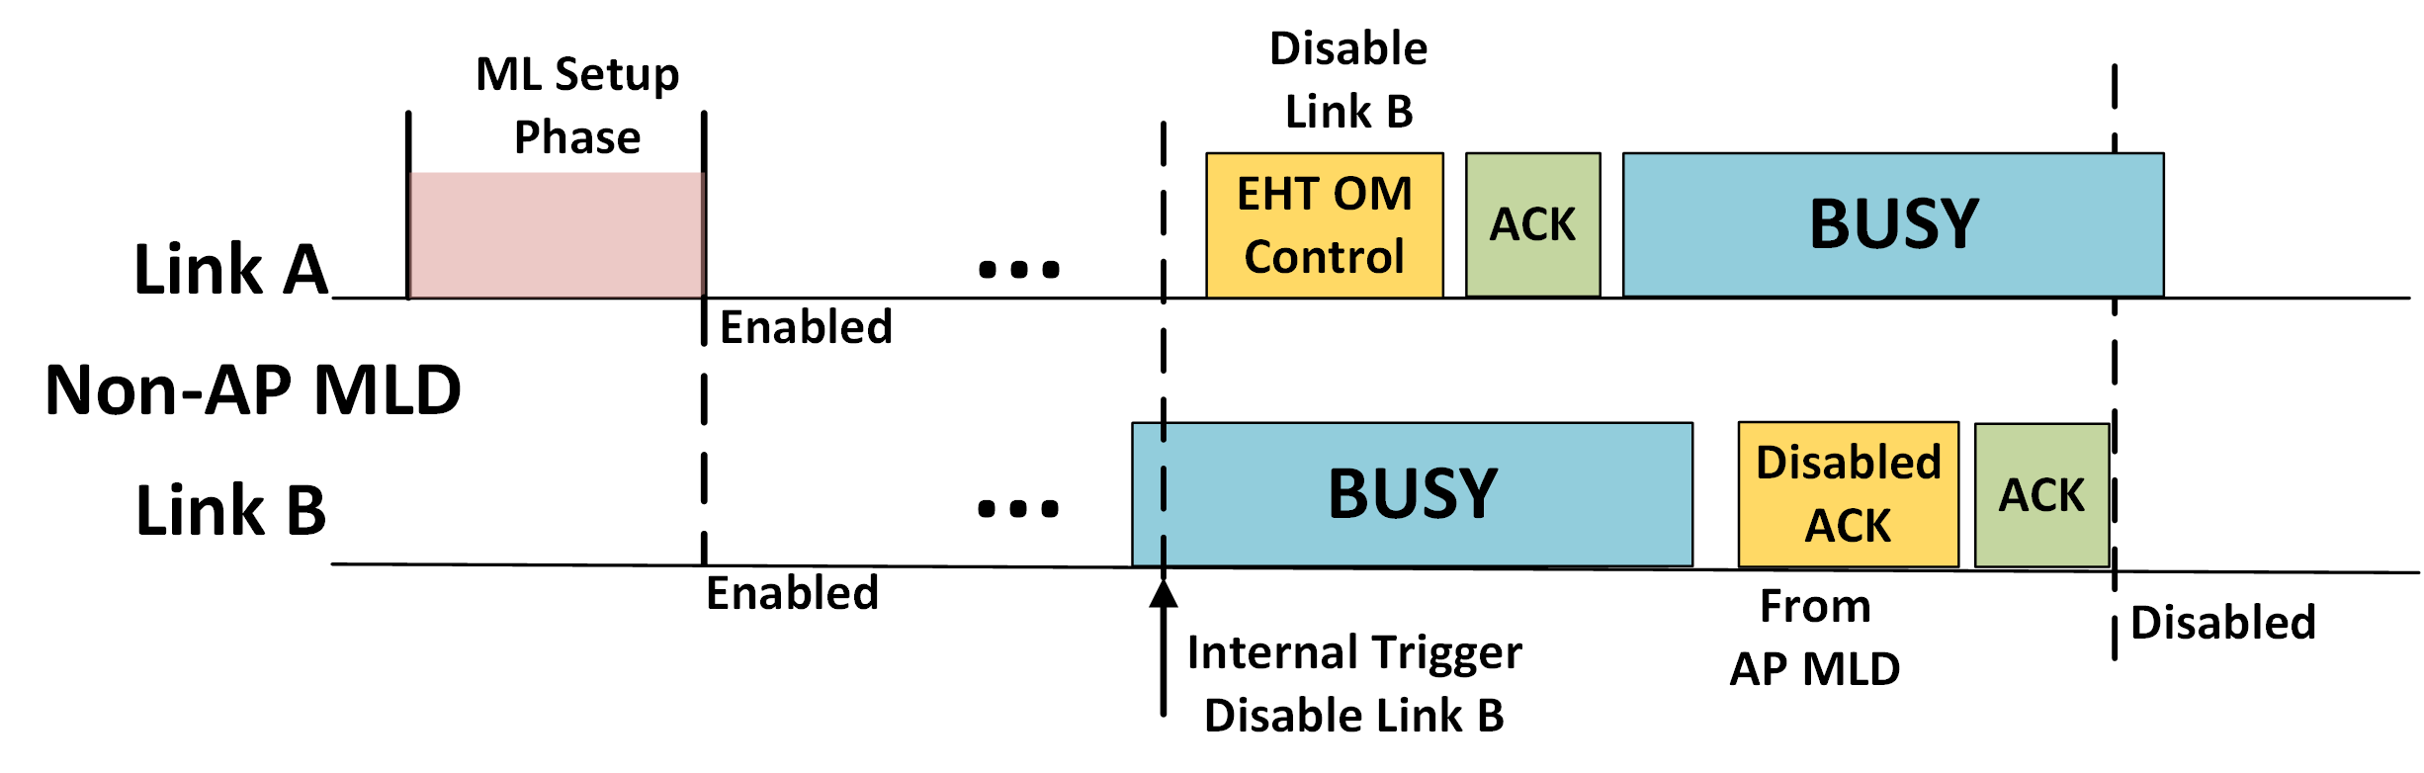
Disabling a Link with AP MLDs Proposal
Option 1: Require AP MLD to transmit explicit Disabled Link acknowledgement for Enabled Link Set update (“TID-to-link mapping” update) that results in a disabled link
  Non-AP MLD shall continue to monitor the disabled link until receiving this explicit acknowledgement
  Disabled link acknowledgement can be transmitted from AP on any link that is enabled prior to transmission of this frame

Slide 13
Disabling a Link with AP MLDs Proposal
Option 2: AP MLD can provide a pre-defined timer value to non-AP MLD during multi-link setup as the wait time to disable a link.
  After non-AP MLD transmits the EMT OM Control message to disable a link, the timer countdown begins
  During the countdown, the non-AP MLD continues to monitor the link but does not initiate any frame exchanges
  After the timer expiry, the link is considered disabled by both AP MLD and non-AP MLD

Slide 14
BSS Parameters Update on Disabled Link
During the temporary disabled state of a link, BSS Parameters of this link may get updated
To avoid Beacon bloating, AP MLD might not include the complete set of BSS operating parameters of one link in the Beacons or Probe Responses sent on other link
  Even including just the updated BSS parameters can be significant due to repetition
Essential information such as operating channel, primary 20 MHz of other link should be still included to aid in multi-link discovery and in case of channel switch when the link is disabled
When a disabled link is re-enabled, the non-AP MLD would have to wait until receiving Probe Response or Beacon for updated BSS parameters before it can initiate frame exchanges
Highly desirable for non-AP MLD to perform fast transitions into updated Enabled Link Set and perform frame exchanges

Slide 15
Option 1: BSS Parameter Update Notification
In the same message to disable a link, non-AP MLD requests for notification from the AP MLD if the BSS Parameters of this link get updated during the disabled status
When BSS Parameters of a disabled link get updated, AP MLD includes notification in unicast transmissions to this non-AP MLD on other enabled links
  A single bit is sufficient to indicate update has taken place
Assisted by the AP’s notification, Non-AP MLD can monitor Beacon/ Probe Responses of a disabled link prior to re-enabling of that link
Cons: AP MLD needs to maintain snapshot of BSS Parameters of setup links at the time of disabling a link and notify non-AP MLD when there is BSS Parameters update

Slide 16
Option 2: Per-link BSS Parameter Version ID
AP of an AP MLD includes in its Beacons and Probe Responses the Version ID of the BSS Parameters of other AP(s) belonging to this AP MLD e.g. in EHT Operation, ML IE, etc.
The complete set of BSS Parameters or even the updated parameters need not be included
Size of Version ID is TBD
In contrast to Option 1, AP MLD does not need to maintain snapshot of BSS Parameters for each non-AP MLD’s enabled link set update
AP can also include this Version ID information in EHT Control of unicast transmissions
Can also be utilized by non-AP MLDs with active TWT sessions on one or more links
  Do not need to wake up for Beacon if Version ID of TWT link is not changed
In both options 1 and 2, non-AP MLD, upon receiving notification that the BSS parameters of disabled link have updated, can use existing mechanisms such as ANQP query on the enabled link to receive updated BSS parameters of disabled link

Slide 17
Channel Switch in Multi-link BSS Context
AP MLD may switch the channel of a link over time to a new spectrum
  interference conditions, load balancing, co-existence e.g. radar DFS channels in 5 GHz
Non-AP MLD might not be able to operate on new channel after switch
  In-device co-existence e.g. peer-to-peer traffic, UWB in 6 GHz, etc.
STR capability on a link pair is dependent on several factors of implementation
  Channel separation, operating BW on each channel, bands of operation, antenna distribution across links (all antennas for all links, separate antennas per link, ..), etc.
  Static STR capability map provided during multi-link setup would be insufficient
After channel switch on a link, AP MLD needs to update for an associated non-AP MLD
  Enable/disable state of this link
  If link still enabled, pairwise STR capability of this link with other enabled links

Slide 18
Potential Link Management Mechanisms for Channel Switch
Option 1: No Implicit Update by AP MLD of link status and STR cap. of non-AP MLD
  AP MLD does not perform any implicit update
  Non-AP MLD can explicitly disable link after receiving Channel Switch Announcement
    Non-AP MLD can request update of enabled link set using any enabled link
  If switched link still enabled, non-AP MLD can provide updated STR capability information
    Non-AP MLD shall be allowed to provide STR capability information using any enabled link
Option 2: Link Disabled by AP MLD after Channel Switch
  AP MLD disables the link in UL and DL for associated non-AP MLDs after channel switch
  In case, a TID is mapped to just the link undergoing channel switch
    The TID shall be remapped to all other enabled links
  Non-AP MLD can explicitly request to enable this link and indicate STR capability information
    This information can be provided before the channel switch and link disabling by AP MLD
      Typically, channel switch is performed after several TBTTs
    If provided before the channel switch, AP MLD shall not disable the link for the non-AP MLD
STR Capability information can be included in uplink transmissions in EHT Control

Slide 19
Summary
AP MLD maintains enabled link set and link-pairwise STR capability of non-AP MLDs
Non-AP MLD can dynamically update STR capability and Enabled Link Set for different reasons
Proposed rules for Enabled Link Set update initiated by non-AP MLD including disabling of link
Proposed AP MLD notifying BSS Parameters update of disabled links using Version ID
Proposed link management mechanisms and updated STR Capability information for channel switch events

Slide 20
Straw Poll #1
Do you support the addition of following text to the TGbe SFD?
  TID-to-link mapping update can be performed on any enabled link.

Slide 21
Straw Poll #2
Do you support the addition of following text to the TGbe SFD?
An AP MLD shall not reject TID-to-link mapping update initiated by an non-AP MLD intending to disable a link or links

Slide 22
Straw Poll #3
Do you support the addition of following text to the TGbe SFD?
An AP MLD should not reject TID-to-link mapping update initiated by an non-AP MLD intending to enable a link or links

Slide 23
Straw Poll #4
Do you support the following mechanism to be defined in 802.11be?
An AP MLD can include in its Beacons and Probe Responses the Version ID of the BSS Parameters set of another AP part of this AP MLD

Slide 24
Straw Poll #5
Do you support the addition of following text to the TGbe SFD?
A non-AP MLD can update STR capability of a pair of setup links even after the multi-link setup
  This update can be transmitted by non-AP MLD to AP MLD on any enabled link

Slide 25
Straw Poll #6
Which of the following options do you support as default multi-link management mechanism to be used by AP MLD performing channel switch on a link?
  Option 1: No Implicit Update by AP MLD of link status and STR cap. of non-AP MLD (details in Slide 15)
  Option 2: Link Disabled by AP MLD after Channel Switch (details in Slide 15)
  Abstain

Slide 26
References
[1] 11-19-1262-07-00be-specification-framework-for-tgbe
[2] 11-19-1405-07-00be-multi-link-operation-channel-access-discussion

