Slide 1
Multi-Link BA compression
Date: 2020-01-06
Authors:

Slide 2
Background
Multi-Link operation is discussed in various presentation for 11be and considered as key feature to achieve higher throughput
Following Motion have been adopted in SFD [5]
[Motion 20]: 802.11be shall allow the following asynchronous multi-link channel access:
Each of STAs belonging to a MLD performs a channel access over their links independently in order to transmit frames.
Downlink and uplink frames can be transmitted simultaneously over the multiple links.
[Motion 9]: 802.11be define mechanism(s) for multi-link operation that enables the following
An operational mode for concurrently exchanging frames on more than one link for one or more TID(s).
An operational mode for restricting exchanging frames of one or more TID(s) to be on one link at a time.
[Motion 37]: Sequence numbers are assigned from a common sequence number space shared across multiple links of a MLD, for a TID that may be transmitted to a peer MLD over one or more links.

Slide 3
Motivation
Multi link device [1][2][4]
Concurrently exchange frames on more than one link for one or more TID(s)
Can have single Block Ack negotiation for multiple link
802.11be PAR proposes at least one mode of operation capable of supporting a maximum throughput of at least 30 Gbps
This may lead to increase in MPDU aggregation
The size of Block ACK may increase to support higher aggregation over multi-link
Block ACK frames are transmitted at lower rate
Increased Block ACK size lead to increased medium utilization
Increased medium utilization in tern results into decreased medium efficiency
Proposed scheme discusses reduction of Block ACK overhead

Slide 4
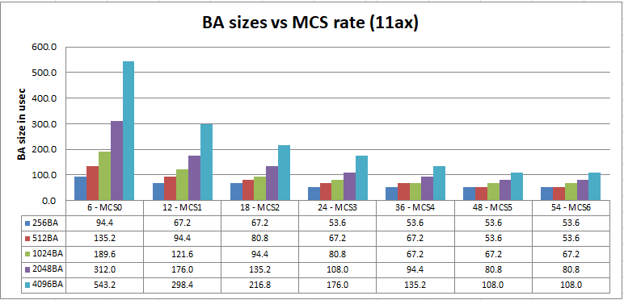
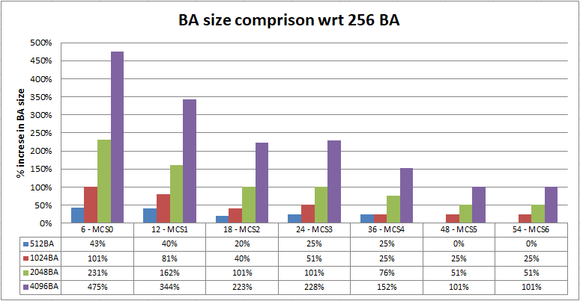
Proposal 1: BA compression → BA size for single TID
Plot shows size of compressed BA for various MCS rate if 11ax compressed BA frame is scaled for 512/1024/2048 and 4096 MPDUs
Assumed 11ax preamble
(L-STF + L-LTF + L-SIG + RL-SIG + HE-SIG-A + HE-STF + HE-LTF)
Plots shows that overhead for lower MCS rates is high
For MCS0
512BA is 43% longer than 256BA
1K BA is 101% longer than 256BA
4K BA is 475% longer than 256BA
For MCS6
512BA has no overhead
1K BA is 15% longer than 256BA
4K BA is 101% longer than 256BA

Slide 5
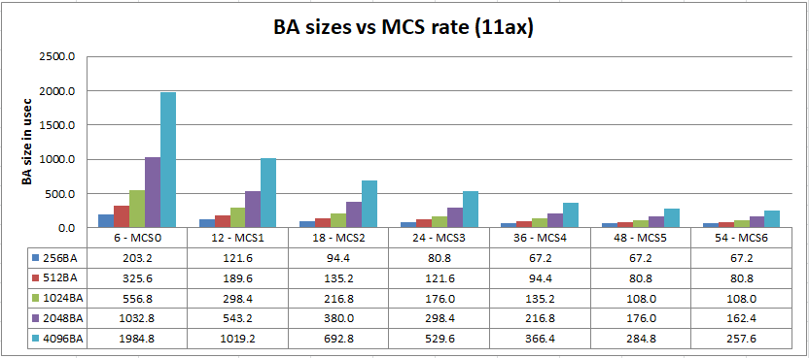
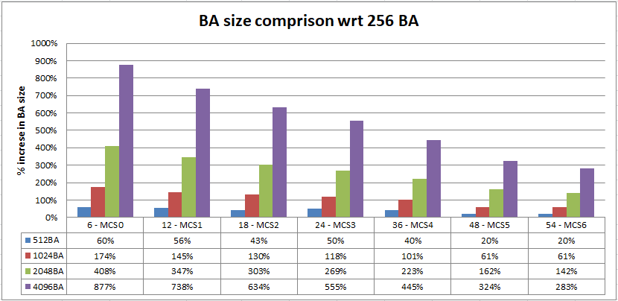
Proposal 1: BA compression → BA sizes for multi TID
Plot shows size of multi-STA BA frame for various MCS rate if 11ax multi-STA BA frame is scaled for 512/1024/2048 and 4096 MPDUs
Number of TID assumed 4 for analysis
Assumed 11ax preamble
(L-STF + L-LTF + L-SIG + RL-SIG + HE-SIG-A + HE-STF + HE-LTF)
BA size increase is significant for lower MCS
For MCS0
512BA is 60% longer than 256BA
1K BA is 174% longer than 256BA
4K BA is 877% longer than 256BA
For MCS6
512BA is 20% longer than 256BA
1K BA is 61% longer than 256BA
4K BA is 283% longer than 256BA

Slide 6
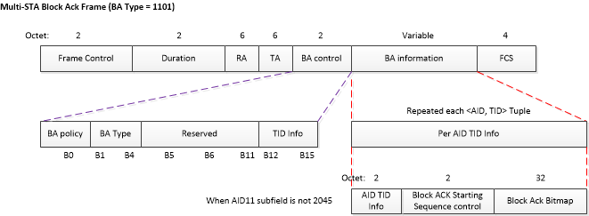
Proposal 2: BA frame format
Figure 1 shows compressed BA frame
Figure 2 shows multi-STA BA frame
For maximum aggregation,
‘Block Ack Bitmap’ contains 256 bits each representing single MPDU
For multi-STA BA if BA acknowledges multiple TID, ‘Per AID TID info’ contains the 256 bits repeated for each TID.

Slide 7
Proposal 2: 11be Single Layer BA
Add new ‘BA Type’
Compressed Block ACK with (a) Single Layer BA (SLB) and (b) Multi Layer BA (MLB)
Multi-STA Block ACK with (a) Single Layer BA (SLB) and (b) Multi Layer BA (MLB)
Define new field in ‘BA Control’
SL compression Size (SLZ) : 8 bits/ 16bits/ 32 bits
ML compression Size (MLZ) : 256 bits/ 512 bits/ 1024bits/ 2048 bits
Redefine BA bitmap
SLB Bitmap should contain {Bitmap SL header, Bitmap Segments}
MLB Bitmap should contain {Bitmap ML header, {Bitmap SL header, Bitmap Segments}}
BA frame configuration
For SLB frame → MLZ is reserved; SLZ can be 8 bits/ 16bits/ 32 bits ;
For MLB frame → MLZ can be 256 bits/ 512 bits/ 1024bits/ 2048 bits ; SLZ can be 8 bits/ 16bits/ 32 bits
Note: Field names are symbolic and can be changed to suite overall 11be naming convention

Slide 8
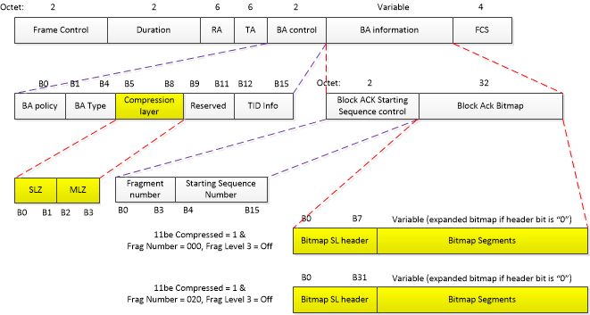
Proposal 2: Single Layer BA (compressed BA)
Each bit in ‘Bitmap SL header’ corresponds to segment of size SLZ in ‘Bitmap Segment’
A ‘1’ in ‘Bitmap SL header’ indicates absence of corresponding ‘Bitmap Segment’
A ‘0’ in ‘Bitmap SL header’ indicates presence of corresponding ‘Bitmap Segment’ and each bit in ‘Bitmap Segment’ corresponds to one MPDU in AMPDU

Slide 9
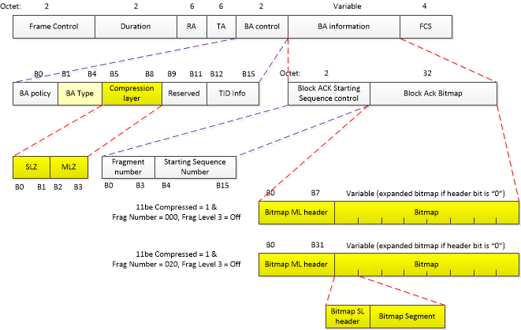
Proposal 2: Multi Layer BA (compressed BA)
Each bit in ‘Bitmap ML header’ corresponds to segment of size MLZ in Bitmap
Each MLZ size bitmap further have two field {Bitmap SL header, Bitmap Segment}
A ‘1’ in ‘Bitmap ML header’ indicate absence of corresponding ML sized Bitmap
A ‘0’ in ‘Bitmap ML header’ indicates the presence of {Bitmap SL header, Bitmap Segment}
‘Bitmap SL header’ and ‘Bitmap Segment’ definition remains same as Single Layer BA

Slide 10
Conclusion
If AMPDU aggregation needs to be increased to support higher throughput, the BA size also need to increase
Increase in BA time significantly affects the medium occupancy since BA is transmitted at lower rate
There is need to optimized the BA size to conserve medium utilization

Slide 11
Straw Poll 1
Should 11be include one such mode which supports the mechanism to compress BA?

Slide 12
Straw Poll 2
Should 11be one of the following BA types?
(A) only Single layer BA
(B) only Multi-layer BA
(C) Both Single and Multi layer BA

Slide 13
Straw Poll 3
In principle, do you support the compression scheme suggested by ‘Single layer BA’ and ‘Multi-layer BA’ in this presentation?
(Name and field position may change)

Slide 14
References
[1] 11-19-1291r3: Performance aspects of Multi-link operations
[2] 11-22-823/r2 - Multi-Link Operation: Design Discussion
[3] 11-19-1512/r6: Multi-link Block Acknowledgment
[4] 11-19-1082/r4: multi-link operation
[5] 11-19-1262/r6: Specification framework for tbge
[6] 11-19-0244-00-0eht-eht-par-document

