Slide 1
Multi-link Triggered Uplink Access
Date: 2020-03-26
Authors:

Slide 2
Recap: Synchronous Multi-link Transmission
When a STA simultaneously transmits and receives frames on multi-link, it may have some in-device coexistence (IDC) interference.
  When simultaneous Tx and Rx is happened between 2.4 GHz band and 5 GHz band, the IDC interference is probably negligible.
  But, the IDC interference caused by simultaneous Tx and Rx between 5 GHz band and 6 GHz band may be significantly problematic worse depending on some implementation capability like the RF filter performance.

Slide 3
Multi-link Triggered Uplink Access (TUA)
An AP performs an independent EDCA channel access on each link with its own EDCA parameters (CWmin, CWmax, AIFS, CW, and Retry Counter).
After obtaining a TXOP, the AP sends the Trigger frame and the STAs responds with the EHT TB PPDU.
  On each link, the PPDUs carrying the Trigger frame and the EHT TB PPDU can be independently encoded into one of frequency segments.
Back-off
…
AP
9
8
7
6
5
4
3
2
1
0
Trigger
Block ACK
Trigger
6GHz
STA
EHT TB PPDU
EHT TB PPDU
Back-off
…
AP
5
4
3
2
1
0
Trigger
Block ACK
Trigger
5GHz
STA
EHT TB PPDU
EHT TB PPDU

Slide 4
Constrained Multi-link TUA
But, when the STA has the IDC interference issue, the AP shall not schedule to the STA the PPDU carrying the trigger frame while the STA is responding with an EHT TB PPDU.
Error by IDC interference
Back-off
…
AP
8
7
6
5
4
3
2
1
0
Trigger
Block ACK
Trigger
6GHz
STA
No Response
EHT TB PPDU
Back-off
…
AP
5
4
3
2
1
0
Trigger
Block ACK
Trigger
5GHz
STA
EHT TB PPDU
EHT TB PPDU

Slide 5
Constrained Multi-link TUA
Synchronization requirement [1]
  A difference between the ending times of PPDU transmissions shall be less than SIFS - (10%×aSlotTime).
    Because a minimum inter-frame space is not less than SIFS, Tx and Rx are not overlapped.
      A margin of 10%×aSlotTime considers the SIFS accuracy of the IEEE 802.11-2016 spec.
Difference between the ending times of the transmissions is less than
SIFS - (10%×aSlotTime).
AP
Trigger
(CS Required = 0)
MAC Padding
PHY Padding
PE
6GHz
STA
SIFS
EHT TB PPDU
AP
Trigger
(CS Required = 0)
MAC Padding
PHY Padding
PE
5GHz
STA
SIFS
EHT TB PPDU

Slide 6
Constrained Multi-link TUA
Additionally, a STA’s IDC interference can change the carrier sense (CS) of another link to a busy state (e.g., greater than ED threshold) while the STA is transmitting an EHT TB PPDU. In such case, the STA may not respond to the Trigger frame with the CS Required field set to 1.
Difference between the ending times of the transmissions is less than
SIFS - (10%×aSlotTime).
AP
Trigger
(CS Required = 1)
MAC Padding
PHY Padding
PE
6GHz
STA
SIFS
EHT TB PPDU
AP
Trigger
(CS Required = 1)
MAC Padding
PHY Padding
PE
5GHz
STA
Interference leakage cause the CS status to a busy state.

Slide 7
Constrained Multi-link TUA
So, when the AP sends to the STA a PPDU containing the Trigger frame with the CS Required field set to 1, the AP should meet the following additional requirement.
  The difference between the ending time of the soliciting PPDU and the starting time of the first solicited PPDU that is sent immediately after the soliciting PPDU is greater than or equal to aCCATime (TBD).
    aCCATime (e.g., 4μs, 8μs) can be predetermined in the spec.
    Or, each STA can signal its aCCATime requirement to the AP.
The time difference between the soliciting PPDU and the solicited PPDU is greater than or equal to aCCATime.
AP
Trigger
(CS Required = 1)
MAC Padding
PHY Padding
PE
6GHz
STA
SIFS
EHT TB PPDU
AP
Trigger
(CS Required = 1)
MAC Padding
PHY Padding
PE
5GHz
STA
SIFS
EHT TB PPDU

Slide 8
References
[1] https://mentor.ieee.org/802.11/dcn/19/11-19-1305-00-00be-synchronous-multi-link-operation.pptx

Slide 9
Straw Poll 1
Do you support the following PPDU transmission restriction in the MLO?
  When an AP MLD aligns the ending time of DL PPDUs, the alignment requirement (i.e., the difference restriction between the ending times of transmitting DL PPDUs) is determined independent of the frame contained in the DL PPDUs.

Slide 10
Straw Poll 2 (Backup)
Do you support the following PPDU transmission restriction in the MLO?
  An AP in the AP MLD should not send a Trigger frame with the CS Required subfield set to 1 to a STA in a non-STR STA MLD, when a response PPDU transmission from other STAs in the same non-STR STA MLD can be started before TBD (aCCATime) time has expired after the PPDU containing the Trigger frame.

Slide 11
Backup

Slide 12
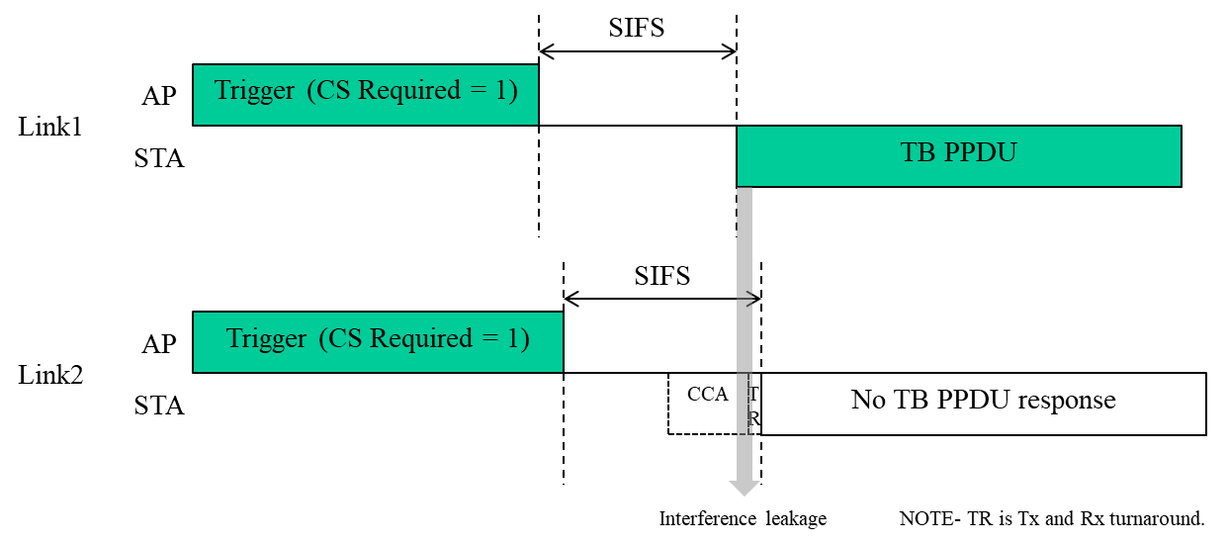
Synchronization Requirement in 11-20/433
Basically, 11-20/433 presumes that the STA on the link2 responding the Trigger frame with the CS Required equal to 1 may need to perform the CCA until just before the TxRx turnaround.
In such case, if a difference between the ending times of the PPDUs carrying the Trigger frames with the CS Required equal to 1 is less than TxRx Turnaround time, the interference leakage makes the STA2 to not transmit the TB PPDU response.

Slide 13
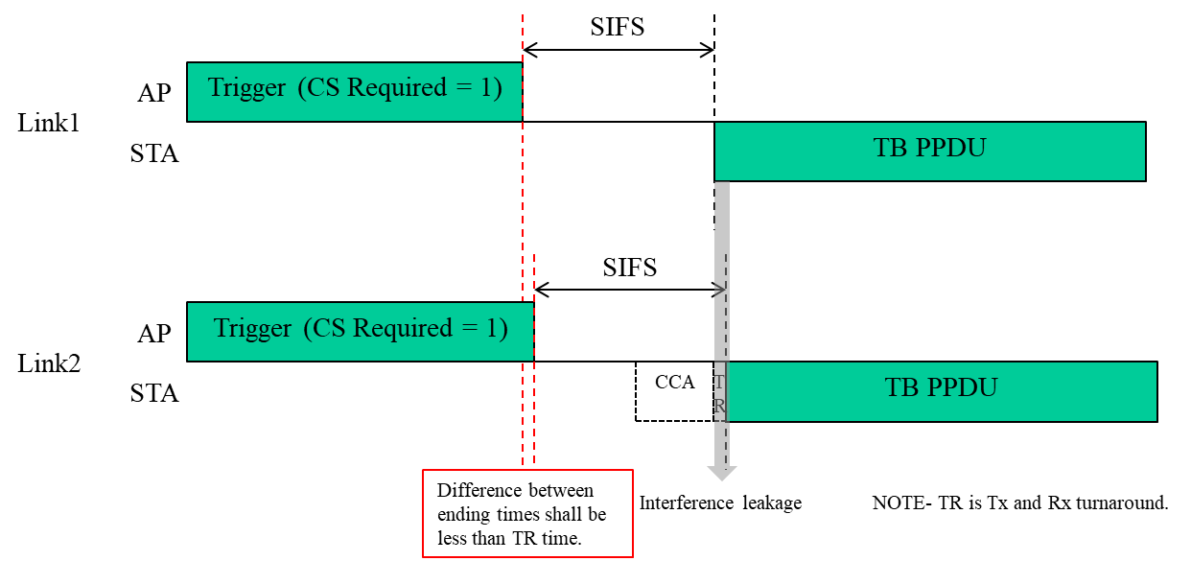
Synchronization Requirement in 11-20/433
In this case, the solution is that a difference between the ending times of the PPDUs carrying the Trigger frames with the CS Required equal to 1 shall be less than the TxRx Turnaround time.
Because TxRx Turnaround time is less than 2us or 4us (from 11-20/433), this synchronization requirement is very tight.

Slide 14
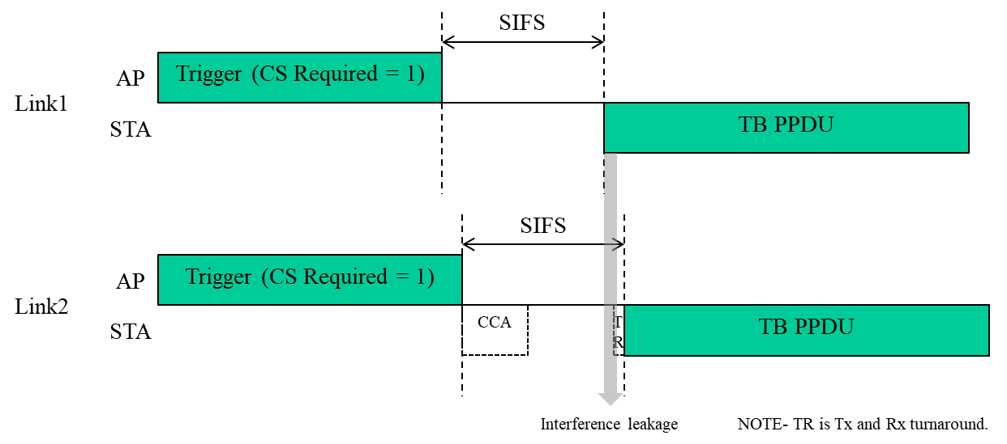
Synchronization Requirement in 11-20/188
In 11-20/188, we think that the STA is not necessary to perform the CCA until just before the TxRx turnaround.
The CCA can be started immediately after receiving the Trigger frame. But, the exact timing is an implementation issue. Even though the MAC processing delay is considered until start the CCA, we think that all required time until finishing the CCA may be less than aSlotTime (9us).

Slide 15
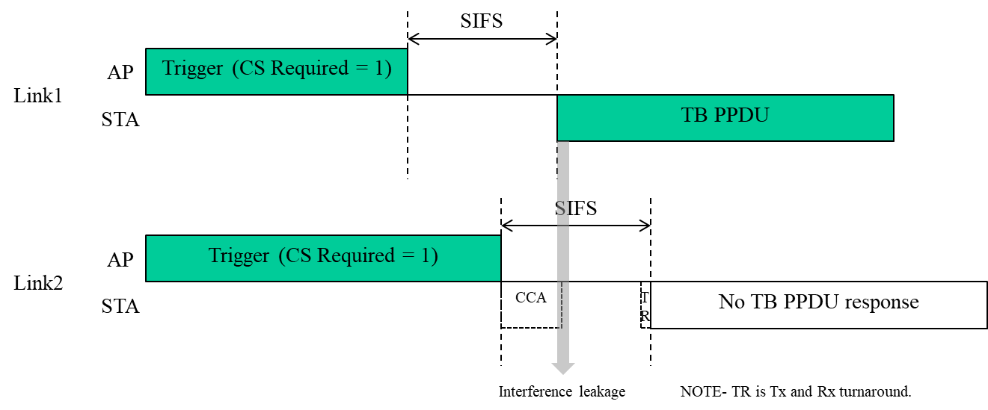
Synchronization Requirement in 11-20/188
In such case, the interference leakage issue is happened when a difference between the ending times of the PPDUs carrying the Trigger frames with the CS Required equal to 1 is greater than or equal to the SIFS-CCATime.
And, the CCATime may be less than aSlotTime (= aCCATime + aMACProcessingDelay + aRxTxTurnaroundTime + aAirPropagationTime).

Slide 16
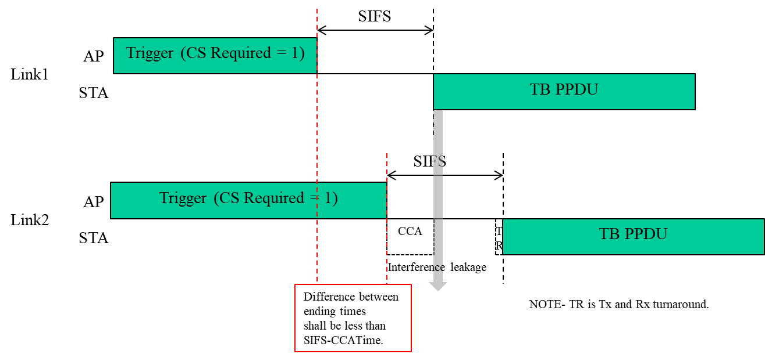
Synchronization Requirement in 11-20/188
The solution of 11-20/188 is that a difference between the ending times of the PPDUs carrying the Trigger frames with the CS Required equal to 1 shall be less than the SIFS-CCATime.
When we consider the CCATime to 8us, this synchronization requirement is not much tight. We can apply 8us synchronization requirement to all scenarios.

Slide 17
Summary
In a conclusion, 11-20/433 and 11-20/188 are addressing the same problem and saying almost same solution.
But, two contributions have a different view on when the CCA mechanism during the SIFS before sending the TB PPDU is triggered and finished.
But, this is a fully implementation issue.
But, while considering that the CCA is performed after D1+M1, we don’t think that too strict synchronization requirement (as in 11-20/433) is not needed.

