Slide 1
EN 301 893 Spectrum Mask Puncturing Update
Date: 2020-01-16
Authors:
Name | Affiliations | Address | Phone | email
David Boldy | Broadcom |  |  | david.boldy@broadcom.com

Slide 2
Abstract
Updates from ETSI BRAN Meeting#104 (related to Spectrum mask puncturing in the EN 301 893 standard).

Slide 3
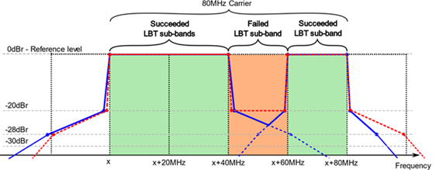
Spectrum Mask Questions
Q1:RAN4 would kindly request ETSI TC BRAN understanding whether preamble punctured mask for a wide band carrier larger than 20MHz having a relaxed mask requirement with a constant reference level of -20dBr in the punctured region(s) is compliant to ETSI mask?
Q2: RAN4 respectfully asks ETSI TC BRAN to confirm this understanding and explain the reasoning of the ETSI transmit spectral mask widening with increased bandwidth configurations, particularly at the -20dBr limit.

Slide 4
Update on Spectrum Mask (Discussions at Waikoloa)
There was some agreement to use the Nokia proposal detailed in BRAN(19)101019 but with the lower limit for all cases being increased from -28dBr to -25dBr.
Huawei raised concerns with the measurement RBW with regards to the limits in the proposals (i.e. ETSI is typically 1MHz but IEEE is 100kHz). Huawei will put in a contribution to further highlight their concern.
LOs were also discussed and there was some agreement that we may need to build some sort of exceptions into the ETSI language for this.
Nokia have updated their contribution to BRAN(19)101019r1 to reflect the changes to the minimum -25dBr for in band mask as agreed in the meeting.
Some concerns with regards to the Out of Band (e.g. for a 60MHz BW channels what roll off to apply for the mask) still to be addressed.
GoToMeeting to discuss further on 27th Nov (Note the agreed output of this meeting was BRAN(19)103f005r1. This was used as the basis for discussions at BRAN#104).

Slide 5
Update on Spectrum Mask (Outcome of BRAN#104 Dec 2-6)
Based on the received input and discussions, TC BRAN developed a compromise proposal as detailed in BRAN(19)103f005r2. In summary:
  Lower mask limit for channel edge puncturing cases changed from -25dBr to -28dBr
  Cases for puncturing fully within the channel (see slide 6).
  The measurement bandwidth for verifying the mask is 1 MHz. To accommodate potential measurement issues within the first 1 MHz going from 0 dBr to -20 dBr, it was agreed to rely on the 99% OCBW measurement for those transmitted channels which fail the 1MHz mask in this region. This applies to both the transmit spectral power mask, and the in-carrier transmit spectral power mask. For example: If a DUT fails the mask within the first 1 MHz going from 0 dBr to -20 dBr with a RBW of 1 MHz, but the remaining transmissions (after puncturing) falls within the “n x 20MHz” equivalent channel mask using a 99 % OCBW test then the device passes.
  Roll off of the mask is to be based upon the widest transmission BW of the remaining transmissions after puncturing (e.g. 20MHz and 60MHz for the examples on slide 7)
Outstanding issues: LO leakage [and >80MHz channels].
GoToMeeting scheduled: Jan 30, 2020, 15:00-18:00 CET

Slide 6
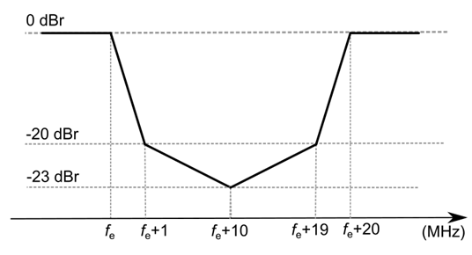
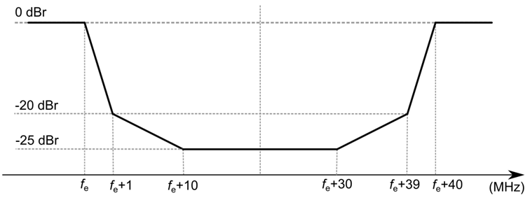
Extracts from BRAN(19)103f005r2.
Puncturing cases within the channel

Slide 7
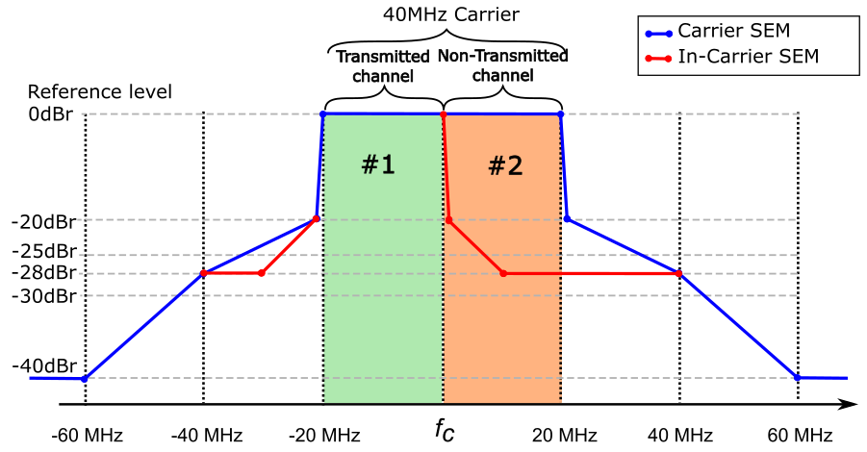
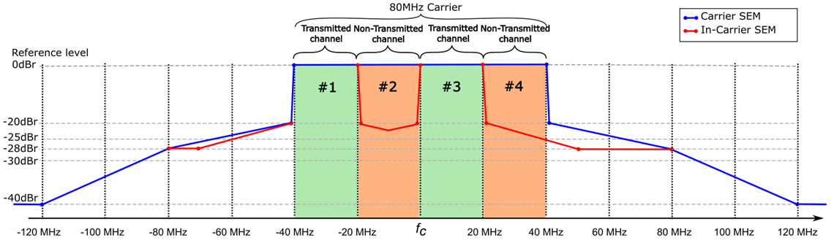
Extracts from BRAN(19)103f005r2 for information (1)

Slide 8
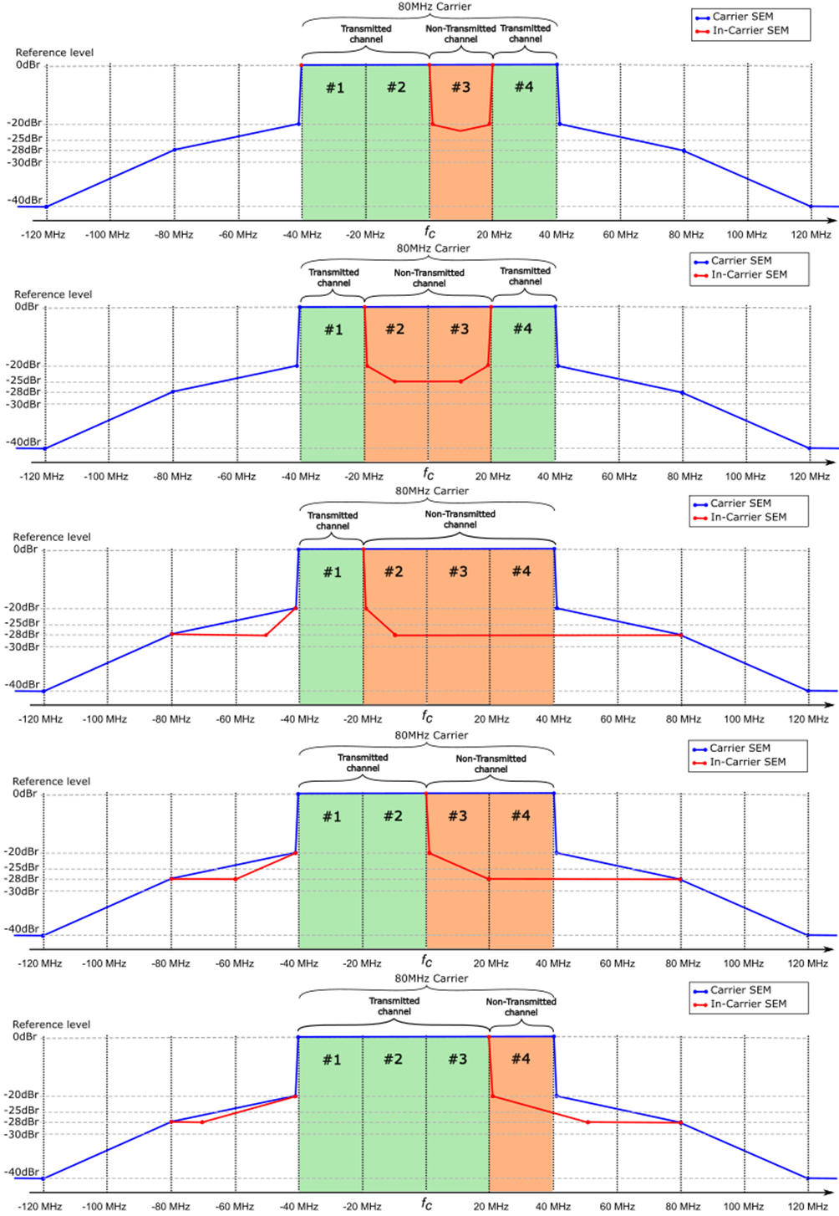
Extracts from BRAN(19)103f005r2 for information (2)

Slide 9
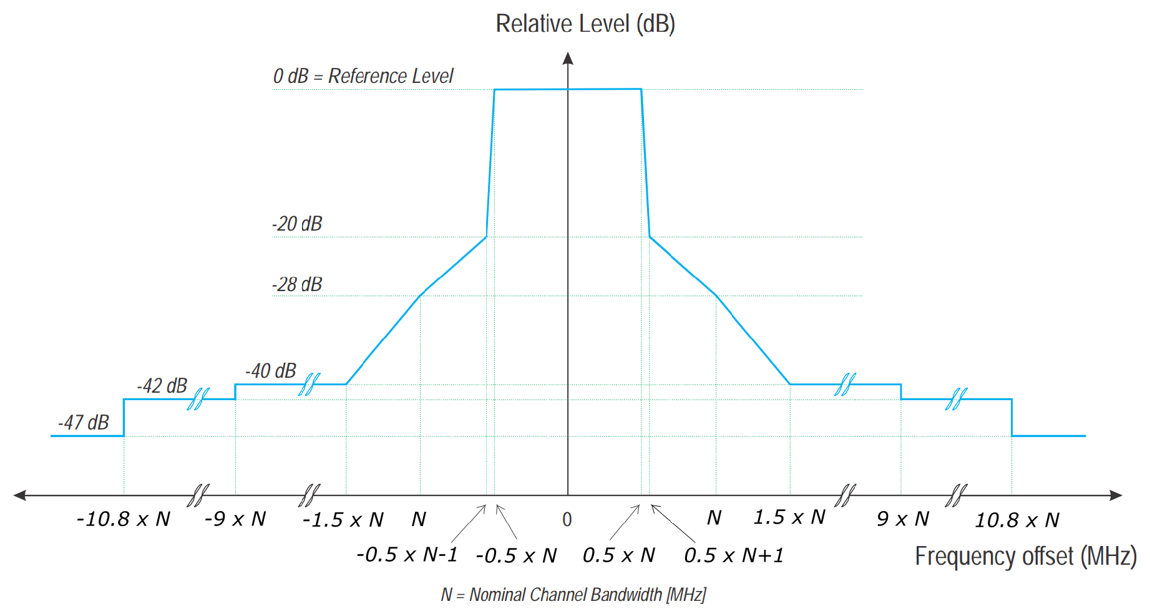
EN 301 893: Figure 1 - Transmit Spectral Power Mask (Information)

