Slide 1
CID 4076 Technical Motivation
Date: 2020-01-15
Authors:

Slide 2
Abstract
Technical motivation for 8PSK modes for the DMG SC PHY

Slide 3
Outline
Background
Proposed new constellations and code rates
Simulation Results
Changes to 802.11md Clause 9 and Clause 20 to Implement 8 PSK
Summary

Slide 4


Background (1)
The primary market today for Clause 20 / DMG STAs is backhaul
60 GHz backhaul applications will benefit from greater range
  Backhaul typically uses highly directional antennas
  Resulting channel has few reflections and therefore low inter-symbol interference
  Range is limited by available transmit power and required receiver SNR
  Friis Equation and the definition of receiver signal-to-noise ratio
  Combine and solve for range, R, as a function of SNR and transmitter power

Slide 5

Background (2)
Combined Equation
Range is limited by the square root of the ratio of available transmit power to required SNR at the receiver
By using 8 PSK instead of 16 QAM for MCS 10 and 11, we can greatly increase this ratio

Slide 6
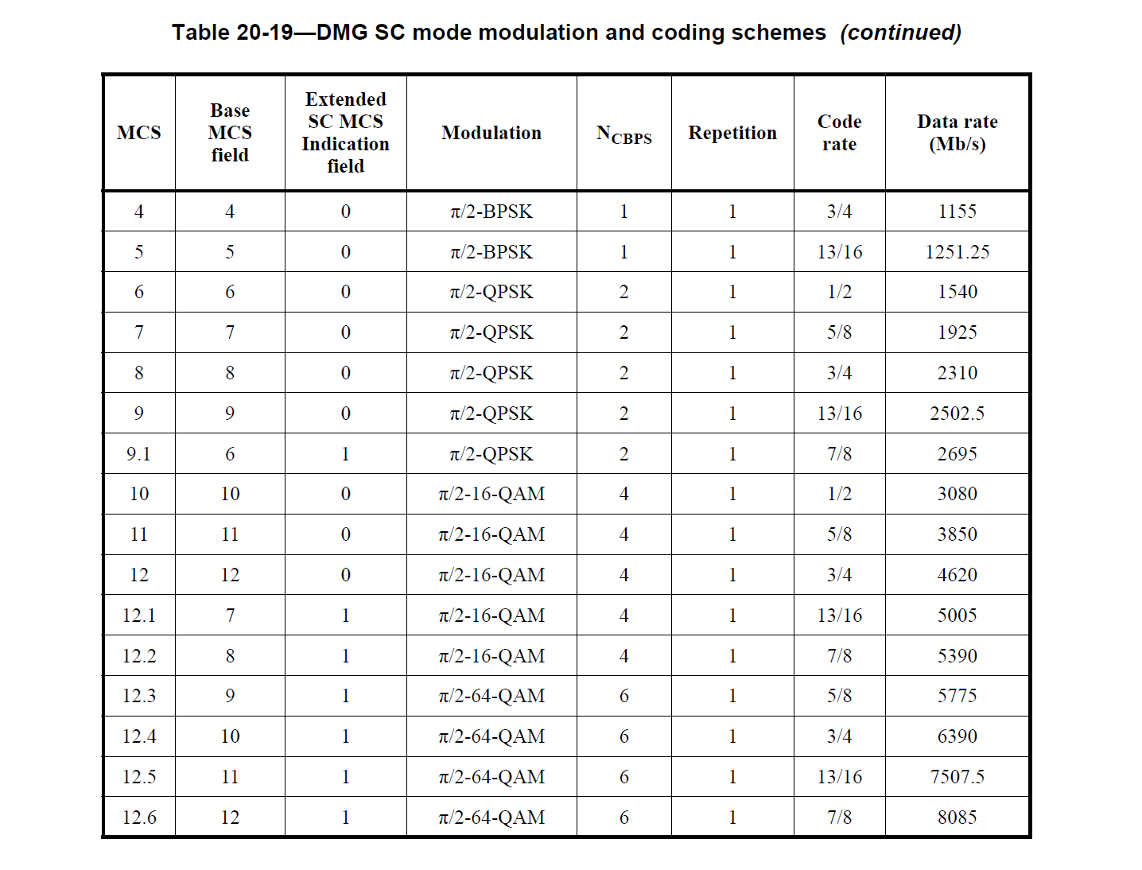
Background (3)
DMG contains moderate rate MCS modes with 16 QAM constellations
QAM modulation will increase the peak to average ratio of transmitted signals relative to PSK modulations
Practical transmit power amplifiers can transmit much more power using PSK modulation

Slide 7
Background (4)
For a given constellation, the peak power is the power of the constellation point at the greatest distance from the origin (center). The average power is the mean over all constellation points.
Circular constellations, such as 8 PSK have a peak power equal to the average power. Thus, their peak-to-average power ratio (PAPR) is minimized
16 QAM PAPR = 18/10 = 2.55 dB
8 PSK PAPR = 1/1 = 0.0 dB
16 QAM PAPR = 18/10 = 2.55 dB
8 PSK PAPR = 1/1 = 0.0 dB

Slide 8
Background (5)
Compression of QAM signals in non-linear components, such as mmwave power amplifiers, low noise amplifiers, and mixers, will also have greater impact on QAM signals than it will on PSK signals
  Compression tends to reduce the minimum distance between outer constellation points and increases the average EVM (error vector magnitude)
  Since bit error rate is a function of minimum distance, the bit error rate increases more for QAM

Slide 9
Background (6)
8PSK and 16QAM shown with EVM = -19 dB
16 QAM has a much higher peak-to-average ratio and requires a much greater back off from amplifier saturation
This results in a lower transmitter power for 16 QAM.

Slide 10
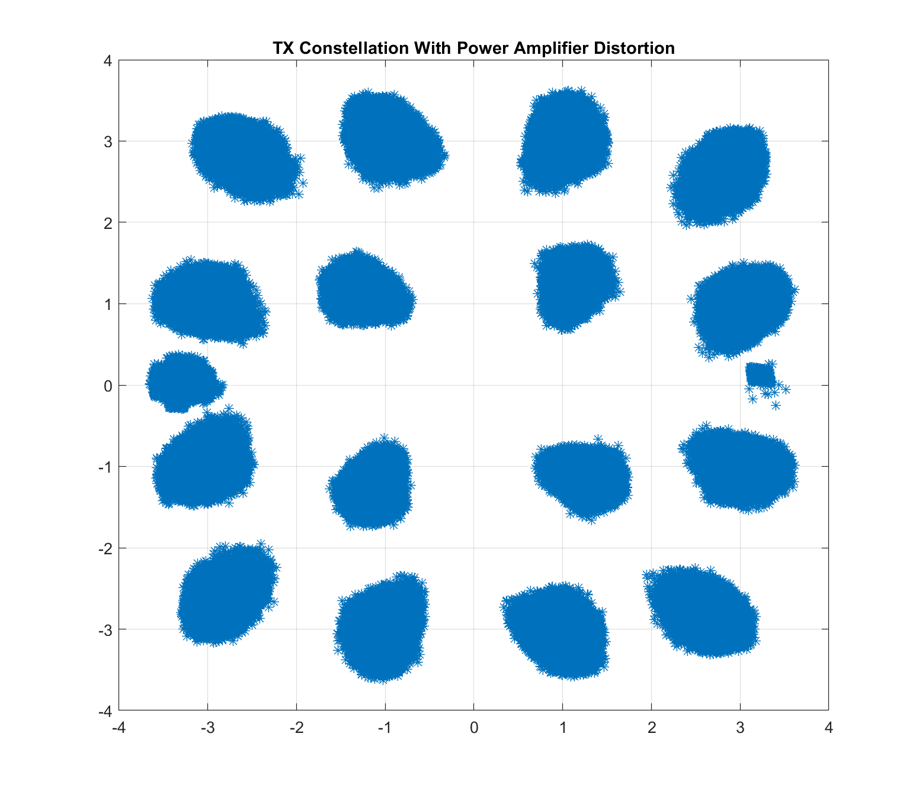
Background (7)
16QAM constellation after distortion created with the Rapp Model in the 802.11ay Evaluation Methodology
4.8 dB backoff
-19 dB EVM

Slide 11
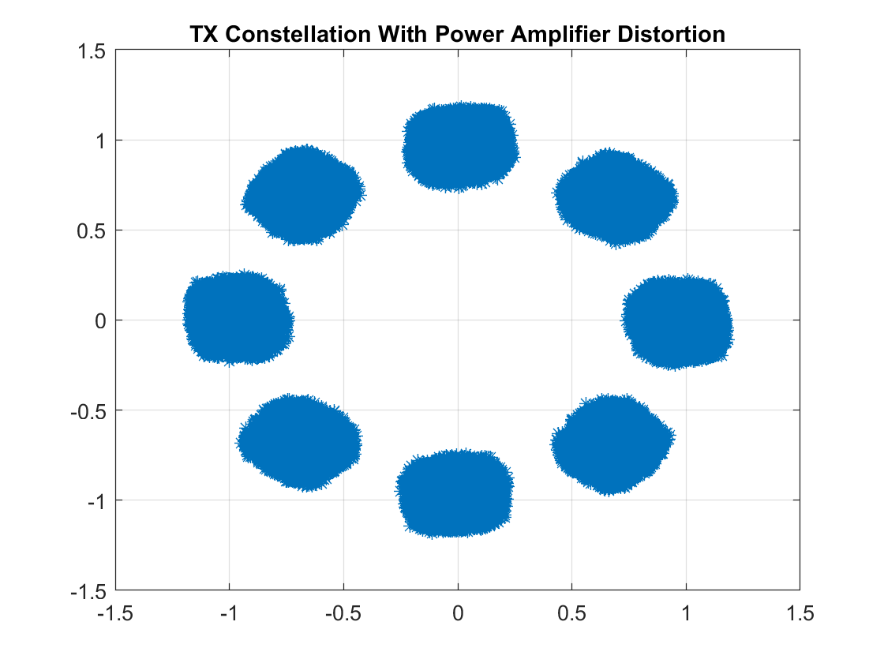
Background (8)
8 PSK Constellation
-1.0 dB backoff
-19 dB EVM
Even at a higher average output power, the 8PSK constellation is more tolerant of amplifier distortion than 16 QAM

Slide 12
MCS 10 and 11 with 8PSK (1)
8 PSK constellations with higher code rates can be employed instead of 16 QAM constellation with lower code rates
MCS 10: 8 PSK with a rate 2/3 code instead of 16-QAM with rate ½ code
  Rate 2/3 code is generated by shortening the Clause 20 rate ¾ LDPC code
    On encoding, pad 168 zero bits to fill the codeword
    Do not transmit pad bits
    No new LDPC code is needed
Apply pi/2 phase shift per symbol to 8PSK the same way we do for existing DMG SC modulations

Slide 13
MCS 10 and 11 with 8PSK (2)
MCS 11 – 8 PSK with rate 5/6 code instead of 16QAM with rate 5/8
  Shorten the draft 802.11ay rate 7/8 code to rate 5/6 by padding with zeros to fill the information part of the codeword
  Padded zeros are not transmitted
New LDPC code matrices are not needed
Shortening code words is already a part of 802.11

Slide 14
MCS 10 Simulation Results
MCS 10 PER with 4096 byte packets, phase noise, and PA distortion. EVM = -19 dB
10 iterations on LDPC decoder
8 PSK requires 0.6 dB greater SNR at 1% PER
8 PSK TX power is 3.9 dB higher
Range increase of 47%

Slide 15
MCS 11 Simulation Results (1)
MCS 11 PER with 4096 byte packets, phase noise, and PA distortion. EVM = -20 dB
10 iterations on LDPC decoder
8 PSK requires 2.1 dB greater SNR at 1% PER
8 PSK TX power is 4.0 dB higher
Range increase of 27%

Slide 16
Proposed Changes to 802.11md D3.0
Add options to use MCS 10 and 11 with 8-PSK instead of 16-QAM
Signal the capability to employ this option in the DMG Capabilities Field (9.4.2.127)
  1 bit required - Many bits available in the Supported MCS Sub-field
Signal the use of this option in the DMG SC Mode PPDU Header (Table 20-13 in 20.5.3.1.1)
  Under discussion. Possibilities include:
    Bit 47 of the DMG SC Header is unused
    Bit 45 of the DMG SC Header is also unused in Clause 20. A similar header in Clause 24 PHY (CDMG) uses bit 45, but this PHY has a different symbol rate, so there are no possibility of misinterpretation of the bit by CDMG STAs.
    Unused MCS values in DMG SC Header
Use existing LDPC codes with shortening (additions to 20.5.3.2.3 Encoding)
Add 8-PSK modulation to 20.5.3.2.4 Modulation mapping

Slide 17
Summary
8 PSK has been evaluated using the phase noise, PA models, and EVM targets for DMG STAs
Range increases of 27% to 47% are possible with MCS10 and MCS11 using 8 PSK instead of 16 QAM
Existing Clause 20 LDPC codes can be shortened to achieve the rate 2/3 and rate 5/6 codes required for 8 PSK
  No new encoder / decoder
Small additions to 802.11md Clause 9 and Clause 20 will be proposed to support 8 PSK operation

Slide 18
Backup

Slide 19
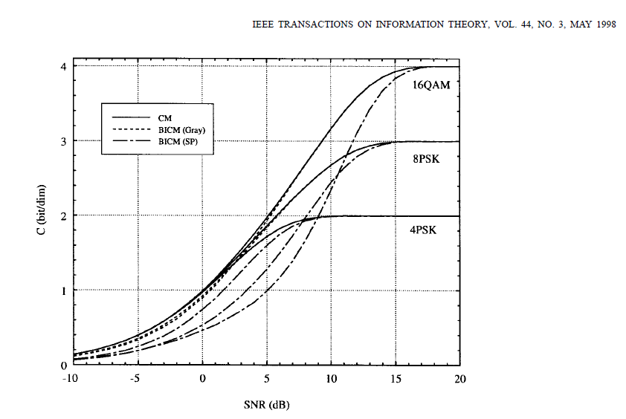
AWGN Channel Capacity Comparison
From “Bit-Interleaved Coded Modulation” by G. Caire, G. Taricco, and Ezio Biglieri
MCS11 (2.5 bits per symbol)
MCS10 (2 bits per symbol)

