Slide 1
TGbe PHY Adhoc Meeting Agenda - January 2020
Date: 2020-01-13
Authors:

Slide 2
IEEE 802.11 TGbe Meeting
Extremely High Throughput (EHT) WLAN PHY Ad Hoc
Irvine, CA
January 12-17, 2020
Co-Chairs:
Sigurd Schelstraete (Quantenna/ON Semiconductor)
Tianyu Wu (Apple)

Slide 3
Meeting Protocol
Please announce your affiliation when you first address the group during a meeting slot

Slide 4
Attendance
https://imat.ieee.org/my-site/home
Register
Indicate attendance

Slide 5
Agenda items for PHY Adhoc
Call meeting to order
Patent policy, etc. (Call for Potentially Essential Patents)
Review ad hoc rules
PHY technical presentations for this week, and related straw polls
Adjourn

Slide 6
Patent Policy and Other Guidelines
Following 5 slides

Slide 7
Participants, Patents, and Duty to Inform
All participants in this meeting have certain obligations under the IEEE-SA Patent Policy.
  Participants [Note: Quoted text excerpted from IEEE-SA Standards Board Bylaws subclause 6.2]:
    “Shall inform the IEEE (or cause the IEEE to be informed)” of the identity of each “holder of any potential Essential Patent Claims of which they are personally aware” if the claims are owned or controlled by the participant or the entity the participant is from, employed by, or otherwise represents
    “Should inform the IEEE (or cause the IEEE to be informed)” of the identity of “any other holders of potential Essential Patent Claims” (that is, third parties that are not affiliated with the participant, with the participant’s employer, or with anyone else that the participant is from or otherwise represents)
  The above does not apply if the patent claim is already the subject of an Accepted Letter of Assurance that applies to the proposed standard(s) under consideration by this group
  Early identification of holders of potential Essential Patent Claims is strongly encouraged
  No duty to perform a patent search
Slide #1

Slide 8
Patent Related Links
  All participants should be familiar with their obligations under the IEEE-SA Policies & Procedures for standards development.
  Patent Policy is stated in these sources:
  IEEE-SA Standards Boards Bylaws
  http://standards.ieee.org/develop/policies/bylaws/sect6-7.html#6
  IEEE-SA Standards Board Operations Manual
  http://standards.ieee.org/develop/policies/opman/sect6.html#6.3
  Material about the patent policy is available at
  http://standards.ieee.org/about/sasb/patcom/materials.html
If you have questions, contact the IEEE-SA Standards Board Patent Committee Administrator at patcom@ieee.org or visit http://standards.ieee.org/about/sasb/patcom/index.html
This slide set is available at https://development.standards.ieee.org/myproject/Public/mytools/mob/slideset.ppt
Slide #2

Slide 9
Call for Potentially Essential Patents
If anyone in this meeting is personally aware of the holder of any patent claims that are potentially essential to implementation of the proposed standard(s) under consideration by this group and that are not already the subject of an Accepted Letter of Assurance:
  Either speak up now or
  Provide the chair of this group with the identity of the holder(s) of any and all such claims as soon as possible or
  Cause an LOA to be submitted
Slide #3

Slide 10
Other Guidelines for IEEE WG Meetings
All IEEE-SA standards meetings shall be conducted in compliance with all applicable laws, including antitrust and competition laws.
  Don’t discuss the interpretation, validity, or essentiality of patents/patent claims.
  Don’t discuss specific license rates, terms, or conditions.
    Relative costs, including licensing costs of essential patent claims, of different technical approaches January be discussed in standards development meetings.
      Technical considerations remain primary focus
  Don’t discuss or engage in the fixing of product prices, allocation of customers, or division of sales markets.
  Don’t discuss the status or substance of ongoing or threatened litigation.
  Don’t be silent if inappropriate topics are discussed … do formally object.
---------------------------------------------------------------
See IEEE-SA Standards Board Operations Manual, clause 5.3.10 and “Promoting Competition and Innovation: What You Need to Know about the IEEE Standards Association's Antitrust and Competition Policy” for more details.
Slide #4

Slide 11
Participation in IEEE 802 Meetings
All participation in IEEE 802 Working Group meetings is on an individual basis
• Participants in the IEEE standards development individual process shall act based on their qualifications and experience. (https://standards.ieee.org/develop/policies/bylaws/sb_bylaws.pdf section 5.2.1)
• IEEE 802 Working Group membership is by individual; “Working Group members shall participate in the consensus process in a manner consistent with their professional expert opinion as individuals, and not as organizational representatives”. (http://ieee802.org/PNP/approved/IEEE_802_WG_PandP_v19.pdf section 4.2.1)
You have an obligation to act and vote as an individual and not under the direction of any other individual or group. Your obligation to act and vote as an individual applies in all cases, regardless of any external commitments, agreements, contracts, or orders.
You shall not direct the actions or votes of any other member of an IEEE 802 Working Group or retaliate against any other member for their actions or votes within IEEE 802 Working Group meetings, see https://standards.ieee.org/develop/policies/bylaws/sb_bylaws.pdf section 5.2.1.3 and http://ieee802.org/PNP/approved/IEEE_802_WG_PandP_v19.pdf section 3.4.1, list item x
By participating in IEEE 802 meetings, you accept these requirements. If you do not agree to these policies then you shall not participate.
Slide #5

Slide 12
Ad Hoc Groups Operation
Only straw Polls are allowed during Ad Hoc group meeting
  no motions
  anyone can vote in SP
Each Presentation is suggested to have 25 minutes including presenting and Q&A.

Slide 13
PHY Adhoc Time Slots
 | Monday | Tuesday | Wednesday | Thursday
AM 1 |  | TGbe | TGbe Ad-Hoc [MAC/PHY] | TGbe Ad-Hoc [MAC/PHY
AM 2 |  | TGbe |  | TGbe Ad-Hoc [MAC/PHY
PM 1 | TGbe | TGbe Ad-Hoc [MAC/PHY] |  | TGbe
PM 2 | TGbe Ad-Hoc [MAC/PHY] |  | TGbe Ad-Hoc [MAC/PHY] | TGbe
EVE |  | TGbe Ad-Hoc [MAC/PHY]

Slide 14
Straw Polls Submission’s List
January 2020
DCN | Title | Author | Status | Topic | Session
1868r2 | Signaling support for multi-RU assignment | Lei Huang | Pending (2 SPs) | Multi-RU/Puncture | PHY
1869r0 | Preamble Puncturing and RU Aggregation | Bin Tian | Pending (3 SPs) | Multi-RU/Puncture | PHY
1877r0 | 16 Spatial Stream Support | Wook Bong Lee | Pending (2SPs) | MIMO | PHY
1890r0 | Phase Rotation Follow-up (pending r1) | Eunsung Park | Pending (5 SPs) | L-Preamble | PHY
1907r1 | Multiple RU Combinations for EHT | Jianhan Liu | Pending (7 SPs) | Multi-RU/Puncture | PHY
1908r0 | Multi RU support (pending r1) | Ron Porat | Pending (4 SPs) | Multi-RU/Puncture | PHY
1914r2 | Multiple RU discussion | Ross Jian Yu | Pending (1 SPs) | Multi-RU/Puncture | PHY
1980r1 | EHT P matrices Discussion | Dandan Liang | Pending (1 SP) | MIMO | PHY
1981r1 | Phase Rotations Design for EHT | Dandan Liang | Pending (1 SP) | L-Preamble | PHY
Presented submissions are highlighted in green
Deferred submissions are highlighted in yellow

Slide 15
Back-Logged Submissions
January 2020
DCN | Title | Author | Status | Topic | Session
1910r1 | P matrices to support more than 8 TX chains | Miguel López | Pending | MIMO | PHY
1925r0 | Consideration of EHT-LTF | Jinmin Kim | Pending | EHT Preamble | PHY

Slide 16
New Submission’s List-1
January 2020
DCN | Title | Author | Status | Topic | Session
19/1579r2 | Adapting the 11be channel model to modern (Doppler) use cases | Shimi Shilo | Pending (Update) | Channel Model | PHY
19/2161r1 | Multiple RU Support for 11be | Myeongjin Kim | Pending | Multi-RU/Puncture | PHY
20/0019r0 | 11be PPDU format | Dongguk Lim | Pending | PPDU format | PHY
20/0020r0 | Consideration for EHT-SIG transmission | Dongguk Lim | Pending | EHT Preamble | PHY
20/0022r0 | Consideration on 240/160+80 MHz and Preamble Puncturing | Eunsung Park | Pending | Multi-RU/Puncture | PHY
20/0023r0 | Multiple RU Aggregation | Eunsung Park | Pending | Multi-RU/Puncture | PHY
20/0029r0 | Preamble structure and SIG contents | Ross Jian Yu | Pending | EHT Preamble | PHY
20/0031r0 | Considerations on EHT PPDU formats | Lei Huang | Pending | PPDU format | PHY
20/0041r0 | Additional overhead reduction in mixed beamforming feedback | Genadiy Tsodik | Pending | MIMO | PHY
20/0048r0 | RU Aggregation for 240MHz and 320MHz | Bin Tian | Pending | Multi-RU/Puncture | PHY
20/0049r0 | PPDU Types and U-SIG Content | Sameer Vermani | Pending | EHT Preamble | PHY
20/0058r1 | Preamble Puncturing for Transmission to Multiple STAs in 802.11be | Oded Redlich | Pending | Multi-RU/Puncture | PHY
20/0065r0 | Implicit sounding scheme | Lily Yunping Lyu | Defer (C. Call) | Sounding | PHY
20/0067r0 | Restrictions for 16 SS based MU MIMO Scheduling | Junghoon Suh | Pending | MIMO | PHY
20/0072r0 | Performance and EVM Evaluation on 4096-QAM in 11be | Jianhan Liu | Pending | 4K QAM | PHY

Slide 17
New Submission’s List-2
DCN | Title | Author | Status | Topic | Session
20/0075r0 | Performance comparison of LTF designs in JT | Ron Porat | Pending | EHT Preamble | PHY
20/0076r0 | Simulation results of 4K QAM | Ron Porat | Pending | 4K QAM | PHY
20/0080r0 | Calibration for Implicit Feedback | Qinghua Li | Pending | Sounding | PHY
20/0087r0 | Discussions on U-SIG content and EHT-SIG format | Rui Cao | Pending | EHT Preamble | PHY
20/0089r0 | Multi-AP Implicit Channel Sounding | Roya Doostnejad | Pending | MAP-Sounding | PHY
20/0090r0 | Implicit Feedback, Feasibility and Gains | Roya Doostnejad | Pending | Sounding | PHY
20/0108r0 | Multi-RU support for OFDMA | Sigurd Schelstraete | Pending | Multi-RU/Puncture | PHY
20/0109r0 | Further considerations for multi-RU | Sigurd Schelstraete | Pending | Multi-RU/Puncture | PHY
20/0110r0 | 11be preamble and forward compatibility | Sigurd Schelstraete | Pending | EHT Preamble | PHY
20/0111r0 | 4096 QAM definition | Sigurd Schelstraete | Pending | 4K QAM | PHY
20/0117r0 | EHT-LTFs Design for Wideband | Dandan Liang | Pending | EHT Preamble | PHY
20/0128r0 | Discussion on Multi-RU in 802.11be | Oded Redlich | Pending | Multi-RU/Puncture | PHY

Slide 18
Order of PHY Topics
Guideline for PHY ad-hoc group:
  EHT Preamble; L-Preamble
  Multi-RU/Puncture;
  PPDU format;
  MIMO/Sounding;
  4K QAM;
  Other
Presented submissions are highlighted in green
Deferred submissions are highlighted in yellow

Slide 19
PHY ad-hoc Agenda for Monday PM2
Call meeting to order
IEEE-SA IPR policy and Procedure
Set and approve agenda
Presentation of submissions
  Deferred SPs
    1868r2 Signaling support for multi-RU assignment
    1869r0 Preamble Puncturing and RU Aggregation
    1877r0 16 Spatial Stream Support
    1890r0 Phase Rotation Follow-up (pending r1)
    1907r1 Multiple RU Combinations for EHT
    1908r1 Multi RU support
    1914r2 Multiple RU discussion
    1980r1 EHT P matrices Discussion
    1981r1 Phase Rotations Design for EHT
  Backlogged submissions
    1910r1 P matrices to support more than 8 TX chains
    1925r0 Consideration of EHT-LTF
Recess

Slide 20
PHY ad-hoc Agenda for Tuesday PM1
Call meeting to order
IEEE-SA IPR policy and Procedure
Set and approve agenda
Presentation of submissions
  Deferred SPs
    1914r2 Multiple RU discussion
    1980r1 EHT P matrices Discussion
    1981r1 Phase Rotations Design for EHT
  Backlogged submissions
    1910r1 P matrices to support more than 8 TX chains
    1925r1 Consideration of EHT-LTF
  EHT Preamble
    20/0020r0 - Consideration for EHT-SIG transmission ((Dongguk Lim)
    20/0029r0 - Preamble structure and SIG contents (Ross Jian Yu)
    20/0049r1 - PPDU Types and U-SIG Content (Sameer Vermani)
    20/0075r0 - Performance comparison of LTF designs in JT (Ron Porat)
    20/0087r0 - Discussions on U-SIG content and EHT-SIG format (Rui Cao)
    20/0110r0 - 11be preamble and forward compatibility (Sigurd Schelstraete)
    20/0117r0 - EHT-LTFs Design for Wideband (Dandan Liang)
Recess

Slide 21
PHY ad-hoc Agenda for Tuesday EVE
Call meeting to order
IEEE-SA IPR policy and Procedure
Set and approve agenda
Presentation of submissions
  EHT Preamble
    20/0029r0 - Preamble structure and SIG contents (Ross Jian Yu)
    20/0049r0 - PPDU Types and U-SIG Content (Sameer Vermani)
    20/0075r0 - Performance comparison of LTF designs in JT (Ron Porat)
    20/0087r0 - Discussions on U-SIG content and EHT-SIG format (Rui Cao)
    20/0110r0 - 11be preamble and forward compatibility (Sigurd Schelstraete)
    20/0117r0 - EHT-LTFs Design for Wideband (Dandan Liang)
Recess

Slide 22
PHY ad-hoc Agenda for Wednesday AM1
Call meeting to order
IEEE-SA IPR policy and Procedure
Set and approve agenda
Presentation of submissions
  EHT Preamble
    20/0110r0 - 11be preamble and forward compatibility (Sigurd Schelstraete)
    20/0117r0 - EHT-LTFs Design for Wideband (Dandan Liang)
  Multi-RU/Puncturing
    19/2161r1 - Multiple RU Support for 11be (Myeongjin Kim)
    20/0022r0 - Consideration on 240/160+80 MHz and Preamble Puncturing (Eunsung Park)
    20/0023r0 - Multiple RU Aggregation (Eunsung Park)
    20/0048r0 - RU Aggregation for 240MHz and 320MHz (Bin Tian)
    20/0058r1 - Preamble Puncturing for Transmission to Multiple STAs in 802.11be (Oded Redlich)
    20/0108r0 - Multi-RU support for OFDMA (Sigurd Schelstraete)
    20/0109r0 - Further considerations for multi-RU (Sigurd Schelstraete)
    20/0128r0 - Discussion on Multi-RU in 802.11be (Oded Redlich)
Recess

Slide 23
PHY ad-hoc Agenda for Wednesday PM2
Call meeting to order
IEEE-SA IPR policy and Procedure
Set and approve agenda
Presentation of submissions
  Multi-RU/Puncturing
    20/0023r0 - Multiple RU Aggregation (Eunsung Park)
    20/0048r0 - RU Aggregation for 240MHz and 320MHz (Bin Tian)
    20/0058r2 - Preamble Puncturing for Transmission to Multiple STAs in 802.11be (Oded Redlich)
    20/0108r0 - Multi-RU support for OFDMA (Sigurd Schelstraete)
    20/0109r0 - Further considerations for multi-RU (Sigurd Schelstraete)
    20/0128r0 - Discussion on Multi-RU in 802.11be (Oded Redlich)
Recess

Slide 24
PHY ad-hoc Agenda for Thursday AM1
Call meeting to order
IEEE-SA IPR policy and Procedure
Set and approve agenda
Presentation of submissions
  Continue multi-RU discussions + SPs
  PPDU format
    20/0019r0 - 11be PPDU format (Dongguk Lim)
    20/0031r2 - Considerations on EHT PPDU formats (Lei Huang)
  MIMO/Sounding
    20/0041r0 - Additional overhead reduction in mixed beamforming feedback (Genadiy Tsodik)
    20/0065r0 - Implicit sounding scheme (Lily Yunping Lyu)
    20/0067r0 - Restrictions for 16 SS based MU MIMO Scheduling (Junghoon Suh)
    20/0080r0 - Calibration for Implicit Feedback (Qinghua Li)
    20/0089r0 - Multi-AP Implicit Channel Sounding (Roya Doostnejad)
    20/0090r0 - Implicit Feedback, Feasibility and Gains (Roya Doostnejad)
Adjourn

Slide 25
PHY ad-hoc Agenda for Thursday AM2
Call meeting to order
IEEE-SA IPR policy and Procedure
Set and approve agenda
Presentation of submissions
  PPDU format
    20/0019r0 - 11be PPDU format (Dongguk Lim)
    20/0031r2 - Considerations on EHT PPDU formats (Lei Huang)
  MIMO/Sounding MIMO/Sounding
    20/0041r0 - Additional overhead reduction in mixed beamforming feedback (Genadiy Tsodik)
    20/0065r0 - Implicit sounding scheme (Lily Yunping Lyu)
    20/0067r0 - Restrictions for 16 SS based MU MIMO Scheduling (Junghoon Suh)
    20/0080r0 - Calibration for Implicit Feedback (Qinghua Li)
    20/0089r0 - Multi-AP Implicit Channel Sounding (Roya Doostnejad)
    20/0090r0 - Implicit Feedback, Feasibility and Gains (Roya Doostnejad)
  4096 QAM
    20/0072r0 - Performance and EVM Evaluation on 4096-QAM in 11be (Jianhan Liu)
    20/0076r0 - Simulation results of 4K QAM (Ron Porat)
    20/0111r0 - 4096 QAM definition (Sigurd Schelstraete)
  Channel model
    19/1579r2 - Adapting the 11be channel model to modern (Doppler) use case (Shimi Shilo)
Adjourn

Slide 26
SP #1 (1868r2)
Do you agree that a user specific field of EHT-SIG in an EHT PPDU transmitted to multiple users comprises more than one user fields?
  Note: each user field contains user-specific allocation information.
  Withdrawn

Slide 27
SP #2 (1868r2)
Do you agree that the formats of 11be user specific fields should be designed for improving STA’s power efficiency?
Y/N/A: 21/0/38
NOTE: not intended to be included in SFD

Slide 28
SP #3 (1869r0)
Do you support in 11be
  CCA minimum BW resolution is 20MHz
  Preamble puncturing resolution is 20MHz
  Y/N/A: 59/0/3
Sigurd Schelstraete (Quantenna/ON)

Slide 29
SP #4 (1869r0)
Do you support one PSDU per STA for single link in 11be?
Y/N/A: 48/0/5
Sigurd Schelstraete (Quantenna/ON)

Slide 30
SP #5 (1869r0)
For one PSDU, do you support in 11be to use one LDPC encoder?
  Y/N/A: 49/0/4
Sigurd Schelstraete (Quantenna/ON)

Slide 31
SP #6 (1877r0)
Do you support that 11be defines a maximum of 16 spatial streams for SU-MIMO?
Y/N/A: 37/0/7
Sigurd Schelstraete (Quantenna/ON)

Slide 32
SP #7 (1877r0)
Do you support maximum 16 spatial streams for MU-MIMO in 11be?
Y/N/A: 46/0/2
Sigurd Schelstraete (Quantenna/ON)

Slide 33
SP #8 (1890r0)
Do you agree that preamble puncturing can be considered in order to design phase rotation applied to the legacy preamble part of 320/160+160 MHz EHT PPDU?
Note: not intended for inclusion in SFD
Y/N/A: 9/0/31
Sigurd Schelstraete (Quantenna/ON)

Slide 34
SP #9 (1890r0)
Which option do you prefer for the phase rotation applied to the legacy preamble part of 320/160+160 MHz EHT PPDU
  Option 1: Unified phase rotation regardless of whether the preamble puncturing is applied or not
  Option 2: Different phase rotation according to whether the preamble puncturing is applied or not
  Note: not intended to include in SFD
Option 1/Option 2/A: 11/13/22
Sigurd Schelstraete (Quantenna/ON)

Slide 35
SP #10 (1890r0)
Which option do you prefer for the phase rotation applied to the legacy preamble part of 320/160+160 MHz EHT PPDU
  Option 1: repeat 11ax 80MHz phase rotation
  Option 2: repeat 11ax 80MHz phase rotation and apply additional coefficients to 80MHz segments
  Option 3: repeat new 80MHz phase rotation [1 1 -1 -1]
  Option 4: repeat new 80MHz phase rotation [1 1 -1 -1] and apply additional coefficients to 80MHz segments
Option 1/Option 2/Option 3/Option 4/A: ////
Deferred
Sigurd Schelstraete (Quantenna/ON)

Slide 36
SP #11 (1890r0)
Do you agree to add the following text to the TGbe SFD?
  [1 1 -1 -1 j j -j -j -j -j j j -1 -1 1 1] is used for the phase rotation applied to the legacy preamble part of 320/160+160 MHz EHT PPDU
    Application to the other fields is TBD
Y/N/A : //
Deferred
Sigurd Schelstraete (Quantenna/ON)

Slide 37
SP #12 (1890r0)
Do you agree to add the following text to the TGbe SFD?
  [1 -1 -1 -1 j -j -j -j 1 -1 -1 -1 j -j -j -j] is used for the phase rotation applied to the legacy preamble part of 320/160+160 MHz EHT PPDU
    Application to the other fields is TBD
Y/N/A : //
Deferred
Sigurd Schelstraete (Quantenna/ON)

Slide 38
SP #13 (1890r0)
Do you agree to add the following text to the TGbe SFD?
  [1 -1 -1 -1 j -j -j -j j -j -j -j 1 -1 -1 -1] is used for the phase rotation applied to the legacy preamble part of 320/160+160 MHz EHT PPDU
    Application to the other fields is TBD
Y/N/A : //
Deferred
Sigurd Schelstraete (Quantenna/ON)

Slide 39
SP #14 (1907r1)
Do you agree that small-size RUs can only combine with small-size RUs and large-size RUs can only combine with large-size RUs?
  RUs with equal to or more than 242 tones are called as large-size RUs
  RUs with less than 242 tones as small-size RUs
Y/N/A: 45/0/11
Sigurd Schelstraete (Quantenna/ON)

Slide 40
SP #15 (1907r1)
Do you agree that combination of small-size RUs shall not cross 20MHz channel boundary?
Y/N/A: 34/1/22

Slide 41
SP #16 (1907r1)
Do you agree that only allowed small-RU combinations are RU106+RU26 and RU52+RU26?
Y/N/A: 35/10/12

Slide 42
SP #17 (1907r1)
    Do you agree that for 20 and 40 MHz PPDU, within 20MHz boundary, any contiguous RU26 and RU106 can be combined?
    Y/N/A: 32/0/12

Slide 43
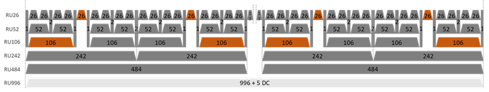
SP #18 (1907r1)
    Do you agree that for 80MHz BW, only the orange colored RU combinations are allowed?
    Y/N/A: 21/15/16

Slide 44
SP #19 (1907r1)
    Do you agree that for 20 and 40 MHz PPDU, the blue colored combination of RU52 and RU26 are allowed?
    Y/N/A: 30/3/10

Slide 45
SP #20 (1907r1)
Do you agree that for 80MHz PPDU, the blue colored combination of RU52 and RU26 are allowed?
Y/N/A: 31/0/20

Slide 46
SP #21 (1907r1)
Do you agree that for 80MHz PPDU, large-size RU combinations of RU242+RU484 (contiguous and non-contiguous) are allowed?
Withdrawn

Slide 47
SP #22 (1907r1)
Do you agree the following large-size RU combinations for 160MHz PPDU?
  Within each 80MHz segment
    RU combination RU242+RU484 (both contiguous and non-contiguous)
  Crossing 80MHz
    RU combinations of RU484+RU996
    RU combinations of RU242+484+RU242+484
    RU combinations of RU242+484+RU996
    Withdrawn

Slide 48
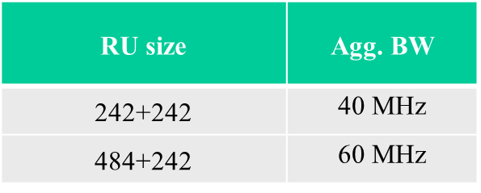
SP #23 (1908r1)
Do you support the conditional mandatory (conditional on supporting puncturing) large RU combinations for 80MHz non-OFDMA as described below?
484+242 supports contiguous 60MHz and non-contiguous 60MHz
  Puncturing one 20MHz anywhere in the 80MHz channel
For 242+242 we only propose to support the case where both 242 RUs are the outer ones in the 80MHz (a [1001] configuration)
NOTE: several tones at the edge may be punctured
Y/N/A: 18/16/19

Slide 49
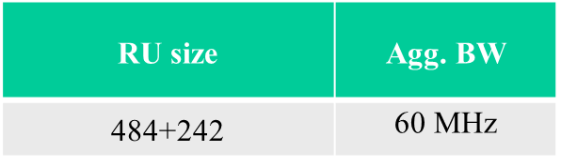
SP #24 (1908r1)
Do you support the large RU combinations for 80MHz OFDMA as described below?
Y/N/A: 29/0/14

Slide 50
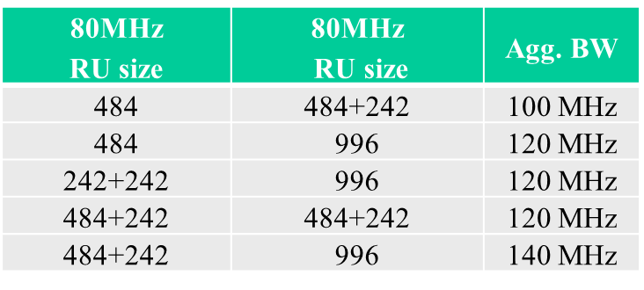
SP #25 (1908r1)
Do you support the conditional mandatory large RU combinations for 160MHz non-OFDMA as described as described below?
Y/N/A:
Deferred

Slide 51
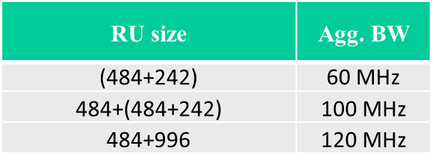
SP #26 (1908r1)
Do you support the large RU combinations for 160MHz OFDMA as described below?
() means within 80 MHz
Y/N/A:
Deferred

Slide 52
SP #27 (1908r1)
Do you support the small RU combinations of 26+52 and 26+106?
Y/N/A:
Deferred

Slide 53
SP#28 (1908r3)
Do you support the conditional mandatory (conditional on supporting puncturing) large RU combinations for 80MHz non-OFDMA as described below:
484+242 supports contiguous 60MHz and non-contiguous 60MHz
  Any one of four 242RU can be punctured
Y/N/A:40/0/6
RU size | Agg. BW | Notes
484+242 | 60 MHz | 4 options

Slide 54
SP#29 (1908r3)
Do you support the conditional mandatory (conditional on supporting puncturing) large RU combinations for 160MHz non-OFDMA as described as described below?
  Any one of eight 242RU can be punctured
  Any one of four 484RU can be punctured
Y/N/A: 32/1/14
80MHz RU size | 80MHz RU size | Agg. BW | Notes
484 | 996 | 120 MHz | 4 options
484+242 | 996 | 140 MHz | 8 options

Slide 55
SP#30 (1908r3)
Do you support the large RU combinations for 160MHz OFDMA as described below?
Y/N/A: 34/0/13
80MHz RU size | 80MHz RU size | Agg. BW | Notes
484 | 996 | 120 MHz | 4 options

Slide 56
SP#31 (1908r3)
Do you support the conditional mandatory (conditional on supporting puncturing) large RU combinations for 240MHz non-OFDMA as described as described below?
  Any one of six 484RU can be punctured
  Any one of three 996RU can be punctured
Y/N/A: 32/1/11
80MHz RU size | 80MHz RU size | 80MHz RU size | Agg. BW | Notes
484 | 996 | 996 | 200 MHz | 6 options
- | 996 | 996 | 160 MHz | 3 options

Slide 57
SP#32 (1908r3)
Do you support the conditional mandatory (conditional on supporting puncturing) large RU combinations for 320MHz non-OFDMA as described as described below?
  Any one of eight 484RU can be punctured
  Any one of four 996RU can be punctured
Y/N/A: 34/0/16
80MHz RU size | 80MHz RU size | 80MHz RU size | 80MHz RU size | Agg. BW | Notes
484 | 996 | 996 | 996 | 280 MHz | 8 options
- | 996 | 996 | 996 | 240 MHz | 4 options

Slide 58
SP #33 (1914r2)
Which option do you prefer?
  Opt2:
  Opt4:
  Need more discussion:
Withdrawn
 | Method
Opt1 | act as transmit the data to two different users, each RU is encoded, interleaved separately
Opt2 | The bits are encoded together, and parse to different RUs, separate interleaver/tone mapper
Opt3 | Opt1/Opt2+interleaver across RUs
Opt4 | Act as one big continuous RU

Slide 59
SP#34 (1914r3)
Do you support that for LDPC coding, for combined RUs sent to a user with RU size less than 242-tone, a single tone mapper shall be used?
Y/N/A: 40/0/5

Slide 60
SP #35 (1980r1)
Do you support to include 1x EHT-LTF and 2x EHT-LTF in 802.11be?
Y/N/A: 47/0/2

Slide 61
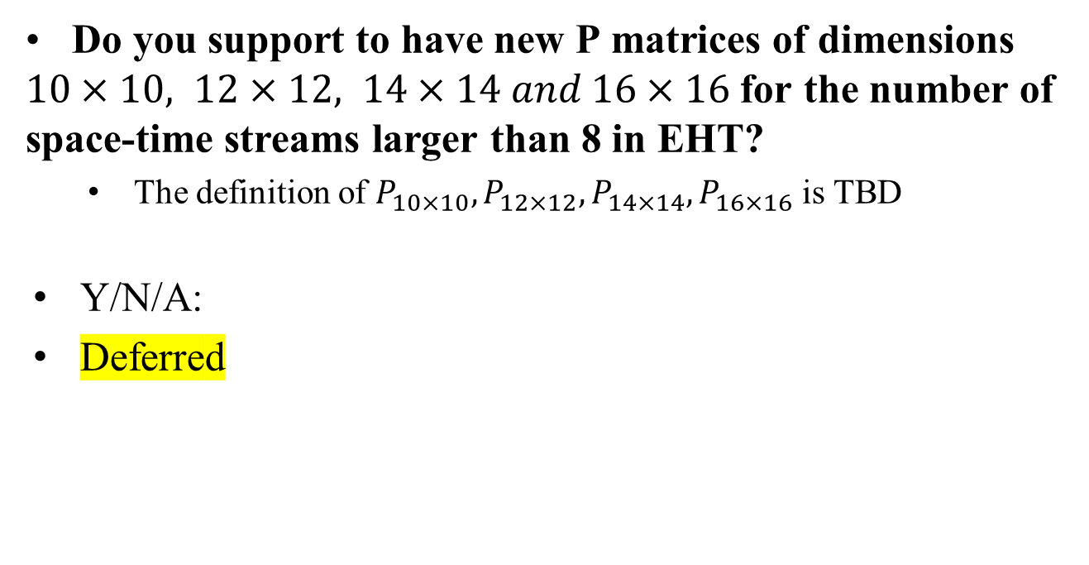
SP #36 (1980r1)
Do you support to have new P matrices of dimensions $10×10, 12×12, 14×14 and 16×16$ for the number of space-time streams larger than 8 in EHT?
  The definition of $P_{10×10},P_{12×12},P_{14×14},P_{16×16}$ is TBD
Y/N/A:
Deferred

Slide 62
SP #37 (1925r1)
Do you agree to add the following text into SFD?
  EHT-LTF should be designed to support 16 spatial streams.
Y/N/A: 58/0/2

Slide 63
SP #38 (1925r1)
Which option do you prefer for 11be 240/320MHz EHT-LTF design by minimizing PAPR?
  Opt1: Restrict preamble puncturing cases by practical puncturing patterns (The detail on puncturing patterns is TBD)
  Opt2: Consider defining whole new sequences
Opt1/Opt2/A: 6/4/38
Note: not intended for SFD

Slide 64
SP #39 (0029)
Do you agree to have RU Allocation subfield in the Common field of the EHT-SIG field of an EHT PPDU sent to multiple users?
  Compressed modes are TBD
  Contents of RU allocation subfield are TBD
  Y/N/A: 33/0/4

Slide 65
SP #40 (0029)
Do you agree to have at least one compressed mode in which RU Allocation subfield doesn’t exist in the Common field of the EHT-SIG field of an EHT PPDU sent to multiple users?
  Signaling method is TBD
  Y/N/A: 18/6/14

Slide 66
SP #41 (0029)
Do you agree to have more than one content channel in the EHT-SIG field of an EHT PPDU sent to multiple users?
  Content channel conceptis defined in 11ax
  Y/N/A:
Deferred

Slide 67
SP #42 (0029)
Do you agree to have more than one content channel in the EHT-SIG of an EHT PPDU sent to one user?
  Y
  N
  A
  Deferred

Slide 68
SP #43 (0029)
Do you agree to have the following subfields in U-SIG and/or EHT-SIG of an EHT PPDU sent to single user?
  MCS (for data)
  NSTS
  GI+EHT-LTF Size
  Coding
Y/N/A: 36/0/1

Slide 69
SP #44 (0029)
Do you agree to have the following subfields in EHT-SIG of an EHT PPDU sent to single user?
  Preamble puncture signaling, exact contents TBD
Deferred

Slide 70
SP #45 (0029)
Do you agree to have the following subfields in U-SIG of an EHT PPDU sent to multiple user?
  EHT-SIG MCS
  Number of EHT-SIG Symbols
Y/N/A: 34/0/7

Slide 71
SP #46 (0029)
Do you agree to have the following subfields in U-SIG or EHT-SIG of an EHT PPDU sent to multiple user?
  GI+EHT-LTF Size
Y/N/A: 38/0/2

Slide 72
Str SP #47 (0049r1)
Do you agree U-SIG will contain bandwidth information, carried as a version independent field?
  This information may also convey some puncturing information
  Number of bits is TBD
Y/N/A: 39/0/8

Slide 73
SP #48 (0049r1)
Do you agree to add “PPDU type” as a version dependent field in U-SIG?
  Number of bits is TBD
Y/N/A: 46/0/0

Slide 74
SP#49 (0049r1)
Do you agree that in EHT, SU and MU PPDU formats will be signaled using the same value of the PPDU type field?
Y/N/A: 27/11/6

Slide 75
SP #50 (0087)
Do you agree that U-SIG version-dependent bits include PPDU format bits for EHT?
Number of bits TBD
Withdrawn – covered by earlier SP

Slide 76
SP #51 (0087)
Do you agree that EHT defines single PPDU format for EHT SU and EHT MU?
Deferred

Slide 77
SP #52 (00117)
Do you agree to add the following text into SFD?
-EHT-LTF sequences are the same as HE-LTF sequences in 20/40/80/160/80+80MHz PPDU
Y/N/A:
Deferred
Sigurd Schelstraete (Quantenna/ON)

Slide 78
SP #53 (00117)
Do you agree to have 4x EHT-LTF for 320MHz/160+160MHz/240 MHz/160+80MHz?
Y/N/A: 30/0/18
Sigurd Schelstraete (Quantenna/ON)

Slide 79
SP #54 (2161)
Do you support that small-size multiple RUs can be combined and assigned to a single STA as a new RU type?
  Small-size RUs: RU26, RU52, RU106
Withdrawn

Slide 80
SP #55 (2161)
Do you support that large-size multiple RUs can be combined and assigned to a single STA by allowing RU/RUs to be punctured?
  Large-size RUs: RU242, RU484, RU996
Withdrawn

Slide 81
SP #56 (0022)
Do you agree to add the following text to the TGbe SFD?
  For the PPDU transmitted to SU, the preamble puncturing pattern field having TBD bits is contained in EHT-SIG
    Detailed descriptions are TBD
    Note: The field name can be changed
Y/N/A:
Deferred

Slide 82
SP #57 (0022)
Do you agree to add the following text to the TGbe SFD?
  For the PPDU transmitted to MU, the User field having TBD bits is contained in the user specific field of EHT-SIG
    The User field indicates user information assigned to each RU similar to that used in HE MU PPDU
    Detailed descriptions are TBD
Y/N/A: 18/1/13

Slide 83
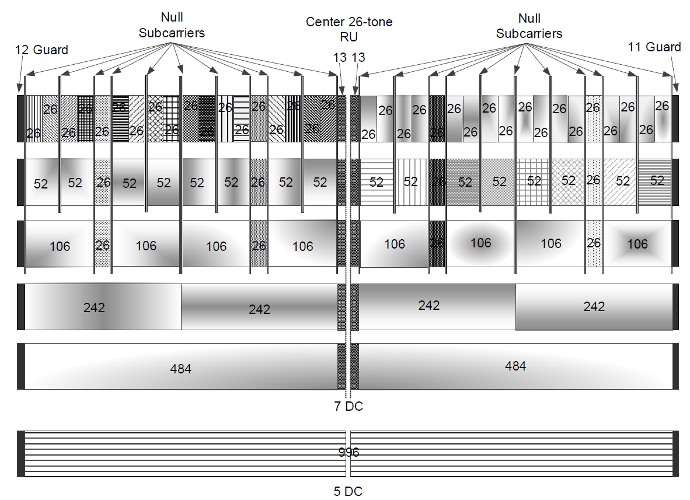
SP#58 (0023)
Do you agree to add the following text to the TGbe SFD?
  For the PPDU transmitted to SU, the following RU combinations of 106+26+52+26 in each 80MHz segment of all bandwidths should be used for each 20MHz channel when the adjacent 20MHz channel is punctured
Withdrawn
106+26+52+26 in red should be used when the second lowest 20MHz channel is punctured in each 80MHz segment
106+26+52+26 in blue should be used when the lowest 20MHz channel is punctured in each 80MHz segment
106+26+52+26 in green should be used when the highest 20MHz channel is punctured in each 80MHz segment
106+26+52+26 in yellow should be used when the second highest 20MHz channel punctured in each 80MHz segment

Slide 84
SP#59 (0023r1)
Do you agree to add the following text to the TGbe SFD?
  For the OFDMA transmission in contiguous 240MHz, for one STA large size RU aggregation is allowed only within 160MHz which is composed of two adjacent 80MHz channels
  For the OFDMA transmission in non-contiguous 160+80MHz, for one STA large size RU aggregation is allowed only within contiguous 160MHz or the other 80MHz, respectively
  2x996+484 is TBD
Y/N/A: 30/1/9

Slide 85
SP#60 (0023r1)
Do you agree to add the following text to the TGbe SFD?
  For the OFDMA transmission in 320/160+160 MHz, for one STA large size RU aggregation is allowed only within primary 160 or secondary 160, respectively
    Note that primary 160 is composed of primary 80 and secondary 80 and secondary 160 is 160MHz channel other than primary 160 in 320/160+160 MHz
  Exception: 3x996 is supported
  3x996+484 is TBD
Y/N/A: 22/0/8

Slide 86
SP#61 (0048)
For OFDMA in 320MHz, do you support no aggregated RU>=160 MHz except for
  RU996x3
  RU996x2
  Note: RU996x3+484 (TBD)
Withdrawn
Sigurd Schelstraete (Quantenna/ON)

Slide 87
SP#62 (0048)
For OFDMA in 240 MHz, do you support no aggregated RU>=160 MHz except for
  RU996x2
  Note: RU996x2+484 (TBD)
Withdrawn
Sigurd Schelstraete (Quantenna/ON)

Slide 88
SP#63 (0058r2)
Do you agree to add preamble puncturing indication about S80 for BW=160MHz in U-SIG of a PPDU transmitted to multiple users?
Deferred
Sigurd Schelstraete (Quantenna/ON)

Slide 89
SP#64 (0058r2)
Do you agree to add preamble puncturing indication about S80 of P160 for BW=320MHz in U-SIG of a PPDU transmitted to multiple users?
  Puncturing indication of S160 shall be performed in EHT-SIG
Deferred
Sigurd Schelstraete (Quantenna/ON)

Slide 90
SP#65 (0058r2)
Do you agree that 802.11be should allow (support) 160 and 320 MHz BW when (1) the secondary 20 MHz and (2) the other 20MHz channel corresponding to the same content channel of the secondary 20MHz in P80 are punctured?
Deferred
Sigurd Schelstraete (Quantenna/ON)

Slide 91
SP#66 (0108)
Do you agree that multi-RU for OFDMA shall support up to three RUs to be sent to same user?
Withdrawn

Slide 92
SP#67 (0108)
Do you agree that multi-RU for OFDMA shall support at least the RU combinations listed on Slide 17?
Withdrawn

Slide 93
SP#68 (0108)
Do you agree that multi-RU for OFDMA shall support only contiguous RU combinations for small-RU combinations?
Y/N/A: 22/8/12

Slide 94
SP#69 (0109)
Do you agree that multi-RU signaling shall reuse the HE-SIG-B protocol, modified such that multiple User Specific fields are allowed to have the same STA-ID (other than 2046)?
Withdrawn

Slide 95
SP#70 (0109)
Do you agree that multi-RU bit processing shall be per user (specifically, one encoder/decoder per user)?
Withdrawn

Slide 96
SP#71 (0109)
Do you agree that all RUs that carry the same PSDU within one PPDU shall use the same MCS and N_STS?
Y/N/A: 26/11/22

Slide 97
SP#72 (0128)
Do you agree to allow multi-RU structure to be any RU52 + any of its adjacent RU26 within a 20MHz channel
  RUs in the following refer to RUs as defined in 802.11ax
Y/N/A: 14/18/15
Sigurd Schelstraete (Quantenna/ON)

Slide 98
SP#73 (0128)
    Do you agree that for 80 MHz and above PPDU, within 20MHz boundary, any contiguous RU26 and RU106 can be combined?
Y/N/A: 13/20/11
Sigurd Schelstraete (Quantenna/ON)

Slide 99
SP#74 (0128)
Do you agree to allow multi-RU structure to be the center RU26 of a 80MHz channel with any of its two adjacent RU106?
  (RUs in the following refer to RUs as defined in 802.11ax)
Y/N/A: 11/14/3
Sigurd Schelstraete (Quantenna/ON)

Slide 100
SP#75 (0019)
Do you agree to add the following into the 11be SFD?
  The extra 4 subcarriers are applied to L-SIG and RL-SIG.
    The indices for extra subcarriers are [-28, -27, 27, 28]
    The extra subcarriers are BPSK modulated
    The coefficients [-1 -1 -1 1 ] as in 11ax are mapped to the extra subcarriers
Y/N/A: 32/0/0

Slide 101
SP#76 (0019)
Do you agree to add the following into the 11be SFD?
  11be has the four PPDU formats, i.e., SU PPDU, MU PPDU, TB PPDU, ER SU PPDU.
    Other PPDU format is TBD
Deferred

Slide 102
SP#77 (0019)
Do you agree that EHT SU PPDU format is configured as following?
  EHT-SU PPDU consists of L-STF, L-LTF, L-SIG, RL-SIG, U-SIG, EHT-SIG, EHT-STF, EHT-LTF, DATA
  EHT-SIG field contains only common field.
    Common field contains the version dependent information.
    This field shall be encoded by BCC at rate, R=1/2, and modulated with BPSK.
    The size of EHT-SIG field is TBD.
  Deferred

Slide 103
SP#78 (0019)
Do you agree that one PPDU format that is sent to multiple users is configured as follows?
  L-STF, L-LTF, L-SIG, RL-SIG, U-SIG, EHT-SIG, EHT-STF, EHT-LTF, DATA
    additional fields TBD
Y/N/A: 33/0/1

Slide 104
SP#79 (0019)
Do you agree that EHT TB PPDU format is configured as following?
  L-STF, L-LTF, L-SIG, RL-SIG, U-SIG, EHT-STF, EHT-LTF, DATA
    additional fields TBD
  Y/N/A: 19/2/7

Slide 105
SP#80 (0019)
Do you agree that EHT-ER SU PPDU is configured as following?
  EHT ER-SU PPDU consists of L-STF, L-LTF, L-SIG, RL-SIG, U-SIG, EHT-SIG, EHT-STF, EHT-LTF, DATA
    The sizes of U-SIG field and EHT-SIG field are twice as the U-SIG field and EHT-SIG field in EHT SU PPDU format, respectively
    The detail on the repetition of U-SIG and EHT-SIG is TBD
  Deferred

