Slide 1
Virtual Carrier Sense in Multi-Link
Date: 2020-02-19
Authors:
Name | Affiliations | Address | Phone | email
Thomas Handte | Sony Corporation |  |  | thomas.handte (at) sony.com
Dana Ciochina |  |  |  | dana.ciochina (at) sony.com
Mohamed Abouelseoud |  |  |  | mohamed.abouelseoud (at) sony.com

Slide 2
Introduction
Multi-link is key feature of EHT
  Allows exchange of frames over multiple links concurrently or non-concurrently
  Multi-link enhances throughput and latency
Several submissions analyzed operation of multi-link [1, 2, 3]
  Asynchronous or quasi-/semi-asynchronous operation provides higher gains than synchronous
  Asynchronous operation requires multiple contention channels [4]
    Contention is performed independently on each link
This presentation addresses virtual carrier sense (CS) in context of multiple links
  How to determine NAV in asynchronous multi-link
    Throughout this presentation, we assume that multiple links are formed by different channels

Slide 3
Advantages of NAV specific to asynchronous multi-link
Avoid hidden node problem
  As in single link
Advantages of multi-link arise because of fast link switching
  Waiting for a NAV setting frame or a time period equal to probe delay in the recently switched link is often unacceptable
  Simulation results in [5] show gain in throughput and latency if NAV conditions in all links are known
    ~50% improvement in latency (50%ile)
    ~25% improvement in throughput
Multi-link NAV helps to switch from asynchronous to synchronous or quasi synchronous operation
  NAVs getting zero at same time is a necessary condition for successful synchronous operation

Slide 4
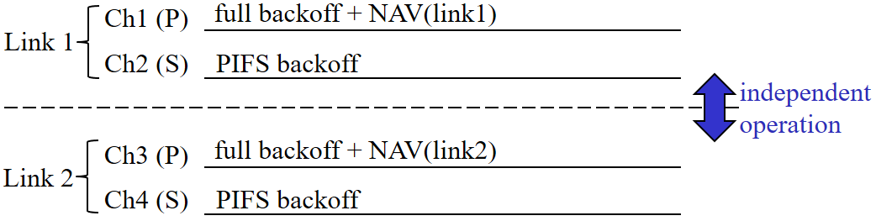
Primary channel in single link and multi-link
Single link (today’s operation)
  Primary/ secondary channel concept
    Full backoff on primary channel, PIFS backoff on secondary channels
    A STA maintains NAV based on observation of primary channel
Multi-link
  Assume straight forward application of single link concept to multi-link
    Each link has its own primary channel
      i.e. multi-link has multiple primary channels
    Each STA needs to observe the primary channel of each link to maintain NAV information for that link

Slide 5
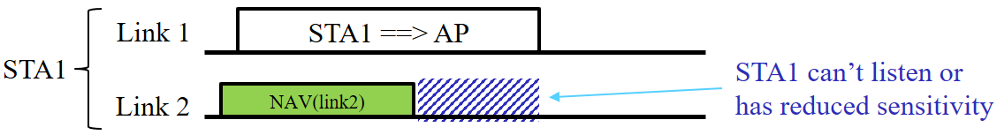
Virtual CS implications of multiple primary channels
Low power efficiency
  STA needs to listen to multiple primary channels (i.e. listen to each primary channel of each link)
Restrictions on simultaneous transmit or receive operation may disallow to observe multiple primary channels at all times [3]
  E.g. STA is transmitting on 1st link but needs to listen on primary channel of 2nd link at same time
Single radio STAs, i.e. STAs that can listen to only one link at a time, can’t do simultaneous reception on multiple primary channels

Slide 6
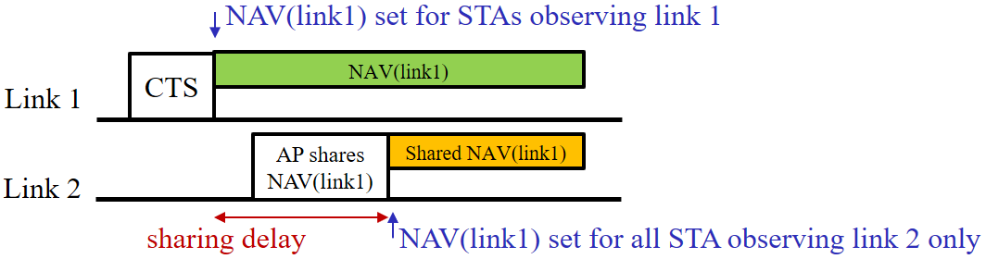
Proposal (1/3)
Sharing of NAV information
  On each primary channel the NAV information of the other primary channel(s) of the other link(s) is shared
    The definition of a multi link primary channel where NAV information of all links is shared may be envisioned as well [6]
NAV sharing should preferably be done by AP MLD
  AP has typically best multi-link hardware capabilities in BSS
    It may access all channels of multi-link setup
    It may have least restrictions regarding simultaneous transmit or receive operation
  AP has reliable NAV information of all links at all times
Example for sharing NAV(link1) over link2

Slide 7


Proposal (2/3)
Envisioned AP operation
  Once AP obtains NAV information of a link, it shares on the other link(s) as soon as possible
    AP could enforce restrictions on max. PPDU or TXOP length to limit sharing delay
    AP doesn’t share if sharing delay exceeds NAV time that is to be shared
Implementation of NAV sharing
  Frame of CTS-type (“multi-link CTS”)
    Pros: simple, well-known
    Cons: rare update if long TXOPs present, detection MCS depended
  Include multi-link NAV information in 11be PHY preamble (preferred)
    Pros: update every time an AP transmits 11be preamble, detection MCS independent
    Cons: need to compress NAV info, need BSS identifier in PHY preamble (could reuse BSS Color)

Slide 8
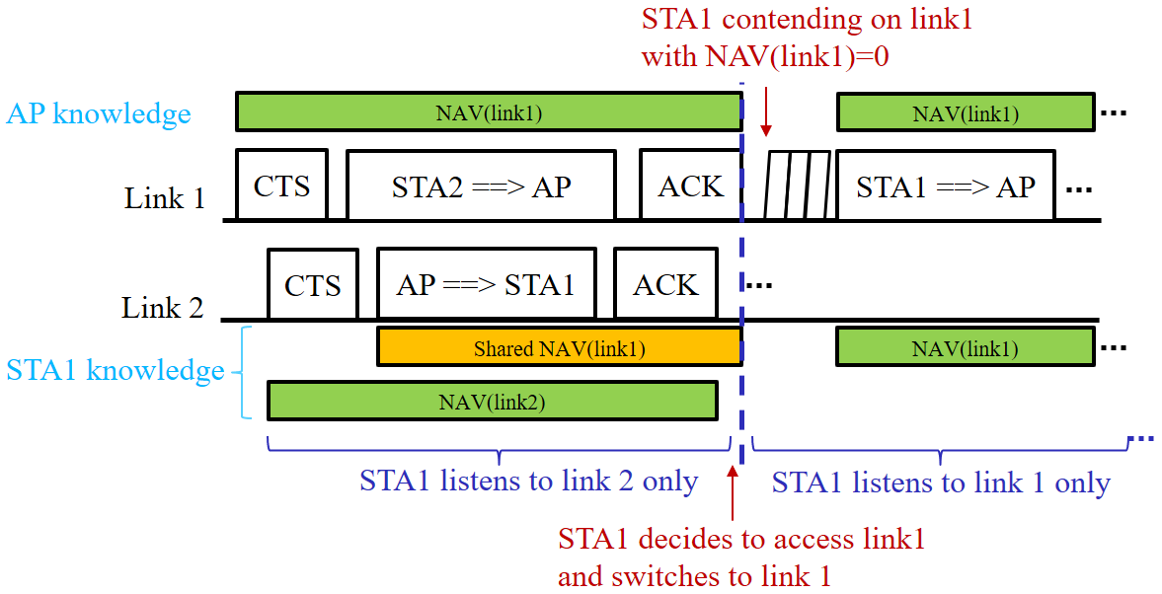
Proposal (3/3)
Envisioned STA operation
  STA listens on the primary channel of a link or on the multi-link primary channel
    STA obtains NAV for this link as usual
    STA obtains NAV for all other links based on shared NAV
  Before shared NAV of a link reaches zero, a STA shall either
    switch to that link and determine NAV
    as usual
    or
  stay on the current link and await new
  shared NAV information
  If STA decides to transmit on a link that
  doesn’t include the currently observed
  primary channel, it should switch to that
  channel as early as possible and before
  shared NAV of that link reaches zero.

Slide 9
Benefits
Proposal avoids reception on multiple links at same time for NAV maintenance
  High power efficiency
  No impact of joint transmission and reception restrictions
  Single radio STAs may participate in and benefit from multi-link operation
Enable fast transmission after link switching
  Shared NAV may reduce the waiting time before a non-observed channel may be accessed
Robust NAV detection in frames that are transmitted in non-duplicate non-HE format
  AP can demodulate any PPDU format that is used in BSS
If AP has restrictions for responding independently on different links [7,8], it may implement restrictions via shared NAV
  AP may alter shared NAV such that restrictions are fulfilled

Slide 10
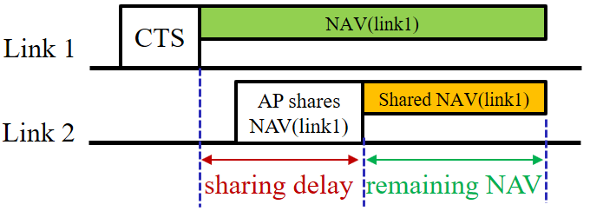
Simulation (1/3)
Analysis of sharing delay and remaining NAV
  Remaining NAV is the value of shared NAV once it is shared, i.e. after
  sharing delay passed
Simulation setup
  2 links, fully asynchronous operation
    Link 1 shares NAV of link 2
    Each link: 1 AP entity, 5 STAs, EDCA (best effort)
    No implementation delay, i.e. zero sharing delay between AP entities
  Link 1
    Limits
      TXOP {3.2ms or 6.5ms}
      PPDU {2ms or 3ms}
    Mainly UL traffic (type of worst case scenario because AP entity transmits rarely)
      UL: full buffer traffic
      DL: BAck
  Link 2
    Variable TXOP length between 0.5ms and 6.5ms (uniform distribution)

Slide 11
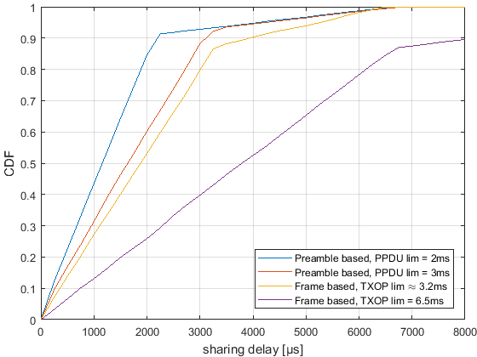
Simulation (2/3)
Sharing delay
  Preamble based vs. frame based NAV sharing
  Preamble based shows smaller sharing delay because AP entity has more opportunities to
  share NAV
  Sharing delay larger than respective limit in ≈10% of cases
    Caused by collisions
    May be avoided by trigger based channel access

Slide 12
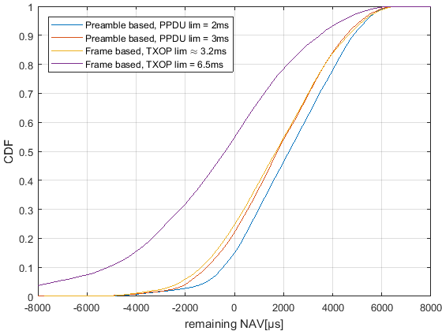
Simulation (3/3)
Remaining NAV
  Remaining NAV smaller zero doesn’t provide any benefit
    AP shares NAV only when remaining NAV>0
  In case of preamble based sharing with PPDU limit of 2ms, AP shares NAV in 85% of the cases
  In case of frame based sharing with TXOP limit of 6.5ms, AP shares NAV in 45% of the cases
Area of interest

Slide 13
OBSS scenario
NAV info of AP is not complete in OBSS scenario
  Shared NAV may differ from the NAV that a STA would obtain on a channel
Potential solutions
  STAs may report NAV that has been set by a OBSS PPDUs to AP in order to improve shared NAV information (similar to [9])
    Sharing delay may increase
    Reported NAV may not be applicable for all STAs of BSS
  APs share shared NAV info via multi-AP concepts
    Requires OBSS to be part of multi-AP group
    Reported NAV may not be applicable for all STA of BSS
  STAs may switch link early and listen for OBSS PPDUs
    May define a minimum listening time for STAs and links that are subject to OBSS interference

Slide 14
Summary
Virtual carrier sense is important in multi-link
  ~50% improvement in latency (50%ile), ~25% improvement in throughput [5]
Maintaining NAV from multiple primary channels of multiple links has drawbacks
  Low power efficiency
  Not feasible if STAs have restrictions on simultaneous transmit or receive operation
Proposal: Share NAV information among links
  On each primary channel of a link the NAV information of the other primary channel(s) of other link(s) is shared
  Sharing may preferably be implemented by NAV information within PHY preamble
Main benefits
  High power efficiency, no restrictions on simultaneous transmit/ receive operation
Simulation results
  Restrictions to TXOP length or PPDU length help to achieve small sharing delay
  Preamble based sharing with a max. PPDU length of 2 ms achieves successful NAV sharing in 85% of the cases

Slide 15
References
[1] 11-19/1291r3 Performance aspects of Multi-link operations
[2] 11-19/1405r7 Multi-Link Operation Channel Access Discussion
[3] 11-19/1541r1 Performance aspects of Multi-link operations with constraints
[4] 11-19/1144r6 Channel Access for Multi-link Operation
[5] 11-19/1930r2 AP assisted ML operation
[6] 11-19/1526r1 Multi-Link Power-save
[7] 11-19/1836r1 Multi-link Channel Access Discussion Follow-up
[8] 11-19/1548r1 Channel access design for synchronized multi-links
[9] 11-19/1918r0 UL MU efficiency enhancement using multi-link

Slide 16
Straw Poll
Do you support that an AP entity which is part of a AP MLD can transmit channel busy information of the other AP entities which are part of the same AP MLD?
  Note 1: Definition of channel busy information is TBD
  Note 2: How non-AP MLD use this information is TBD

