Slide 1
January 2020
doc.: IEEE 802.11-20/0133r0
Emergency Alerts Using IEEE 802.11 WLAN
Date: 2020-01-13
Authors:
Name | Affiliation | Address | Phone | Email
Sandeep Agrawal | Centre For Development of Telematics (C-DOT) | Mehrauli, New Delhi, India Electronic City, Bangalore, India |  | sandeepa@cdot.in
Kavita Mathur |  |  |  | kavitam@cdot.in
Vipin Tyagi |  |  |  | vipin@cdot.in
Submission
Sandeep Agrawal, C-DOT India

Slide 2
January 2020
doc.: IEEE 802.11-20/0133r0
Outline
Introduction
WLAN Deployment in India
Scenario in India
Support in Cellular Technology & Challenges
IEEE 802.11 WLAN for Emergency Communication
C-DOT Proprietary solution
Use case
Requirement
IEEE 802.11 WLAN Capability
Summary
References
Submission
Sandeep Agrawal, C-DOT India

Slide 3
January 2020
doc.: IEEE 802.11-20/0133r0
Introduction
Early Emergency Alert to the citizens living in areas prone to natural disasters such as floods, earthquake, cyclones, man-made disasters such as terrorist attacks etc. Is a very critical requirement.
In such situation, all available communication infrastructure in the area require to be efficiently used to enable critical communication.
Today cellular, TETRA, P25, old analog system or satellite hand phones etc. are the main communication medium in such situations.
ITU has defines CAP (Common Alert Protocol) to send emergency alert message in all disaster situations.
Cellular based communication is limited to only SIM based devices. Other non-SIM based devices such as Laptops, Tablets and desktops used by citizen in such areas shall also be used in such situations.
The Public Wi-Fi infrastructure is being deployed in every country. We propose to use this massive infrastructure for critical communication in emergency situation.
Submission
Sandeep Agrawal, C-DOT India

Slide 4
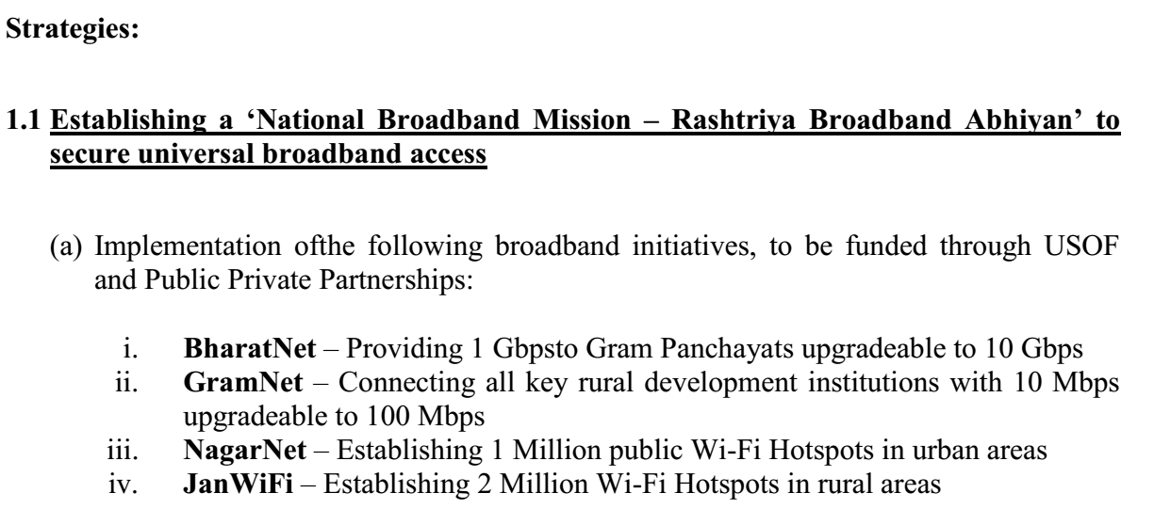
January 2020
doc.: IEEE 802.11-20/0133r0
WLAN Deployment in India
Submission
Sandeep Agrawal, C-DOT India

Slide 5
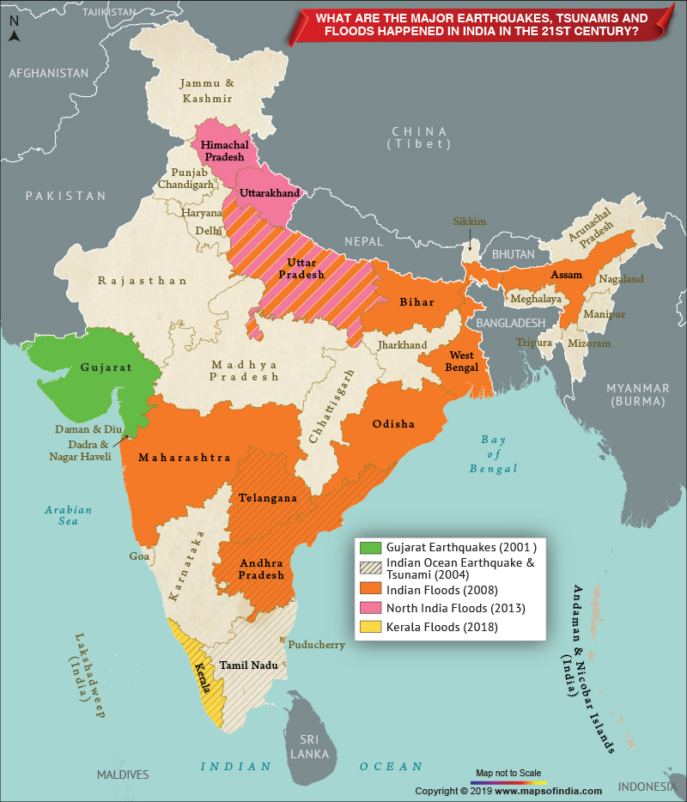
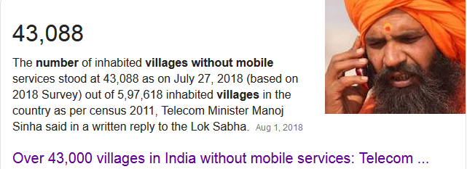
January 2020
doc.: IEEE 802.11-20/0133r0
Scenario in India
Submission
Sandeep Agrawal, C-DOT India

Slide 6
January 2020
doc.: IEEE 802.11-20/0133r0
Emergency Alert in Cellular Technology
Cell Broadcast/Cell Information (CB) is a common method of sending messages to multiple mobiles telephone users in a defined area at the same time in all cellular networks.
A Cell Broadcast Centre (CBC), a system which is the source of SMS-CB, is connected to a base station controller (BSC) in GSM networks, to a radio network controller (RNC) in UMTS networks, to a Mobility Management Entity (MME) in LTE networks or to a core Access and Mobility management Function (AMF) in 5G networks.
A Cell Broadcast Entity (CBE) is a multi-user front-end that allows the definition and control of SMS-CB messages. A CBE can be located at the site of a content provider. At the site of the operator a so-called Cell Broadcast Centre (CBC) is located. The CBC is the heart of the Cell Broadcast System and acts as a server for all CBE clients. It takes care of the administration of all SMS-CB messages it receives from the CBEs and does the communication towards the GSM network.
Submission
Sandeep Agrawal, C-DOT India

Slide 7
January 2020
doc.: IEEE 802.11-20/0133r0
Challenges with Cellular Network
Network Congestion
Licensed Spectrum (costly)
Very High CAPEX and OPEX
Emergency messages can only be convey to SIM based devices
Not easily deployable
Coverage issue
Rural: No Coverage
Urban: Poor mobile coverage inside the buildings
Mines, High rise building etc. Has coverage issue.
Submission
Sandeep Agrawal, C-DOT India

Slide 8
January 2020
doc.: IEEE 802.11-20/0133r0
IEEE 802.11 WLAN for Emergency Communication
802.11 WLAN is suitable network for Emergency Communication due to following features:
Low cost network
Low powered Hotspot (Can work on Solar powers)
Unlicensed Spectrum
A large number of users can be served with one Hotspot
Backward compatible standards to support all user devices
Easily deployable. (Deploying Wi-FI Hotspot with Satellite Backhaul is very easy compared to deploying Cellular)
High Data Rate support
SIM as well as Non SIM devices can get alerts
Indoor coverage as well as outdoor
Mesh topology for coverage extension in a given area
Submission
Sandeep Agrawal, C-DOT India

Slide 9
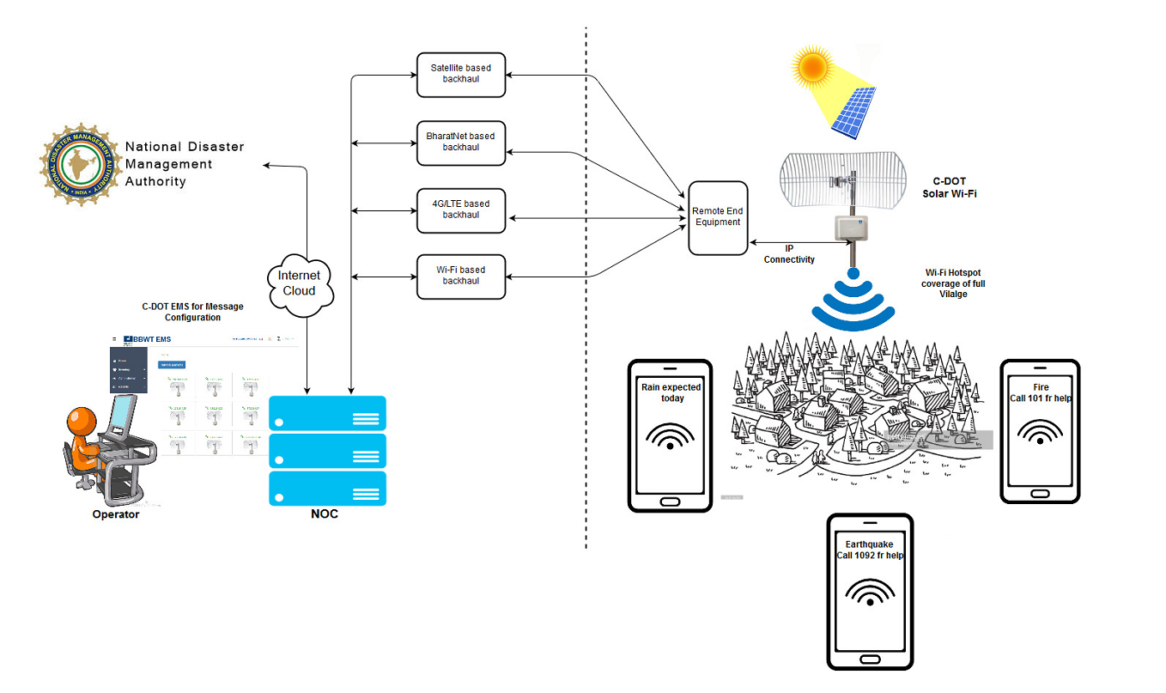
January 2020
doc.: IEEE 802.11-20/0133r0
C-DOT Proprietary Solution
Submission
Sandeep Agrawal, C-DOT India

Slide 10
January 2020
doc.: IEEE 802.11-20/0133r0
How it works
When users are not connected to the 802.11 WLAN Access Point
Configure multiple Virtual WLAN on the Access Point installed in the area
Configure each Virtual WLAN SSID name with "Emergency Alert message" i.e. Rain is expected, Heavy Wind etc.
When a user scan Wi-Fi Radio, he will see Emergency Alert message notification in the form of SSID name
When users are connected to the 802.11 WLAN Access Point
An application will be pre-installed on user device (in our case, the APP name is SAJAG (a Hindi word for ALERT))
The AP will send Emergency Alert message to the connected user device which will be received by the pre-installed application and display the message or enabling ringing etc. For notification.
Submission
Sandeep Agrawal, C-DOT India

Slide 11
January 2020
doc.: IEEE 802.11-20/0133r0
Use case
To provide Emergency Alerts in:
Remote and unconnected area with no cellular coverage
Multi Dwelling and other buildings with intermittent or no cellular coverage
Any indoor or outdoor locations (Urban, Semi Urban and Rural) with Wi-Fi coverage
Submission
Sandeep Agrawal, C-DOT India

Slide 12
January 2020
doc.: IEEE 802.11-20/0133r0
Network Requirement
Dedicated Channel: Dedicated Channel assigned for Emergency Alert messages
Broadcast and multicast over Wireless: Communication medium to broadcast messages to all the clients (connected as well as not connected clients).
Scalable and Easily Configurable: Network devices should be easily configurable and scalable.
Provide Integrated Services: Voice, data and video information and integrating all communications from multimedia centre are required to enable fast and effective real-time decision making.
Security: Security of messages are essential. Identification of valid source is mandatory
Reliability: Reliability of an emergency network is important as emergency messages are exchanged in adverse environment. Dedicated resource allocation and priority routing for Emergency Message (preferable ITU defined CAP enabled messages)
Communication and Response: The communication and response in an emergency network would be real-time and having low latency is crucial.
Spectrum Sharing: Need optimal way to share spectrum since resources available during disaster would be limited.
Dispatch and Control: In a classical emergency communication system, messages are routed through hierarchical dispatch and control structure.
Robust and Resilient: Rescue operations take place under unfavourable conditions and the in order to cope, the networks deployed should be robust and resilient.
QoS: An emergency network has to conform to a strict Quality of Service (QoS) to ensure optimised performance with limited resources.
Backward compatibility: to support all generation of mobiles with Wi-Fi support
Submission
Sandeep Agrawal, C-DOT India

Slide 13
January 2020
doc.: IEEE 802.11-20/0133r0
Summary
We propose to IEEE 802.11 WNG to start a Technical Study to find gaps in existing WLAN standard to support reliable communication for Emergency alerts during disaster situation
Submission
Sandeep Agrawal, C-DOT India

Slide 14
January 2020
doc.: IEEE 802.11-20/0133r0
References
https://www.itu.int/en/ITU-D/Emergency-Telecommunications/Pages/default.aspx
www.cellbroadcastforum.org
https://www.cse.wustl.edu/~jain/cse574-14/ftp/disaster/index.html
https://standards.ieee.org/standard/802_11-2016.html
http://www.ieee802.org/11/Reports/tgbc_update.htm
https://www.sharetechnote.com/html/Handbook_LTE_ETWS.html
http://dot.gov.in/sites/default/files/Final%20NDCP-2018_0.pdf
Submission
Sandeep Agrawal, C-DOT India

