Slide 1
Discussion on Multi-RU in 802.11be
Date: 2020-xx-xx
Authors:

Slide 2
Background
It was agreed that 11be shall allow more than one Resource Unit (RU) to be assigned to a single STA.
As the supported BW in 802.11be is increased to 320MHz, many multiple RUs (abbreviated here as “MRU”) combinations exist
In order to limit the overhead it is essential that only a subset of these combinations shall be allowed.
One of the ideas discussed in various contributions ([1], [2]) is to split the RUs to 2 types: “small RUs” (size <=106) and “large RUs” (size>=242) so that MRU allocations consist of RUs of one type only.
In this contribution we suggest some alternatives to define MRUs in 802.11be.

Slide 3
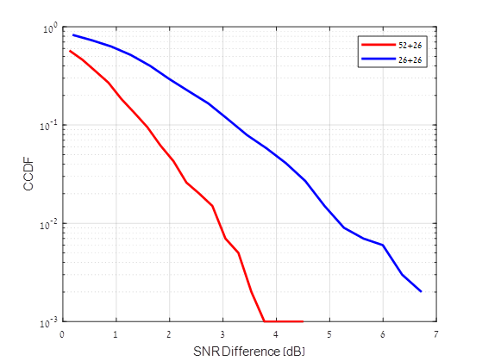
Assumptions for MRU
A single FEC with the same parameters (MCS, coding, N_SS etc.) shall be assigned to a STA allocated with an MRU
Small RUs and large RUs shall not be aggregated to the same MRU allocation
Small RUs shall not be aggregated across multiple 20MHz channels
As also suggested in [3], it is reasonable not limit the MRUs of small RUs to be comprised only of contiguous RUs for two reasons:
  Scheduling RUs based on SNR (e.g. based on CQI feedback)
  can yield non-negligible SNR improvement, as shown in
  the figure on the right, and such schedulers would benefit from
  using any combination of MRU
  Increasing spectrum usage by allocating empty (unused)
  RUs which are not necessarily contiguous
Simulation results (4Tx, 2Rx, TGn-D) show that
aggregating an arbitrary RU26 to the best RU26
yields significant SNR gain; aggregating an arbitrary
RU52 to the best RU26 yields lower SNR gain (as
expected)
Therefore, combining RU26 with a non-contiguous RU>26 may be
defined only if the overhead is reasonable

Slide 4
Assumptions for EHT-SIG
EHT-SIG (the successor of HE-SIG-B) shall have 2 fields: common field and user-specific field; both fields purposed shall be similar to 11ax
The structure of EHT-SIG being comprised of a common part and a user-specific part passed motion
User field length either remains 21 bits as in 11ax or is changed to a different but predefined number in order to avoid indicating it in U-SIG
In 11ax, the SIG-B user-fields are decoded in a chronological order; changing this in 11be would open possibilities for MRU signaling but it would increase the complexity of the EHT-SIG
Supporting MU-MIMO in MRUs comprised of RUs<106 need to be addressed

Slide 5
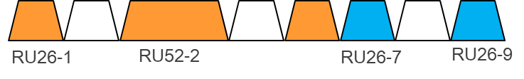
Alternative #1
  EHT-SIG user-specific field is slightly modified to allow MRU signaling
The first user-field content remains similar to the 11ax user-field (additional bit/bits may be added to support e.g. 16SS)
The other user-fields are placed according to their locations as in 11ax, however their content is modified:
  the first 11bits remain the same for STA_ID
  The remaining bits shall have new content related to MRU
A STA shall know if an MRU is assigned to it after it decodes EHT-SIG; thus no need for special signaling for MRU user-field
STA 1
RU_Allocation Subfield = 00000100
(No change required for MRU signaling)
STA 2
UF1
UF2
UF3
UF4
UF5
UF6
UF7
UF8
STA1_ID
11ax user-field sub-fields
Other STA
STA1_ID
New content
Other STA
STA1_ID
New content
STA2_ID
11ax user-field sub-fields
Other STA
STA2_ID
New content

Slide 6
Alternative #2
  EHT-SIG shall be significantly modified to allow MRU signaling in an efficient manner
  MRUs will be signaled in a separate subfield within the user-specific field
  The common field
    Add 2 new sub-fields to the EHT-SIG common field
    N_MRU_1 (N x Nb bits) – this field indicates how many small MRU allocation (26/52/106) exist in the corresponding 20MHz channel
      Nb may be either 1 or 2; we suggest to limit the number of MRUs per 20MHz to 2; more than this seems too complex and redundant
    N_MRU_2 (2 bits) – this field indicates how many large MRU allocation (242/484/996) exist in the entire BW
RU Allocation Subfield (Nx8/9 bits)
N_MRU_1 (NxNb bits)
N_MRU_2 (2 bits)
CRC & Tail (10 bits)
    And in general each CC common field will be of the form:
…
RA Subfield
N_MRU_1
RA Subfield
N_MRU_1
N_MRU_2
CRC & Tail

Slide 7
Alternative #2 (cont.)
  The user-specific field
    Define a new structure to the user specific field
    The user-specific field is split to 2 fields:
      Multi-RU user specific field (always precedes single-RU specific field)
      Single-RU user specific field (with user-fields similar to 11ax)
    Each Multi-RU user specific field shall contain the following subfields
      STA_ID (11 bits)
      MCS (4 bits)
      Coding (1 bit)
      RU bitmap (16 bits) – pointers to RUs that belong to the same MRU allocation
      CRC & Tail (10 bits)
    RU bitmap:
      For small RUs there are 9 26-tones RUs, therefore 7 bits are not used
      Alternatively, the number of RUs in each 20MHz may be extracted from the common field
      for large RUs there are 16 242-tones RUs (for 320MHz BW)
      Examples are given in the appendix
    Multi-RU user specific field
  Single-RU user specific field

Slide 8
Alternative #3
A straightforward approach may be to define new RU sizes that are comprised of combinations of 802.11ax RU sizes
Add description for these RUs in the RU Allocation subfield
The user-specific field will most likely be shorter (and in any case will not be longer) because only a single user-field is required for each RU/MRU (we don’t need multiple user fields to describe an MRU)
Based on the previous assumptions (given in slide 3) and in order to reduce the MRU signaling overhead the following restrictions on MRUs are considered:
  add the middle RU26 to its adjacent RU52/RU106 or
  combine two RU26 that are different from the already defined RU52
But even with the above restrictions, there are still too many entries required to support other MRU combinations so expanding the RU Allocation table is impractical

Slide 9
Alternative #3 (cont.)
So, instead of expanding the RU Allocation subfield to a huge dimension, we suggest to add another field that will follow the common field, let it be denoted as
“Common-MRU”.
This field existence should be signaled either in the common field (preferred) or in the U-SIG (similarly to signaling the SIG-B compression mode in 802.11ax)
11be Common field
Common field (similar to 11ax)
Common-MRU
CRC+Tail
MRU_1
MRU_2
MRU_3
…
MRU_1
MRU_2
MRU_3

Slide 10
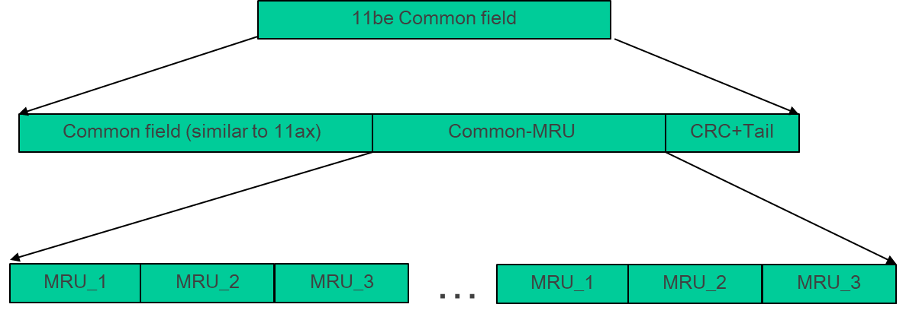
Alternative #3 (cont.)
Small MRUs:
Common-MRU is encoded separately and is comprised of 3 bitmap subfields:
  MRU_1 – 9 bits: indicates which RUs comprises the 1st MRU
  MRU_2 – 7 bits: indicates which RUs comprises the 2nd MRU
  MRU_3 – 5 bits: indicates which RUs comprises the 3rd MRU
So, additional 21 (22 including the signaling bit) are required for signaling any combination of up to 3 MRUs per 20MHz channel
Although it may appear as high overhead, we should bear in mind that a larger amount of additional bits will be saved later due to the reduction in the number of user-fields in the user-specific field
An example is given in the appendix

Slide 11
Alternative #3 (cont.)
Large MRUs:
Large MRUs are identified by the corresponding RU Allocation subfield for RU>=242 tones
In this case the Common-MRU field bitmap indicates which other RUs (>242) correspond to the same MRU
  MRU_1 – 8 bits (9th bit is omitted): indicate which RU242 belong to the MRU of this RU
  MRU_2 – omitted
  MRU_3 – omitted
Similar to the small MRU case, the user-specific field overhead is also reduced
An example is given in the appendix

Slide 12
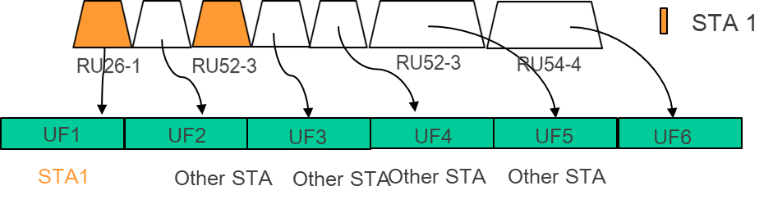
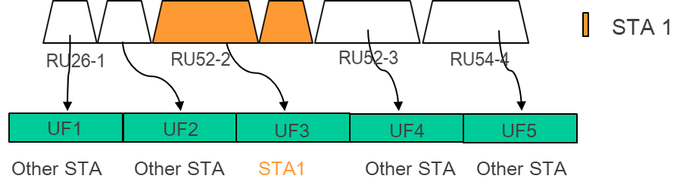
Alternative #3 (cont.)
Decoding the user-specific field
A STA will decode the user-specific field similarly to the way it does on 802.11ax. A user-field location of a MRU will be in accordance with the RU of the lowest frequency as shown in the 2 examples below
Each user-field points to the first RU (the RU located in the lowest frequency) of the MRU. All STAs are already familiar with the RU structure (signaled in the common field) so they know that the user-field skips the rest of the RUs of the same MRU

Slide 13
Alternative #4
(Further Thoughts about MRU)
There is a clear tradeoff between flexibility and overhead/complexity
A reasonable compromise would be to omit the too-complex combinations and stay with the most simple and likely
Therefore we suggest to allow the following subset of combination within a given 20MHz channel:
  Any RU52 + any of its adjacent RU26
  Any of the two RU106 + middle RU26
  The middle RU26 of the 80MHz with any of its two adjacent RU106

Slide 14

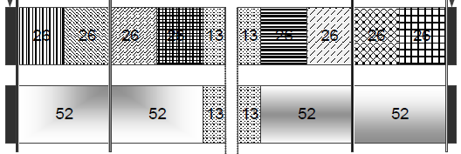
Alternative #4 (cont.)
Assuming support of 16SS and MU-MIMO for MRU that includes RU106, the above (1) and (2) require additional 38 entries to the RU Allocation subfield; Supporting (3) requires 32 additional entries (so total 70 additional entries for supporting all 3 combination types).
EHT-SIG structure remains similar to HE-SIG-B.
(1)
(2)

Slide 15





Alternative #5
(OFDMA with puncturing)
  Assuming puncturing is a relatively common case (especially in dense networks):
  Referring to RU>484, we may use the puncturing information (likely to be defined in U-SIG) in order to define a non-contiguous large RU so that a single RU is defined instead of a MRU which is likely to require additional overhead
  Example:
STA 1
STA 2
/
Available
P80
S80
Punctured
  STA1 allocation consists of 1st RU-242 and 2nd RU-484.
  STA2 allocation consists of 6th RU-242 and 8th RU-242.
  Both can be defined as 1 (punctured) RU-996, hence using a single RU definition instead of two (MRU)
  When a STA realizes that RU-996 is assigned to it, it already knows that this RU is punctured
  Note:
  This definition doesn’t contradict other MRU definitions
  Puncturing mechanism should be revised to provide info on S80

Slide 16
Conclusions
Alternative | Description | Pros | Cons
#1 | Modify remaining bits in duplicated user-fields | Allows to indicate additional MRU info | Efficiency is not improved (Same number of user-fields as in 802.11ax)
 |  | Does not require additional entries in the RU Allocation subfield
 |  |  | All STAs need to detect all user-specific fields
 |  | MRU definition and signaling is simple
#2 | Separate MRU user-specific and Single-RU user specific fields | MRU information may be added | implementation complexity may be higher
 |  | Same error probability of SIG-B per STA
 |  |  | Single-RU STAs need to decode the MRU field in order to realize the RUs structure
 |  | For MRU that consists of 3 or more RUs total size is reduced
#3 | A new Common sub-field with MRU bitmap | Any combination of MRU may be defined | Add new content to the common field
 |  | Avoid expanding the RU Allocation subfield make the implementation practical
 |  | Overall overhead in EHT-SIG is reduced
#4 | Restricted combinations | Reduced overhead, reduced complexity | Reduced flexibility
 |  |  | Compromise in channel utilization
Special Case | OFDMA with puncturing | Reduce overhead | Relevant for large Rus
 |  |  | Only for STAs that support puncturing

Slide 17
References
[1] 11-19-1907-00-00be-multiple-ru-combinations-for-eht (Mediatek)
[2] 11-19-1908-00-00be-multi-ru-support (Broadcom)
[3] 11-19-1126-01-00be-enhanced-resource-unit-allocation-schemes-for-11be (Mediatek)

Slide 18
Straw Poll 1
Do you agree to allow multi-RU structure to be any RU52 + any of its adjacent RU26 within a 20MHz channel
  RUs in the following refer to RUs as defined in 802.11ax
Y/N/A

Slide 19
Straw Poll 2
Do you agree to allow multi-RU structure to be any of the two RU106 + middle RU26 within a 20MHz channel?
  (RUs in the following refer to RUs as defined in 802.11ax)
Y/N/A

Slide 20
Straw Poll 3
Do you agree to allow multi-RU structure to be the middle RU26 of a 80MHz channel with any of its two adjacent RU106?
  (RUs in the following refer to RUs as defined in 802.11ax)
Y/N/A

Slide 21
Straw Poll 4
Do you agree that within a 20MHz channel, a MRU may be comprised of non-contiguous RUs
  RUs in the above refer to RUs as defined in 802.11ax
Y/N/A

Slide 22
Straw Poll 5
Do you agree to limit the number of small RUs exist in a multiple RU within a 20MHz channel
  RUs in the above refer to RUs as defined in 802.11ax
Y (2 RUs)
Y (3 RUs)
N (4 RUs)
A

Slide 23
Straw Poll 6
Do you agree that within a 20MHz channel there is no combination of 2 RUs that is statistically superior to any of the other combinations of the same size
  Superior in means of SNR
  RUs in the above refer to RUs as defined in 802.11ax
  For example there is no RU26+RU52 pair that is superior to the other same-size pairs
Y/N/A

Slide 24
Appendix: Examples

Slide 25
Alternative #1 – Example
  For small-RUs: a 9-bits bitmap shall indicate which 26-tones RUs in the same 20MHz channel are part of the MRU allocation. A 52-tones RU or 106 tones RU shall be indicated by the appropriate 2/4 bits. The 10th bit is reserved.
RU_Allocation Subfield = 00000100
(8 user-fields)
STA 1
STA 2
RU26-1
RU52-2
RU26-7
RU26-9
UF1
UF2
UF3
UF4
UF5
UF6
UF7
UF8
STA1_ID
11ax user-field sub-fields
Other STA
STA1_ID
bitmap=
101101000
OR:
STA1_ID
N_RU=10
Other STA
STA1_ID
bitmap=
101101000
OR:
STA1_ID
N_RU=10
STA2_ID
11ax user-field sub-fields
Other STA
STA2_ID
bitmap=
000000101
OR:
STA2_ID
N_RU=01

Slide 26

Alternative #1 - Example (cont.)
  For large-RUs: a 8-bits bitmap shall indicate which 242-tones RUs in the same 80MHz channel and the next 80MHz channel are part of the MRU allocation. A 484-tones RU or 996-tones RU shall be indicated by 2/4 bits (2/4 X 242 tones-RU). The 9th and 10th bits are reserved. MRU is limited to 160MHz boundaries.
CC1
CC2
CC1
CC2
CC1
CC2
CC1
CC2
STA 1
STA 2
P80
S80
CC1-common = 11000000 11001000 11000000 11000000
CC2-common = 11000000 11001000 11000000 11000000
CC1 user-specific field
UF1
UF2
UF3
UF4
STA1_ID
11ax user-field sub-fields
STA1_ID
bitmap=
10110000
Other STA
Other STA
CC2 user-specific field
UF1
UF2
UF3
UF4
Other STA
STA1_ID
bitmap=
10111000
STA2_ID
11ax user-field sub-fields
STA2_ID
bitmap=
0101xxxx

Slide 27
Alternative #2 - Example
  Example for 40MHz BW with MRU of small RU):
RU Allocation Subfield (Nx8/9 bits)
N_MRU_1 (Nx2 bits)
N_MRU_2 (2 bits)
CRC & Tail (10 bits)
STA 1
STA 2
STA 3
RU_Allocation_dubfield
N_MRU_1
N_MRU_2
STA 4
CC1
0 0 0 0 0 1 0 0
1 0
0 0
CRC & Tail (10 bits)
CC2
0 0 0 0 1 0 1 1
1 0
0 0
CRC & Tail (10 bits)
STA 5

Slide 28
Alternative #2 – Example (cont.)
STA 1
  CC1:
  CC2:
STA 2
STA 3
STA 4
STA 5
    Multi-RU user specific field
  Single-RU user specific field
  STA1_ID
  MCS
  Coding
  101101000
STA1_ID
  MCS
  Coding
  00000101
  UF(RU26-2)
  UF(RU26-5)
  UF(RU26-8)
    Multi-RU user specific field
  Single-RU user specific field
  STA3_ID
  MCS
  Coding
  111000000
STA4_ID
  MCS
Coding
  000111100
UF(STA-5)

Slide 29
Alternative #2 – Example (cont.)
STA 1
  CC1:
  CC2:
STA 2
RU Allocation subfield: 00000100 (8 RUs)
RU Allocation subfield: 00001011 (6 RUs)
STA 3
STA 4
STA 5
    Multi-RU user specific field
  Single-RU user specific field
  STA1_ID
  MCS
  Coding
  10101000
STA1_ID
  MCS
  Coding
  00000101
  UF(RU26-2)
  UF(RU26-5)
  UF(RU26-8)
    Multi-RU user specific field
  Single-RU user specific field
  STA3_ID
  MCS
  Coding
  110000
STA4_ID
  MCS
Coding
  001110
UF(STA-5)

Slide 30





Alternative #3
Example (small MRU):
The RU_allocation: 0 0 0 0 0 1 1 1
Using a bitmap that is corresponding to the actual number of RUs, in this case 6 bits for MRU_1, 4 bits for MRU_2 and 2 bits for MRU_3.
The unused bits are set to ‘0’
    Common Field: 0 0 0 0 0 1 1 1
    Common-MRU field, MRU_1: 0 0 0 1 0 0 0 0 1 (Only 6 bits required, therefore 3 MSB are 0)
    Common-MRU field, MRU_2: 0 0 0 1 0 0 1 (Only 4 bits required, therefore 3 MSB are 0)
    Common-MRU field, MRU_3: 0 0 0 1 1 (Only 2 bits are required, therefore 3 MSB are 0)
    The complete common field:
RU26-1
RU52-2
RU52-3
RU54-4
Unused bits
Unused bits
Unused bits
Common field
CRC+Tail
(Similar to 802.11ax)
+ MRU signal bit
MRU_1 MRU_2 MRU_3
Common_MRU

Slide 31
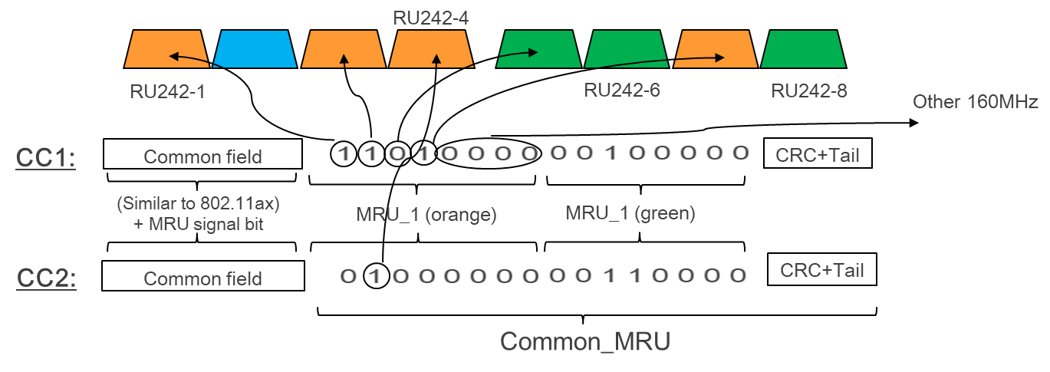
Alternative #3 (cont.)
Example (large MRU)
Consider a 160MHz BW with MRUs as shown below
    Common Field of each 20MHz: 1 1 1 0 0 x x x (from 802.11ax, could be other options to signal the RU484)
    Orange and green are MRUs. Blue is a RU242 (not MRU):
    Only MRU_1 is valid and is 8 bits of length. MRU_2 & MRU_3 are omitted (based on the MRU signal bit + RA subfield)
    In the User-Specific field, each MRU will be indicated by a single user-field, hence “reducing back” the over-head

Slide 32
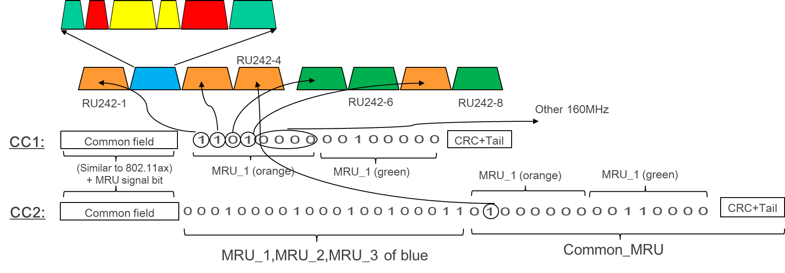
Alternative #3 (cont.)
Example (mixed MRU)
Consider a 160MHz BW with MRUs as shown below
    Common Field of each 20MHz: 1 1 1 0 0 x x x (from 802.11ax, could be other options to signal the RU484)
    Orange and green are MRUs. Blue is a RU242 that contains small MRUs as described in slide 12

Slide 33
Alternative #3 (cont.)
    1 0 0 0 0 0 1 1 1 1 0 0 0 0 0 0 1 1 0 1 0 0 0 1 1 0 0 1 1 1
Alternative signaling
The RU_allocation:
The equivalent allocation
using only RU26
(for the bitmap)
    Common Field: 0 0 0 0 0 1 1 1
    Common-MRU field, MRU_1: 1 0 0 0 0 0 0 1 1
    Common-MRU field, MRU_2: 0 1 0 0 0 1 1 Only 6 bits required, therefore MSB is 0)
    Common-MRU field, MRU_3: 0 0 1 1 1 (Only 3 bits are required, therefore 2 MSB are 0)
    The complete common field:
RU26-1
RU52-2
RU52-3
RU54-4
RU26-1
RU52-2
RU26-7
RU26-9
RU_allocation MRU_1 MRU_2 MRU_3

