Slide 1
Further considerations for multi-RU
Date: 2020-01-10
Authors:

Slide 2
Introduction
It has been agreed in principle to support multiple RUs for a single STA in 11be
RU sizes and combinations were discussed in [4]
In this submission we additionally consider:
Signaling for multi-RU
Bit processing and frequency domain processing
MCS selection
Combination with MU-MIMO

Slide 3
Multi-RU signaling
Current RU addressing in an HE MU PPDU does not allow allocating more than one RU to a single STA (see D6.0, clause 26.5.1.2)
Equivalently, all (occupied) user specific fields in HE-SIG-B have a unique STA-ID
However in spite of the usage restriction, nothing in the actual format of TXVECTOR or HE-SIG-B precludes using the same STA-ID for multiple RUs
E.g. have two user specific fields with the same STA-ID field

Slide 4
Multi-RU signaling (2)
The easiest way is to signal multi-RU appears to be to reuse 11ax TXVECTOR/HE-SIG-B format without the usage restriction
No explicit signaling is needed beyond that
A receiving STA can recover the needed information from parsing HE-SIG-B and collecting all fields matching its STA-ID
NOTE: Receiver can no longer stop processing at the first User Specific field that has a matching STA-ID
Not a very onerous requirement
STAs not included in an MU transmission already process all user specific fields
NOTE: new signaling may still be needed for use of multi-RU in UL OFDMA

Slide 5
Bit processing for multi-RU transmission
In general, we can observe that bit processing (coding/Padding/scrambling, …) is done per user
Stream Parsing/interleaving/constellation mapping/tone mapping/pilot insertion for each user is done per RU
As also proposed elsewhere, we suggest to stay with this approach for the case of multi-RU transmissions
Single encoder per user
Coded bits per symbol divided over RUs and processed per RU

Slide 6
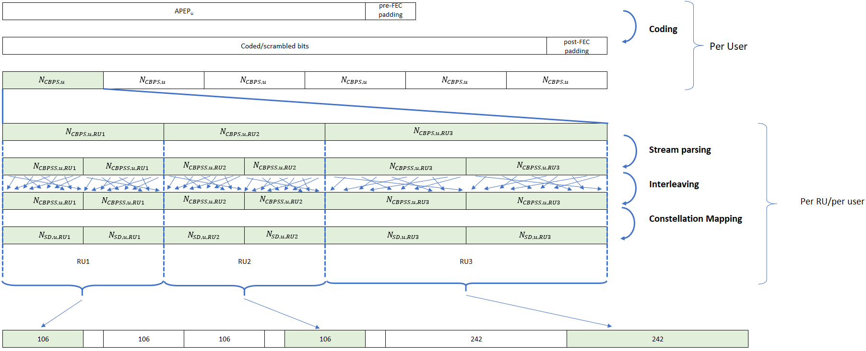
Bit Processing & Freq domain processing

Slide 7
MCS and N_STS for multi-RU
All RUs for a given STA go through essentially the same channel (same transmitter, same receiver), similar to SU transmission
If single bit stream is mapped to multi-RU, no separate link adaptation information is available per RU
If there is a single encoder for the bit stream, different MCS per RU would still have to use the same code rate, imposing a quite impractical constraint on link adaptation
The most practical approach appears to be to assume the same MCS and N_STS for all RUs sent to a given STA in a multi-RU transmission

Slide 8
Multi-RU in combination with MU-MIMO
802.11ax optionally allows MU-MIMO within an RU
When multi-RU is used as implementation of preamble puncturing, MU-MIMO support would be reasonable
Do we need to support combination of OFDMA, MU-MIMO and multi-RU support?
We propose to only support combined multi-RU and MU-MIMO for the “non-OFDMA” case
i.e. all RUs allocated to same user

Slide 9
Straw Poll
Do you agree that multi-RU signaling shall reuse the HE-SIG-B protocol, modified such that multiple User Specific fields are allowed to have the same STA-ID (other than 2046)?
Y/N/A:

Slide 10
Straw Poll
Do you agree that multi-RU bit processing shall be per user (specifically, one encoder/decoder per user)?
Y/N/A:

Slide 11
Straw Poll
Do you agree that all RUs in an OFDMA transmission that are addressed to the same STA-ID shall use the same MCS and N_STS?
Y/N/A:

Slide 12
Straw Poll
Do you agree that MU-MIMO shall only be used in combination with multi RU if all RUs are addressed to the same (MU) group of STAs?
Y/N/A:

Slide 13
References
[1] Preamble puncturing and RU aggregation, IEEE 802.11-19/1869r0
[2] Multiple RU Combinations for EHT, IEEE 802.11-19/1907r0
[3] Multi-RU Support, IEEE 802.11-19/1908r0
[4] Multi-RU support for OFDMA, IEEE 802.11-20/0108r0

