Slide 1
Multi-AP coordination for spatial reuse
Name | Affiliations | Address | Phone | Email
Dmitry Akhmetov | Intel
Laurent Cariou
Das Dibakar
Huang, Po-kai

Slide 2
Problem Statement
We see a growing interest in smart medium use with Multi-AP coordination techniques like COFDMA, CBF and JT
The goal of this presentation is to explore another one possible mode of Multi-AP coordination.
  C-SR or Coordinated spatial reuse where resources allocated to 2 APs

Slide 3

Spatial reuse to the rescue
We propose to use OTA sync between APs to announce upcoming transmission
  Announce SR-TXOP to transmit together with neighboring APs to SR-capable STAs
  For simplicity we use A-SR for Announced Spatial-Reuse frame
  (we can also use AP-A-SR to underline that it is done between APs)
STA 4.1
STA1.2
STA1.3
STA 4.3
AP1
data
A-SR
AP4
STA 4.2
data
STA1.1
AP2
STA2.1
data
STA2.2
data
STA2.3

Slide 4
Detailed Flow of Operation
AP1 A-SR (TX power limitations, RSSI, duration, type)
Preamble from AP1 AP2 AP4
STA1.1 to AP1
STA2.2 to AP2
AP1 to STA1.1
AP2 to STA2.2
sifs
sifs
Spatial reuse
Spatial reuse
80 MHz
Step 1
Step 2
Step 3
STA1.1
Step 1: AP1 A-SR frame contains description of an upcoming transmission, for example
  TX power constraints/acceptable RSSI
  Planned TXOP/DL/UL duration
  TX type (DL or UL)
Step 2: AP1 and AP2 transmit to their selected STAs
Step 3: STAs respond with Acknowledgement
  Note: AP2 shall not exceed announced TX duration but may end their TX earlier.
  Note: AP2 may start its transmission later than AP1, but shall align TX end time
STA2.3
AP1
STA 4.3
STA 4.1
STA2.2
AP2
AP3
AP4
STA3.1
STA 4.2

Slide 5
Identification of SR-enabled STAs and APs
Learning phase (LP) (ongoing):
  APs learn from/survey its STAs for RSSI levels from surrounding BSSes (Aps)
  APs analyze/record RSSI from other APs
Use/Announcement phase
  AP1 choose STA1 for Tx
    AP1 calculate how much interference STA1 can accept when using own TX power, MCS and STA1/AP1 PHY capabilities
    derive which AP (AP2)can be selected for SR announcement as well as TX restrictions for other AP
  Contention winner (AP1) construct A-SR frame which include
    TX power restrictions for AP2
    Acceptable level of interference for AP1
    Duration
    Direction\transmission type
  Upon reception of A-SR frame AP2
    Select own STA2 for transmission taking into account a) TX power constraints b) RSSI at STA2 from AP1 to make sure STA2 transmission won’t affect AP1 RX process
STA 3
STA1
STA2
AP2 to STA1 RSSI
AP1 to STA2 RSSI
AP2 to STA2 RSSI
AP2 to STA2 RSSI
AP1 to AP2 RSSI
AP1
AP2
STA 4

Slide 6
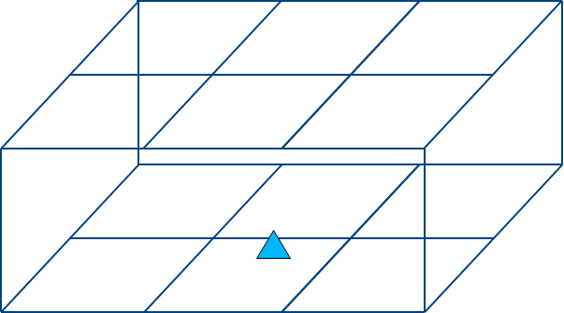
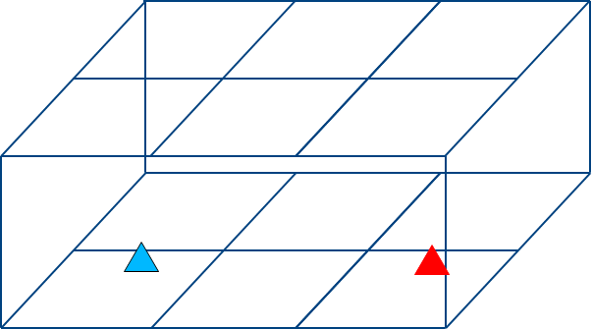
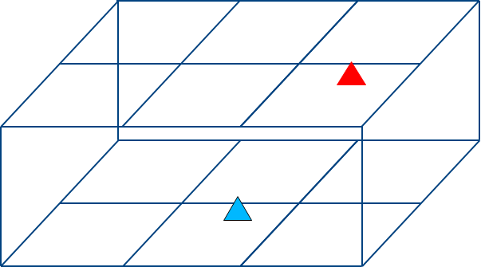
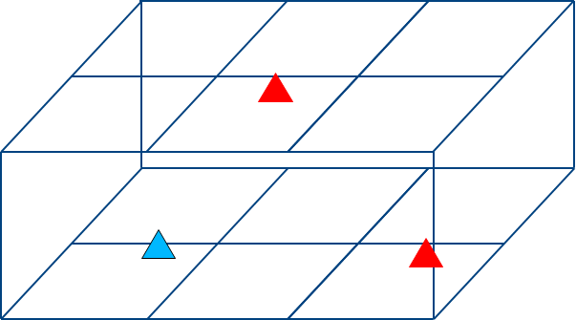
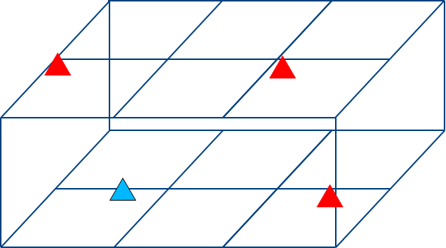
Simulation setup
1-4 APs considered with following topologies:
1 AP
2 AP Config 1
2 AP Config 2
3 AP
We study three cases
  Complete control
  C-SR
  EDCA
STAs randomly dropped in a building
4 STAs per AP
Building with 2 floors , 6 rooms per florr, room size 5x5x3 meters
Results averaged over multiple topologies
4 AP
Notes:
80 MHz channel BW.

Slide 7
Simulation setup
Scheduling algorithm for Complete Coordination scheme:
  Select an AP for transmission with equal probability among all APs
  Inside the selected AP, use RR to select a STA the first active link.
  Select a second active link (that achieves <= 10% PER) for concurrent transmission (if any) such that doing so still allows 1st active link to achieve <= 10% PER.
    Consider both sharing the entire 80 MHz channel and sharing separate 40 MHz channel modes.
    Second active link allowed to reduce Tx power from 15dBm to 0 dBm in steps of 1 dB.
    By analyzing all links from other Aps to their STAs pick one that has highest total (over first and second links) throughput.
Scheduling algorithm for Announced Spatial Reuse scheme:
  use RR to select first active link from an AP that wins contention
  Identify SR-enable AP
  Identify SR-enabled link within SR-enabled AP.
Scheduling algorithm for baseline (EDCA):
  Use RR to select a downlink STA.

Slide 8
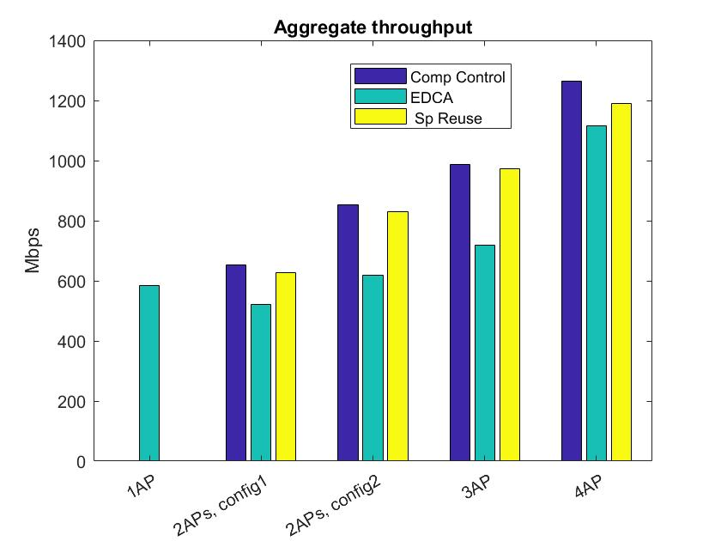
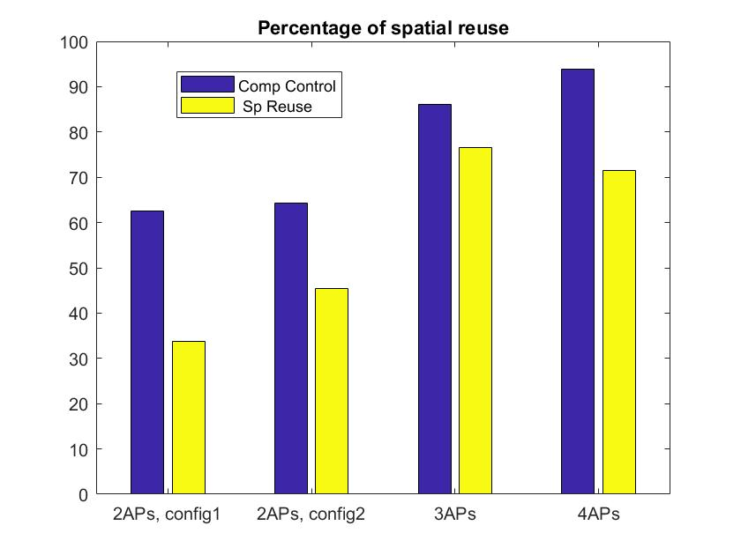
Simulation result
C-SR provides comparable performance as Complete Control
Higher spatial reuse opportunity as number of APs increase
Notes:
Best configuration ?

Slide 9
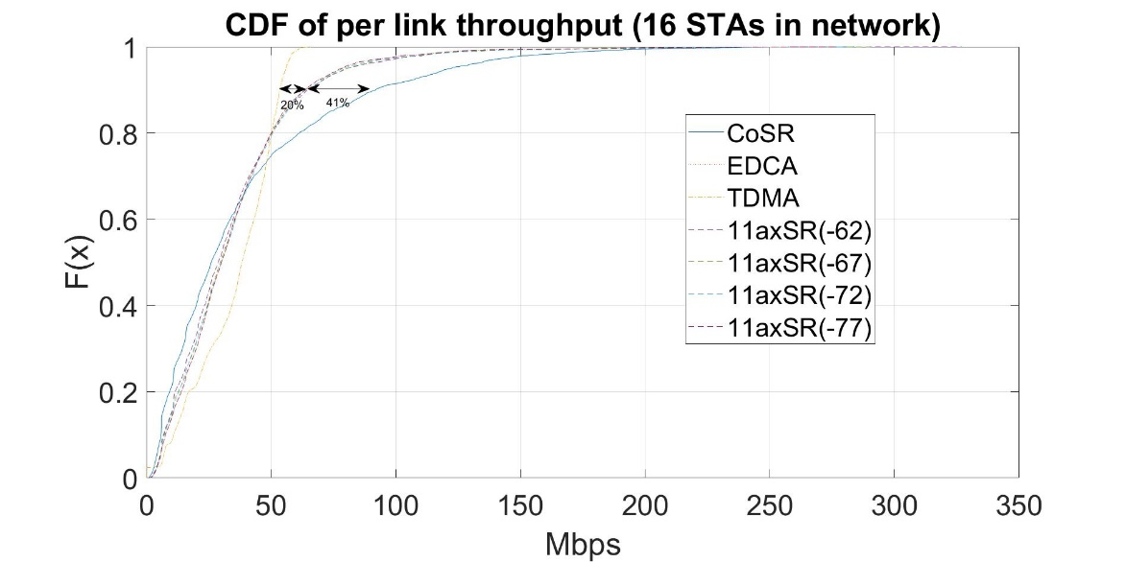
Comparison with 11ax SR
2 floor residential complex. All APs in ground floor.
15m
AP
10m
Compared to 11ax SR, about 40% gain in 90-tile throughput
Notes:
80 MHz channel BW.

Slide 10
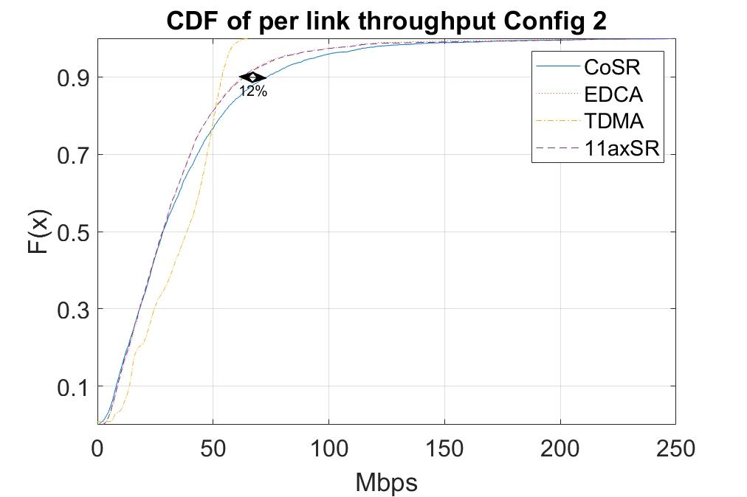
Comparison with 11ax SR (Config 2)
2 floor residential complex. All APs in ground floor.
20m
AP
10m
Lesser gain compared to Config 1 => gains are dependent on scenarios as in 11ax SR
Notes:
80 MHz channel BW.

Slide 11
Straw poll
Do you agree to add support of Coordinated Spatial Reuse in 11be multi-AP system?

Slide 12
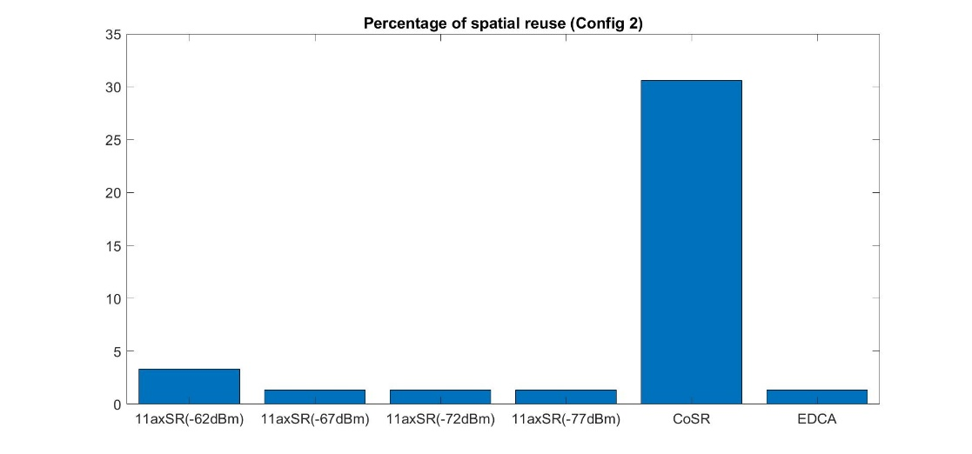
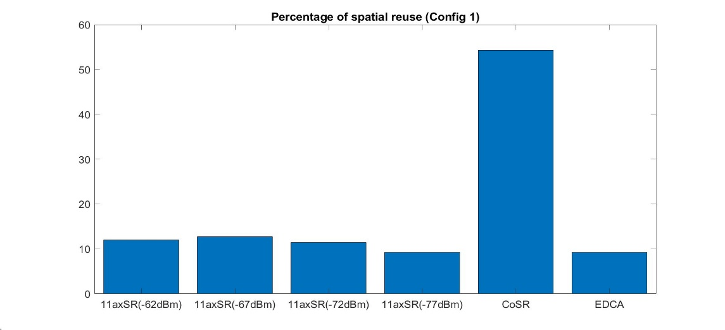
Backup (spatial reuse)
Ratio of successful SR-enabled operations (transmission) to total number of transmission

