Slide 1
Follow up of discussion on multi-link operation with leakage on non-AP MLD
Date: 2020-03-11
Authors:
Name | Affiliations | Address | Phone | Email
Dmitry Akhmetov | Intel
Laurent Cariou
Das Dibakar
Notes:
September 2012

Slide 2
Recap [1]:
In [1] we proposed classification of multi-link device operations based on channel access capabilities
  SPC – single primary channel operation
  MPC – multiple primary channel operation
  JMPC – join multiple primary channel operation
We discussed performance of such modes in comparison with a single link operation
  ~1.27x gain for SPC mode of operation
  ~2.09x gain for MPC mode of operation
  ~2.22x gain for JMPC mode of operation
We concluded that MPC seems to be preferable mode of operation over other modes because
  Other modes of operation brings fairness issues
  Other modes overcomplicate standard development while MPC is a naturally reuse existing access mode
  Chances of achieving synchronous operations are small
EHT MLLE 1
STA
STA
Link 1
Link 2
EHT MLLE 2
STA
STA

Slide 3
Recap [2]:
In [2] we discussed limitations raised by radio coexistence issues of co-located radios
We introduced two modes of operation to address operations with constraints:
  Isolated RMPC
    Leakage/interference from TX on link1 is not sufficient to cross ED threshold on link2
    Leakage sufficient to harm data frame receptions on a high MCSes but not enough to damage RX of control frames reception
  Non-isolated RMPC
    Leakage from TX on link1 is sufficient to cross ED threshold on link2
    Leaking power rise CCA Busy signal on link 2 stopping it from contention and destroying all ongoing RX events/processes
TXOP
TXOP
MLLE STA
STA1
Tx data
Rx ack
Tx data
Rx ack
Tx data
Rx ack
band 1
3
2
1
0
5
4
3
2
1
0
TXOP
TXOP
STA 2
band 2
Tx data
Rx ack
Rx data
Tx ack
Tx
Rx
Tx data
Rx ack
Tx data
Rx ack
1
0

Slide 4
Recap [2]:
For both modes of operation we discussed a number of proprietary rules to mitigate cross link interference, e.g.
  do not initiate TX operation if other link/radio is in RX state unless STA is not an intended receiver of that transmission
  do not initiate TXOP if a response is expected on link 2
  do not initiate TXOP if STA on link 2 is going to send a response frame on link 2
  if the other link/radio is in TX state, limit own TX duration to match end of the other transmission
  If status of link 2 does not allow MLLE STA to initiate TXOP, restart backoff counter on link 1
We showed that for STAs that have Tx/Rx constraints, in both isolated and non isolated RMPC mode of operations preform much better than fully synchronized access
  MPC mode of operation: DL case: 2.07x;
  isolated RMPC mode of operation: DL case: 1.91x;
  non-isolated RMPC: DL case: 1.6x* ;
  SPC mode of operation: DL case: 1.27x;
* Note: performance gain varies a lot depending on a BSS load from 1.16 with 25% BSS load to 1.77 with 100% BSS load and OBSS loads of 10% to 40%
Even with Tx/Rx constraints, RMPC still can provide benefits in terms of reduced latency for UL traffic
  Both for RTA-like traffic and heavy bursty traffic
  30% and more improvement observed for congested networks
  MLLE performance is better the sooner it can resolve RX activity on a busy link
Based on [1] and [2] we conclude that preferable in terms of Channel Access mode of operation (or TXOP initiation) is asynchronous mode of operation a.k.a. Multiple Primary Channels mode (MPC)

Slide 5
Recap:
Lowlight/downsides/bright sides of Sync/JMPC access
What is it:
  Sync, one primary channel and a secondary channel
    80+80 type of operation – already exist in a spec
    Contend on a dedicated primary channel/link, access to the medium on a “secondary\other\second” link by doing ED for PIFS time
  JMPC, multiple primary channels with join contention
    New mode that has to be defined in a spec
    All links contend for medium, access to the medium on another link a by doing ED for PIFS time
Why it is attractive
  Allow easy link aggregation in both DL and UL
  Seems to be a solution for non-STR operation – synchronous access which naturally align TX/TX and RX/RX operations
Why it is not attractive
  Regulatory restriction\prohibition on access to a medium with PIFS access
  Limited applicability
    Synchronous access only works in clean environment (no OBSS/legacy/hidden nodes around)
    JMPC is independent of environment but chances of join medium access are not high
  JMPC has fairness issues
  If implemented for Multi-Link operations may provide a door for channel access abuse (see backup)

Slide 6
Recap conclusion
Asynchronous mode offers the best performance when there is no leakage between links at non-AP MLD side
Asynchronous mode for constrained operations with proprietary TX/TX or Rx/Rx alignment solutions offers
  very good performance when the leakage is low (backoff is still possible)
  and reasonably well when the leakage is high.
Fully synch mode shows gains only where there are no OBSSs on one link
  but in this situation a proprietary solution on asynch mode will provide similar gains
So we believe that asynchronous mode of operations (i.e. MPC or Multipe Primary Channels) is well suited unified existing solution for all modes of operation
  which only require minor tweaks to manage interference/leakage in some cases

Slide 7
Assumptions
We assume STR AP MLD and non-STA STA MLD is more viable combination, at least from R1 spec perspective
  In order to get most from multi-link opportunities, an AP MLD shall be STR capable
  Therefore only focus on scenarios where non-AP MLD side suffers from leakages
As AP MLD has STR capabilities, DL might be much easier to handle.
  In reality, most of the traffic (80%-90%) is downlink
  Most likely, a STAs willing to implement multi-link aggregation will be measured based on their DL throughput
  UL traffic is smaller, moreover device with constraints will be self-synchronized on link(s) for UL transmission
  As we showed before latency benefits preserved even in presence of leakage on a STA side
With async channel access start of PPDU can totally be independent.
  that’s what will provide much better performance than fully synch mode with start of PPDU alignment
What happen is we do nothing on handling TX/RX constraints in DL direction?

Slide 8
Do nothing, DL only case
Do nothing at all
  issue is only that the transmission of BA on one link will force misdetection of some MPDUs of an A-MPDU on the other link.
  Or loss of the end of A-MPDU due to the losing of sync after interference depending on level of interference/bad/weak implementation of tracking

Slide 9
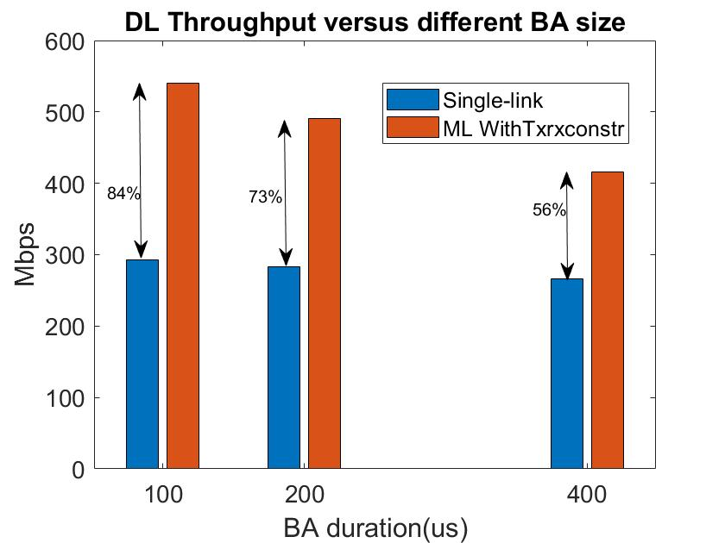
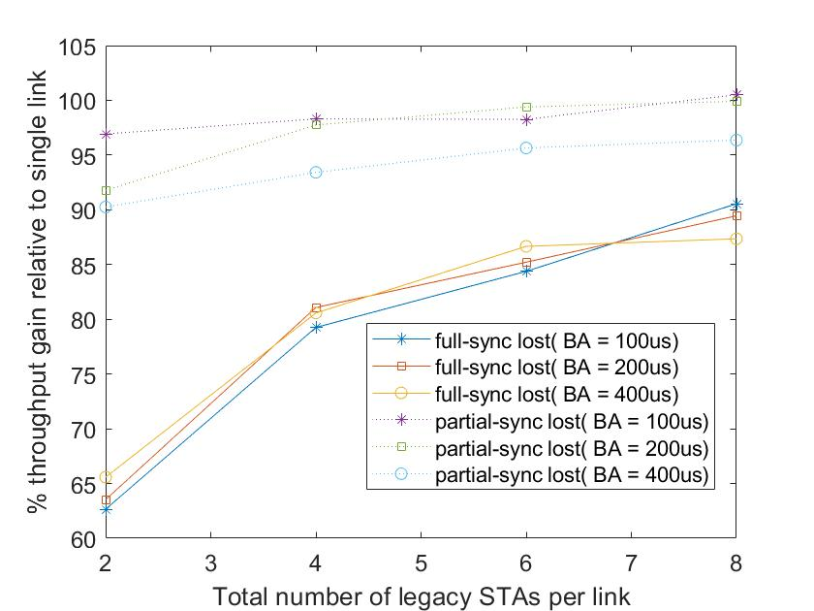
Do nothing
Corner case: 1 MLD AP + 1 MLD STA
  of ~1.5x – 1.8x vs single link
Generic case: 1 AP + multiple STAs
  ~1.9x gain in case of partial AMPDU losses
  ~1.5x – 1.8x gain in case of lost the end of AMPDU
Note: Provided results include effect of loss of entire PPDU if response BA happens during preamble reception

Slide 10
Do something, DL case:
Issue occurs only at the end of PPDU, where one solution is to have alignment (end roughly at the same time)
  As it’s alignment at the end of the PPDU, achieving this is much easier
Option 1:
  AP MLD is capable of signaling “end of PPDU time” between links
Option 2:
  end of PPDUs can be forced be on boundaries that are known to both APs (on every ms boundary for instance )

Slide 11
Do something, DL case:
Option 3:
  If APs have no other ways to quickly indicate end of PPDU, while STA has synch abilities, we could also just have an RTS/CTS on second link, where the CTS gives back the PPDU end time on the other link if there is an ongoing reception
    Require new frame format
Option 4:
  Clever use of delayed BA

Slide 12
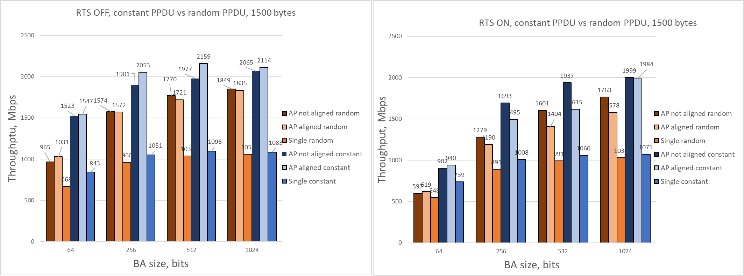
PPDU alignment analysis, DL case
1 STA, 1 AP, 2x2x80, MCS11
BA/AMPDU size : 64, 256, 512, 1024
For each transmission PPDU size is:
Random case: PPDU size randomly selected between 2 and MAX PPDU size (64/256/512/1024) and MAX PPDU duration
Constant case: PPDU limited by MaxPPDU size and Max PPDU duration
  64, 256, 512 and 512

Slide 13
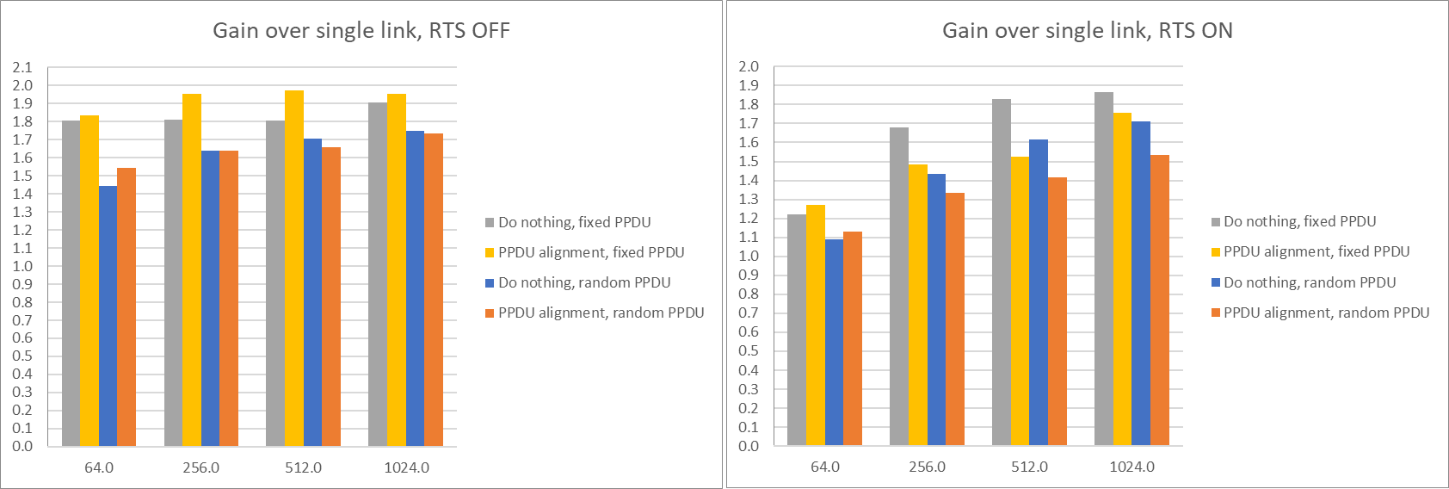
PPDU alignment analysis, DL case
Overall gain over single link varies between 1.4x and 1.9x for the case with RTS OFF and between 1.1x and 1.8x when RTS is ON
PPDU alignment works better than “Do Nothing” option with fixed PPDU size, but difference is insignificant when RTS is OFF
PPDU alignment does not provide benefits over “Do nothing” option when RTS is ON

Slide 14
Intermediate conclusion
For DL only use case in a frame exchange between STR AP MLD and non-STR STA the “Do Nothing” option provide similar performance to PPDU alignment option
In case if MLD AP is able to perform end of PPDU alignment it can be done in proprietary way
End of PPDU alignment is not a universal solution and specific to scenario/use case
If TX sequence involve anything more than A-MPDU/BA exchange (i.e. RTS/CTS) the gain of alignment disappears.

Slide 15
Notes on DL and UL traffic coexistence
DL traffic :
  DL traffic prevail in a network, so addressing DL aggregation would be logically the first thing to do
  We assume AP MLD side does not suffer from leakages so DL might be easier to handle
  Simulation results shows that in DL only case w/o applying any special techniques we get decent performance
  No need to develop complex schemes or mandate certain behavior to handle DL
UL traffic
  is important, but much smaller comparing to DL traffic
  non-STR device is self aware about constraints and in most cases will be self-synchronized between links
  TX on one link stop/pause the other link – so device is naturally should does not hurt self RX operations
So, separately DL and UL traffic are not a concern to each other in a communication between STR AP and non-STR STA

Slide 16
What seems more important for constrained devices
Is to have a separation of DL and UL traffic in time
  To avoid uncontrolled DL/UL mix but to have only UL or DL over a period of time,
    As we have shown before, DL case perform well for STR AP – non-STR STA combination
    It turn, UL is “self-controlled” at non-STR STA (one link block the other preventing a mix of TX and RX ops)
      It is a general understanding that STA, unlike AP, will have better/tighter link integration/interaction, so quick state signaling or operation management is possible
  A separation of DL and UL traffic would solve UL/DL mix use case
Few possible options to organize that:
  TWT negotiation to say only DL/Triggered UL or only EDCA based UL during the SP,
  A signaling so that STA informs AP about whether it can receive Dl frames.
    After receiving this signaling the AP is recommended not to transmit DL Data frames.
    STA comes out of that state to be able to receive DL packets on both links.
    This can be done today with power state changes or power mode changes as STA behavior is similar to that being in PS mode.
    May require adding flexibility to existing signaling to cover some cases (e.g., U-APSD) and add signaling in UL BA frames.
  Or may be have special rules to disallow certain operation on links per TXOP basis
    For instance, mandate RTS/CTS exchange when talk to/from non-STR device and have special rules for CTS response to indicate STA unavailability for operation on a certain link during TXOP

Slide 17
DL-Rx unavailable state
The STA can signal when it is unable to receive DL frames by a one bit signaling in UL frames (incl. Data or BA frames).
On reception of this frame and after ACKing, the AP does not transmit any DL Data frames to this STA regardless of the power state and modes of that STA starting the end of current TXOP
By default the signaling is done independently on all links.
DL-Rx Available = 0
DL-Rx Available = 1
AP MLD
Non-AP MLD
AP 1
STA 1
Link 1
AP 2
STA 2
Link 2
time
Suspend DL Data frames
: Ack
: UL Data
: DL Data
: U-APSD SP
: STA in Doze
Notes:
Alternatively, a softer AP behavior will be that the STA is requesting the AP to do RTS-CTS prior to every DL Data frame transmission.

Slide 18
Desirable direction of development
Agree on capability indication and let AP and STA to handle indicated restrictions in proprietary way as much as possible
Treat each STA of an MLD as a device with independent channel access mechanism and avoid defining methods for artificial synchronous channel access modes
  Together this open a door for any proprietary mechanism to address TX/RX operations with leakage as long as they follow basic channel access rules of each individual device
Use existing mechanisms to enable TX/TX and RX/Rx operations through traffic separation
  Update/provide extra tools for quick signaling of STA unavailability for certain type of operation
  Refer to 0455r0 submission for more details

Slide 19
Straw poll 1
Do you agree for R1 spec version to reuse existing channel access mechanism as a mechanism to initiate TXOP operations on any link of MLD device?

Slide 20
Straw poll 2
Do you agree as a part of R1 spec for an AP to advertise whether it is capable of aligning end of PPDU alignment in DL to a non-STR non-AP MLD.
  The alignment procedure is implementation-specific

Slide 21
Straw poll 3
Do you agree as a part of R1 to define a way for the for non-AP STA to indicate its unavailability to receive DL frames at that time
    Note: Following that indication and acknowledgement, the AP should not transmit to the STA data frames in DL, while the STA will be able to transmit data frames in UL

Slide 22
References
[1] 11-19-1291-03-00be-some-aspects-of-multi-link-op-performance, Intel
[2] 11-19-1541-01-00be-performance-aspects-of-multi-link-op-with constraints, Intel
[3] 11-20-0081-00-00be-mlo-synch-transmission, Broadcomm
[4] 11-20-0455-00-00be-async-mlo-for-non-str-sta, Intel

Slide 23
Backup

Slide 24
Risks with a sync mode
We don't want to break backoff rules and allow an AP that is in synch on a channel with other contending STAs to be able to ignore backoff and just follow NAV + CCA
  This is different from secondary channel access, as the STA accessing secondary channel is not in synch with the other contending STAs (does not know when the CP occurs). The “other” link is an independent link with independent channel access aligned with other devices operating on that link
  There are regulatory restrictions to do PIFS access on independent channel/link
Risks of unfairness if we go full-sync direction:
  A sync AP MLD with an AP1 alone on link 1 and with an AP2 sharing medium with other AP(s) on link2.
  If that AP1 carefully chooses TxOP duration on link 1 to always end (Backoff time) before TxOP on link2, so that AP1 ends backoff right at the start of the CP on link 2: this way, link2 is always gained by the AP2.
  Basically if we allow this mode, there is a clear potential abuse.

Slide 25
Further details
The signaling may also include the time at or after which it is valid. A default value signals its valid right after transmission of this frame.
By default the signaling is done independently on all links.
DL-Rx Available = 0 after T us
DL-Rx Available = 1 after 0 us
AP MLD
Non-AP MLD
AP 1
STA 1
Link 1
T
AP 2
STA 2
Link 2
time
Suspend DL Data frames
: Ack
: UL Data
: DL Data
: U-APSD SP
: STA in Doze

Slide 26
Signaling in BA
For faster indication the signaling could be included in UL BA frames. We can use few Reserved bits in BA to signal the same.
B0 B1-B4 B5 B6-B11 B12-B15
BA Ack Policy
BA Type
Reserved DL-Rx Unavailable
Reserved
TID_Info
Modified BA Control field to signal STA unavailability for DL Rx.

Slide 27
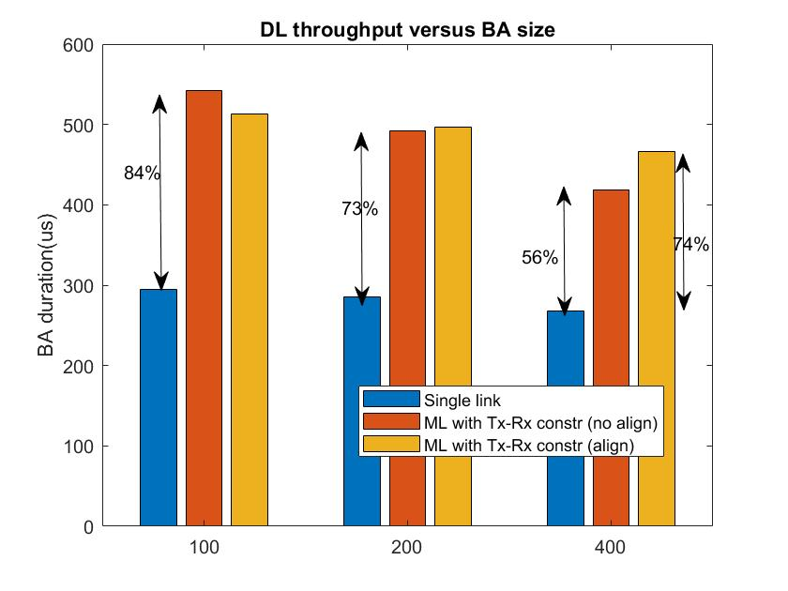
PPDU alignment, DL case
1 AP, 1 STA
2x2x80, MCS7
AMSDU ON
64 A-MPDU size
Note: Provided results include effect of loss of entire PPDU if response BA happens during preamble reception

