Slide 1
Follow up on aspects of Multi-link mode of operations
Date: 2020-01-16
Authors:
Name | Affiliations | Address | Phone | Email
Dmitry Akhmetov | Intel
Laurent Cariou
Das Dibakar
Notes:
September 2012

Slide 2
Recap [1]:
In [1] we proposed classification of multi-link device operations based on channel access capabilities
  SPC – single primary channel operation
  MPC – multiple primary channel operation
  JMPC – join multiple primary channel operation
We discussed performance of such modes in comparison with a single link operation
  ~1.27x gain for SPC mode of operation
  ~2.09x gain for MPC mode of operation
  ~2.22x gain for JMPC mode of operation
We concluded that MPC seems to be preferable mode of operation over other modes because
  Other modes of operation brings fairness issues
  Other modes overcomplicate standard development while MPC is a naturally reuse existing access mode
  Chances of achieving synchronous operations are small
EHT MLLE 1
STA
STA
Link 1
Link 2
EHT MLLE 2
STA
STA

Slide 3
Recap [2]:
In [2] we discussed limitations raised by radio coexistence issues of co-located radios
We introduced two modes of operation to address operations with constraints:
  Isolated RMPC
    Leakage/interference from TX on link1 is not sufficient to cross ED threshold on link2
    Leakage sufficient to harm data frame receptions on a high MCSes but not enough to damage RX of control frames reception
  Non-isolated RMPC
    Leakage from TX on link1 is sufficient to cross ED threshold on link2
    Leaking power rise CCA Busy signal on link 2 stopping it from contention and destroying all ongoing RX events/processes
TXOP
TXOP
MLLE STA
STA1
Tx data
Rx ack
Tx data
Rx ack
Tx data
Rx ack
band 1
3
2
1
0
5
4
3
2
1
0
TXOP
TXOP
STA 2
band 2
Tx data
Rx ack
Rx data
Tx ack
Tx
Rx
Tx data
Rx ack
Tx data
Rx ack
1
0

Slide 4
Recap [2]:
For both modes of operation we discussed a number of proprietary rules to mitigate cross link interference, e.g.
  do not initiate TX operation if other link/radio is in RX state unless STA is not an intended receiver of that transmission
  do not initiate TXOP if a response is expected on link 2
  do not initiate TXOP if STA on link 2 is going to send a response frame on link 2
  if the other link/radio is in TX state, limit own TX duration to match end of the other transmission
  If status of link 2 does not allow MLLE STA to initiate TXOP, restart backoff counter on link 1
We showed that for STAs that have Tx/Rx constraints, in both isolated and non isolated RMPC mode of operations preform much better than fully synchronized access
  MPC mode of operation: DL case: 2.07x;
  isolated RMPC mode of operation: DL case: 1.91x;
  non-isolated RMPC: DL case: 1.6x* ;
  SPC mode of operation: DL case: 1.27x;
Even with Tx/Rx constraints, RMPC still can provide benefits in terms of reduced latency for UL traffic
  Both for RTA-like traffic and heavy bursty traffic
  30% and more improvement observed for congested networks
  MLLE performance is better the sooner it can resolve RX activity on a busy link
Based on [1] and [2] we conclude that preferable in terms of Channel Access mode of operation (or TXOP initiation) is asynchronous mode of operation a.k.a. Multiple Primary Channels mode (MPC)

Slide 5
Recap summary
So, from simulations we know that
  Asynchronous mode offers the best performance when there is no leakage between links at non-AP MLD side
  Asynchronous mode with proprietary alignment solutions offers very good performance when the leakage is low (backoff is still possible), and reasonably well when the leakage is high.
  Fully synch mode shows same gains only where there are no OBSSs on one link, but in this situation a proprietary solution on asynch mode which does not break existing channel access rules will provide similar gains
So we believe the only thing need is:
  asynchronous mode in the spec
  to have some ways to manage interference if it’s needed in some cases
Question is: do we need to define anything in the spec for helping PPDU alignments or can it be all done in a proprietary manner?

Slide 6
Assumptions
First, as discussed in previous meetings, we assume AP MLD side does not suffer from leakages
  We therefore only focus on scenarios where non-AP MLD side suffers from leakages
Second, as AP does not have leakage issues, DL might be much easier to handle.
  In reality, most of the traffic (80%-90%) is downlink
  Most likely, a STAs willing to implement multi-link aggregation will be measured based on their DL throughput
  UL traffic is much smaller, moreover device with constraints will be self-synchronized on link for UL transmission
  As we showed in [2] latency benefits are preserved even in presence of leakage on STA side
With async channel access start of PPDU can totally be independent.
  that’s what will provide much better performance than fully synch mode with start of PPDU alignment
What happen is we do nothing on handling TX/RX constraints in DL direction?

Slide 7
Do nothing
Do nothing at all
  issue is only that the transmission of BA on one link will force misdetection of some MPDUs of an A-MPDU on the other link.

Slide 8
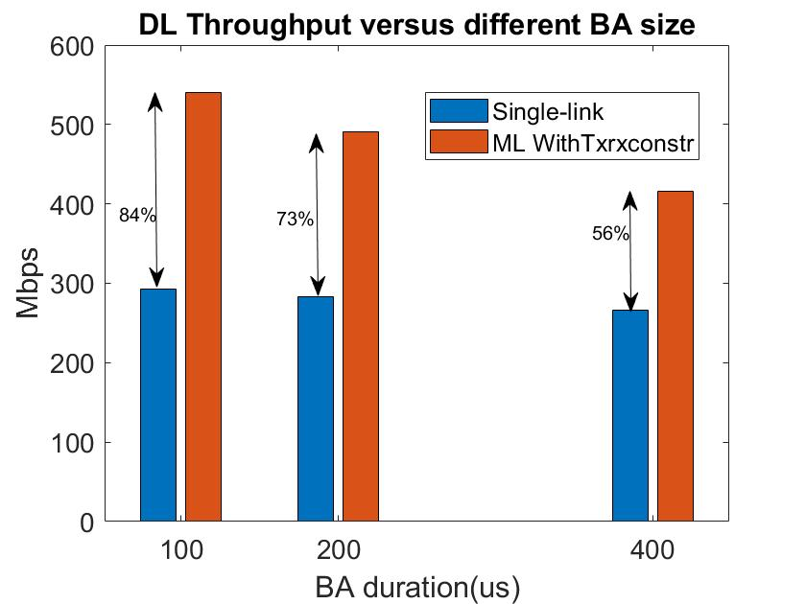
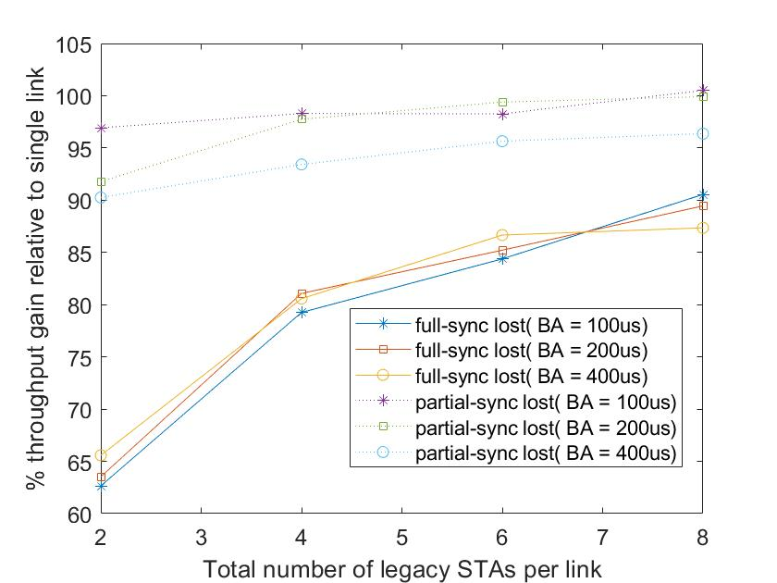
Do nothing
Simulations shows performance gain of ~1.5x – 1.8x vs single link
  corner case: 1 MLD AP with 1 MLD STA
Depending on level of interference a STA may lost of the end of PPDU
  ~1.9x gain in case of no loss
  ~1.5x – 1.8x gain in case of lost the end of PPDU depending on number of associated devices

Slide 9
Straw poll
Do you agree to keep existing channel access mechanism as the only mechanism to initiate TX operations on any link of MLD device?

Slide 10
Referencies
[1] 11-19-1291-03-00be-some-aspects-of-multi-link-op-performance, Intel
[2] 11-19-1541-01-00be-performance-aspects-of-multi-link-op-with constraints, Intel
[3] 11-20-0081-00-00be-mlo-synch-transmission, Broadcomm

Slide 11
Backup

Slide 12
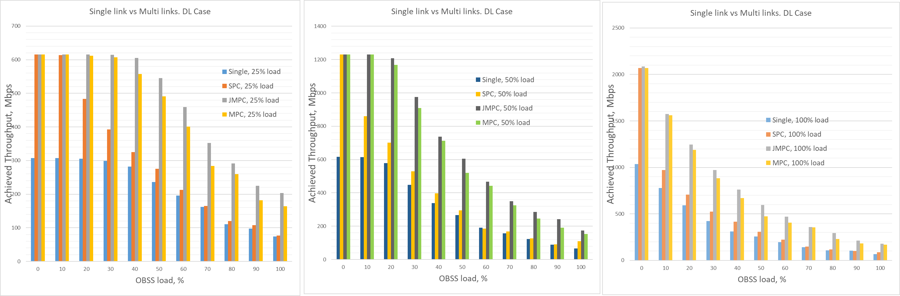
Single link vs Multi-link. DL case

Slide 13
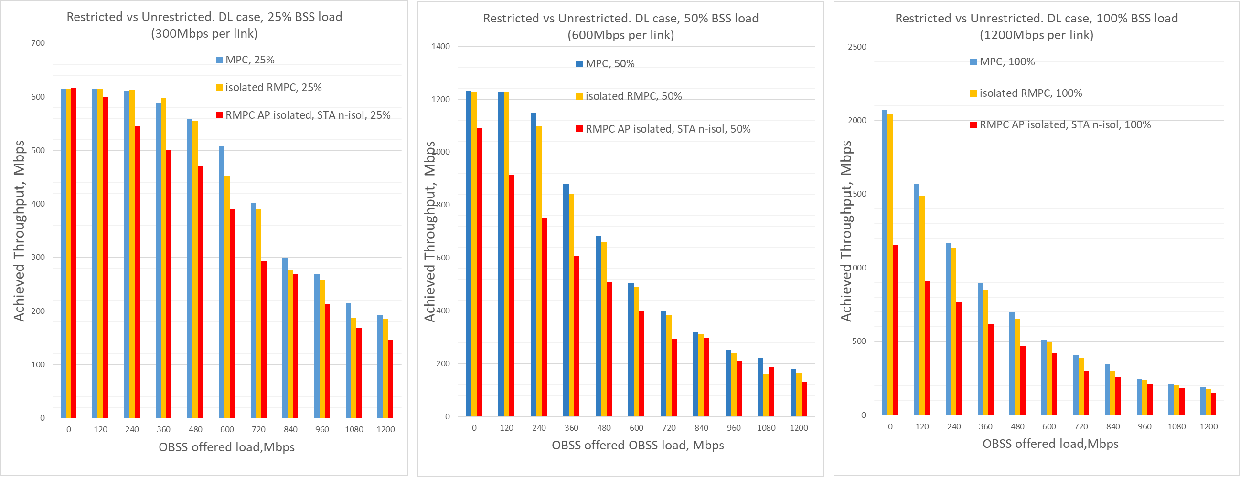
Restricted vs Unrestricted. DL case
Depending on the link load there might be a huge impact on throughput. In certain cases (high link load, lightly loaded BSS/OBSS) dual link performance might be converging to a single link operation performance
  A potential for improvement/proprietary implementation exist
OBSS equally affect all modes of operation

Slide 14
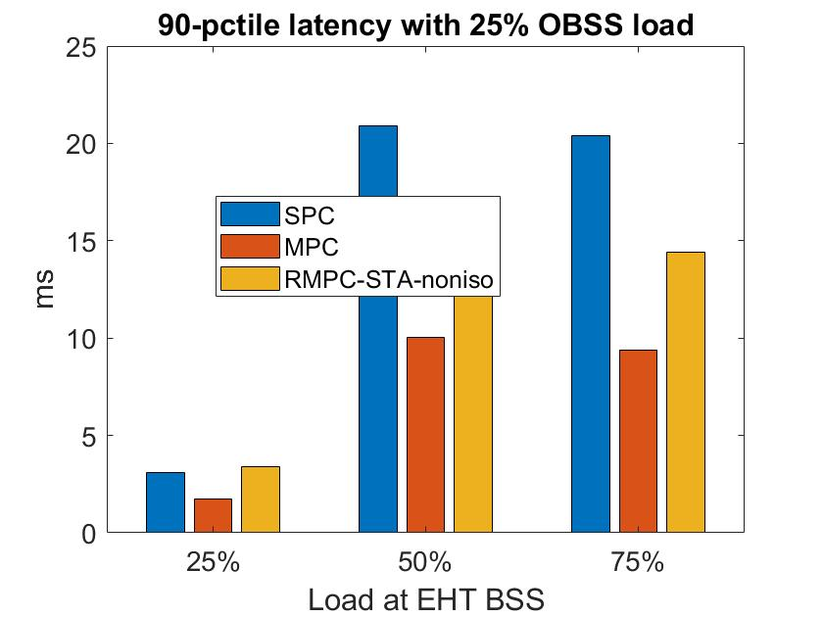
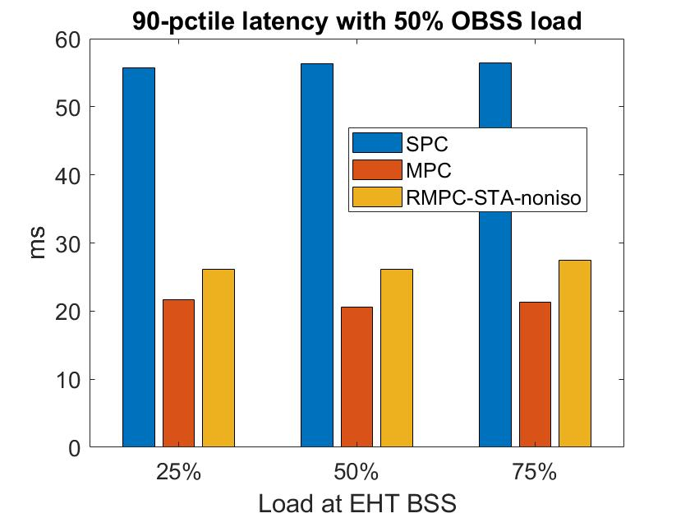
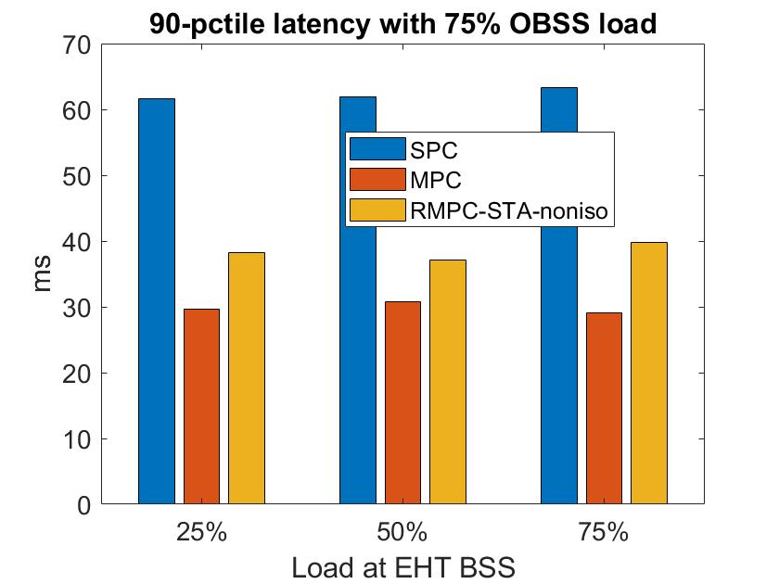
Light CBR UL traffic (Config 1b)
~38% reduction in latency from SPC to RMPC when the network is congested. Gap between MPC and RMPC therein is about 25%.

Slide 15
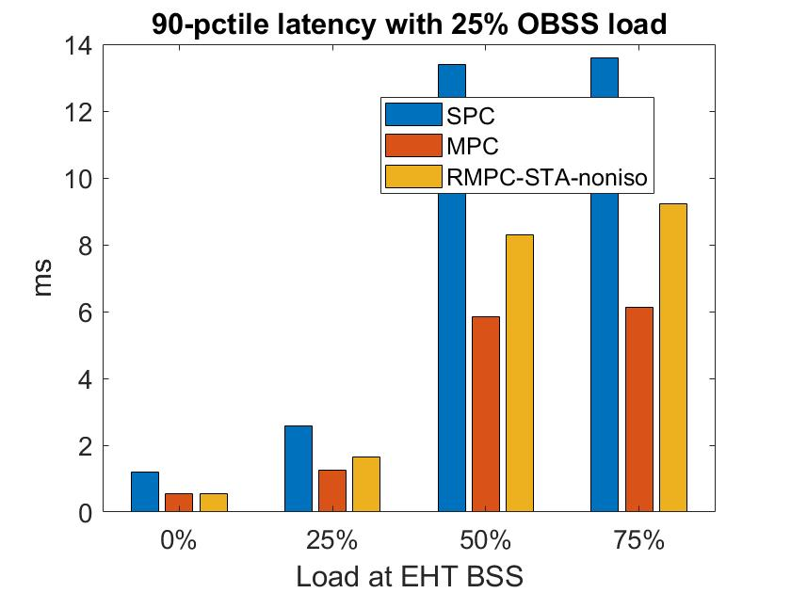
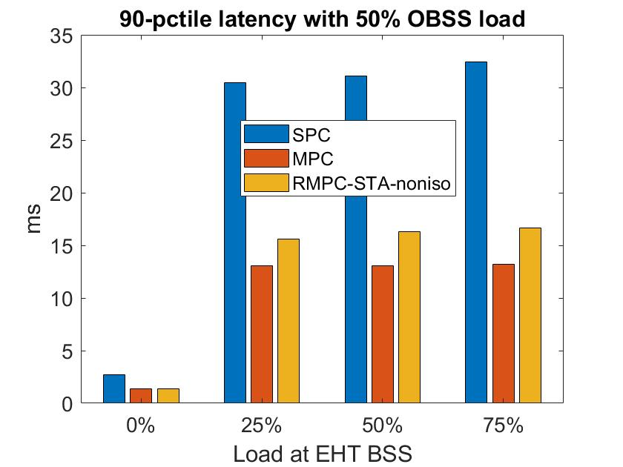
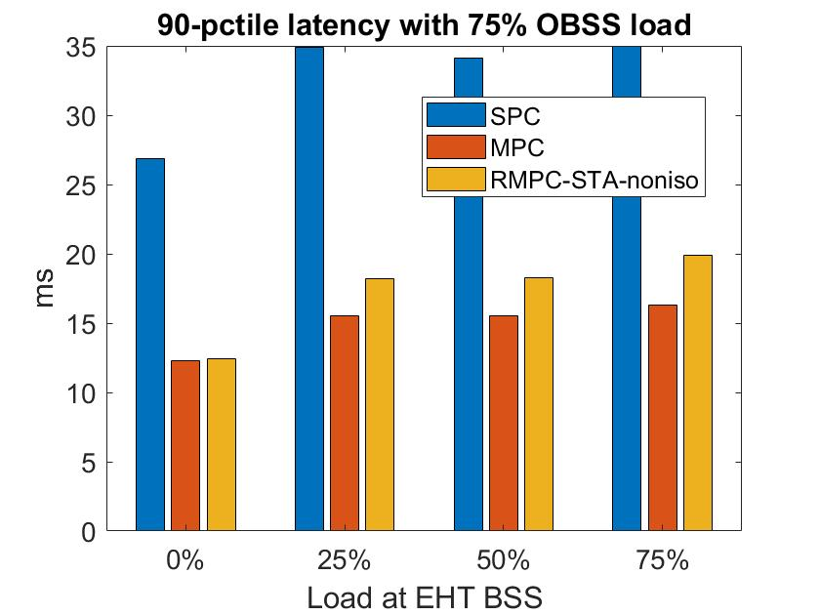
Heavy UL CBR traffic (Config 2)
~44% reduction in latency from SPC to RMPC when the network is congested. Gap between MPC and RMPC therein is ~16%.

